Slide 1
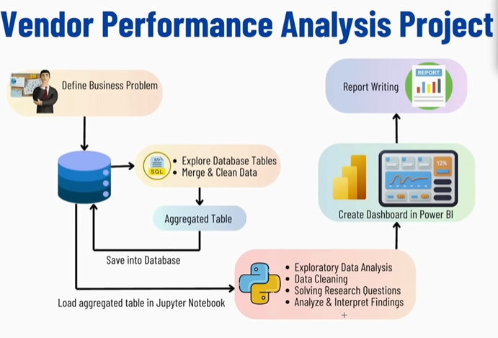

Slide 2
1. What Logging Does in Your Code 🔹 In simple words: Logging is like your program writing a diary 📖 — it records everything that happens while your code runs.

Slide 3
