Slide 1


UG-PG INTERNSHIP MODULE

Slide 2

Agenda
PROBLEM STATEMENT
ABSTRACT
INTRODUCTION
SOFTWARES AND TOOLS REQUIRED
UML DIAGRAMS
APPLICATION SCREENSHOTS

Slide 3

PROBLEM STATEMENT
Managing and tracking the internship experiences of a large number of UG and PG students poses significant challenges for educational institutions. Teachers often struggle with the administrative burden of collecting, organizing, and analyzing internship data manually. This process is time-consuming and prone to errors, leading to inefficiencies and a lack of comprehensive oversight. Furthermore, without a streamlined system, it becomes difficult to ensure that internships are effectively aligned with students' academic goals and industry standards. There is also a need for a mechanism that provides clear, actionable feedback to students, helping them to reflect on their experiences and identify areas for improvement. Our project addresses these issues by developing a UG/PG Internship Module that simplifies data management through automated Excel sheet uploads, provides detailed overviews of internship statuses, and facilitates better mentorship and performance assessment. This solution aims to improve the administration and educational value of internships, ensuring that students gain meaningful,
hands-on experience that complements their academic learning..

Slide 4

ABSTRACT
The UG/PG Internship Module is designed to streamline the process of managing and monitoring internships for undergraduate and postgraduate students. This module allows teachers to upload Excel sheets containing detailed information about students' internships. Upon uploading, the system generates a comprehensive overview of the internship details, providing insights into student placements, project progress, and mentorship effectiveness. The module aims to enhance the administrative efficiency of handling internships, ensure alignment between academic and industry experiences, and support the overall development of students through structured, real-world work engagements. By integrating these functionalities, the UG/PG Internship Module seeks to bridge the gap between classroom learning and practical industry experience, thereby preparing students for successful careers.

Slide 5

INTRODUCTION
In today's competitive job market, gaining practical experience through internships is crucial for students' career readiness. Internships bridge the gap between academic theory and real-world application, providing students with hands-on experience in their chosen fields. However, managing and monitoring these internships can be a complex task for educational institutions. Teachers are often overwhelmed with the administrative workload of tracking internship details, ensuring alignment with academic goals, and providing effective mentorship and feedback. The UG/PG Internship Module is designed to address these challenges by offering a streamlined solution that simplifies the management of internship data. By allowing teachers to upload Excel sheets containing students' internship information and generating comprehensive overviews, this module enhances administrative efficiency and supports students' professional development. Through this innovative approach, the UG/PG Internship Module aims to ensure that internships are valuable, well-organized experiences that significantly contribute to students' future career success.

Slide 6


SOFTWARES AND TOOLS REQUIRED
React.js (Frontend)
Node.js (Backend)
Express JS (Backend)
MongoDB (Database)
Visual Studio Code (Code Editor)
REST-client (Backend Testing)
Npm (package management)
Redux (state management)
Git/Github (version control)]

Slide 7



UML DIAGRMSL OT

Slide 8
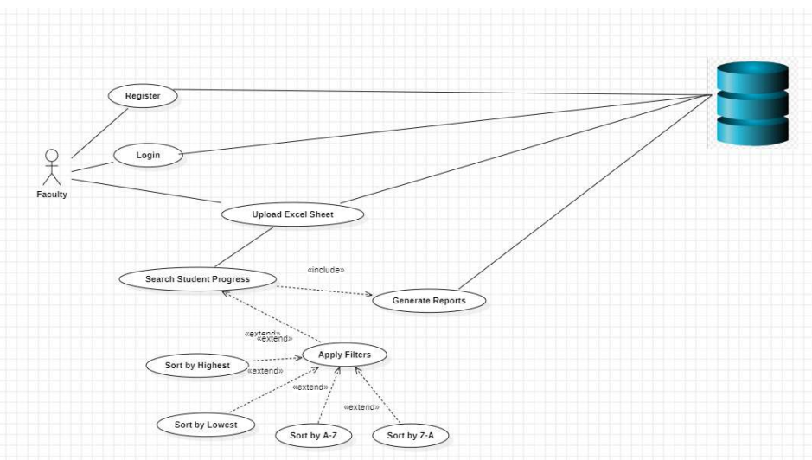
USECASE DIAGRAM

Slide 9
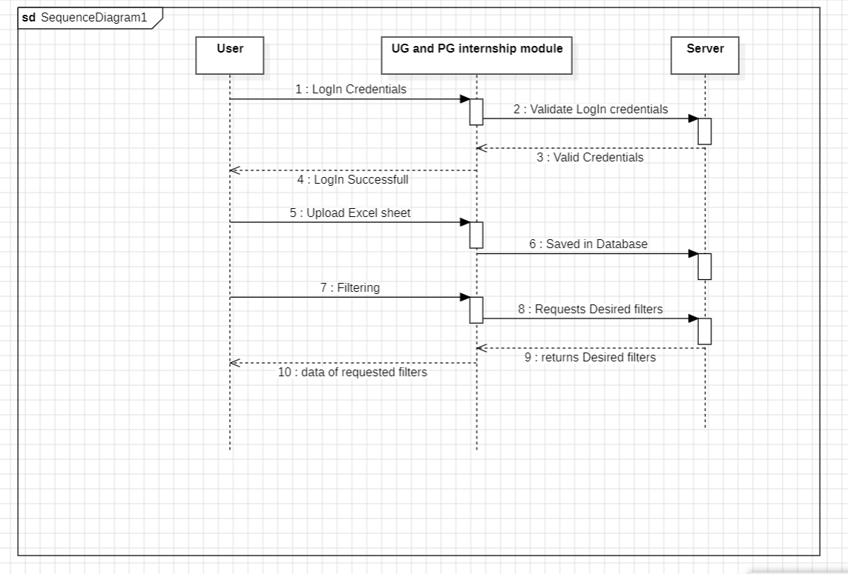
SEQUENCE DIAGRAM
Applying Filters to Excel data

Slide 10
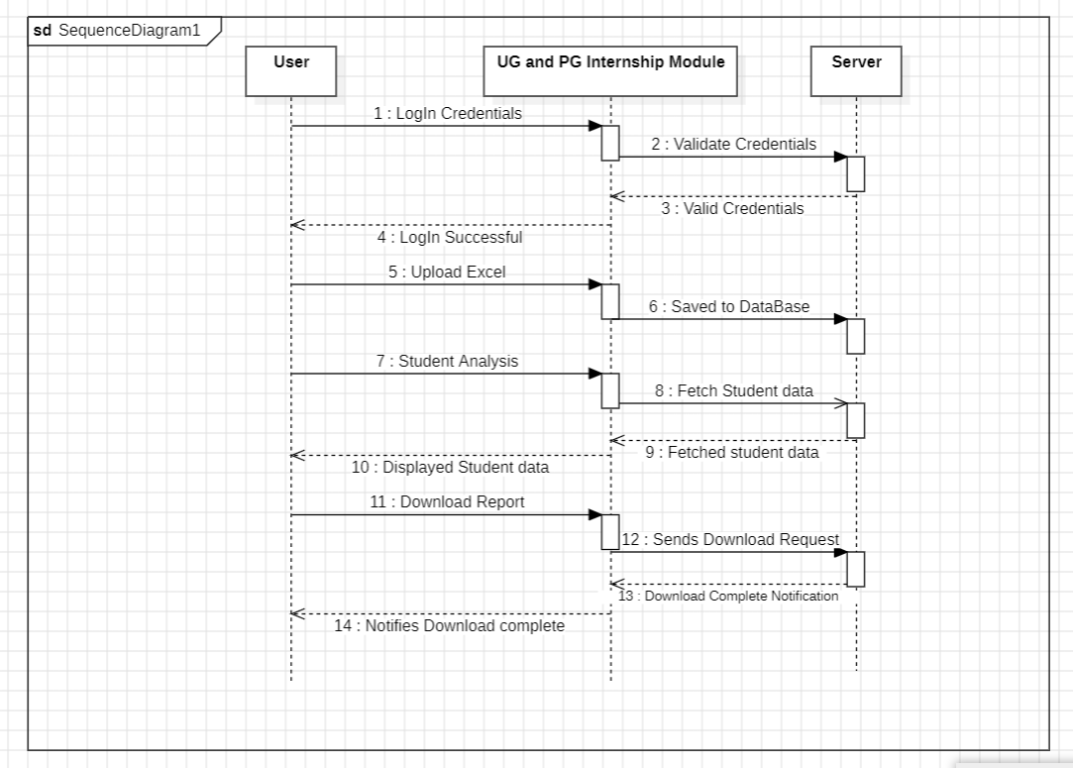
SEQUENCE DIAGRAM
Generating and Downloading report

Slide 11
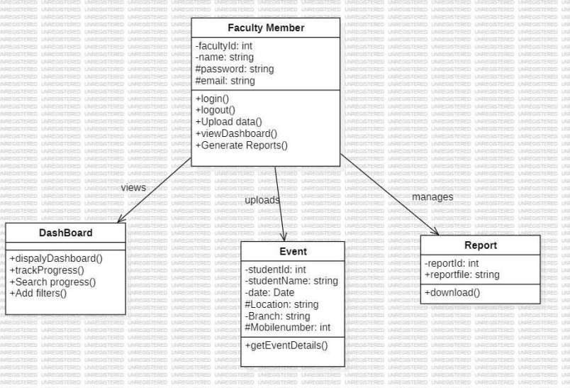
CLASS DIAGRAM

Slide 12
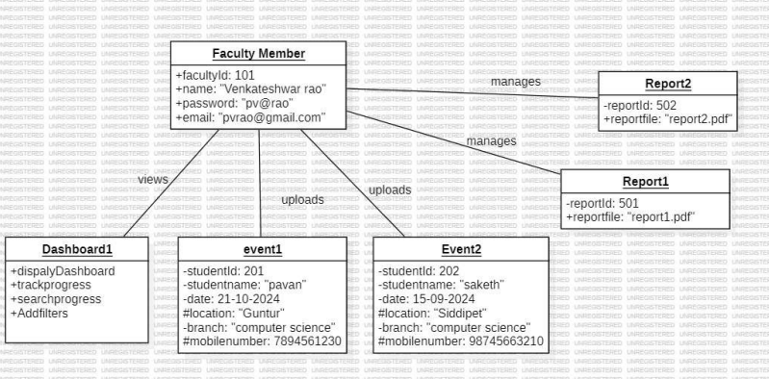
OBJECT DIAGRAM

Slide 13
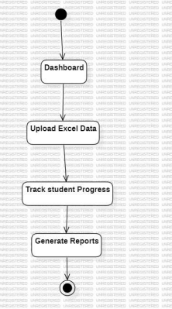
STATECHART DIAGRAM

Slide 14
ACTIVITY DIAGRAM

Slide 15
ACTIVITY DIAGRAM

Slide 16
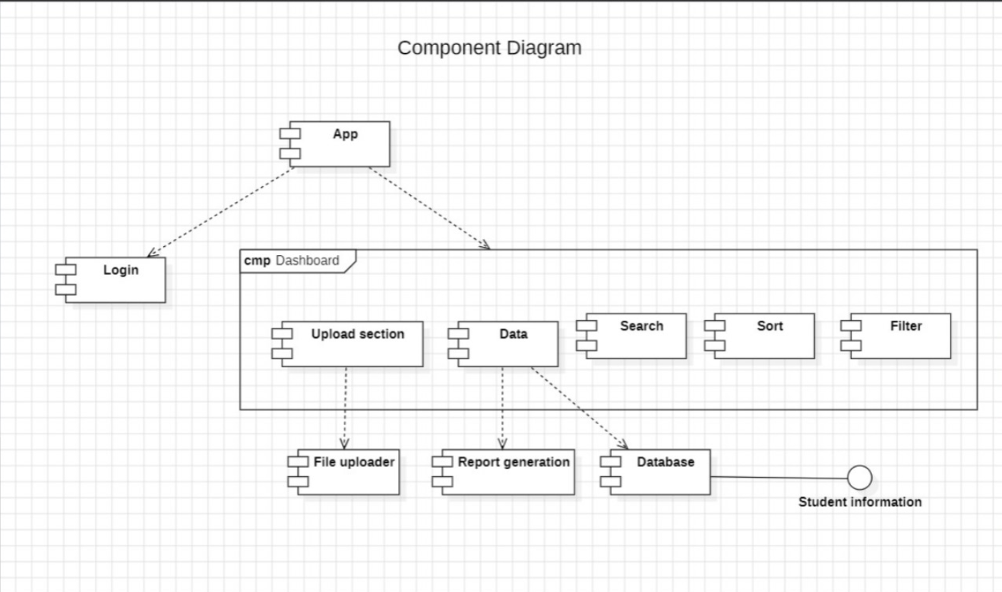
Component Diagram

Slide 17
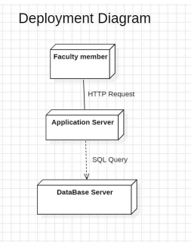
DEPLOYMENT DIAGRAM

Slide 18

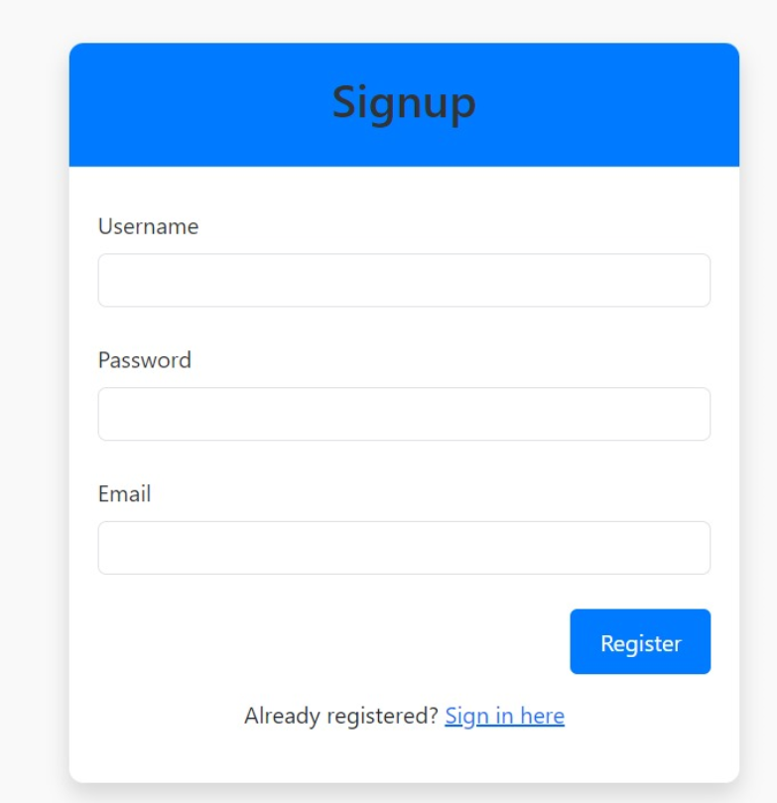
APPLICATION RESULTS

Slide 19
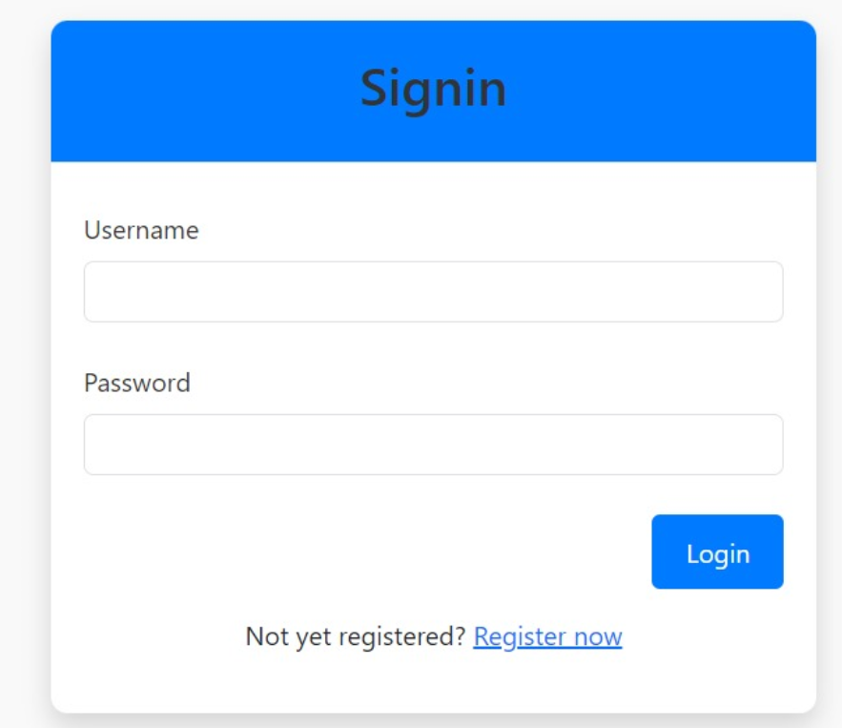
APPLICATION RESULTS

Slide 20
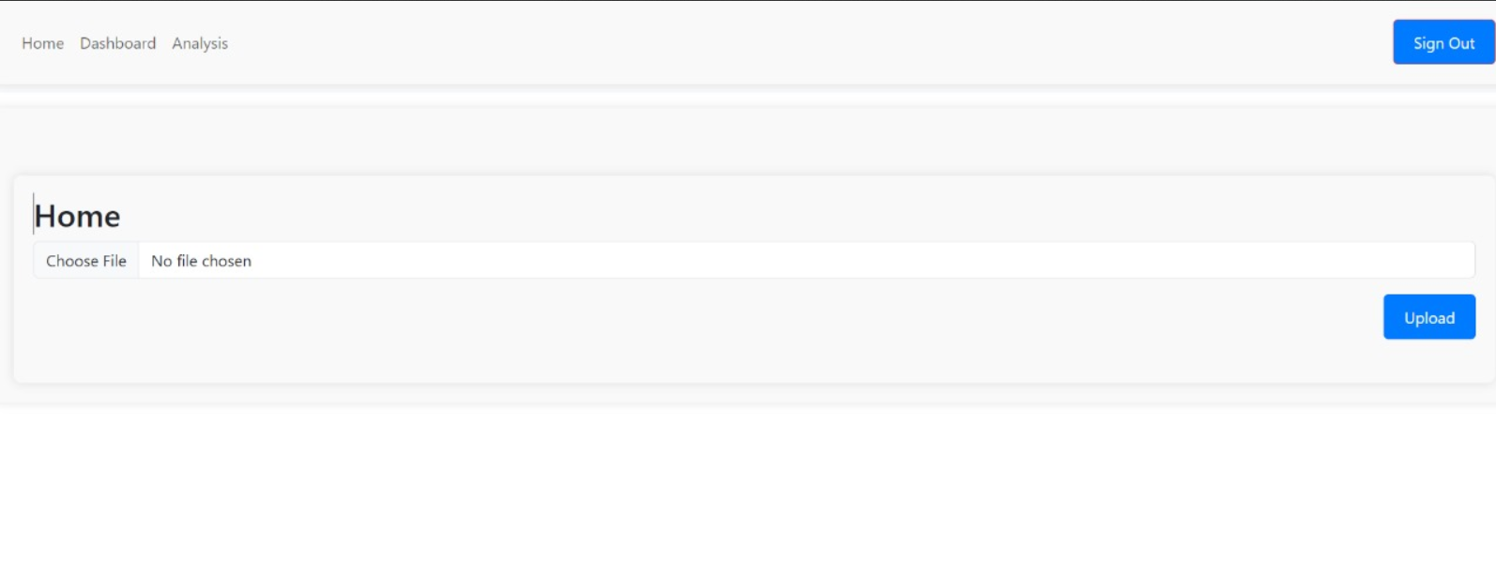
APPLICATION RESULTS

Slide 21
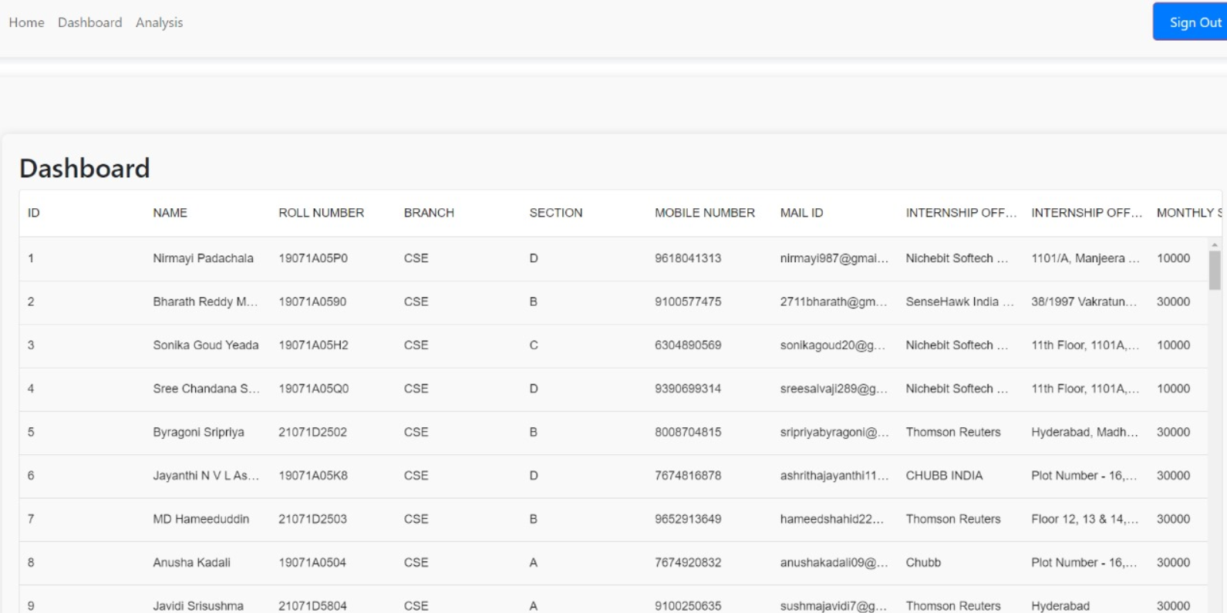
APPLICATION RESULTS

Slide 22
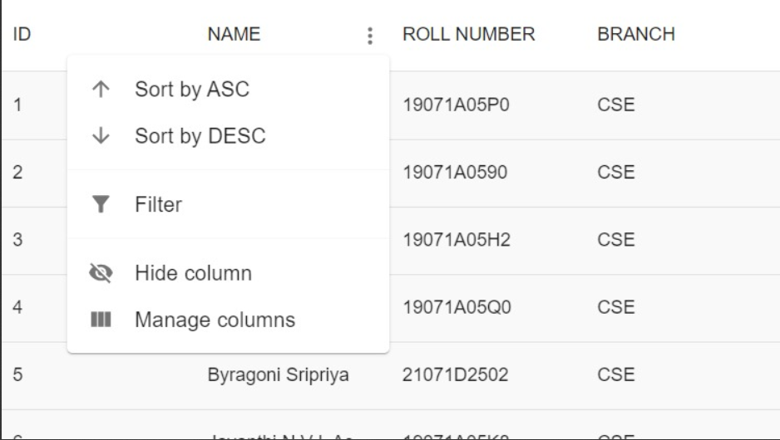
APPLICATION RESULTS

Slide 23
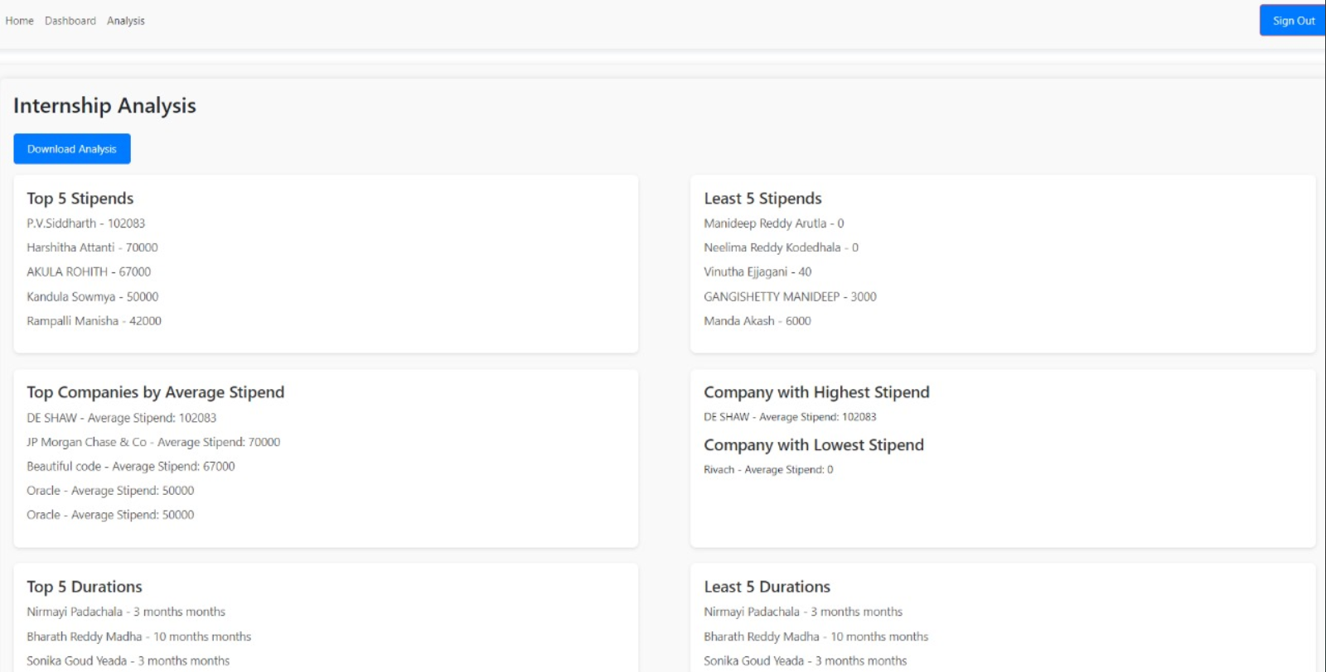
APPLICATION RESULTS

Slide 24
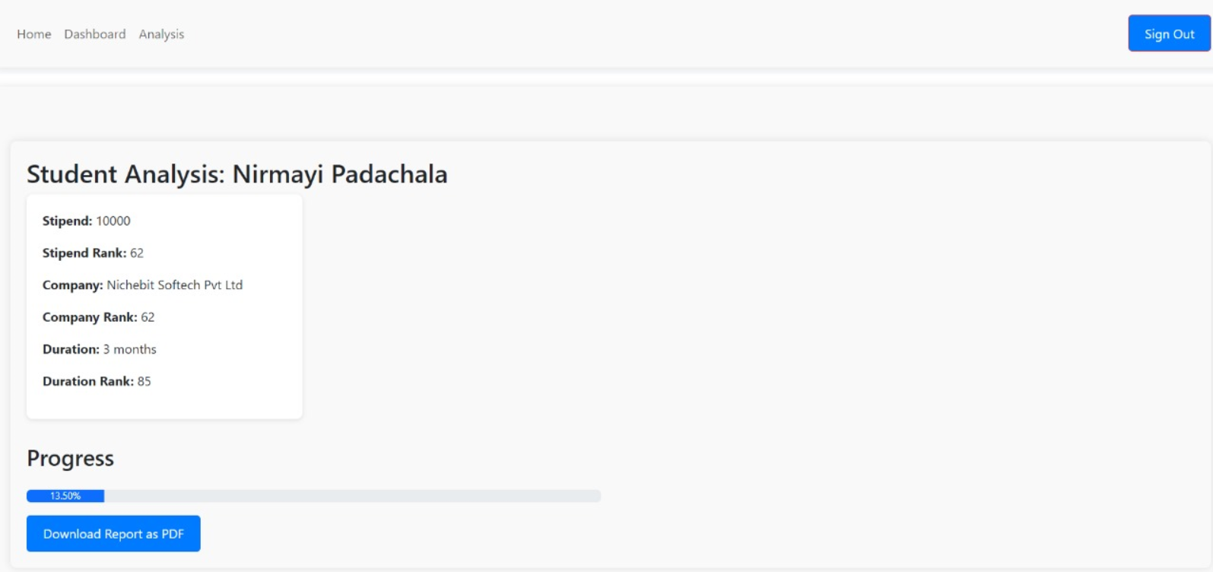
APPLICATION RESULTS

Slide 25

Back to Agenda
THANK YOU
22071A0518- G. ABHISHEK GOUD
22071A0521- G. SAI SRUJITH
22071A0559- V. PAVAN KUMAR
22071A0564-Y. SAKETH

