Slide 1


Week 2 – Group Portfolio Activity
Company Name:
Members:
WARNER BROTHERS DISCOVER
Saketh Reddy Sadu, Varsha Peddineni, Sugan Dutt Katuri

Slide 2

Week 2
Learning Objectives
Upon completion of Week 2, you will be able to:
Discuss the purpose of Enterprise Architecture and its impact on business and information technologies.
Describe Operating Models
Diversification
Unification
Coordination
Replication
Key Concepts
Four Operating Models
Coordination
Diversification
Replication
Unification
Core Diagram

Slide 3

STEPS
In this week’s project activity, your team will brainstorm and build a model diagram of your company as part of the architect’s role. Here are the steps to complete:
1. Create a MindMap to learn more about your company and identify its core components
2. Model a Core Diagram
A core diagram contains four main components:
Core business processes – the stable set of enterprise processes required to execute its operating model and respond to market opportunities;
Shared data driving the core processes – e.g., customer data shared across
product lines or business units of a company
(3) Key linking and automation technologies – technologies that enable integration of applications (middleware) to shared data, major
software packages such as ERP systems, portals providing standardized access to systems and data, and electronic interfaces to key stakeholder groups
(4) Key customers – major customer groups served by the foundation for execution (Ross et al., 2004)

Slide 4

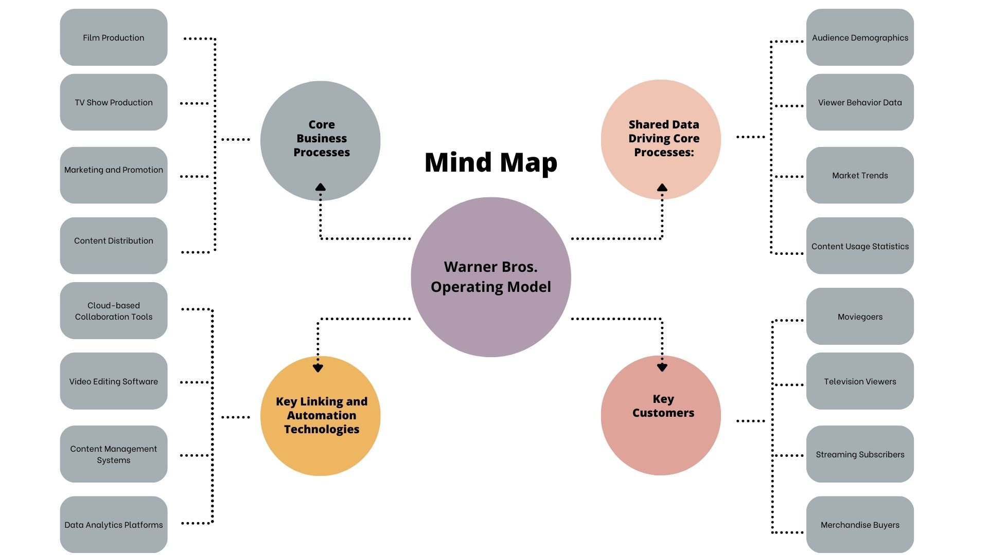
STEP 1: MINDMAP
For your chosen company, develop a Mindmap diagram. As discussed in class, mind mapping is a technique designers and engineers use to express and generate ideas and insert the diagram below.
What are the requirements?
Your team must identify at least four (4) data, core processes, technologies, and customers.

Slide 5
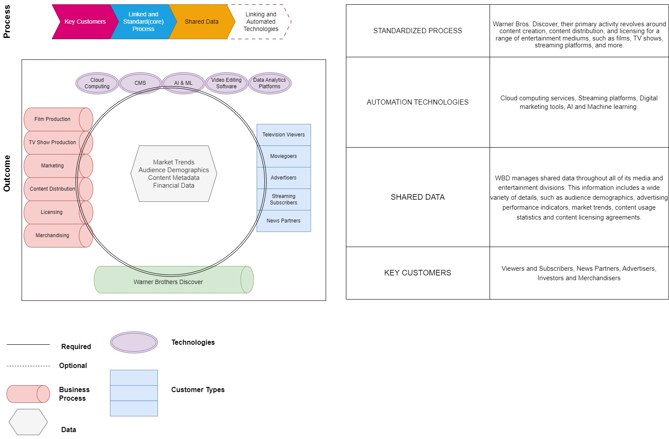
STEP 2: CORE DIAGRAM
For your chosen company, develop a Core Diagram and insert the diagram below. As discussed in class a Core Diagram is used to translate the standardization/integration requirements into the necessary organizing logic for business processes and IT infrastructure.
Please remember the file size limit and resize or paste, as needed.
What are the requirements?
Your team must identify at least four (4) Core business processes: Shared Data, Technologies, Core Processes, and Customers

