Slide 1
Data Analytics with R Project Presentation
Saketh Reddy Garlapati(UCID: sg2485)
Aashrith Surya Visanakarala(UCID:av669)
Lakshmi Prasanna Yakkanti(UCID:Ly33)
Surapareddy Manasa(UCID:MS3265)

Slide 2
Libraries
Numpy:
Pandas
Matplotlib
Seaborn
Gc
Pickle
XGBRegressor
rcParams

Slide 3


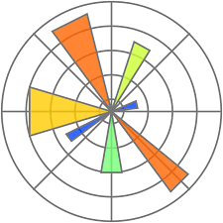
Numpy: a library for the Python programming language, adding support for large, multi-dimensional arrays and matrices, along with a large collection of high-level mathematical functions to operate on these arrays.
Pandas: pandas is a fast, powerful, flexible and easy to use open source data analysis and manipulation tool, built on top of the Python programming language.
Used in reading csv files for the data analysis.
MatplotLib: Matplotlib is a plotting library for the Python programming language and its numerical mathematics extension NumPy.

Slide 4
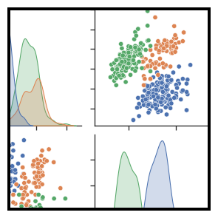
SEABORN: Seaborn is a Python data visualization library based on matplotlib. It provides a high-level interface for drawing attractive and informative statistical graphics.
Gc: imports the garbage collector module in Python. The garbage collector is a tool that manages the memory of a Python program, reclaiming memory that is no longer needed by the program, thus preventing memory leaks and optimizing the use of available memory.
Pickle: Python pickle module is used for serializing and de-serializing python object structures. The process to converts any kind of python objects (list, dict, etc.) into byte streams (0s and 1s) is called pickling or serialization or flattening or marshalling.

Slide 5
DATASETS
Items.csv
Item_categories.csv
Sales_train.csv
Shops.csv
Test.csv

Slide 6
Data Fields
Sales_train.csv – date, date_block_num, shop_id, item_id, item_price, item_cnt_day
Test.csv – id, shop_id
item_categories.csv – item_category_id, item_category_name
Shop.csv – shop_id, shop_name
Items.csv – item_category, item_id, item_name

Slide 7
Data Cleaning
is the process of fixing or removing incorrect, corrupted, incorrectly formatted, duplicate, or incomplete data within a dataset. When combining multiple data sources, there are many opportunities for data to be duplicated or mislabeled.
Challenges faced during data cleaning:
Merging Data from Various Resources. This problem appears when the location name does not exactly match with its original name.
Invalid or Inaccurate Data. Data validation refers to examining the accuracy and quality of records.
Extracting Data from reports.

Slide 8
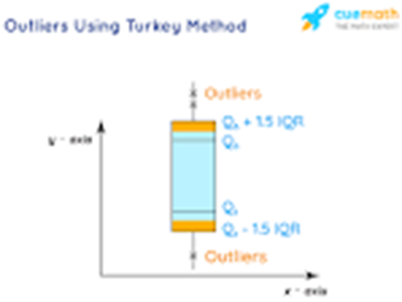
Outliers
Outlier is an observation that lies an abnormal distance from other values in a random sample from a population. In a sense, this definition leaves it up to the analyst (or a consensus process) to decide what will be considered abnormal.
Outliers are problematic for many statistical analyses because they can cause tests to either miss significant findings or distort real results.
Impacts of outliers:
It may cause a significant impact on the mean and the standard deviation.
If the outliers are non-randomly distributed, they can decrease normality.
They can bias or influence estimates that may be of substantive interest.

Slide 9
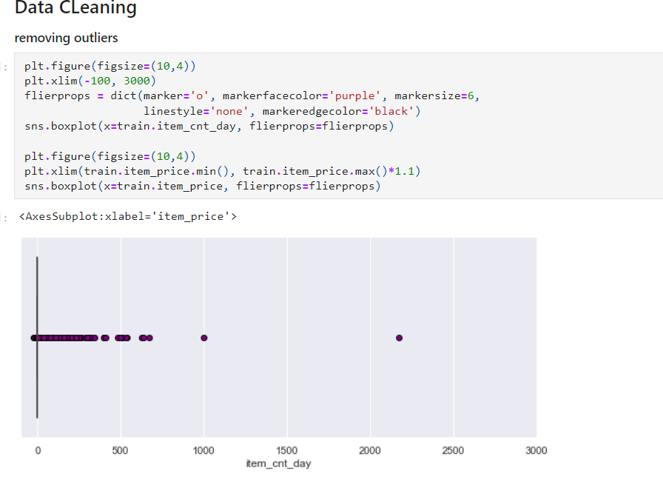

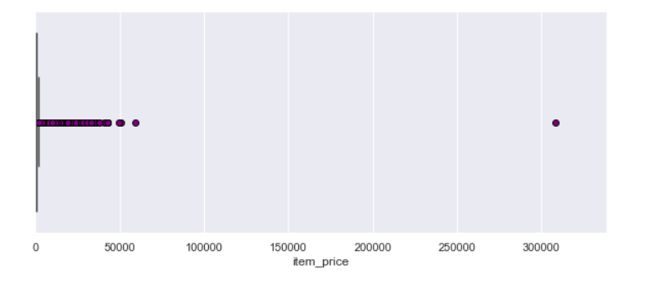

Slide 10
Data Cleaning(cont.)
‘name_correction’- Used to clean up the item names by making them all lowercase, removing special characters and removing leading/trailing whitespace.
Splitting the item into multiple columns: Splitting the item_name in the items dataframe into name1, name2 and name3 based on the presence of square brackets or parantheses
Applying name correction to item_name
Cleaning up name2 and name3
Grouping and dropping categories

Slide 11
Feature Engineering
Lag Features: Target Variable shifted with time. Used to know the behavior of our target value in the past, maybe a day before, a week or a month.
Added lag features to matrix, item_cnt_month, for month/item id, for every shop combination, for item price per month.

Slide 12
Model and Training
We have used the XGBoost (eXtreme Gradient Boosting) Regressor.
XGBoost is a powerful machine learning algorithm used for regression, classification and ranking tasks. Based on the gradient boosting decision tree algorithm and is higholy efficient, scalable and flexible.
It is used in various data science applications and has proven to be an effective algorithm for many real-world problems.

Slide 13
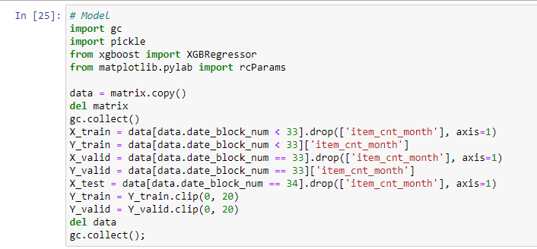
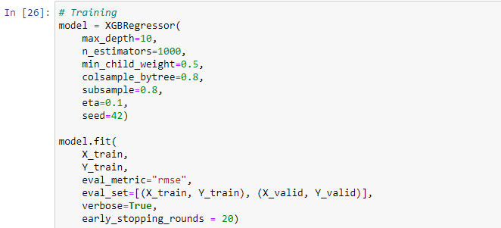
Model and Training(cont.)

Slide 14

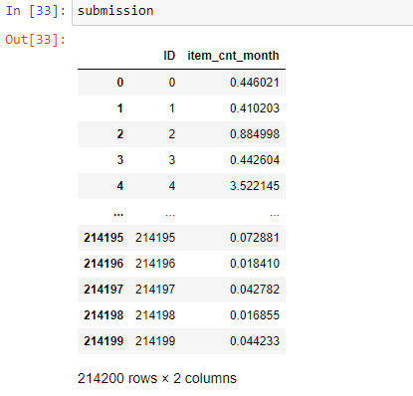
Result
After experimenting with various hyperparameters, I found that the combination of max_depth = 10, min_child_weight = 5, subsample = 0.8, colsample_bytree = 0.8, and alpha = 0.1 resulted in the best performance for this model.

