Slide 1

SRI CHANDRASEKHARENDRA SARASWATHI VISWA MAHAVIDHYALAYA (Deemed to be university u/s 3 of UGC act 1956) (Accredited with “A” by NAAC) Enathur, Kanchipuram – 631561. Tamilnadu www.kanchiuniv.ac.in
BCSF187Z50 - Project Work - Phase I
S-HER WOMEN SAFETY APPLICATION
P. Subrahmanya Vikas 11219A032
R. Saketh Bhargava 11219A038
Guided By
Dr. R. Prema
Assistant Professor
University Review: 11/11/2024

Slide 2
S-HER Women Safety Application
Abstract :
Women's safety is vital for gender equality, personal well-being, and social progress.
Women face challenges such as harassment, violence, discrimination, and unequal access to resources.
Efforts include awareness campaigns to change societal attitudes, promote respect, and challenge gender biases.
S-HER is an Android-based safety app developed using Java and XML, designed to empower women.
The app offers location alerts, emergency calls, safety tips, helpline contacts, and legal information.
S-HER provides practical safety tools, fostering a safer environment for women.
Keywords: Application, Equality, Government, Helplines, Location alerts, Safety, Society
2

Slide 3
S-HER Women Safety Application
Problem Statement :
The safety and security of women remain a critical concern in society, as they continue to face risks such as harassment, violence, and discrimination, which limit their ability to live freely and confidently. Despite various initiatives to address these issues, existing safety measures and resources are often fragmented and lack proper integration, making it challenging for women to access timely assistance during emergencies. Additionally, limited awareness about women’s safety laws and self-defence techniques further exacerbates the problem. There is a pressing need to develop more effective and comprehensive solutions that empower women to protect themselves and seek help when needed.
3

Slide 4
S-HER Women Safety Application
Existing system and its drawbacks :
Basic Emergency Alerts: Most apps offer SOS buttons but lack integration with multiple contacts or real-time GPS sharing, reducing their effectiveness.
Limited Location Services: Apps often fail to provide real-time updates or locate nearby emergency services like police stations and hospitals.
Emergency Contact Access: Features for direct calling to helplines and local authorities are inconsistent, limiting quick access in emergencies.
Awareness & Education: Information on safety laws and self-defence is minimal and lacks interactive features to effectively educate users.
User Interface: Existing apps may not be user-friendly, especially for older or less tech-savvy users.
Security Concerns: Many apps do not offer robust data privacy, leaving user information at risk.
4

Slide 5
S-HER Women Safety Application
Literature Survey :
Authors | Title | Description | Drawbacks | Year
Ravi Sekhar Yarrabothula, Bramarambika Thota | ABHAYA: AN ANDROID APP FOR THE SAFETY OF WOMEN | Android app with GPS tracking and emergency alerts; user-friendly interface. | Limited functionality smartphones may exclude some users. | 2015
Alisha Maruti Gawade, Amruta Jadhav, Sachin Shankar Kumbhar | S-ZONE: A SYSTEM FOR WOMEN SAFETY & SECURITY SYSTEM | Comprehensive system with mobile app and hardware (panic buttons); real-time location tracking. | High hardware costs; dependency on network availability. | 2016
Sagar Khan, Harish Shinde, Ankita Zaroo, Rashmi Koushik | SHIELD: Personal Safety Application | App for emergency messages and safety tips; location data integration. | Usability issues in emergencies; relies on user engagement. | 2017
Piyush Bhanushali, Rahul Mange, Dama Paras, Prof. Chitra Bhole | Women Safety Android App | Simple app with emergency alerts and voice commands. | Limited features; battery and device accessibility concerns. | 2018
N. Ramesh Kannan, S. Sujitha, S. Ganapathy Subramanian | Women Safety Mobile App | Safety alerts and emergency contacts; focuses on user awareness and education. | Limited awareness campaigns; may lack offline functionality in poor connectivity areas. | 2021
5

Slide 6
S-HER Women Safety Application
Proposed Method:
Enhanced Emergency Alerts: Integrate a shake detector and panic button to trigger SOS alerts with GPS location sharing and a siren for emergencies.
Real-Time Location Services: Continuously track and share live location with emergency contacts, including nearby police stations and hospitals.
Direct Access to Emergency Services: Enable one-click calls to local authorities, police, hospitals, and national helplines for immediate assistance.
Comprehensive Educational Support: Provide detailed information on safety laws and rights, along with interactive self-defence videos.
Intuitive User Interface: Design a simple and responsive interface for easy navigation, especially under stress.
Robust Security and Privacy: Protect user data with strong encryption and secure authentication methods.
6

Slide 7
S-HER Women Safety Application
Module Description:
Emergency Contact Management: Users can add, edit, or delete emergency contacts, with data stored using Shared Preferences.
SMS Alert Functionality: Facilitates the sending of pre-configured SMS alerts to emergency contacts.
Panic Button: A dedicated panic button sends an SOS message with the user’s GPS location to emergency contacts.
Shake Detection: Utilizes the accelerometer to detect shake gestures, triggering the panic button automatically.
GPS Tracking: Fetches the user’s current location and passes it to relevant activities, requesting necessary permissions for location access.
Permissions Management: Ensures necessary permissions are requested for both SMS and location functionalities.
7

Slide 8
S-HER Women Safety Application
System Architecture:
Client-Side (Android Device):
User Interface (UI): User-friendly interface with four button cards for managing contacts, sending SMS alerts, displaying women's laws, and accessing self-defence resources.
Permissions: Requires location, phone, SMS, and notification permissions.
Emergency Contacts Database: Users can add and access emergency contacts, with a high-speed cache for quick retrieval.
Backend Services:
Location and GPS Tracking: Retrieves user location via GPS and uses Map APIs to show nearby police stations and hospitals.
Accelerometer Integration: Detects phone shaking (five shakes) to trigger emergency calls and SMS alerts with location details.
8

Slide 9
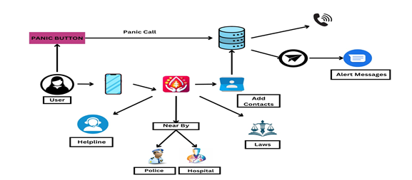
S-HER Women Safety Application
System Architecture:
9

Slide 10
S-HER Women Safety Application
Methodology:
App development: The S-HER app is built using Android Studio, leveraging Java and XML for seamless integration of safety features.
GPS location tracking: Real-time location tracking is implemented to provide accurate information during emergencies.
SOS alerts: Integrated an SOS feature that sends emergency alerts and messages to pre-registered contacts with location details.
Access to emergency services: Developed a system to enable quick access to national helplines and emergency services directly through the app.
User interface design: Focused on creating a user-friendly interface, ensuring easy navigation and accessibility to all safety features.
10

Slide 11
Implementation Details
Set Up Development Environment
Install Android Studio and JDK (Java Development Kit) version 8 or newer. Ensure the Android SDK is up to date.
Create a New Project Open Android Studio and create a new project named W-Safe using the Empty Activity template.
Build Core Features:
MainActivity: Create the home screen with buttons for features (Contact, SMS Alerts, Women's Laws, Self-Defense, Panic Button) and set up navigation.
LawsActivity: Design a screen to display women’s safety laws in a user-friendly manner.
ContactActivity: Manage emergency contacts using SharedPreferences and display them in a RecyclerView.
11

Slide 12
Implementation Details
Self Defence Activity: Use a WebView to show self-defence instructional videos.
SmsActivity: Enable SMS functionality, request permissions, and add options for sending SMS alerts and a helpline button.
Panic Button Activity: Design the panic button screen, check location permissions, and send SOS messages with location to emergency contacts.
Include the Shake Detector library and set up shake detection to trigger the Panic Button.
Request location permissions and use GPS for tracking the user’s location during emergencies.
Test on emulators in Android Studio and on real devices for performance.
Make the interface visually appealing, easy to navigate, and responsive to different screen sizes.
12

Slide 13
Demo
13

Slide 14
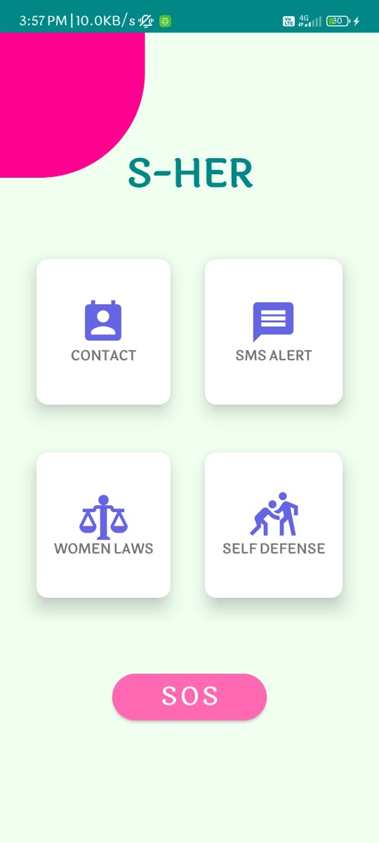
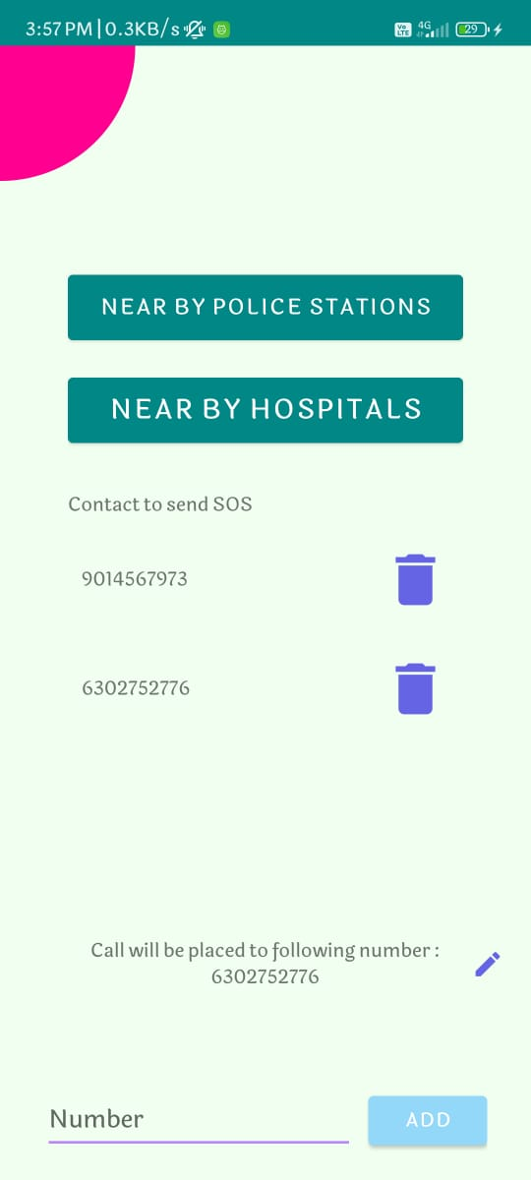
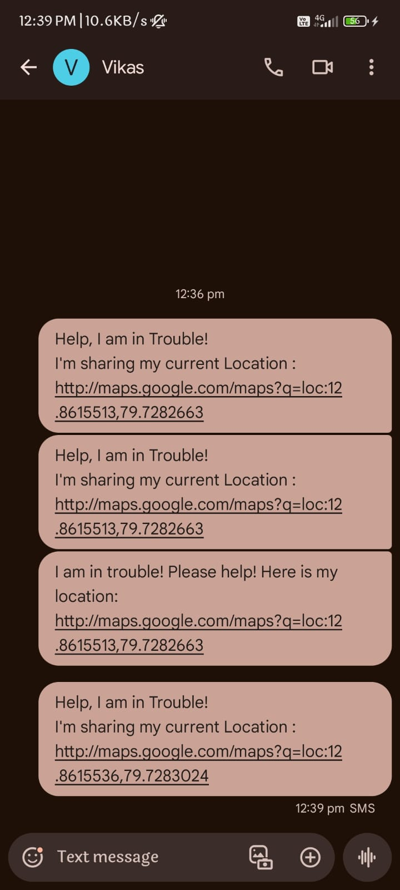
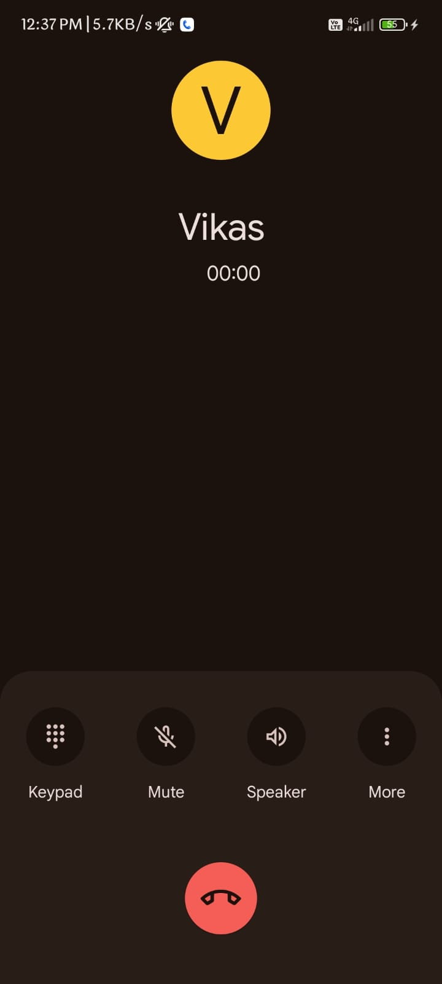
Results
14

Slide 15
Conclusion
The development of the S-HER application has addressed the critical need for women's safety in today's society. The application incorporates features like a shake detector, panic button, SOS alerts, and location tracking to ensure prompt assistance during emergencies. Additionally, the integration of nearby police stations and hospitals, women safety laws, self-defence videos, and national helpline numbers provides users with valuable resources and information. The user-friendly interface and seamless functionalities make S-HER accessible and easy to navigate, further enhancing its effectiveness. The successful implementation of the project showcases the potential of technology in promoting women's safety and creating a safer environment. S-HER serves as a significant step forward in safeguarding women and raising awareness about their rights and well-being.
15

Slide 16
Future Enhancement
AI-Powered Threat Detection: Incorporate machine learning algorithms to detect potential threats based on the user's location and past data patterns. The app could proactively alert users in risky areas or situations and offer preventive safety tips.
Crowdsourced Safety Insights: Create a community-based feature where users can share real-time safety insights and rate the safety of different areas. This data could be aggregated to show safer routes and spots.
Wearable Device Integration: Enable the app to connect with wearable devices like smartwatches. Users could activate emergency features via wearables, which might be more accessible in certain situations.

