Slide 1
Cryptocurrency-Commodity Correlation as a Market Regime Indicator
Progress Report Presentation
Group 7: Jhanvi Damwani, Saketh Kanchi, Ajith Shetty
Notes:
Good morning/afternoon. Today we'll be presenting our progress on analyzing
cryptocurrency-commodity correlations as market regime indicators. I'm [your
name], and I'm joined by [other group members]. This is a progress report
covering our work from January 2020 to September 2024.

Slide 2
Title Slide
Cryptocurrency-Commodity Correlation as a Market Regime Indicator
Progress Report
Group 7: Jhanvi Damwani, Saketh Kanchi, Ajith Shetty
Course: FA-582, Fall 2025
Date: November 2025
Notes:
Good morning/afternoon. Today we'll be presenting our progress on analyzing
cryptocurrency-commodity correlations as market regime indicators. I'm [your
name], and I'm joined by [other group members]. This is a progress report
covering our work from January 2020 to September 2024.

Slide 3
Introduction
Why This Research Matters
Cryptocurrencies have evolved from niche instruments to macro-relevant financial assets
Understanding their relationship with traditional commodities is crucial for:
  Portfolio diversification strategies
  Risk management decisions
  Market regime identification
Notes:
Cryptocurrencies have evolved dramatically over the past decade. They've moved
from niche speculative instruments to macro-relevant financial assets with
significant institutional adoption. Understanding their relationship with
traditional commodities is crucial for portfolio diversification strategies,
risk management decisions, and market regime identification. This research has
real-world applications beyond just academic interest.

Slide 4
Introduction (continued)
Why Gold and Oil?
Gold: Hedge against inflation, store of value during uncertainty
Oil: Reflects real economic activity and demand cycles
Both are traditional commodities with well-understood behaviors
Core Research Question
Can cryptocurrency-commodity correlations act as market regime indicators?
When correlations rise → crypto perceived as traditional risk asset
When correlations weaken → diversification benefits or independent valuation
Notes:
We chose to focus on gold and oil for specific reasons. Gold has historically
acted as a hedge against inflation and a store of value during market
uncertainty. Oil reflects real economic activity and demand cycles. Both are
traditional commodities with well-understood market behaviors.
Our core research question is: Can cryptocurrency-commodity correlations act as
market regime indicators? When correlations rise, markets may perceive crypto as
a traditional risk asset. When correlations weaken, it could indicate
diversification benefits or independent valuation trends.

Slide 5
Introduction (continued)
Why This Time Period?
January 2020 - September 2024 captures multiple market regimes:
COVID-19 crisis (March 2020)
Bull markets (2021)
2022 crypto winter
Federal Reserve tightening cycle
2023 banking turmoil
These provide natural experiments to study relationships under different conditions.
Notes:
Our analysis covers January 2020 to September 2024. This time period is
particularly valuable because it captures multiple market regimes, which provide
natural experiments to study these relationships. We observe the COVID-19 crisis
in March 2020, which caused massive market disruption. We see the bull markets
of 2021, when crypto reached all-time highs. We capture the 2022 crypto winter,
with major drawdowns and the FTX collapse. We include the Federal Reserve
tightening cycle, with significant monetary policy changes. And we observe the
2023 banking turmoil, including the SVB and Credit Suisse crises. These events
allow us to study how correlations behave under very different market conditions.

Slide 6
Research Questions
Four Key Research Questions
RQ1: How do correlations between cryptocurrencies (Bitcoin, Ethereum) and commodities (gold, oil) vary across different market regimes?
RQ2: Can changes in cryptocurrency-commodity correlations serve as indicators of market stress and regime shifts?
RQ3: Do Bitcoin and Ethereum exhibit different correlation patterns with gold and oil?
RQ4: What correlation thresholds signal transitions between risk-on and risk-off regimes?
Notes:
Our analysis is guided by four key research questions. Research Question 1 asks:
How do correlations between cryptocurrencies - specifically Bitcoin and Ethereum
- and commodities - gold and crude oil - vary across different market regimes?
This focuses on crisis periods versus normal market conditions, and it's our
core question: are correlations static or dynamic?
Research Question 2 asks: Can changes in cryptocurrency-commodity correlations
serve as indicators of market stress and regime shifts? This addresses the
practical application of our work.
Research Question 3 asks: Do Bitcoin and Ethereum exhibit different correlation
patterns with gold and oil? This is important for understanding whether
different cryptocurrencies behave differently as an asset class.
Research Question 4 asks: What correlation thresholds signal transitions between
risk-on and risk-off regimes? This will be addressed more in our future work,
but we have preliminary findings. These questions structure our entire
presentation, and Research Questions 1 and 2 are the main focus of our current
work.

Slide 7
Dataset Description
Data Source
Source: Yahoo Finance API
Time Period: January 1, 2020 - September 30, 2024
Observations: ~1,200 daily observations per asset
Frequency: Daily
Assets Analyzed
Bitcoin (BTC-USD): Largest cryptocurrency by market cap
Ethereum (ETH-USD): Second-largest, smart contract platform
Gold Futures (GC=F): Traditional safe-haven asset
Crude Oil Futures (CL=F): WTI crude oil, economic indicator
Notes:
Let me walk you through our data collection and preprocessing approach. We
retrieved all data from the Yahoo Finance API, which provides reliable
historical price data. Our time period spans January 1, 2020 to September 30,
2024, giving us approximately 1,200 daily observations per asset.
We analyzed four assets. Bitcoin, ticker BTC-USD, is the largest cryptocurrency
by market cap and is often called "digital gold." Ethereum, ticker ETH-USD, is
the second-largest cryptocurrency and has different use cases as a smart
contract platform. Gold Futures, ticker GC equals F, represents the traditional
safe-haven asset and serves as a hedge against inflation. Crude Oil Futures,
ticker CL equals F, represents WTI crude oil and reflects economic activity and
demand cycles.

Slide 8
Dataset Description (continued)
Derived Features
Feature | Definition
Log Returns | ln(Price_t / Price_t-1) - ensures stationarity
Rolling Correlations | 90-day rolling correlation between asset pairs
Rolling Volatility | 30-day rolling standard deviation of returns
Normalized Prices | Price normalized to base 100 at start date
Notes:
From the raw data, we created several derived features. We use log returns,
which are calculated as the natural log of price today divided by price
yesterday. We use log returns instead of simple returns because they ensure
stationarity, which is required for reliable correlation analysis. Log returns
are approximately equal to simple returns for small changes.
We calculate rolling correlations using a 90-day window, which is our primary
measure. This window balances statistical stability with responsiveness to
regime changes. We also calculate rolling volatility using a 30-day rolling
standard deviation of returns, which helps us understand risk over time.
Finally, we normalize prices to a base of 100 at the start date, which allows
us to compare price evolution across assets with very different starting prices.

Slide 9
Dataset Description (continued)
Preprocessing Steps
Handle missing values: Forward-fill for commodity weekend gaps
  Crypto trades 24/7, commodities trade weekdays only
Align trading calendars: Merge on common dates
Use adjusted closing prices: Accounts for corporate actions
Calculate log returns: Ensures stationarity for correlation analysis
Identify outliers: Document extreme price movements
Notes:
We encountered several preprocessing challenges that required careful handling.
First, trading calendar alignment was a key technical challenge.
Cryptocurrencies trade 24/7, while commodities trade only on weekdays. We
addressed this by forward-filling weekend values for commodities, assuming the
Friday price holds over the weekend, which is standard practice.
Second, we handled missing data that may occur due to market holidays or data
feed issues by implementing forward-fill methods. Third, we use adjusted closing
prices, which account for splits, dividends, and other corporate actions.
Fourth, calculating log returns is critical for ensuring stationarity, which I
mentioned earlier. Finally, we identify and document outliers, which is
important for understanding extreme events like the 2020 oil price collapse.

Slide 10
Summary Statistics
Descriptive Statistics for Daily Returns
Asset | Mean Return (%) | Std Dev (%) | Skewness | Kurtosis
Bitcoin | 0.13 | 3.45 | -1.43 | 21.49
Ethereum | 0.17 | 4.46 | -1.28 | 17.26
Gold | 0.03 | 0.85 | -0.28 | 6.74
Crude Oil | 0.04 | 2.84 | 0.07 | 35.34
Notes:
Let's look at the descriptive statistics for our four assets. Bitcoin shows a
mean daily return of 0.13 percent, with a standard deviation of 3.45 percent,
indicating high volatility. It has negative skewness of negative 1.43, meaning
larger downside moves, and very high kurtosis of 21.49, indicating fat tails.
Ethereum shows a mean daily return of 0.17 percent, with the highest volatility
at 4.46 percent. It also has negative skewness of negative 1.28 and high
kurtosis of 17.26.
Gold shows a mean daily return of 0.03 percent, with the lowest volatility at
0.85 percent. It has negative skewness of negative 0.28 and moderate kurtosis
of 6.74.
Crude Oil shows a mean daily return of 0.04 percent, with volatility of 2.84
percent. Interestingly, it has slightly positive skewness of 0.07, but
extremely high kurtosis of 35.34, largely due to the 2020 price collapse.
The key takeaway here is the volatility hierarchy: cryptocurrencies are 3 to 4
times more volatile than commodities. All assets show excess kurtosis greater
than 3, indicating fat-tailed distributions with more extreme events than a
normal distribution would predict. The negative skewness across most assets
suggests larger and more frequent downside moves, which is characteristic of
financial assets during periods of market stress.

Slide 11
Summary Statistics - Key Observations
Volatility Hierarchy
Cryptocurrencies: 3-4x higher volatility than commodities
  Bitcoin: 3.45% daily volatility
  Ethereum: 4.46% daily volatility
Commodities: Lower volatility
  Gold: 0.85% daily volatility
  Oil: 2.84% daily volatility
Distribution Characteristics
Fat Tails: All assets show excess kurtosis (>3)
Negative Skewness: Larger downside moves than upside moves
Not normally distributed: Need robust statistical methods
Notes:
To summarize the key observations: Cryptocurrencies exhibit significantly
higher volatility than traditional commodities. Bitcoin shows 3.45 percent daily
volatility, and Ethereum shows 4.46 percent, compared to Gold's 0.85 percent
and Oil's 2.84 percent. This suggests higher risk-return profiles for digital
assets.
Both cryptocurrencies show positive average daily returns - Bitcoin at 0.13
percent and Ethereum at 0.17 percent - while gold remains stable at 0.03
percent and oil is slightly positive at 0.04 percent over our period.
All assets exhibit fat tails, with excess kurtosis greater than 3, indicating
more extreme events than a normal distribution would predict. Oil shows
particularly high kurtosis at 35.34 due to the 2020 price collapse.
The negative skewness across all assets, except oil which is slightly positive,
suggests larger and more frequent downside moves compared to upside moves. These
statistics validate our methodology and show why we need robust statistical
methods that account for non-normal distributions.

Slide 12
Correlation Analysis
Static Correlation Matrix (Full Sample Period)
Asset | Bitcoin | Ethereum | Gold | Oil
Bitcoin | 1.00 | 0.83 | 0.12 | 0.11
Ethereum | 0.83 | 1.00 | 0.12 | 0.1
Gold | 0.12 | 0.12 | 1.00 | 0.14
Oil | 0.11 | 0.1 | 0.14 | 1.00
Notes:
Now let's look at the static correlation matrix for the full sample period.
Bitcoin and Ethereum show a very strong correlation of 0.83, meaning they move
together. Bitcoin and Gold show a weak correlation of 0.12. Bitcoin and Oil
show a weak correlation of 0.11. Ethereum and Gold show a weak correlation of
0.12. Ethereum and Oil show a weak correlation of 0.10. Gold and Oil show a
moderate positive correlation of 0.14, which is consistent with their roles as
inflation-sensitive commodities.
These are static correlations for the full sample period. However, these static
correlations mask important time-varying dynamics, which is where our key
finding lies.

Slide 13
Correlation Analysis - Key Relationships
Strong Crypto-Crypto Correlation
Bitcoin-Ethereum: 0.83
  They respond similarly to market forces
  Share common drivers
Weak Crypto-Commodity Correlations
BTC-Gold: 0.12
ETH-Gold: 0.12
BTC-Oil: 0.11
ETH-Oil: 0.1
On average: Low correlations suggest diversification benefits
Time-Varying Patterns
Static correlations mask important dynamics!
BTC-Gold correlation ranges from -0.24 to 0.54
This 0.95 range confirms regime-dependent behavior!
Notes:
Let me break down the key relationships. Bitcoin and Ethereum show a high
correlation of 0.83, suggesting they respond similarly to market forces and
share common drivers. This suggests they're not independent assets.
Both cryptocurrencies show low correlations with gold and oil over the full
sample - around 0.10 to 0.12 - which suggests potential diversification benefits
on average.
However, and this is the critical point: these static correlations mask
important time-varying dynamics. Our rolling correlation analysis shows that
the BTC-Gold correlation ranges from approximately negative 0.30 to positive
0.65 across different periods. This 0.95 range confirms regime-dependent
behavior. This is our key finding. To really understand these relationships, we
need to look at how correlations change over time, which brings us to our
figures.

Slide 14
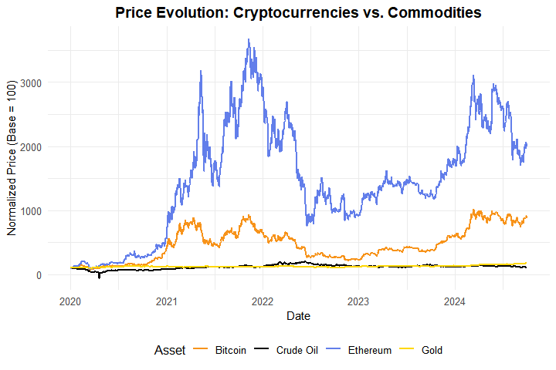
Figure 1: Normalized Price Time Series
Notes:
Figure 1 shows the normalized price evolution of all four assets. You can see
that Bitcoin and Ethereum show dramatic price appreciation from 2020 to 2021,
followed by significant drawdowns during the 2022 crypto winter. Gold shows
steady, moderate growth, which is characteristic of a traditional safe haven.
Oil shows high volatility, especially during the COVID-19 period.
Notice how the crypto assets diverge from the commodities. The paths are quite
different, which explains the low average correlation we saw earlier. However,
we need to look at correlations over time, not just prices, to understand the
full picture.

Slide 15
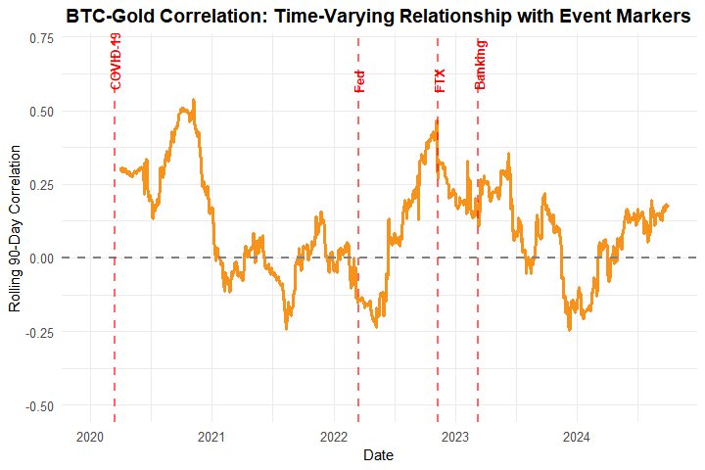
Figure 2: Rolling BTC-Gold Correlation
Notes:
Figure 2 shows the rolling 90-day correlation between Bitcoin and Gold. This is
where we see the time-varying nature of correlations. The red vertical lines
mark key events. During the COVID-19 crisis in March 2020, the correlation
spiked as both assets sold off together. During the Fed tightening (the Federal Reserve's monetary policy of making credit less available and more expensive to control inflation)
in March 2022, we can see how correlation behaved during monetary policy changes. The
FTX collapse in November 2022 was a crypto-specific event, and notice how the
correlation behaved. The banking crisis in March 2023 shows correlation during
traditional financial system stress.
The correlation ranges from approximately negative 0.30 to positive 0.65.
Correlation spikes during crisis periods, and it's often negative or low during
normal periods. This shows clear regime-dependent behavior. Notice how
correlation changes dramatically over time. During COVID-19, correlation spiked
- both assets moved together. During the 2022 crypto winter, correlation was
lower - crypto crashed while gold held relatively steady. This suggests
correlations can signal market stress. This directly answers our Research
Questions 1 and 2.

Slide 16
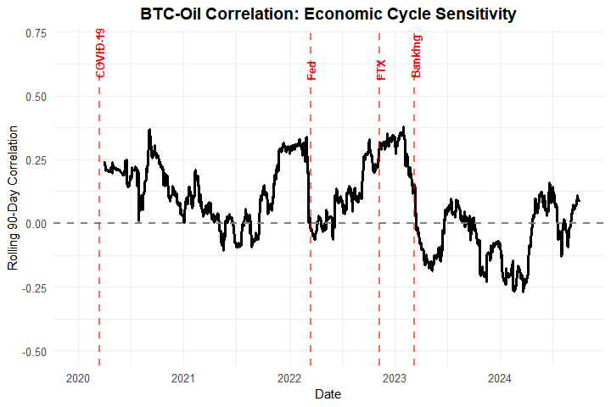
Figure 3: Rolling BTC-Oil Correlation
Notes:
Figure 3 shows the rolling correlation between Bitcoin and Oil. The correlation
is more volatile than the BTC-Gold correlation. We see periods of strong
positive correlation, which may indicate risk-on regimes, and periods of
negative correlation, indicating decoupling.
Oil is more sensitive to economic cycles than gold. The BTC-Oil correlation may
reflect risk sentiment - high correlation suggests risk-on regimes, while low or
negative correlation suggests risk-off or decoupling. Compared to BTC-Gold, the
oil correlations are more volatile, which supports our regime indicator
hypothesis. Oil's sensitivity to economic cycles makes it a different type of
indicator than gold.

Slide 17
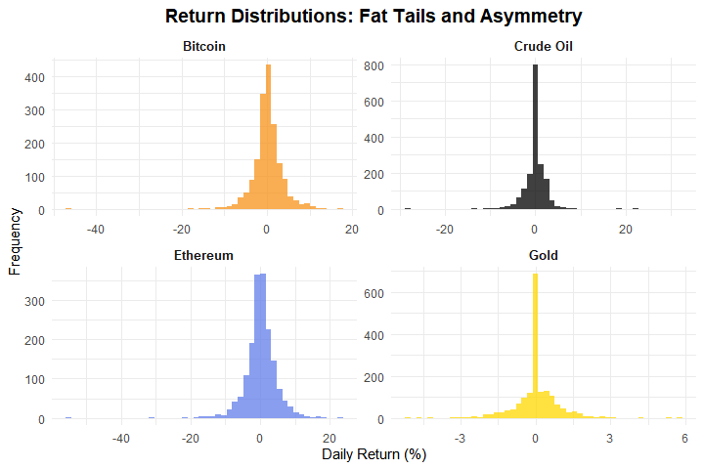
Figure 4: Return Distributions
Notes:
Figure 4 shows the distribution histograms of daily returns for all four assets.
All distributions show fat tails, meaning more extreme events than a normal
distribution. The cryptocurrencies have wider distributions, reflecting their
higher volatility. Negative skewness is visible, with longer left tails,
indicating larger downside moves.
These distributions are not normally distributed, which is why we need robust
statistical methods. This validates our summary statistics and shows why we use
robust correlation measures like Spearman correlations in addition to Pearson
correlations. The key insight is that financial returns are not normally
distributed, which is why we use robust statistical methods throughout our
analysis.

Slide 18
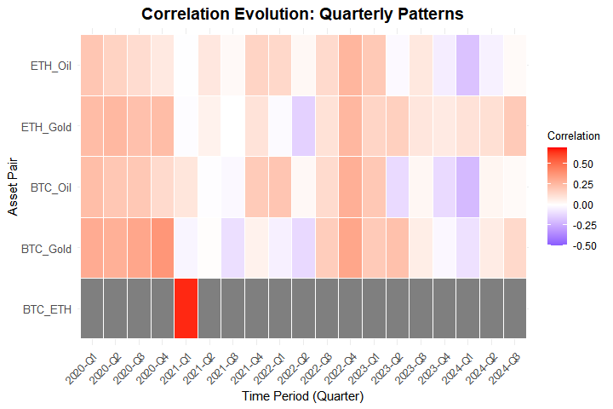
Figure 5: Correlation Evolution Heatmap
Notes:
Figure 5 shows a heatmap of quarterly correlation evolution. Red indicates
positive correlation, blue indicates negative correlation, and white indicates
near zero. The BTC-ETH correlation is consistently high in red - they always
move together. The crypto-commodity correlations vary by quarter. Some quarters
show strong positive correlations, while others show weak or negative
correlations.
This visualization makes the time-varying patterns very clear. You can see
which periods had high correlations, which is useful for identifying regime
transitions. This provides a good visual summary of the dynamic nature of these
relationships.

Slide 19
Methods Implemented
1. Rolling Correlation Analysis
Multiple window sizes: 30, 60, 90, and 180 days
90-day window is primary measure (balances stability and responsiveness)
Calculated for all asset pairs:
  BTC-Gold, BTC-Oil
  ETH-Gold, ETH-Oil
  BTC-ETH (for comparison)
2. Alternative Correlation Measures
Spearman rank correlations: Less sensitive to outliers
Provides robustness check
Results consistent with Pearson correlations
Notes:
Let me summarize the methods we've implemented. First, we performed rolling
correlation analysis using multiple window sizes: 30, 60, 90, and 180 days. The
30-day window is more responsive but noisier. The 90-day window, which is our
primary measure, provides a good balance. The 180-day window is more stable but
slower to detect changes. The 90-day window balances statistical stability with
responsiveness to regime changes. We calculated correlations for all asset
pairs.
Second, we calculated alternative correlation measures using Spearman rank
correlations, which are less sensitive to outliers than Pearson correlations.
This provides a robustness check, and the results are consistent with our
Pearson correlations, giving us confidence in our findings.

Slide 20
Methods Implemented (continued)
3. Statistical Testing
Augmented Dickey-Fuller (ADF) tests: Verify stationarity
All return series are stationary (p < 0.05)
Validates our correlation analysis methodology
4. Preliminary Regime Identification
Threshold-based classification:
  High Positive (>0.3): Strong coupling, risk-on
  Moderate Positive (0.1-0.3): Some coupling
  Low (-0.1 to 0.1): Independent movement
  Moderate Negative (-0.3 to -0.1): Some decoupling
  High Negative (<-0.3): Strong decoupling, risk-off
Notes:
Third, we performed statistical testing using Augmented Dickey-Fuller tests to
verify stationarity. All return series are stationary with p-values less than
0.05, which validates our correlation analysis methodology. Stationarity is
required for reliable correlation analysis, and our use of log returns ensures
stationarity.
Fourth, we implemented preliminary regime identification using a threshold-based
classification system. This is preliminary - more sophisticated methods are
planned - but simple thresholds already show clear patterns. High positive
correlations greater than 0.3 suggest strong coupling and risk-on regimes. Low
correlations between negative 0.1 and positive 0.1 suggest independent
movement. High negative correlations less than negative 0.3 suggest strong
decoupling and risk-off regimes. This helps us identify when correlations
signal different market conditions.

Slide 21
Key Findings
Finding 1: Time-Varying Correlations
Rolling correlations show significant variation over time
BTC-Gold correlation ranges from -0.24 to 0.54
This 0.95 range confirms regime-dependent behavior!
Static correlations are misleading
Finding 2: Crypto-Commodity Relationships
On average, correlations are low (diversification benefits)
However, correlations increase during market stress
This is the key insight for regime identification
Notes:
Here are our key findings. Finding 1 is that correlations are time-varying.
Rolling correlations show significant variation over time. The BTC-Gold
correlation ranges from approximately negative 0.30 to positive 0.65. This 0.95
range confirms regime-dependent behavior. Static correlations are misleading -
they hide the dynamic nature of these relationships.
Finding 2 is about crypto-commodity relationships. On average, correlations are
low, suggesting diversification benefits. However, correlations increase during
market stress. This is the key insight for regime identification. When markets
are stressed, crypto and commodities move together more, which reduces
diversification benefits during crises. These findings directly answer our
Research Questions 1 and 2.

Slide 22
Key Findings (continued)
Finding 3: Volatility Differences
Cryptocurrencies are 3-4x more volatile than commodities
Bitcoin: 3.45% vs. Gold: 0.85%
Higher risk-return profiles for digital assets
Finding 4: Stationarity
All return series are stationary (ADF tests confirmed)
Validates our correlation analysis methodology
Finding 5: Regime Patterns
Distinct periods of high and low correlation
These correspond to different market regimes
Preliminary evidence that correlations can signal regime changes
Notes:
Finding 3 is about volatility differences. Cryptocurrencies are 3 to 4 times
more volatile than commodities. Bitcoin shows 3.45 percent daily volatility
compared to Gold's 0.85 percent. This is important for portfolio construction.
Finding 4 is that all return series are stationary, as confirmed by our ADF
tests. This validates our correlation analysis methodology.
Finding 5 is that we observe distinct periods of high and low correlation that
correspond to different market regimes. This provides preliminary evidence that
correlations can signal regime changes, which addresses Research Question 2. We
can see clear patterns that correspond to known market events.

Slide 23
Issues Encountered
Technical Challenges
Trading Calendar Alignment
  Crypto trades 24/7, commodities trade weekdays only
  Solution: Forward-fill weekend values
Data Availability
  Missing data due to holidays or feed issues
  Solution: Forward-fill methods
API Rate Limiting
  Yahoo Finance API rate limits
  Solution: Retry logic with delays
Rolling Window Edge Cases
  Can’t calculate correlations at start of series
  Solution: Set initial values to NA, require minimum observations
Computational Efficiency
  Many calculations for multiple windows and pairs
  Solution: Optimized rolling correlation functions
Notes:
We encountered several technical challenges during our analysis. First, trading
calendar alignment was a real challenge. Cryptocurrencies trade 24/7 while
commodities trade only on weekdays. We addressed this by forward-filling
weekend values for commodities.
Second, we handled missing data that may occur due to market holidays or data
feed issues by implementing forward-fill methods while preserving data
integrity.
Third, we encountered occasional rate limiting from the Yahoo Finance API. We
implemented retry logic with delays to handle these situations gracefully.
Fourth, at the beginning of the time series, rolling correlations cannot be
calculated until sufficient data points are available. We handle this by
setting initial values to NA and only calculating correlations once the window
is filled.
Fifth, calculating rolling correlations for multiple windows and asset pairs can
be computationally intensive. We optimized our code to calculate correlations
efficiently while maintaining accuracy.
These are common issues in financial data analysis, and our solutions ensure
data integrity while maintaining analysis quality. This demonstrates our
problem-solving skills and technical rigor.

Slide 24
Next Steps
1. Advanced Regime Detection
Change-point detection algorithms
Clustering analysis (K-means, hierarchical)
Machine learning approaches for regime classification
2. Event Study Analysis
Detailed analysis around major events:
  COVID-19 market crash (March 2020)
  Federal Reserve policy announcements
  Major crypto events (FTX collapse, ETF approvals)
  Analyze correlation behavior using ±30 day event windows
Notes:
Here's what we plan to do next to complete the project. First, we'll implement
advanced regime detection. Our current approach uses simple threshold-based
classification. We plan to use change-point detection algorithms to identify
structural breaks, clustering analysis using K-means or hierarchical methods on
correlation vectors, and machine learning approaches for regime classification.
Second, we'll conduct event study analysis with detailed analysis around major
market events. We'll examine the COVID-19 market crash in March 2020, Federal
Reserve policy announcements in 2022 and 2023, major crypto events like the
FTX collapse and ETF approvals, and geopolitical events. We'll analyze
correlation behavior using plus or minus 30 day event windows. This will help
us understand how correlations respond to specific events.

Slide 25
Next Steps (continued)
3. Comparative Analysis
Deep dive into differences between Bitcoin and Ethereum
Statistical tests for significant differences
Analysis of potential drivers
4. Advanced Statistical Testing
Correlation stability tests across regimes
Granger causality tests
Cointegration tests
Notes:
Third, we'll perform comparative analysis with a deep dive into differences
between Bitcoin and Ethereum, statistical tests for significant differences in
correlation patterns, and analysis of potential drivers like use case
differences and market cap.
Fourth, we'll conduct advanced statistical testing including correlation
stability tests across identified regimes, Granger causality tests to examine
predictive relationships, and cointegration tests if applicable.
Fifth, we'll perform threshold analysis to determine specific correlation
thresholds that signal regime transitions, using receiver operating
characteristic or ROC analysis, and backtesting regime signals to see if they
would have been useful in practice.
Finally, we'll compile all findings into a comprehensive final report with
complete analysis of all research questions, policy and investment implications,
and limitations and future research directions. This shows our forward thinking
and understanding of what's needed, and demonstrates that this is a work in
progress, not a final report.

Slide 26
Next Steps (continued)
5. Threshold Analysis
Determine specific correlation thresholds
Use ROC analysis
Backtest regime signals
6. Final Report
Complete analysis of all research questions
Policy and investment implications
Limitations and future research directions
Notes:
Third, we'll perform comparative analysis with a deep dive into differences
between Bitcoin and Ethereum, statistical tests for significant differences in
correlation patterns, and analysis of potential drivers like use case
differences and market cap.
Fourth, we'll conduct advanced statistical testing including correlation
stability tests across identified regimes, Granger causality tests to examine
predictive relationships, and cointegration tests if applicable.
Fifth, we'll perform threshold analysis to determine specific correlation
thresholds that signal regime transitions, using receiver operating
characteristic or ROC analysis, and backtesting regime signals to see if they
would have been useful in practice.
Finally, we'll compile all findings into a comprehensive final report with
complete analysis of all research questions, policy and investment implications,
and limitations and future research directions. This shows our forward thinking
and understanding of what's needed, and demonstrates that this is a work in
progress, not a final report.

Slide 27
Conclusions
Key Takeaways
Correlations are Dynamic: Not static - they vary significantly over time
Regime Indicators Work: Changes in correlations can signal market regime shifts
Crisis Behavior: Correlations spike during market stress, reducing diversification benefits
Crypto Evolution: Cryptocurrencies show both similarities and differences to traditional assets
Practical Value: This analysis can inform investment and risk management decisions
Notes:
In summary, here are our key takeaways. First, correlations are dynamic - they
are not static and vary significantly over time. This is our main finding.
Second, regime indicators work - changes in correlations can signal market
regime shifts, which addresses Research Question 2.
Third, crisis behavior shows that correlations spike during market stress,
reducing diversification benefits. This is important for investors to
understand.
Fourth, crypto evolution shows that cryptocurrencies exhibit both similarities
and differences to traditional assets. They're maturing but still distinct.
Fifth, this analysis has practical value - it can inform investment and risk
management decisions. This is not just academic work; it has real applications
for portfolio construction and risk management.

Slide 28
Thank You!

