Slide 1
Cryptocurrency-Commodity Correlation as a Market Regime Indicator
Progress Report Presentation
Group 7: Jhanvi Damwani, Saketh Kanchi, Ajith Gangishetty

Slide 2
Cryptocurrency-Commodity Correlation as a Market Regime Indicator
Progress Report
Group 7: Jhanvi Damwani, Saketh Kanchi, Ajith Shetty
Course: FA-582, Fall 2025
Date: November 2025

Slide 3
Introduction
Why This Research Matters
Cryptocurrencies: niche instruments → macro-relevant financial assets
Understanding crypto-commodity relationships is crucial for:
  Portfolio diversification strategies
  Risk management decisions
  Market regime identification

Slide 4
Introduction (continued)
Why Gold and Oil?
Gold: Hedge against inflation, store of value during uncertainty
Oil: Reflects real economic activity and demand cycles
Both are traditional commodities with well-understood behaviors

Slide 5
Core Research Question
Can cryptocurrency-commodity correlations act as market regime indicators?
Correlations rise → crypto perceived as traditional risk asset
Correlations weaken → diversification benefits or independent valuation

Slide 6
Introduction (continued)
Why This Time Period?
January 2020 - September 2024 captures multiple market regimes:
COVID-19 crisis (March 2020)
Bull markets (2021)
2022 crypto winter
Federal Reserve tightening cycle
2023 banking turmoil
→ Natural experiments to study relationships under different conditions

Slide 7
Research Questions
Four Key Research Questions
RQ1: How do correlations between cryptocurrencies (Bitcoin, Ethereum) and commodities (gold, oil) vary across different market regimes?
RQ2: Can changes in cryptocurrency-commodity correlations serve as indicators of market stress and regime shifts?
RQ3: Do Bitcoin and Ethereum exhibit different correlation patterns with gold and oil?
RQ4: What correlation thresholds signal transitions between risk-on and risk-off regimes?

Slide 8
Dataset Description
Data Source
Source: Yahoo Finance API
Time Period: January 1, 2020 - September 30, 2024
Observations: ~1,200 daily observations per asset
Frequency: Daily

Slide 9
Assets Analyzed
Bitcoin (BTC-USD): Largest cryptocurrency by market cap
Ethereum (ETH-USD): Second-largest, smart contract platform
Gold Futures (GC=F): Traditional safe-haven asset
Crude Oil Futures (CL=F): WTI crude oil, economic indicator

Slide 10
Dataset Description (continued)
Derived Features
Feature | Definition
Log Returns | ln(Price_t / Price_t-1) - ensures stationarity
Rolling Correlations | 90-day rolling correlation between asset pairs
Rolling Volatility | 30-day rolling standard deviation of returns
Normalized Prices | Price normalized to base 100 at start date

Slide 11
Dataset Description (continued)
Preprocessing Steps
Handle missing values: Forward-fill for commodity weekend gaps
  Crypto trades 24/7, commodities trade weekdays only
Align trading calendars: Merge on common dates
Use adjusted closing prices: Accounts for corporate actions
Calculate log returns: Ensures stationarity for correlation analysis
Identify outliers: Document extreme price movements

Slide 12
Summary Statistics
Descriptive Statistics for Daily Returns
Asset | Mean Return (%) | Std Dev (%) | Skewness | Kurtosis
Bitcoin | 0.13 | 3.45 | -1.43 | 21.49
Ethereum | 0.17 | 4.46 | -1.28 | 17.26
Gold | 0.03 | 0.85 | -0.28 | 6.74
Crude Oil | 0.01 | 3.19 | -3.80 | 94.45

Slide 13
Summary Statistics - Key Observations
Volatility Hierarchy
Cryptocurrencies: 3-4x higher volatility than commodities - Bitcoin: 3.45% | Ethereum: 4.46%
Commodities: Lower volatility - Gold: 0.85% | Oil: 3.19%

Slide 14
Distribution Characteristics
Fat Tails: All assets show excess kurtosis (>3)
Negative Skewness: Larger downside moves than upside moves
Not normally distributed: Need robust statistical methods

Slide 15
Correlation Analysis
Static Correlation Matrix (Full Sample Period)
 | Bitcoin | Ethereum | Gold | Oil
Bitcoin | 1.00 | 0.83 | 0.12 | 0.10
Ethereum | 0.83 | 1.00 | 0.12 | 0.09
Gold | 0.12 | 0.12 | 1.00 | 0.14
Oil | 0.10 | 0.09 | 0.14 | 1.00

Slide 16
Correlation Analysis - Key Relationships
Strong Crypto-Crypto Correlation
Bitcoin-Ethereum: 0.83 - Respond similarly to market forces - Share common drivers

Slide 17
Weak Crypto-Commodity Correlations
BTC-Gold: 0.12 | ETH-Gold: 0.12
BTC-Oil: 0.1 | ETH-Oil: 0.09
On average: Low correlations suggest diversification benefits

Slide 18
Time-Varying Patterns
Static correlations mask important dynamics!
BTC-Gold correlation ranges: -0.24 to 0.54
This 0.78 range confirms regime-dependent behavior!

Slide 19
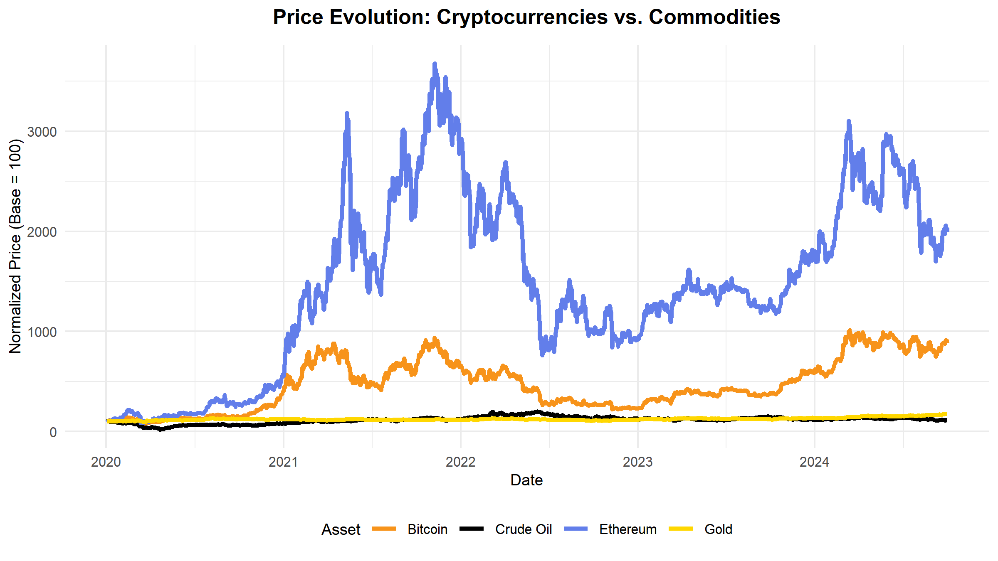
Figure 1: Normalized Price Time Series
Key Observation: Crypto assets show dramatic price appreciation and volatility compared to commodities.

Slide 20
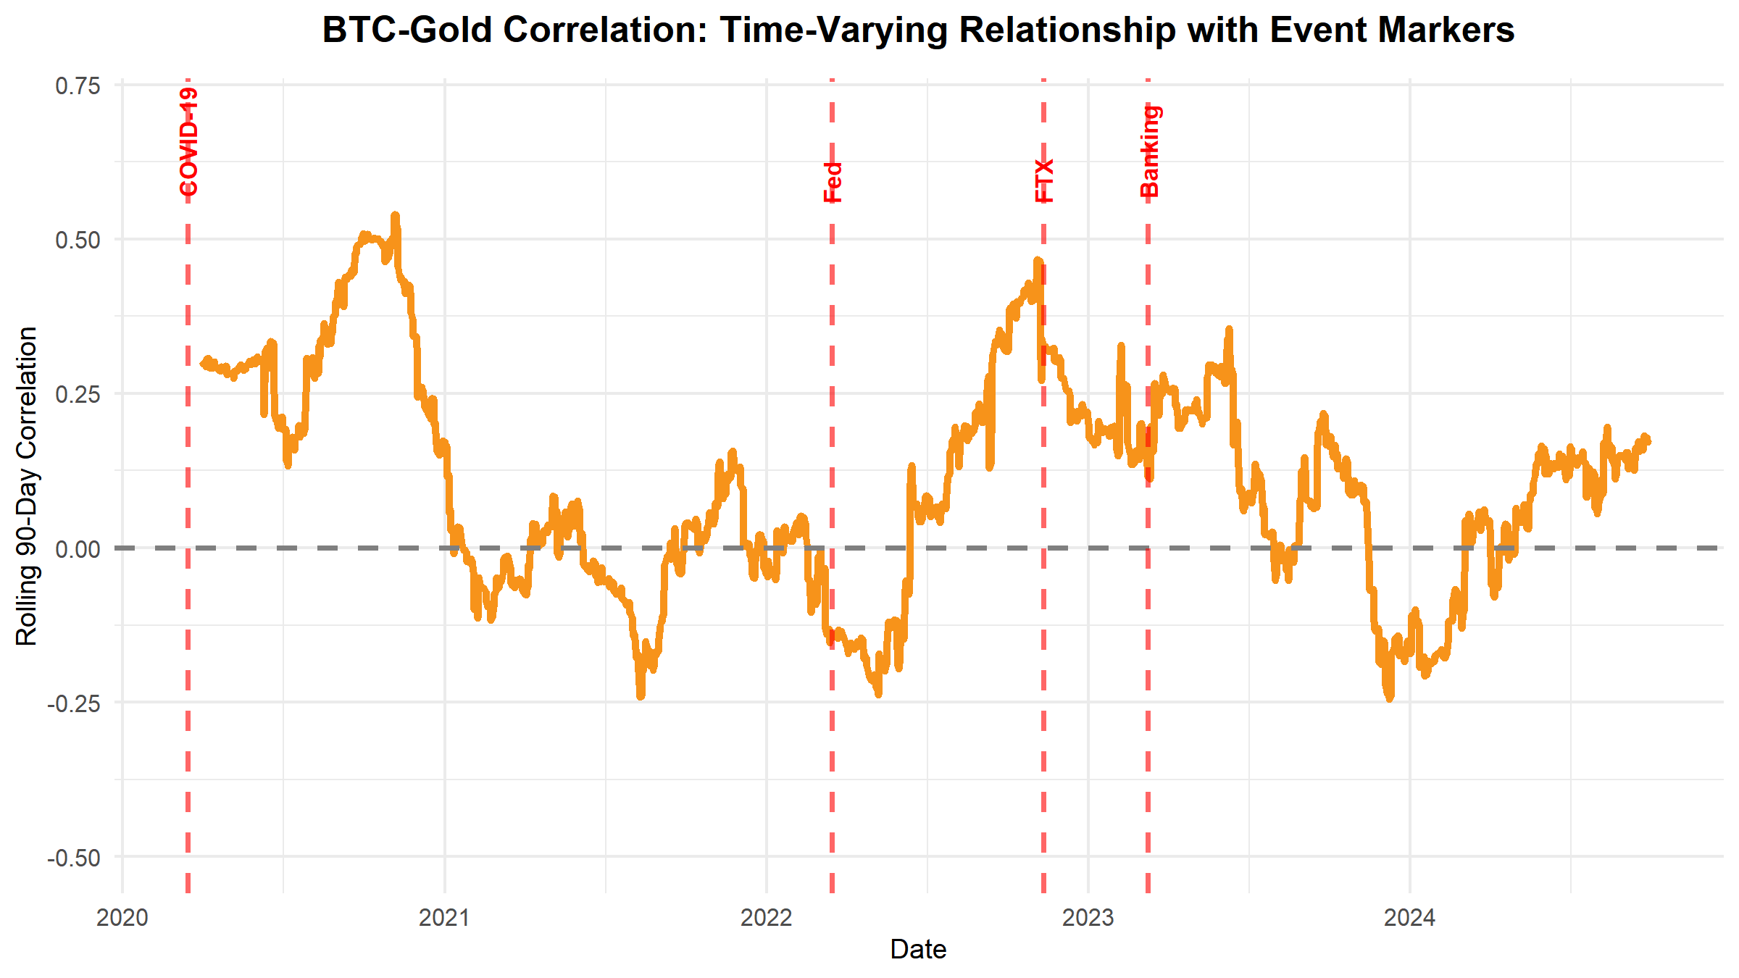
Figure 2: Rolling BTC-Gold Correlation
Key Finding: Correlation spikes during crisis periods, confirming regime-dependent behavior.

Slide 21
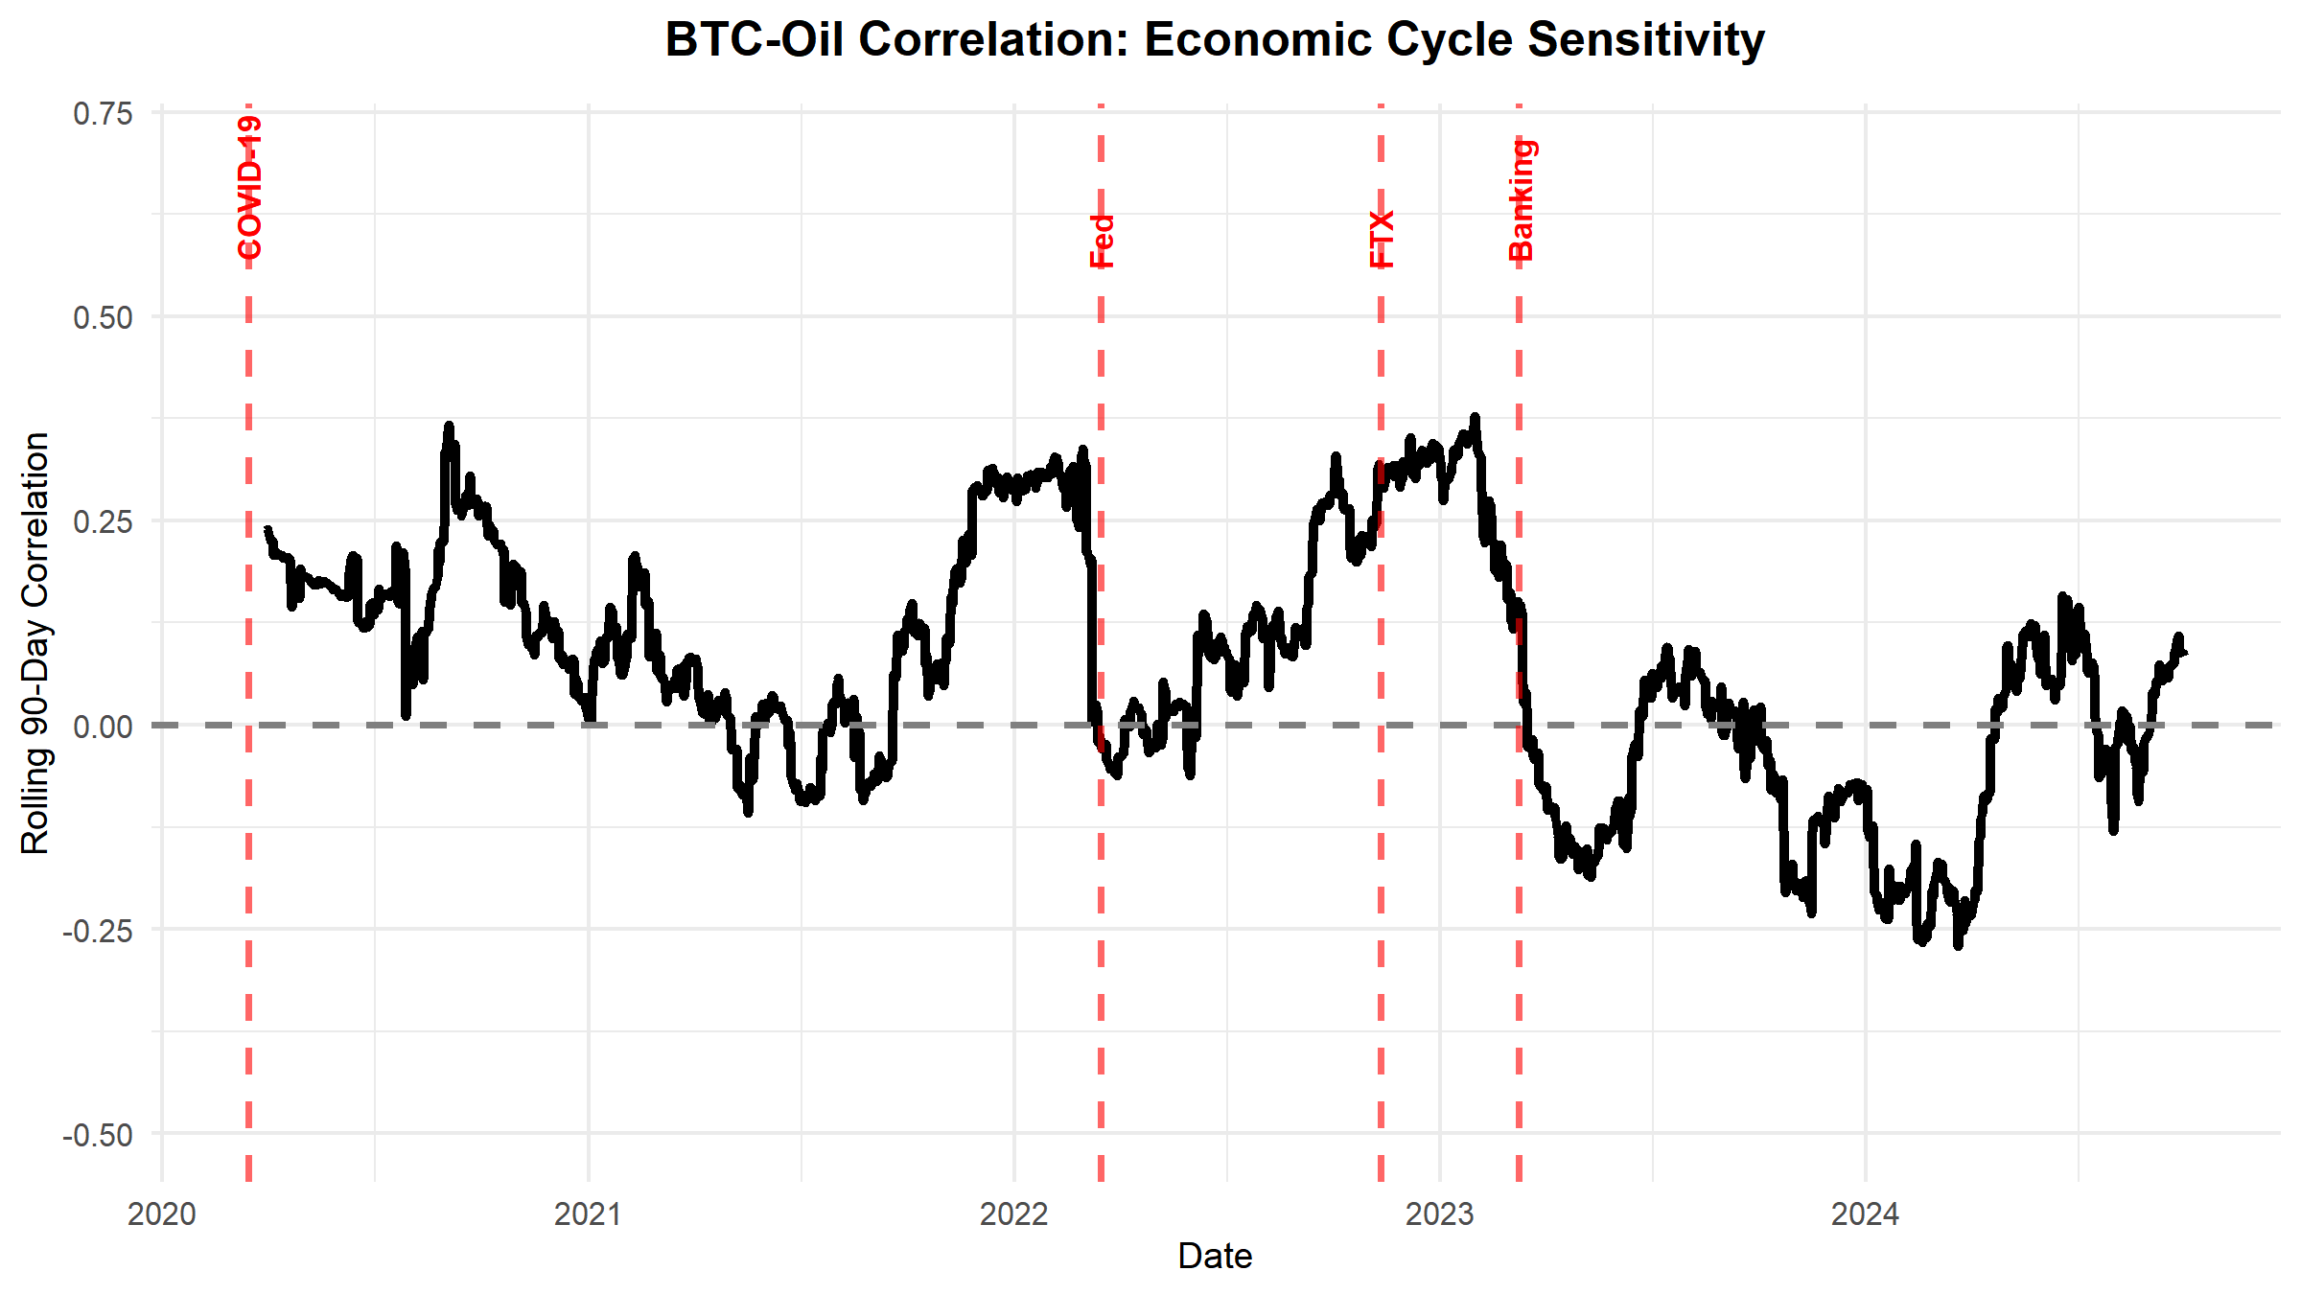
Figure 3: Rolling BTC-Oil Correlation
Key Finding: More volatile than BTC-Gold, reflecting economic cycle sensitivity.

Slide 22
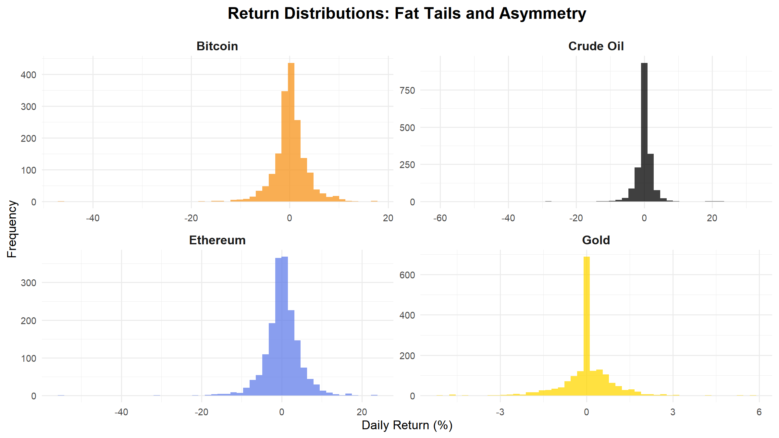
Figure 4: Return Distributions
Key Observation: All distributions show fat tails and negative skewness.

Slide 23
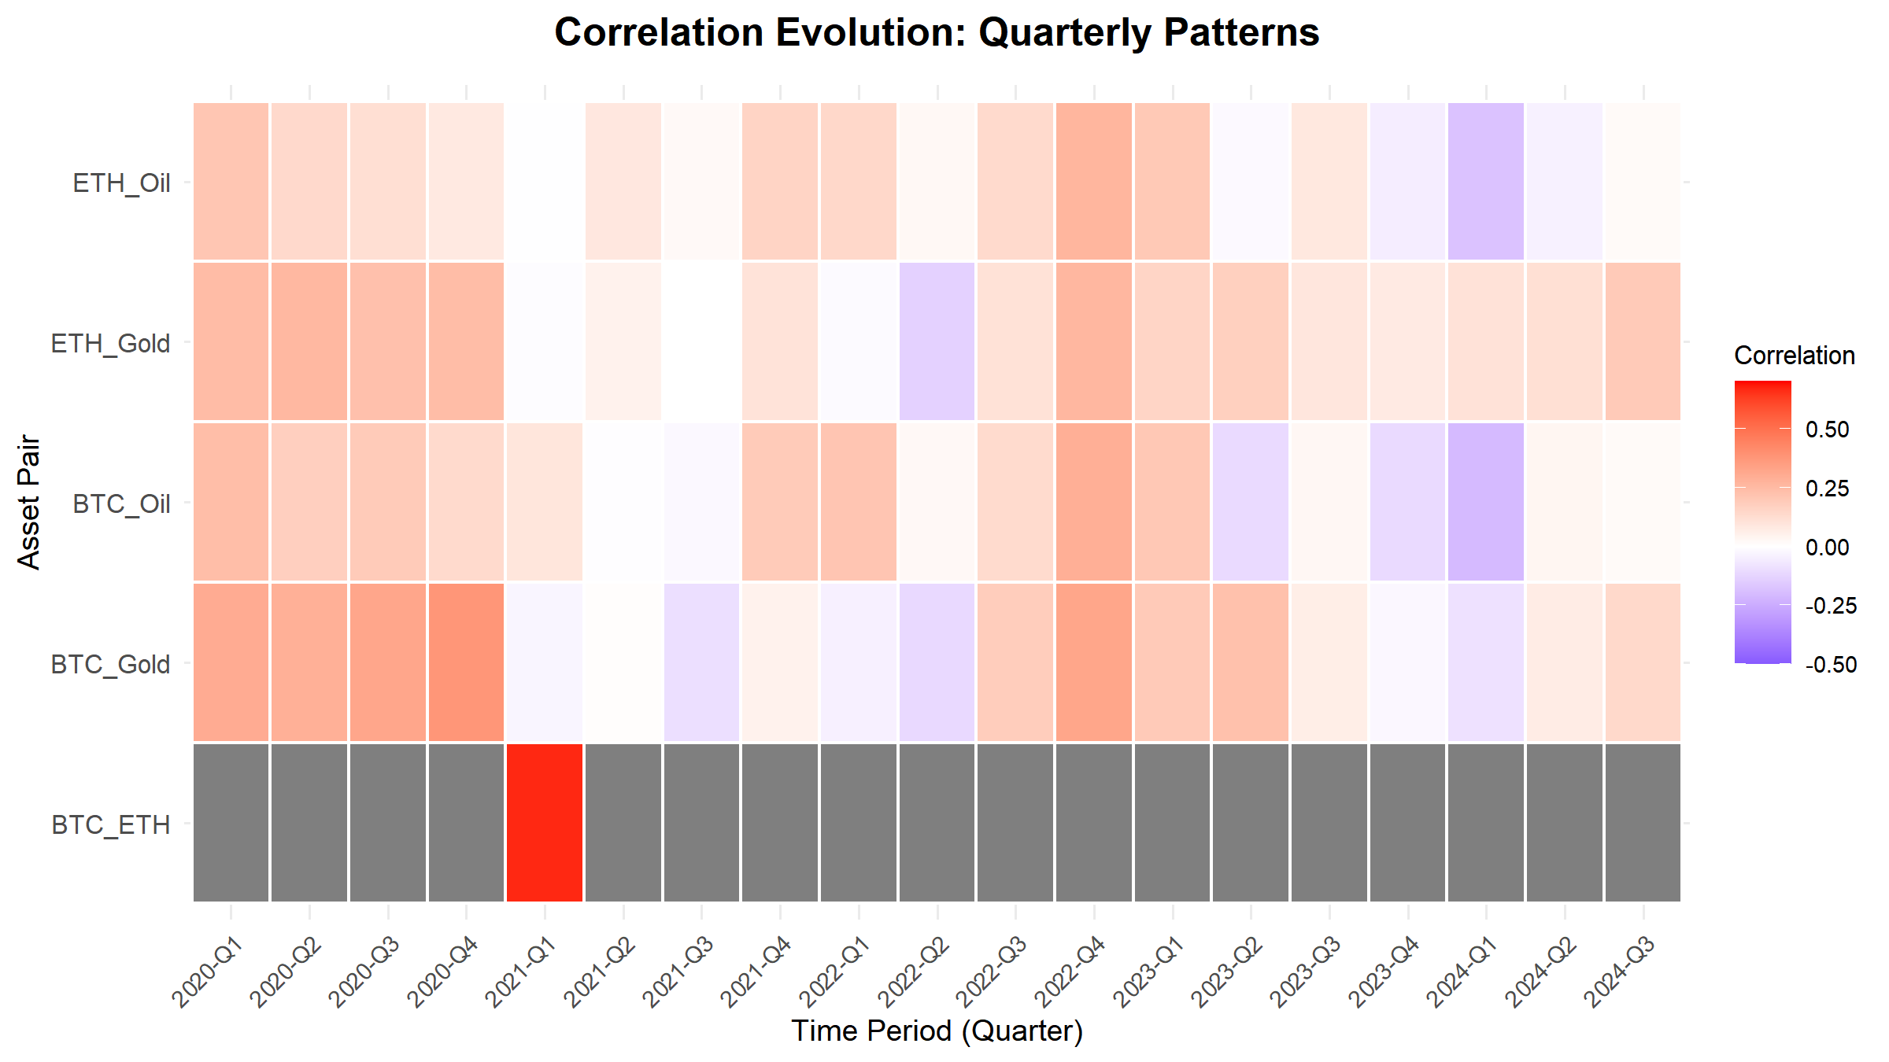
Figure 5: Correlation Evolution Heatmap
Key Observation: Clear time-varying patterns across quarters.

Slide 24
Methods Implemented
1. Rolling Correlation Analysis
Multiple window sizes: 30, 60, 90, and 180 days
90-day window is primary measure (balances stability and responsiveness)
Calculated for all asset pairs:
  BTC-Gold, BTC-Oil
  ETH-Gold, ETH-Oil
  BTC-ETH (for comparison)

Slide 25
2. Alternative Correlation Measures
Spearman rank correlations: Less sensitive to outliers
Provides robustness check
Results consistent with Pearson correlations

Slide 26
Methods Implemented (continued)
3. Statistical Testing
Augmented Dickey-Fuller (ADF) tests: Verify stationarity
All return series are stationary (p < 0.05)
Validates our correlation analysis methodology

Slide 27
4. Preliminary Regime Identification
Threshold-based classification:
  High Positive (>0.3): Strong coupling, risk-on
  Moderate Positive (0.1-0.3): Some coupling
  Low (-0.1 to 0.1): Independent movement
  Moderate Negative (-0.3 to -0.1): Some decoupling
  High Negative (<-0.3): Strong decoupling, risk-off

Slide 28
Key Findings
Finding 1: Time-Varying Correlations
Rolling correlations show significant variation over time
BTC-Gold correlation ranges: -0.24 to 0.54
This 0.78 range confirms regime-dependent behavior!
Static correlations are misleading
Finding 2: Crypto-Commodity Relationships
On average, correlations are low (diversification benefits)
However, correlations increase during market stress
Key insight for regime identification

Slide 29
Key Findings (continued)
Finding 3: Volatility Differences
Cryptocurrencies are 3-4x more volatile than commodities
Bitcoin: 3.45% vs. Gold: 0.85%
Higher risk-return profiles for digital assets
Finding 4: Stationarity
All return series are stationary (ADF tests confirmed)
Validates correlation analysis methodology

Slide 30
Key Findings (continued)
Finding 5: Regime Patterns
Distinct periods of high and low correlation
Correspond to different market regimes
Preliminary evidence: correlations can signal regime changes

Slide 31
Issues Encountered
Technical Challenges
Trading Calendar Alignment
  Crypto trades 24/7, commodities trade weekdays only
  Solution: Forward-fill weekend values
Data Availability
  Missing data due to holidays or feed issues
  Solution: Forward-fill methods
API Rate Limiting
  Yahoo Finance API rate limits
  Solution: Retry logic with delays

Slide 32
Issues Encountered
4. Rolling Window Edge Cases
  Can’t calculate correlations at start of series
  Solution: Set initial values to NA, require minimum observations
5. Computational Efficiency
  Many calculations for multiple windows and pairs
  Solution: Optimized rolling correlation functions

Slide 33
Next Steps
1. Advanced Regime Detection
  Change-point detection algorithms
  Clustering analysis (K-means, hierarchical)
  Machine learning approaches for regime classification
2. Event Study Analysis
  Detailed analysis around major events:
    COVID-19 market crash (March 2020)
    Federal Reserve policy announcements
    Major crypto events (FTX collapse, ETF approvals)
    Analyze correlation behavior using ±30 day event windows

Slide 34
Next Steps (continued)
3. Comparative Analysis
  Deep dive into differences between Bitcoin and Ethereum
  Statistical tests for significant differences
  Analysis of potential drivers
4. Advanced Statistical Testing
  Correlation stability tests across regimes
  Granger causality tests
  Cointegration tests

Slide 35
Next Steps (continued)
5. Threshold Analysis
  Determine specific correlation thresholds
  Use ROC analysis
  Backtest regime signals
6. Final Report
  Complete analysis of all research questions
  Policy and investment implications
  Limitations and future research directions

Slide 36
Conclusions
Key Takeaways
Correlations are Dynamic: Not static - they vary significantly over time
Regime Indicators Work: Changes in correlations can signal market regime shifts
Crisis Behavior: Correlations spike during market stress, reducing diversification benefits
Crypto Evolution: Cryptocurrencies show both similarities and differences to traditional assets
Practical Value: This analysis can inform investment and risk management decisions

Slide 37
Thank You!

