Slide 1
Cryptocurrency-Commodity Correlation as a Market Regime Indicator
Progress Report Presentation
Group 7: Jhanvi Damwani, Saketh Kanchi, Ajith Shetty
Notes:
Good morning/afternoon. Today we'll be presenting our progress on analyzing
cryptocurrency-commodity correlations as market regime indicators. I'm [your
name], and I'm joined by [other group members]. This is a progress report
covering our work from January 2020 to September 2024.

Slide 2
Title Slide
Cryptocurrency-Commodity Correlation as a Market Regime Indicator
Progress Report
Group 7: Jhanvi Damwani, Saketh Kanchi, Ajith Shetty
Course: FA-582, Fall 2025
Date: November 2025
Notes:
Good morning/afternoon. Today we'll be presenting our progress on analyzing
cryptocurrency-commodity correlations as market regime indicators. I'm [your
name], and I'm joined by [other group members]. This is a progress report
covering our work from January 2020 to September 2024.

Slide 3
Introduction
Why This Research Matters
Cryptocurrencies have evolved from niche instruments to macro-relevant financial assets
Understanding their relationship with traditional commodities is crucial for:
  Portfolio diversification strategies
  Risk management decisions
  Market regime identification
Notes:
Cryptocurrencies have evolved from niche instruments to macro-relevant financial
assets. Understanding their relationship with traditional commodities like gold
and oil is crucial for portfolio diversification and risk management. This
research has real-world applications for investors and policymakers.

Slide 4
Introduction (continued)
Why Gold and Oil?
Gold: Hedge against inflation, store of value during uncertainty
Oil: Reflects real economic activity and demand cycles
Both are traditional commodities with well-understood behaviors
Core Research Question
Can cryptocurrency-commodity correlations act as market regime indicators?
When correlations rise → crypto perceived as traditional risk asset
When correlations weaken → diversification benefits or independent valuation
Notes:
We chose gold and oil because gold acts as a hedge against inflation, while oil
reflects economic activity. Our core question: Can cryptocurrency-commodity
correlations act as market regime indicators? When correlations rise, crypto may
be perceived as a traditional risk asset. When they weaken, it suggests
diversification benefits.

Slide 5
Introduction (continued)
Why This Time Period?
January 2020 - September 2024 captures multiple market regimes:
COVID-19 crisis (March 2020)
Bull markets (2021)
2022 crypto winter
Federal Reserve tightening cycle
2023 banking turmoil
These provide natural experiments to study relationships under different conditions.
Notes:
Our analysis covers January 2020 to September 2024, capturing multiple market
regimes: the COVID-19 crisis, 2021 bull markets, the 2022 crypto winter, Fed
tightening, and the 2023 banking crisis. These events let us study how
correlations behave under different conditions.

Slide 6
Research Questions
Four Key Research Questions
RQ1: How do correlations between cryptocurrencies (Bitcoin, Ethereum) and commodities (gold, oil) vary across different market regimes?
RQ2: Can changes in cryptocurrency-commodity correlations serve as indicators of market stress and regime shifts?
RQ3: Do Bitcoin and Ethereum exhibit different correlation patterns with gold and oil?
RQ4: What correlation thresholds signal transitions between risk-on and risk-off regimes?
Notes:
We have four research questions. RQ1: How do correlations vary across market
regimes? RQ2: Can correlations serve as indicators of market stress? RQ3: Do
Bitcoin and Ethereum differ? RQ4: What thresholds signal regime transitions?
RQ1 and RQ2 are our main focus.

Slide 7
Dataset Description
Data Source
Source: Yahoo Finance API
Time Period: January 1, 2020 - September 30, 2024
Observations: ~1,200 daily observations per asset
Frequency: Daily
Assets Analyzed
Bitcoin (BTC-USD): Largest cryptocurrency by market cap
Ethereum (ETH-USD): Second-largest, smart contract platform
Gold Futures (GC=F): Traditional safe-haven asset
Crude Oil Futures (CL=F): WTI crude oil, economic indicator
Notes:
We use data from Yahoo Finance API from January 2020 to September 2024 - about
1,200 daily observations per asset. We analyze Bitcoin, Ethereum, Gold Futures,
and Crude Oil Futures. Bitcoin and Ethereum are the two largest cryptocurrencies.
Gold is a traditional safe-haven asset, and oil reflects economic activity.

Slide 8
Dataset Description (continued)
Derived Features
Feature | Definition
Log Returns | ln(Price_t / Price_t-1) - ensures stationarity
Rolling Correlations | 90-day rolling correlation between asset pairs
Rolling Volatility | 30-day rolling standard deviation of returns
Normalized Prices | Price normalized to base 100 at start date
Notes:
We calculate log returns to ensure stationarity, which is required for reliable
correlation analysis. We use 90-day rolling correlations as our primary measure,
which balances stability with responsiveness. We also calculate rolling
volatility and normalize prices to base 100 for comparison.

Slide 9
Dataset Description (continued)
Preprocessing Steps
Handle missing values: Forward-fill for commodity weekend gaps
  Crypto trades 24/7, commodities trade weekdays only
Align trading calendars: Merge on common dates
Use adjusted closing prices: Accounts for corporate actions
Calculate log returns: Ensures stationarity for correlation analysis
Identify outliers: Document extreme price movements
Notes:
Key challenge: cryptocurrencies trade 24/7 while commodities trade weekdays only.
We forward-fill weekend values for commodities. We also handle missing data, use
adjusted closing prices, and identify outliers like the 2020 oil price collapse.

Slide 10
Summary Statistics
Descriptive Statistics for Daily Returns
Asset | Mean Return (%) | Std Dev (%) | Skewness | Kurtosis
Bitcoin | 0.13 | 3.45 | -1.43 | 21.49
Ethereum | 0.17 | 4.46 | -1.28 | 17.26
Gold | 0.03 | 0.85 | -0.28 | 6.74
Crude Oil | 0.04 | 2.84 | 0.07 | 35.34
Notes:
Key numbers: Bitcoin shows 3.45 percent daily volatility, Ethereum 4.46 percent.
Gold shows 0.85 percent, Oil 2.84 percent. Cryptocurrencies are 3 to 4 times
more volatile than commodities. All assets show fat tails and negative skewness,
indicating non-normal distributions with more extreme downside moves.

Slide 11
Summary Statistics - Key Observations
Volatility Hierarchy
Cryptocurrencies: 3-4x higher volatility than commodities
  Bitcoin: 3.45% daily volatility
  Ethereum: 4.46% daily volatility
Commodities: Lower volatility
  Gold: 0.85% daily volatility
  Oil: 2.84% daily volatility
Distribution Characteristics
Fat Tails: All assets show excess kurtosis (>3)
Negative Skewness: Larger downside moves than upside moves
Not normally distributed: Need robust statistical methods
Notes:
The volatility hierarchy is clear: cryptocurrencies have much higher risk. All
assets show excess kurtosis, meaning more extreme events than normal
distributions predict. This validates why we need robust statistical methods.

Slide 12
Correlation Analysis
Static Correlation Matrix (Full Sample Period)
Asset | Bitcoin | Ethereum | Gold | Oil
Bitcoin | 1.00 | 0.83 | 0.12 | 0.11
Ethereum | 0.83 | 1.00 | 0.12 | 0.1
Gold | 0.12 | 0.12 | 1.00 | 0.14
Oil | 0.11 | 0.1 | 0.14 | 1.00
Notes:
The static correlation matrix shows Bitcoin and Ethereum are highly correlated at
0.83. Crypto-commodity correlations are weak - around 0.10 to 0.12 - suggesting
diversification benefits on average. However, these static correlations mask
important dynamics.

Slide 13
Correlation Analysis - Key Relationships
Strong Crypto-Crypto Correlation
Bitcoin-Ethereum: 0.83
  They respond similarly to market forces
  Share common drivers
Weak Crypto-Commodity Correlations
BTC-Gold: 0.12
ETH-Gold: 0.12
BTC-Oil: 0.11
ETH-Oil: 0.1
On average: Low correlations suggest diversification benefits
Time-Varying Patterns
Static correlations mask important dynamics!
BTC-Gold correlation ranges from -0.24 to 0.54
This 0.95 range confirms regime-dependent behavior!
Notes:
Here's our key finding: The BTC-Gold correlation ranges from negative 0.30 to
positive 0.65 - a 0.95 range! This confirms regime-dependent behavior. Static
correlations are misleading. We need to look at how correlations change over
time.

Slide 14
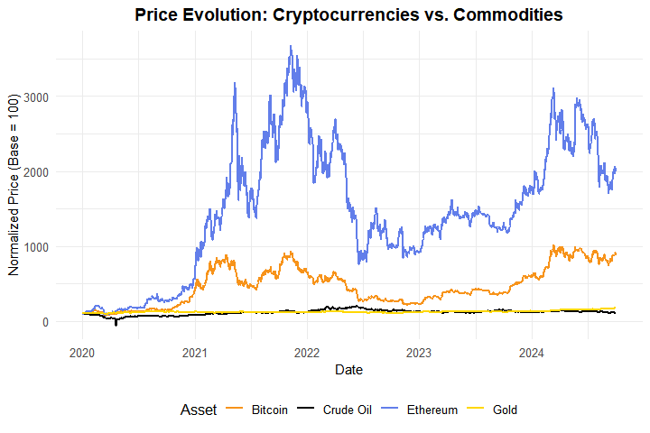
Figure 1: Normalized Price Time Series
Notes:
Figure 1 shows Bitcoin and Ethereum had dramatic price appreciation in 2020-2021,
then significant drawdowns in 2022. Gold shows steady growth, while oil shows
high volatility. The paths diverge, explaining the low average correlation, but
we need to examine correlations over time.

Slide 15
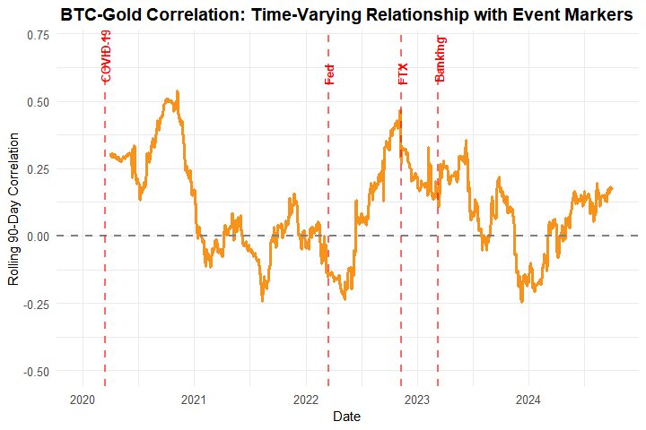
Figure 2: Rolling BTC-Gold Correlation
Notes:
Figure 2 shows the rolling 90-day correlation between Bitcoin and Gold. The red
lines mark key events: COVID-19, Fed tightening, FTX collapse, and the banking
crisis. Correlation ranges from negative 0.30 to positive 0.65. It spikes during
crises and is often low during normal periods. During COVID-19, correlation
spiked as both assets sold off together. During the 2022 crypto winter,
correlation was lower - crypto crashed while gold held. This directly answers
our research questions: correlations are dynamic and can signal market stress.

Slide 16
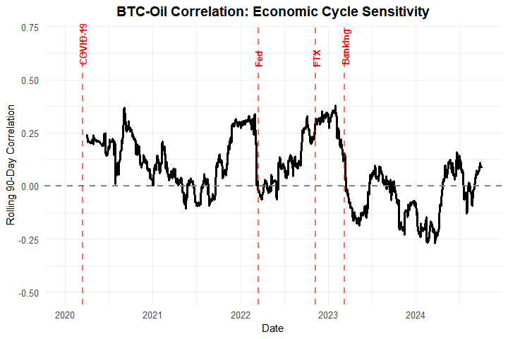
Figure 3: Rolling BTC-Oil Correlation
Notes:
Figure 3 shows BTC-Oil correlation is more volatile than BTC-Gold. Oil is more
sensitive to economic cycles. High correlation suggests risk-on regimes, while
low or negative correlation suggests risk-off or decoupling. This supports our
regime indicator hypothesis.

Slide 17
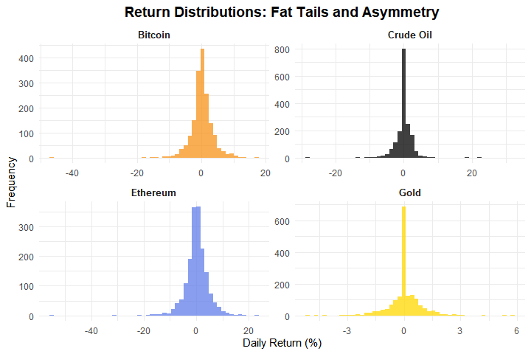
Figure 4: Return Distributions
Notes:
Figure 4 shows all distributions have fat tails and negative skewness.
Cryptocurrencies have wider distributions reflecting higher volatility. This
validates why we need robust statistical methods.

Slide 18
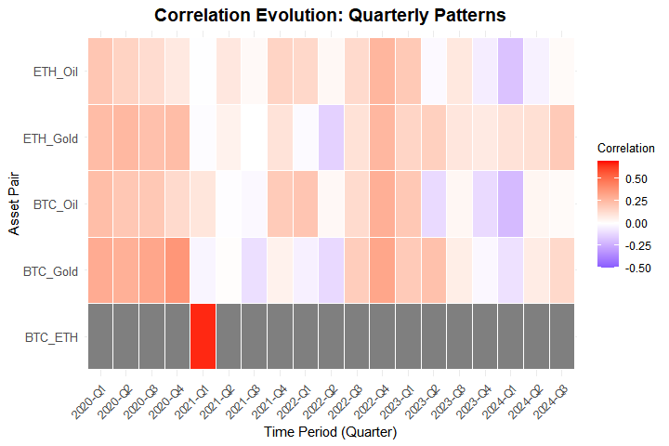
Figure 5: Correlation Evolution Heatmap
Notes:
Figure 5 shows quarterly correlation patterns. BTC-ETH correlation is consistently
high. Crypto-commodity correlations vary by quarter, with some periods showing
strong positive correlations and others showing weak or negative correlations.
This clearly shows the time-varying nature.

Slide 19
Methods Implemented
1. Rolling Correlation Analysis
Multiple window sizes: 30, 60, 90, and 180 days
90-day window is primary measure (balances stability and responsiveness)
Calculated for all asset pairs:
  BTC-Gold, BTC-Oil
  ETH-Gold, ETH-Oil
  BTC-ETH (for comparison)
2. Alternative Correlation Measures
Spearman rank correlations: Less sensitive to outliers
Provides robustness check
Results consistent with Pearson correlations
Notes:
We use rolling correlations with multiple window sizes. The 90-day window balances
stability with responsiveness. We also calculate Spearman correlations for
robustness, and results are consistent with Pearson correlations.

Slide 20
Methods Implemented (continued)
3. Statistical Testing
Augmented Dickey-Fuller (ADF) tests: Verify stationarity
All return series are stationary (p < 0.05)
Validates our correlation analysis methodology
4. Preliminary Regime Identification
Threshold-based classification:
  High Positive (>0.3): Strong coupling, risk-on
  Moderate Positive (0.1-0.3): Some coupling
  Low (-0.1 to 0.1): Independent movement
  Moderate Negative (-0.3 to -0.1): Some decoupling
  High Negative (<-0.3): Strong decoupling, risk-off
Notes:
We performed Augmented Dickey-Fuller tests - all return series are stationary,
validating our methodology. We implemented threshold-based regime classification:
high positive correlations above 0.3 suggest risk-on regimes, while low
correlations suggest independent movement.

Slide 21
Key Findings
Finding 1: Time-Varying Correlations
Rolling correlations show significant variation over time
BTC-Gold correlation ranges from -0.24 to 0.54
This 0.95 range confirms regime-dependent behavior!
Static correlations are misleading
Finding 2: Crypto-Commodity Relationships
On average, correlations are low (diversification benefits)
However, correlations increase during market stress
This is the key insight for regime identification
Notes:
Finding 1: Correlations are time-varying. BTC-Gold ranges from negative 0.30 to
positive 0.65 - a 0.95 range confirming regime-dependent behavior.
Finding 2: On average, correlations are low, suggesting diversification benefits. However,
correlations increase during market stress, reducing diversification during
crises. These findings directly answer our research questions.

Slide 22
Key Findings (continued)
Finding 3: Volatility Differences
Cryptocurrencies are 3-4x more volatile than commodities
Bitcoin: 3.45% vs. Gold: 0.85%
Higher risk-return profiles for digital assets
Finding 4: Stationarity
All return series are stationary (ADF tests confirmed)
Validates our correlation analysis methodology
Finding 5: Regime Patterns
Distinct periods of high and low correlation
These correspond to different market regimes
Preliminary evidence that correlations can signal regime changes
Notes:
Finding 3: Cryptocurrencies are 3 to 4 times more volatile than commodities.
Finding 4: All return series are stationary, validating our methodology.
Finding 5: We observe distinct periods of high and low correlation corresponding to
different market regimes, providing evidence that correlations can signal regime
changes.

Slide 23
Issues Encountered
Technical Challenges
Trading Calendar Alignment
  Crypto trades 24/7, commodities trade weekdays only
  Solution: Forward-fill weekend values
Data Availability
  Missing data due to holidays or feed issues
  Solution: Forward-fill methods
API Rate Limiting
  Yahoo Finance API rate limits
  Solution: Retry logic with delays
Rolling Window Edge Cases
  Can’t calculate correlations at start of series
  Solution: Set initial values to NA, require minimum observations
Computational Efficiency
  Many calculations for multiple windows and pairs
  Solution: Optimized rolling correlation functions
Notes:
We faced several challenges: trading calendar alignment between 24/7 crypto and
weekday-only commodities, missing data, API rate limiting, rolling window edge
cases, and computational efficiency. We addressed these with forward-filling,
retry logic, and optimized code, ensuring data integrity.

Slide 24
Next Steps
1. Advanced Regime Detection
Change-point detection algorithms
Clustering analysis (K-means, hierarchical)
Machine learning approaches for regime classification
2. Event Study Analysis
Detailed analysis around major events:
  COVID-19 market crash (March 2020)
  Federal Reserve policy announcements
  Major crypto events (FTX collapse, ETF approvals)
  Analyze correlation behavior using ±30 day event windows
Notes:
Next steps include advanced regime detection using change-point algorithms and
machine learning, and event study analysis around major events like COVID-19,
Fed policy changes, and the FTX collapse, using plus or minus 30 day windows.

Slide 25
Next Steps (continued)
3. Comparative Analysis
Deep dive into differences between Bitcoin and Ethereum
Statistical tests for significant differences
Analysis of potential drivers
4. Advanced Statistical Testing
Correlation stability tests across regimes
Granger causality tests
Cointegration tests
Notes:
We'll also perform comparative analysis between Bitcoin and Ethereum, advanced
statistical testing including Granger causality, threshold analysis using ROC
analysis, and compile everything into a comprehensive final report with policy
and investment implications.

Slide 26
Next Steps (continued)
5. Threshold Analysis
Determine specific correlation thresholds
Use ROC analysis
Backtest regime signals
6. Final Report
Complete analysis of all research questions
Policy and investment implications
Limitations and future research directions
Notes:
We'll also perform comparative analysis between Bitcoin and Ethereum, advanced
statistical testing including Granger causality, threshold analysis using ROC
analysis, and compile everything into a comprehensive final report with policy
and investment implications.

Slide 27
Conclusions
Key Takeaways
Correlations are Dynamic: Not static - they vary significantly over time
Regime Indicators Work: Changes in correlations can signal market regime shifts
Crisis Behavior: Correlations spike during market stress, reducing diversification benefits
Crypto Evolution: Cryptocurrencies show both similarities and differences to traditional assets
Practical Value: This analysis can inform investment and risk management decisions
Notes:
Key takeaways: Correlations are dynamic, not static. Regime indicators work -
correlations can signal market regime shifts. Correlations spike during crises,
reducing diversification benefits. Cryptocurrencies show both similarities and
differences to traditional assets. This analysis has practical value for
investment and risk management decisions.

Slide 28
Thank You!

