Slide 1
AUTOMATIC VACUUM CLEANER

Slide 2
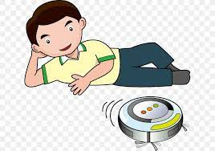
About
Floor cleaner robot, which is not only simple to make but costs very less compared to commercial products available in the market.
The new Arduino Vacuum Cleaner we are going to build here will be compact and more practical.
The ultrasonic sensor will allow the robot to avoid obstacles so that it can move freely until the room is properly cleaned, and the proximity sensor will help it to avoid falling from stairs

Slide 3
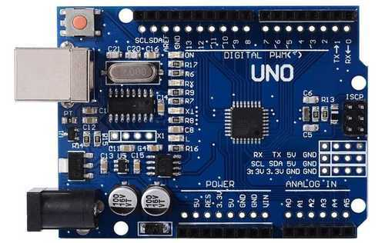
Arduino Uno
The Arduino UNO is the best board to get started with electronics and coding.

Slide 4
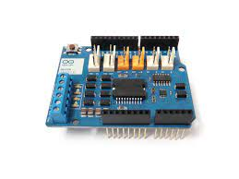
Arduino Motor Shield
The Arduino Motor Shield allows your arduino to drive DC and stepper motors, relays and solenoids.

Slide 5
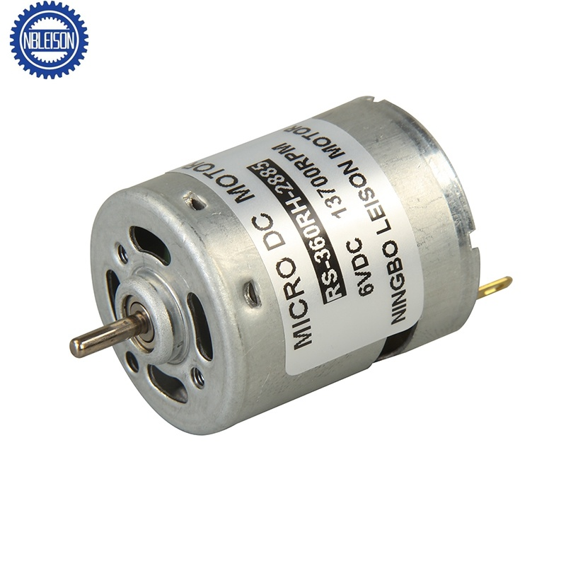
Motor
An electric motor is an electrical machine that converts electrical energy into mechanical energy. Most electric motors operate through the interaction between the motor's magnetic field and electric current in a wire winding to generate force in the form of torque applied on the motor's shaft

Slide 6
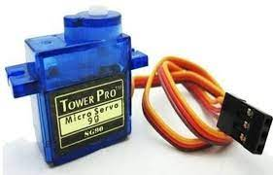
Servo Motor
A servomotor (or servo motor) is a rotary actuator or linear actuator that allows for precise control of angular or linear position, velocity and acceleration.

Slide 7
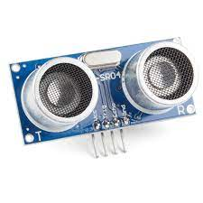
Ultrasonic Sensor
An ultrasonic sensor is an instrument that measures the distance to an object using ultrasonic sound waves.

Slide 8


Applications

Slide 9


Applications

Slide 10
THANK YOU
Serial.println(Team Members)
Output:
Saketh Ram
Sai Manaas
Kiran
Trivedh Sai

