Slide 1

TruthLens AI
Real-Time Fake News Detection
AI · NLP · Source Verification
TEAM 5
KALASALINGAM ACADEMY OF RESEARCH AND EDUCATION
Dept. of Computer Science & Engineering · Guide: M K Nagarajan

Slide 2

The Problem
Rapid Spread
Misinformation outpaces manual fact-checking
Verification Gap
No real-time detection in deployed systems
Accuracy Deficit
Existing models lack explainability and precision
Automation Need
Intelligent, scalable solution required

Slide 3

What Prior Research Missed
LITERATURE REVIEW
ML Models
Naive Bayes, SVM, Logistic Regression
NLP Approaches
TF-IDF, Word2Vec, LSTM networks
Key Gaps
No real-time processing · No source verification · Low accuracy

Slide 4
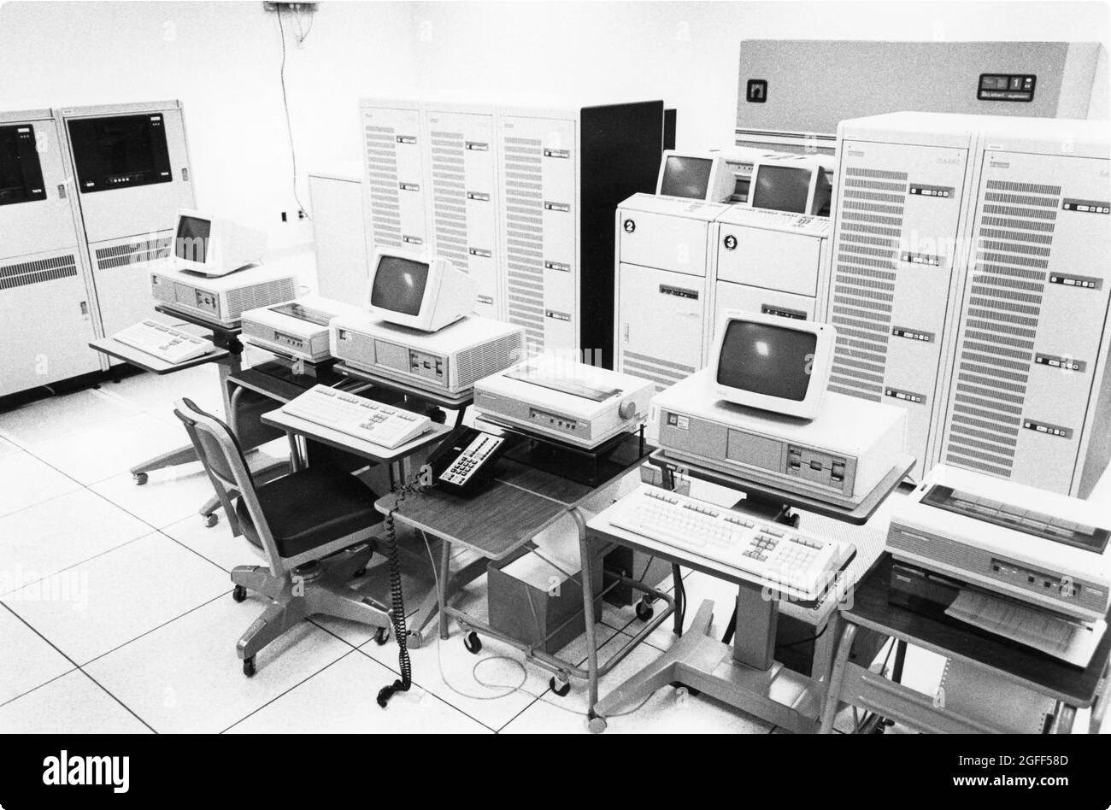


Limitations of Traditional Approaches
EXISTING SYSTEM
Naive Bayes & SVM
Shallow feature extraction; no semantic depth
Keyword Matching
Misses context, sarcasm, and nuance
High False Positives
Poor generalization on unseen data

Slide 5
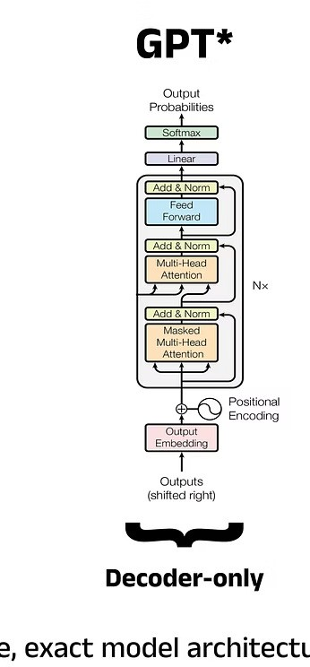



Proposed System: TruthLens AI
BERT Transformer
Deep contextual semantic understanding
NLP Pipeline
Tokenization, embedding, classification
Source Verification
Cross-references trusted databases
Explainable AI
Transparent, interpretable predictions

Slide 6
Hardware & Software Stack
Software
Python 3.9+ — core backend language for NLP and model orchestration
FastAPI — serves predictions and handles API requests
React / Next.js — powers the responsive frontend interface
HuggingFace Transformers — provides BERT-based models for claim analysis
News API — supplies current context for verification
Fact-check APIs — connect to trusted sources for cross- checking claims
Why it matters
Supports the full TruthLens AI workflow
Combines machine learning with live evidence sources Keeps results transparent and traceable

Slide 7
System Modules
01
02
03
Data Collection
News API ingestion
Preprocessing
Cleaning, tokenization
Model Prediction
BERT classification
04
05
06
NLP Analysis
Semantic extraction
Source Verification
Cross-reference sources
Real-Time News
Live stream processing
07
User Interface
React dashboard

Slide 8

System Architecture
Input Layer
NLP
Processing
Classification Engine
Output Layer
End-to-end flow from raw article ingestion through transformer-based NLP processing to a real-time, explainable credibility verdict.

Slide 9
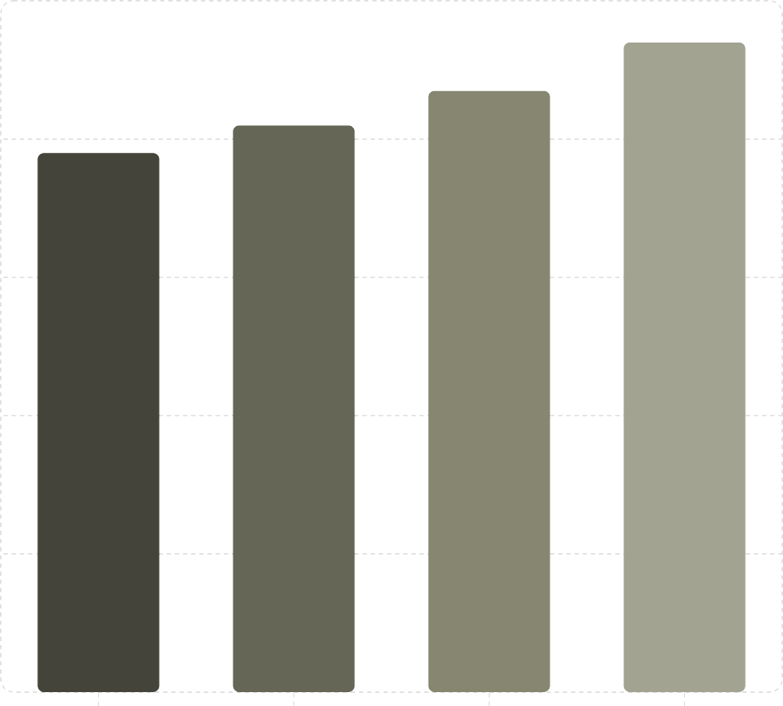
Results & Performance
Accuracy á%â
100
Key Findings
94% accuracy — 12-point gain over SVM baseline Real-time inference under 2 seconds
Explainable output with source credibility scores
80
60
40
20
Naive Bayes
SVM
LSTM
TruthLens AI
0

Slide 10



Publication Progress
Submitted
Papers submitted to conferences for review.
Accepted
Papers that received acceptance from conferences like ICLR and NeurIPS.
Waiting for Conference
Papers currently awaiting decisions from various conferences.

Slide 11

References
FURTHER READING
Devlin, J. et al. (2019). BERT: Pre-training of Deep Bidirectional Transformers for Language Understanding. arXiv:1810.04805.
Wang, W. Y. (2017). "Fake News" Detection: A Survey of Machine Learning Approaches. arXiv:1708.01967.
Thorne, J. et al. (2018). FEVER: a Large-scale Dataset for Fact Extraction and VERification. ACL 2018 Proceedings.
Guo, H. et al. (2022). Explainable AI for Fake News Detection: A Review.
Journal of Information Science, Vol 48(3).
OpenFactCheck Database. (Ongoing). Comprehensive real-time fact- checking data. www.openfactcheck.org.
These foundational works and resources provide deeper insights into AI-driven misinformation detection and NLP advancements.

