Slide 1

Customer Shopping Behavior Analysis
Analyzing 3,900 purchases to uncover insights into spending patterns, customer segments, product preferences, and subscription behavior.

Slide 2
The Dataset:
3,900 Rows
18 Columns
Key Features
Total number of customer purchases analyzed.
Key features include demographics, purchase details, and shopping behavior.
Age, Gender, Category, Purchase Amount, Subscription Status, and Review Rating.
Note: 37 missing values in the Review Rating column were imputed using the median rating per product category.

Slide 3
Exploratory Data Analysis (EDA) in Python
1
Data Preparation & Cleaning
2
Standardization & Engineering
Loaded dataset, checked structure, and imputed missing Review Ratings using category medians.
Renamed columns to snake_case and created new features like age_group and purchase_frequency_days.
3
Consistency Check
4
Database Integration
Verified and dropped the redundant promo_code_used column.
Loaded the cleaned DataFrame into MySQL for structured SQL analysis.

Slide 4
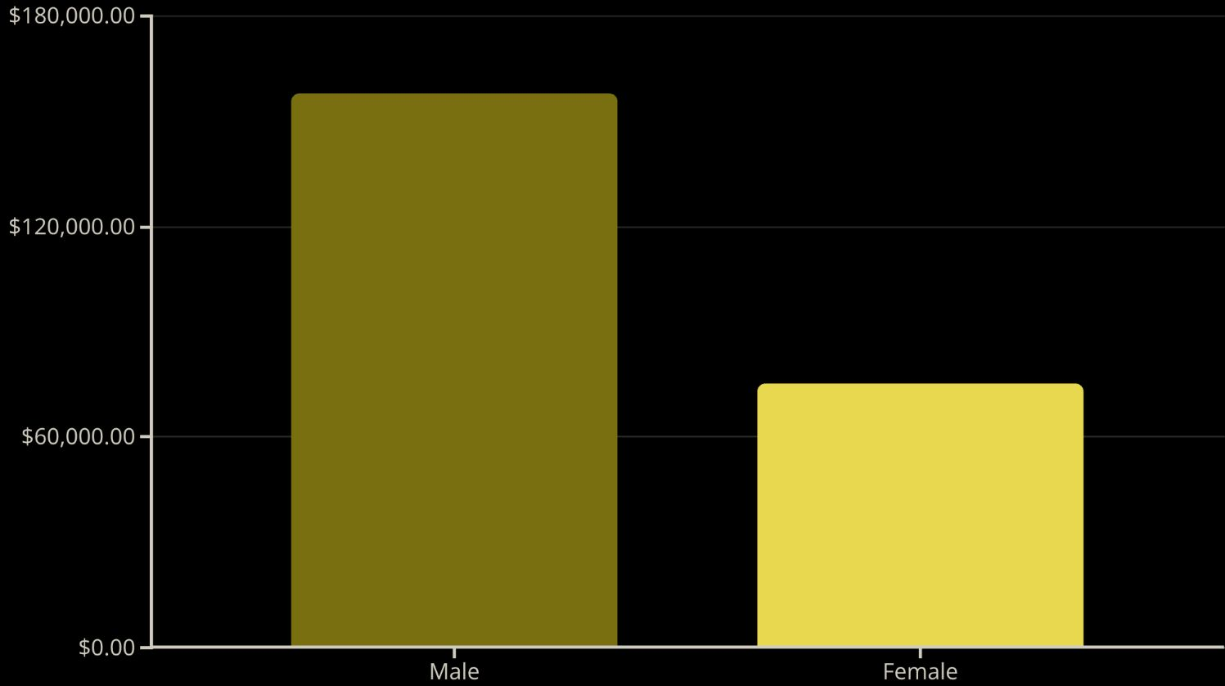
Revenue Drivers: Gender & Age
Male Customers Drive Higher Revenue
Male customers generate significantly more total revenue ($157,890) compared to female customers ($75,191).
Age Group Contribution
Young Adults ($62,143) and Middle-aged customers ($59,197) are the top revenue-contributing age groups.

Slide 5



Subscription & Spending Behavior
59.49
59.87
1053
Subscriber Avg. Spend
Non-Subscriber Avg. Spend
Total Subscribers
Average purchase amount for customers with a subscription.
Average purchase amount for customers without a subscription.
Subscribers account for 1,053 customers, generating $62,645 in revenue.
While non-subscribers have a slightly higher average spend, the overall revenue from non-subscribers is much higher due to their larger volume (2,847 customers, $170,436 revenue).

Slide 6

Shipping & Discount Insights
Shipping Type Comparison
Discount Usage
Customers using Express shipping have a higher average purchase amount ($60.48) than those using Standard shipping ($58.46).
839 customers used discounts but still spent above the average purchase amount, indicating effective discount targeting.
Top 5 products with the highest discount rates:
Hat (50.00%)
Sneakers (49.66%)
Coat (49.07%)

Slide 7
Customer Segmentation
Customers were classified into three segments based on their purchase history:
Loyal
Returning
New
3,116 Customers
701 Customers
83 Customers
Repeat buyers (customers with >5 purchases) are significantly more likely to subscribe (958 Yes vs. 2,518 No).

Slide 8
Top-Rated and Best-Selling Products
Top 5 Products by Average Rating
Top 3 Products per Category
Gloves (3.86)
Accessories
Jewelry, Sunglasses, Belt
Clothing
Blouse, Pants, Shirt
Sandals (3.84)
Footwear
Sandals, Shoes, Sneakers
Outerwear
Jacket, Coat
Boots (3.82)
Hat (3.80)
Skirt (3.78)

Slide 9

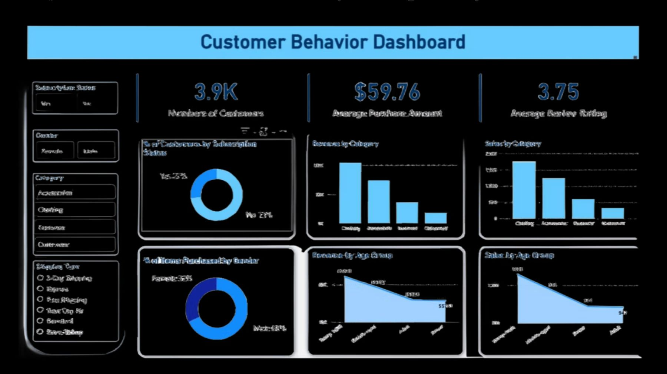
Visualizing Key Metrics
An interactive dashboard was built in Power BI to visually present these key insights and allow for deeper exploration of the data.

Slide 10




Strategic Business Recommendations
Boost Subscriptions
Customer Loyalty
Promote exclusive benefits to increase subscriber numbers and total revenue.
Implement programs to reward repeat buyers and move them into the "Loyal" segment.
Review Discount Policy
Targeted Marketing
Balance sales boosts from discounts with margin control to maintain profitability.
Focus efforts on high-revenue age groups and express-shipping users for maximum impact.

