Slide 1

IE6600 18004 Computation and Visualization for Analysis
Term Project
Group 12
Saketh Rompicherla and Pranjali Prakash Doiphode

Slide 2

Background
The crime rates are increasing with the increasing population
Chicago has crime rate higher than US average (903 vs 382 per 100,000 people in 2017)
Check and analyze the crime pattern and frequency around the city
Relationship between parameters such as location, time of the day, type of residents, type of crime etc.
Simulate various functions on Dataset to obtain insights about crime in Chicago

Slide 3

Primary Objective
Analyzing the impact of multiple parameters as a search criteria
Sorting data according to various parameters
Understand the trends in Chicago crime

Slide 4
Our Aim
Using statistical analysis on dataset, we aim to obtain the most accurate visualization for crime distribution around the city
This approach can be proved to be less time consuming and more efficient as we already have suspects filtered out based on previous data

Slide 5

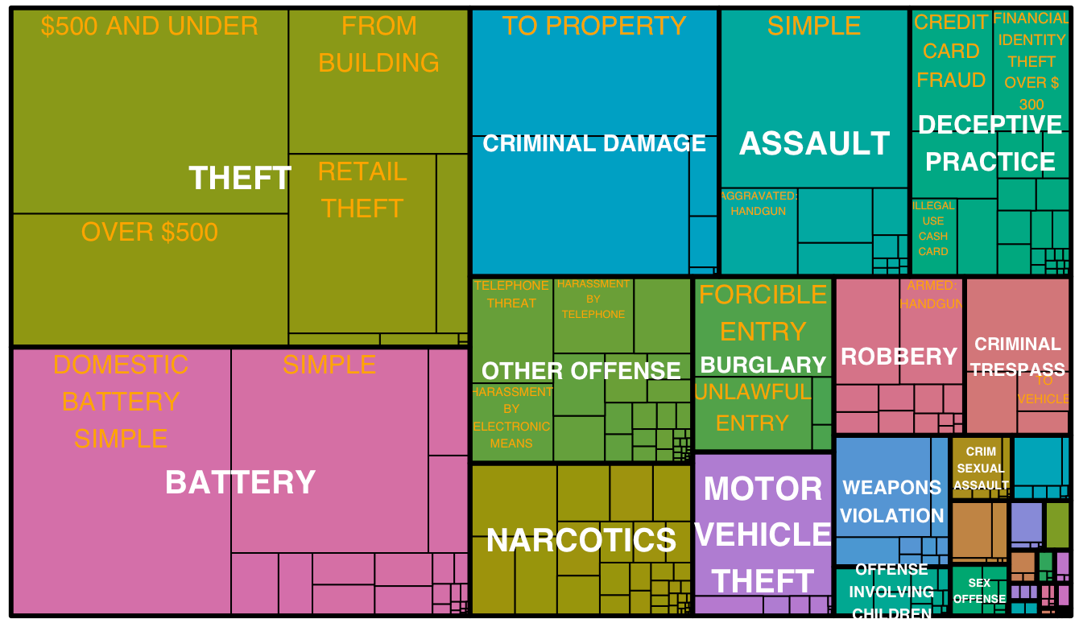
Visualization based on Type of Crime

Slide 6
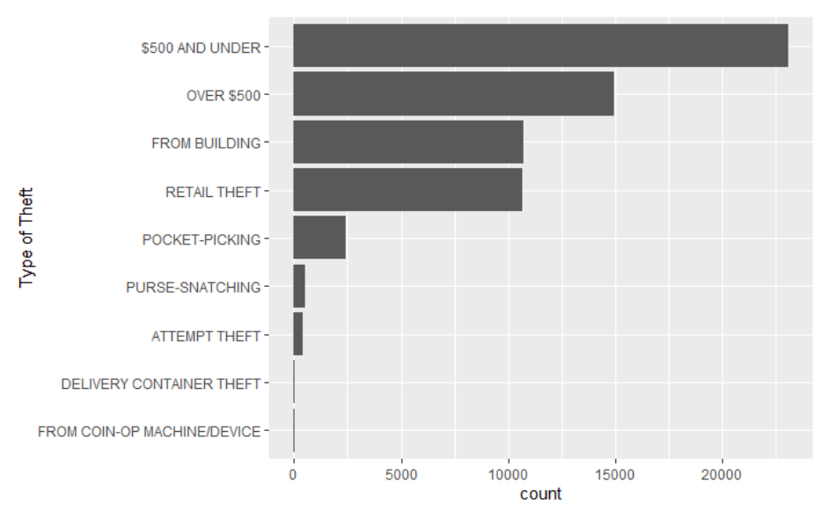
Visualization based on particular type of crime

Slide 7
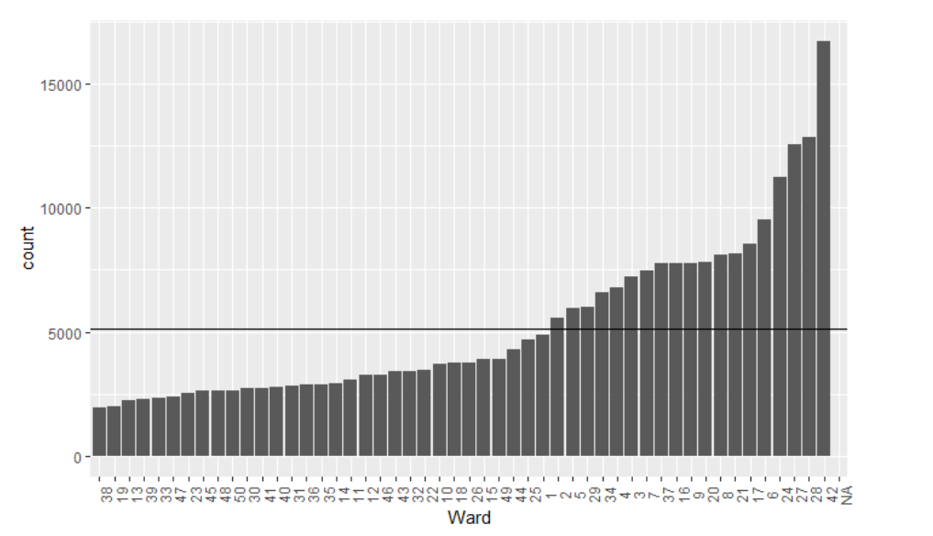
Visualization based on Area of the city(ward)

Slide 8
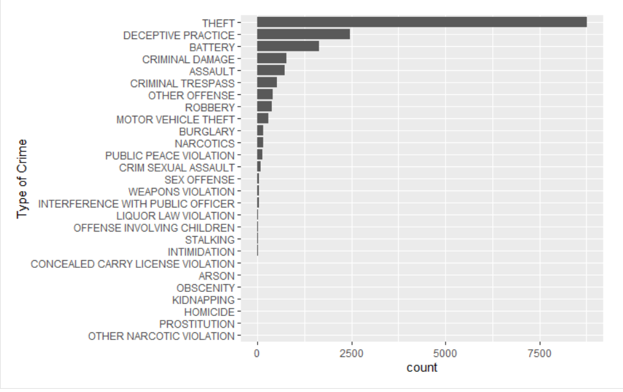
Type of Crime in Ward 42

