Slide 1

Loan Amount Criteria Analysis
Project By-
Ajinkya Prafull Tungare (APT200001)
Rujuta Rathod (RXR210049)
Rushi Pravin Attarde (RPA210000)
Saketh Sadu (SXS210212)

Slide 2
Introduction:
Dataset referred from Kaggle. Has 148647 rows and 30 columns.
Missing values percentage: 4%
Provides loan approval information

Slide 3
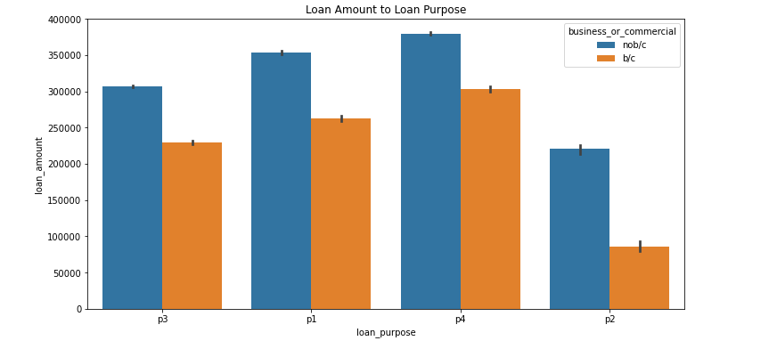
Bar Chart
Impact of Loan Purpose on Loan Amount
Loan Purpose P4 has highest Loan Amount
Lower Amounts of Loan are sanctioned for business or commercial

Slide 4
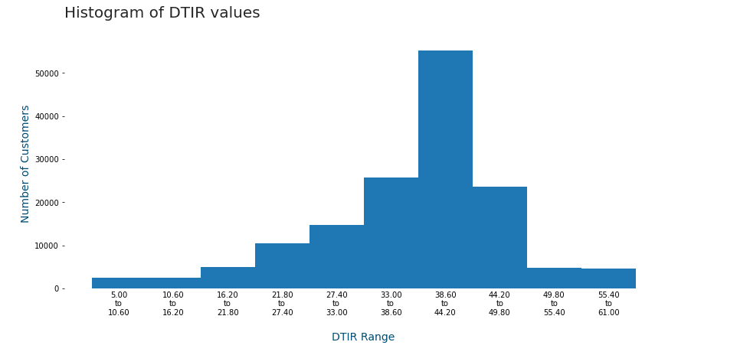
Histogram
Below 43% is generally considered a good DTIR (debt to interest ratio)
More than 50% of the dataset have a DTIR below 43%

Slide 5
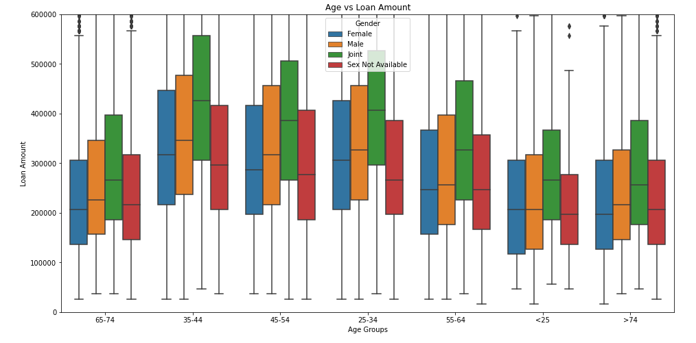
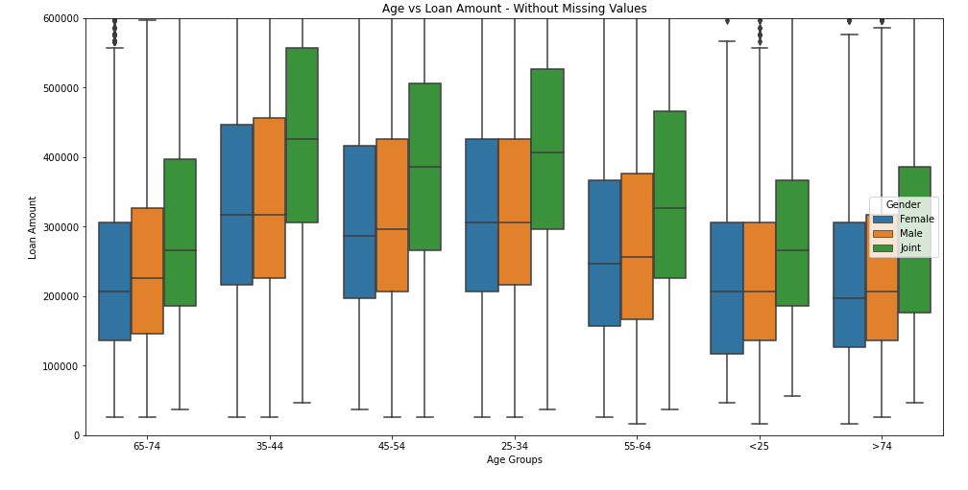
Boxplot
Joint Account have more loan Amount compared to others.
Age group 35 to 44 apply for a higher loan amount.

Slide 6
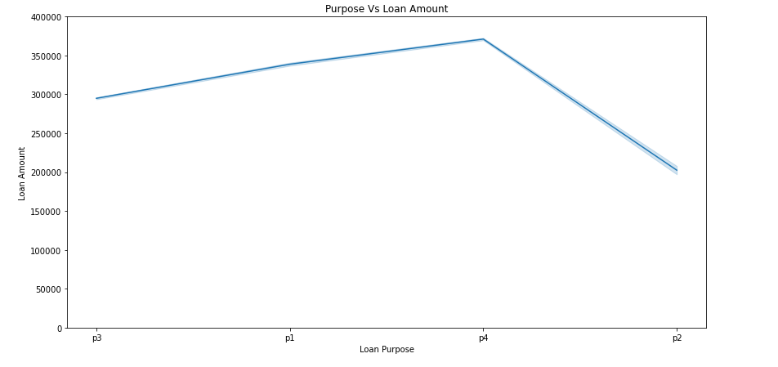
Line Chart
Loan Amount for P4 is the highest.
Loan Amount for P2 is the lowest

Slide 7
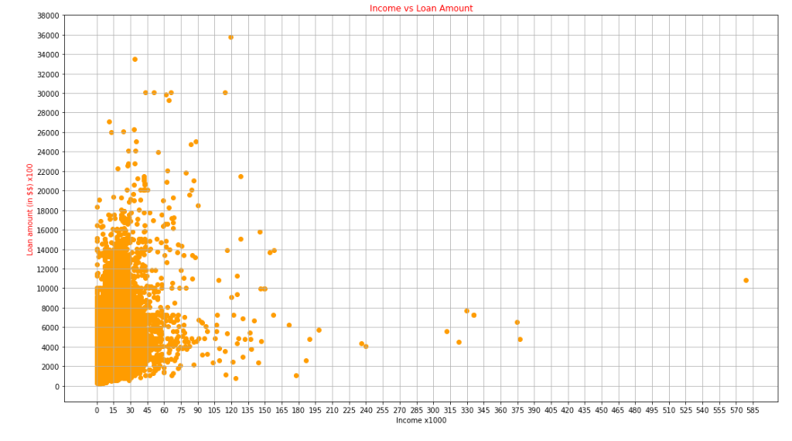
Scatter plots
This scatterplot shows how income of a person affects the need for taking a loan and the loan amount.
We can see that as the income increases, the number of people taking a loan decreases.
Majority of people who have taken a loan are in the low income range

Slide 8
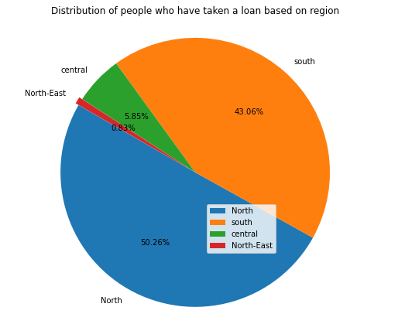
Pie Chart
The pie chart shows the region wise distribution of people who have taken a loan.
We can see that the Northern region has the maximum number of people who have taken a loan while in the North-Eastern region very few people take a loan.

Slide 9
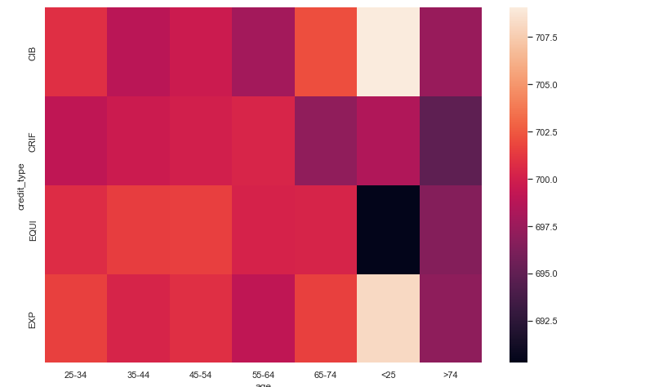
Heatmaps
There are 4 credit bureaus who provide the credit score report.
Age Groups 25 to 54 have a good credit score.

Slide 10
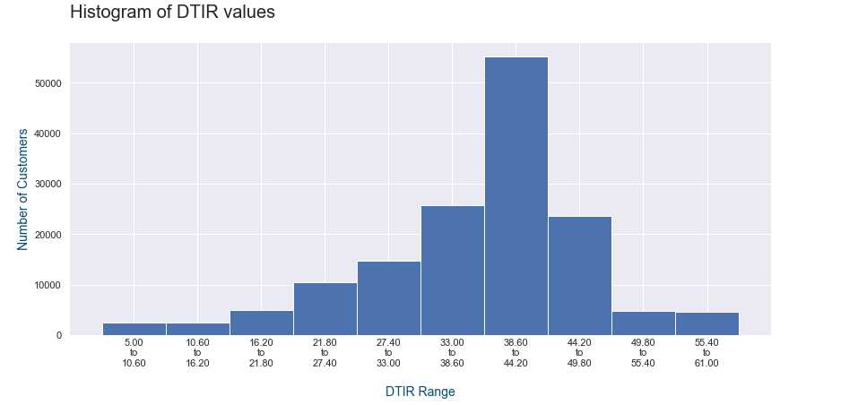
Without and with KNN Imputation
Without KNN
With KNN

Slide 11
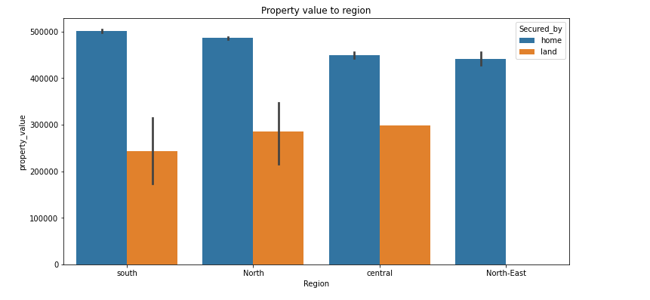
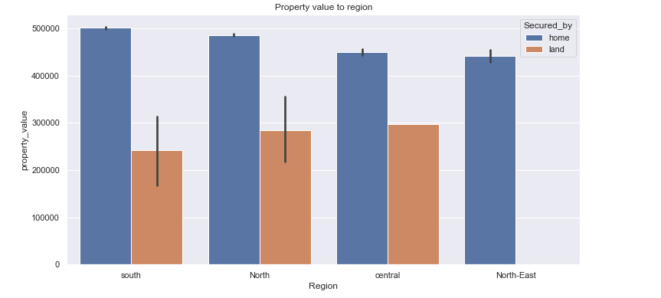
Without and with KNN Imputation
Without KNN
With KNN

Slide 12
Conclusion
Higher loan amount can be approved with:
DTIR below 43%
Credit score more than 500
Collateral with good property value
Higher income

Slide 13
Recommendation
The analysis can be more thorough and accurate if the dataset also involves the exact loan purpose.
More information about the income and employment background of the customers.
More information about the gender of the customers and clarification on joint accounts.

