Slide 1
IPL 2025
AUCTION STRATEGY &
PLAYER VALUE ANALYSIS
Data Analytics and Visualization · DSL251
Thammandra Saketh Ram
B24DS034
League Overview · Phase Dynamics · Batting Overview · Bowling Overview
Auction Economics · Venues & Pitches · Home Advantage · Value Quadrants

Slide 2
The League Landscape
74
10
70
4
Total Matches
Teams
League Games
Playoff Matches

Slide 3
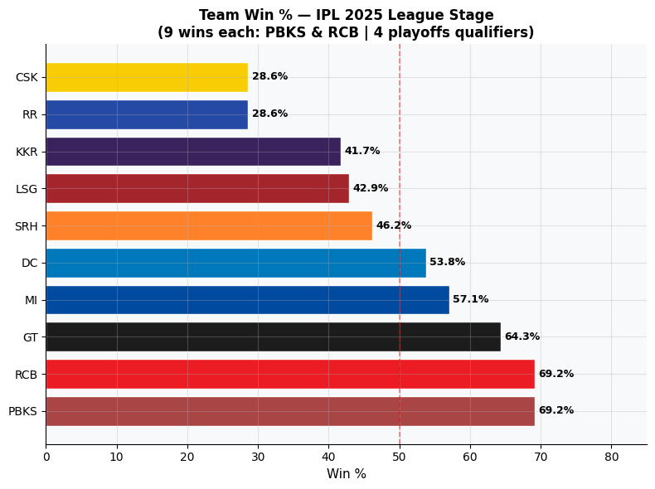
Who Ruled the League Stage?
IPL 2025 Team Win % — League Stage
How was this calculated?
Win % = Wins ÷ Matches played by that team (not total league matches). PBKS played 17, CSK played only 9.
PBKS & RCB jointly topped at 69.2% — both won exactly 9 matches each from different total fixtures.
GT (64.3%) and MI (57.1%) secured 3rd and 4th, both above the 50% playoff threshold.
KKR — defending champions — crashed to 41.7%. RR and CSK at 28.6% were the biggest underperformers relative to their auction spend.
Only 5 of 10 teams finished above 50% — the league was evenly contested, not dominated by one franchise.
3

Slide 4
Phases of the Game
Understanding the 20-over structure that decides match outcomes

Slide 5
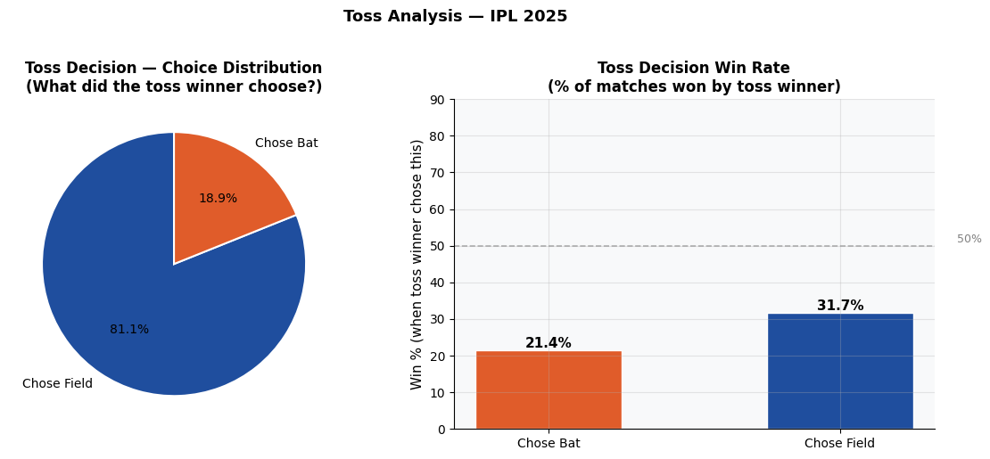
Does Winning the Toss Actually Matter?
Toss decision distribution and resulting win rates across all 74 matches
The Toss Analysis
81.1% of captains chose to field after winning the toss — an overwhelming preference for chasing in T20.
Yet chasing teams won only 31.7% and batting-first teams won only 21.4% — both below the 50% coin-flip baseline.
This is the most counter-intuitive finding: winning the toss does NOT give a decisive tactical edge.
Squad composition and in-match execution matter far more than the toss decision. Teams that relied on toss strategy as an advantage were misguided.
81.1%
31.7%
21.4%
Chose Field First
Chase Win Rate
Bat-First Win Rate
5

Slide 6
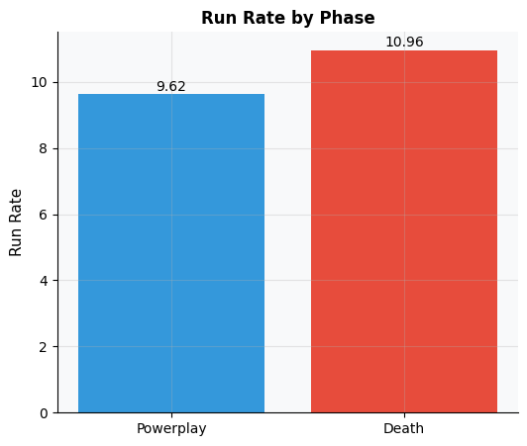
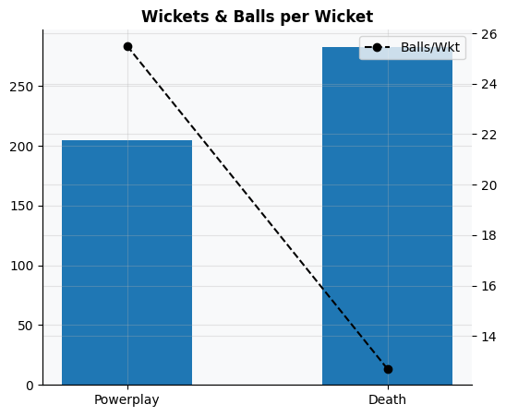
Powerplay vs Death: The 20-Over Battle
Run rate & wickets by phase — where do matches tilt and why?
How the game's momentum shifts across 20 overs
Death overs (16–20) average 10.96 runs/over vs 9.62 in powerplay — a 14% surge. The wickets chart shows a paradox: more wickets fall in death overs in absolute count, but balls-per-wicket is LOWER in powerplay — bowlers strike more frequently per ball in overs 1–6. This confirms powerplay bowlers must do a dual job: restrict runs AND take early wickets. Death bowlers face batters going purely for power.
6

Slide 7
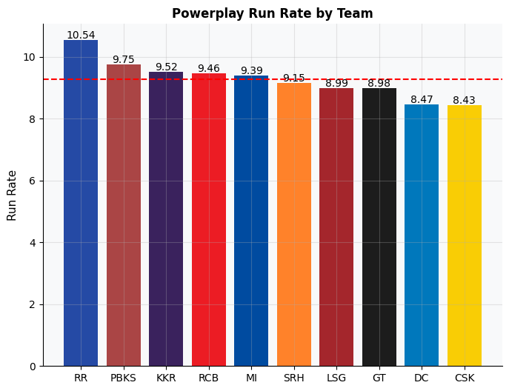
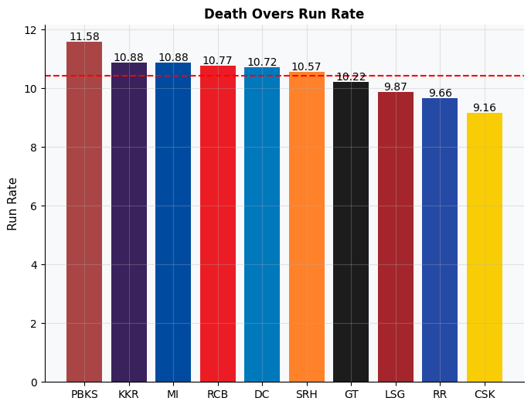
Phase-Specific Batting by Team
Powerplay (left) and Death Overs (right) run rates — which squads exploit each phase?
Powerplay: RR leads at 10.54 runs/over — evidence of dominant openers. CSK trails at 8.43 — a structural gap. Death Overs: PBKS explodes at 11.58 — their finisher combination was the best in IPL 2025. CSK again trails at 9.16. A team strong in BOTH phases is almost guaranteed a high total. Lagging in both signals franchise-level squad-building failures that expensive signings alone cannot fix.
11

Slide 8
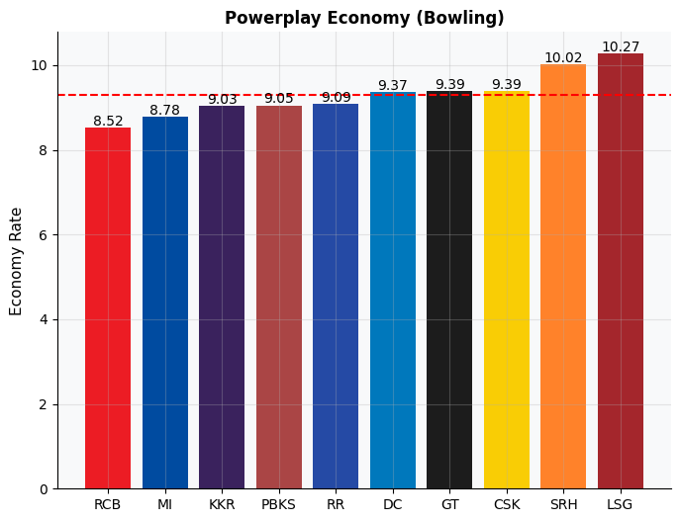
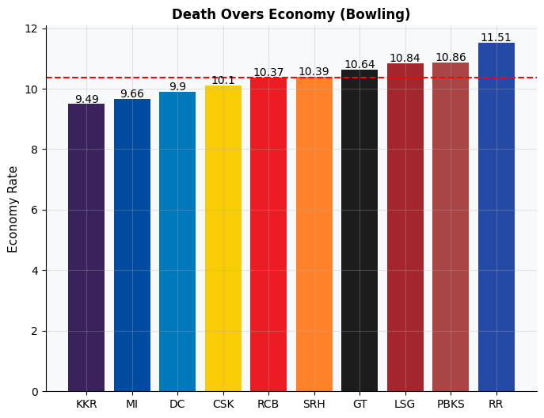
Phase-Specific Bowling Economy by Team
Powerplay (left) and Death Overs (right) economy — lower is better | Red dashed line = league average
Powerplay: RCB leads at 8.52 — their opening bowlers consistently throttled opponents in the first 6 overs. LSG conceded 10.27 — a structural gap. Death: KKR best at 9.49. RR leaks 11.51 — exposing why they struggled in close games. Teams performing well in BOTH phases (RCB, MI, KKR) correlated strongly with top-4 finishes. Bowling cohesion beats individual stars.
17

Slide 9
Batting Overview
Who scored the runs — and who was truly worth it?

Slide 10
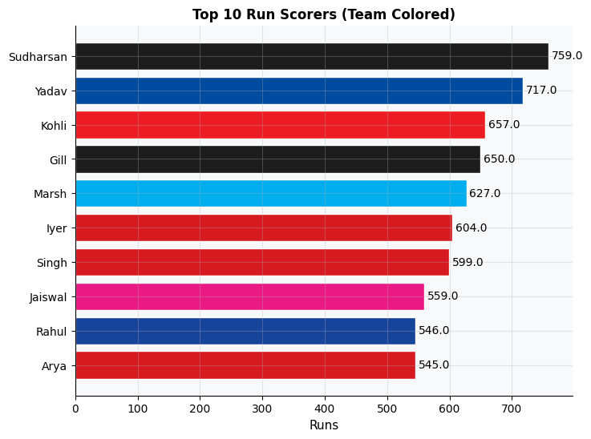
Top 10 Run Scorers of IPL 2025
Ranked by total runs | Min. qualification: 5 innings played
How this Top 10 was derived
Metric: Total runs scored across all league matches. Minimum 5 innings to qualify.
Sudharsan (759, GT) and Yadav/SKY (717, MI) lead — no single franchise monopolised the top spots.
Kohli (657) and Gill (650) in 3rd and 4th confirm their positions as anchors of their franchises.
Key insight: several top-10 scorers like Sudharsan cost relatively little — reinforcing the market inefficiency angle explored later.
Arya (545) as 10th confirms depth of batting talent available beyond marquee names.
9

Slide 11
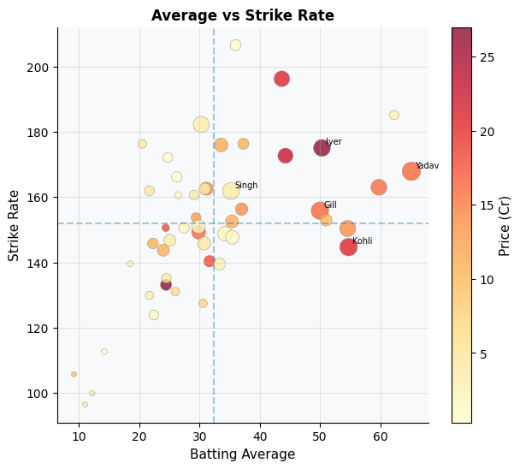
Batting Average vs Strike Rate: The Value Map
Bubble size = runs scored | Colour = auction price (darker = more expensive)
TOP-RIGHT QUADRANT (ideal — high Avg + high SR): rarest and most desirable. Several LIGHT-coloured (cheap) dots sit here — the clearest proof of auction undervaluation. Large DARK (expensive) bubbles appear across ALL quadrants — money did not reliably buy elite performance.
10

Slide 12
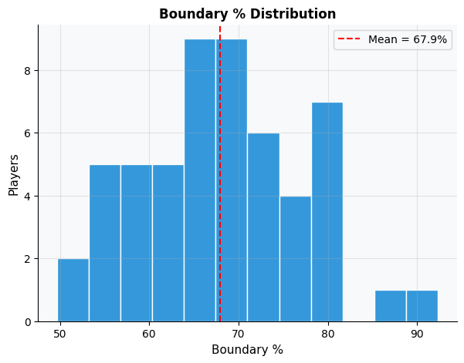
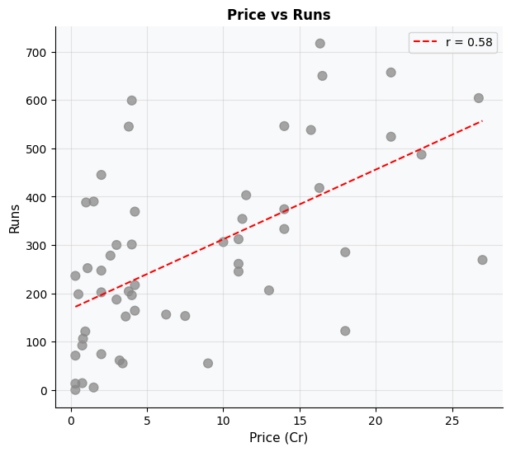
Boundary Distribution & The Price-Runs Relationship
How batters score their runs — and whether high auction prices guarantee more of them
Boundary % peaks at 65–70% for most batters — a healthy norm. Batters above 80% are pure death hitters with limited overall innings. The Price vs Runs scatter shows r=0.58 — a positive but weak relationship. Several low-price dots sit above the trend line — they punched far above their auction valuation. This scatter is the first visual foundation for our undervalued player analysis.
12

Slide 13
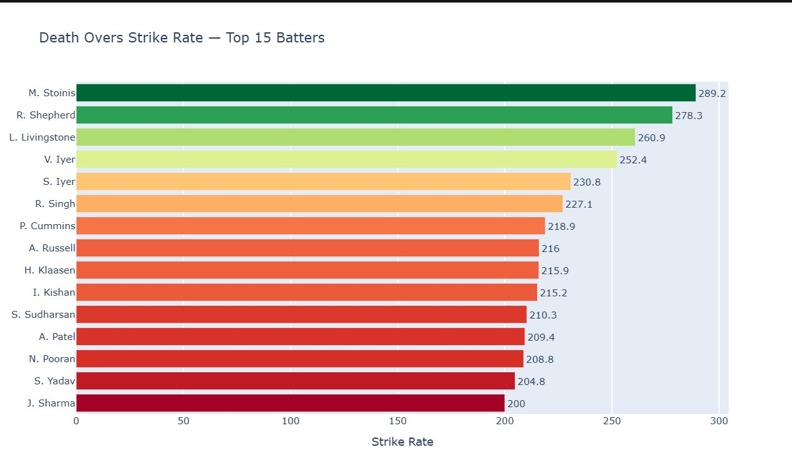
Who Destroys Bowlers in Death Overs?
Death Overs Strike Rate — Top 15 Batters (overs 16–20) | Min. 20 balls faced in death
How this Top 15 was derived
Metric: Strike Rate in overs 16–20 only (death phase), minimum 20 balls faced in death to qualify.
M. Stoinis tops at SR 289 — nearly 3 runs per ball. R. Shepherd (278) and L. Livingstone (261) follow.
All 15 exceed SR 200 — confirming death specialists are a distinct player class with rare, game-changing value.
Colour gradient (green→red) shows SR decline down the list. Even rank 15 (J. Sharma at 200) is elite by any standard.
Budget finishers like R. Shepherd deliver explosive return — critical for the value analysis ahead.
13

Slide 14
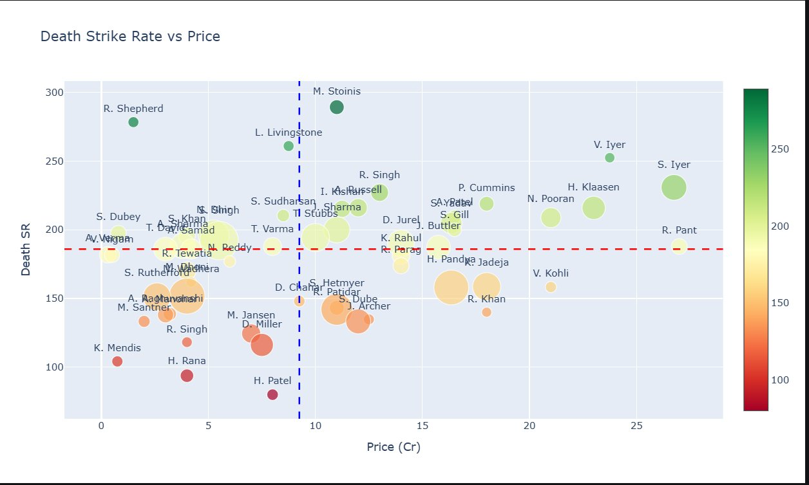
Death SR vs Price — Value in the Final Overs
Bubble size = balls faced in death | Colour = death SR (green=high, red=low) | 4-quadrant value map
TOP-LEFT = UNDERVALUED FINISHERS: R. Shepherd & L. Livingstone — high death SR, cheap. BOTTOM-RIGHT = OVERPAID: big bubbles, mediocre death SR. M. Stoinis (mid-price) is the single best finisher by SR at a non-premium price.
14

Slide 15
Bowling Deep Dive
Who took the wickets — and at what cost?

Slide 16
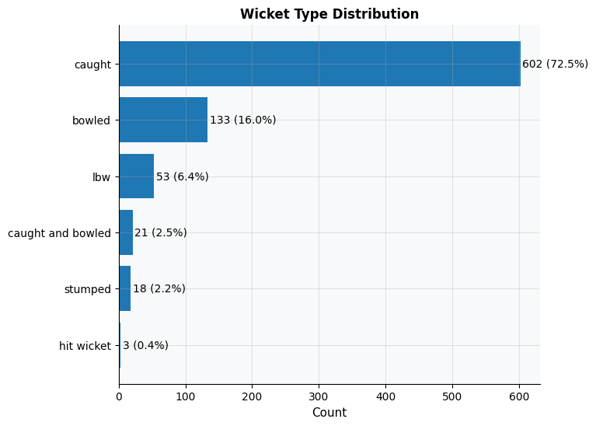
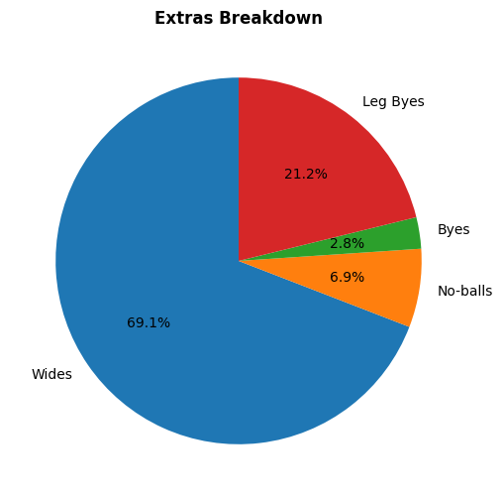
How Wickets Fall & What Extras Cost Teams
Dismissal mode distribution and extras breakdown across all league matches
Caught dominates at 72.5% of all dismissals — confirming that aggressive fielding placements on boundary edges are the #1 wicket-taking strategy. Wides account for 69.1% of all extras, gifting runs freely. Every wide in death overs costs teams position — controlling wides is a simple but high-impact discipline metric that separates elite bowling attacks from average ones.
7

Slide 17
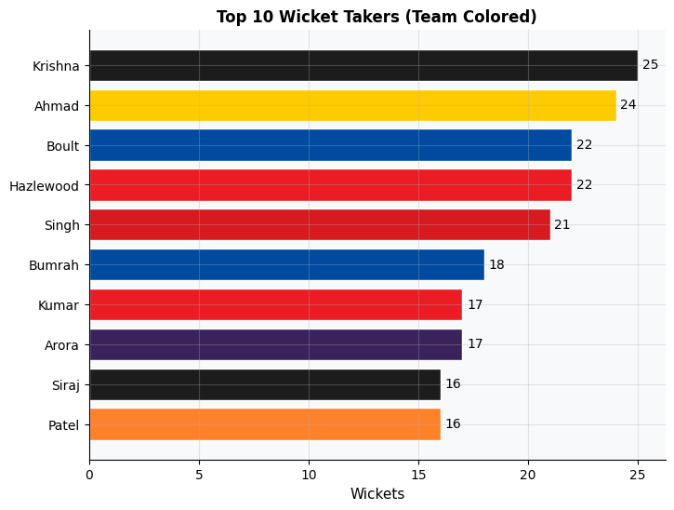
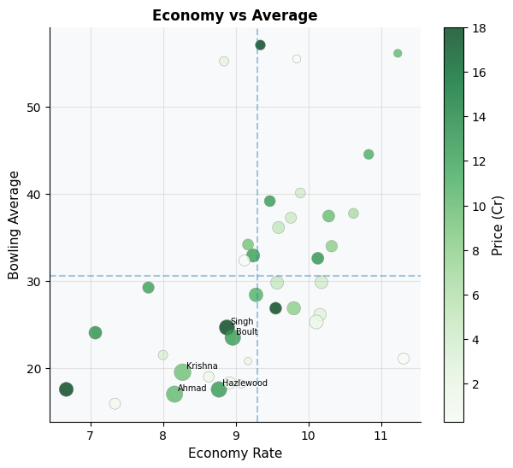
Top 10 Wicket Takers of IPL 2025
Ranked by total wickets | Economy vs Average scatter reveals who was also economical
How Top 10 derived: Total wickets in league stage, all bowlers who bowled at least 5 overs. Krishna (25) and Ahmad (24) led. Scatter: BOTTOM-LEFT = ideal (low economy + low avg). Ahmad, Hazlewood, Krishna cluster here — premium value. High-price dots in top-right = overvalued reputation buys.
16

Slide 18
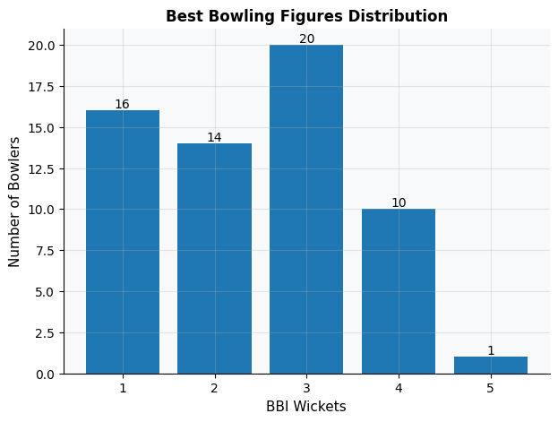
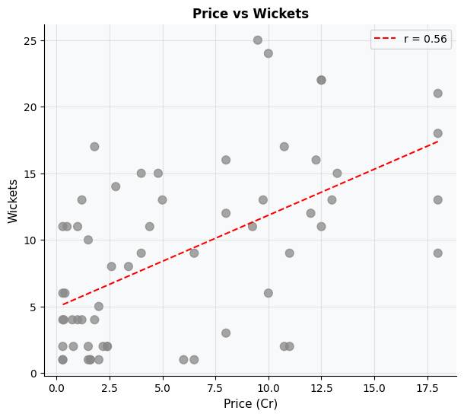
Best Bowling Figures & Price vs Wickets
BBI haul distribution and whether auction price predicts wicket output (r=0.56)
Price and wickets are weakly correlated
BBI shows most bowlers peaked at 2–3 wicket hauls in their best match — 4+ hauls are rare and extremely valuable. Price vs Wickets scatter (r=0.56): weak positive link — many cheap bowlers took identical or more wickets than expensive counterparts. This disconnect is the core finding driving the overvalued bowler list ahead.
18

Slide 19
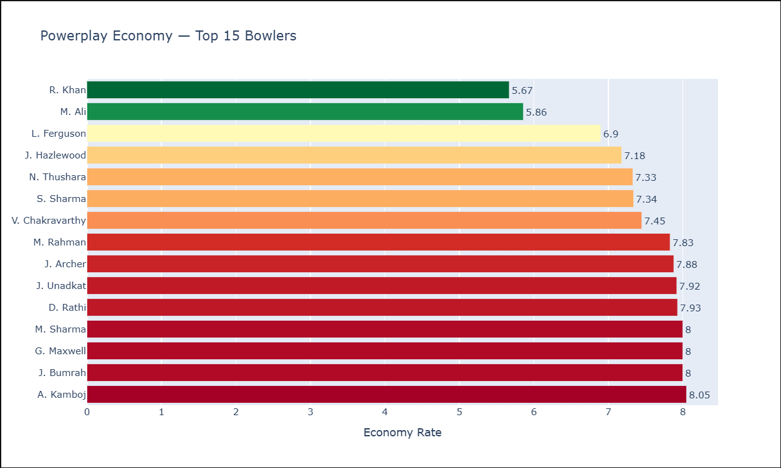
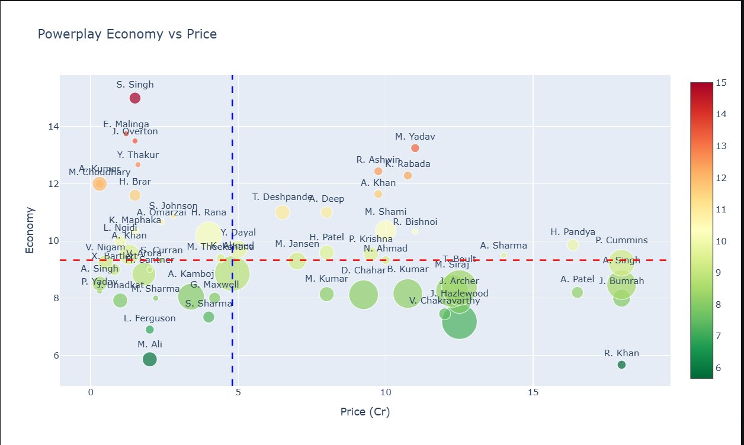
Powerplay Economy: Best Bowling Restrictors
Top 15 by PP economy (left) · PP Economy vs Price scatter (right) | Min. 3 powerplay overs bowled
How Top 15 derived: Powerplay economy rate (runs conceded per over in overs 1–6), min 3 overs bowled. R. Khan (5.67) and M. Ali (5.86) are world-class. Scatter: top-left = cheap AND restrictive = best PP value. Chakravarthy, Ferguson, Sharma deliver at under ₹5Cr.
19

Slide 20
Auction Economics
The gap between price paid and value delivered

Slide 21
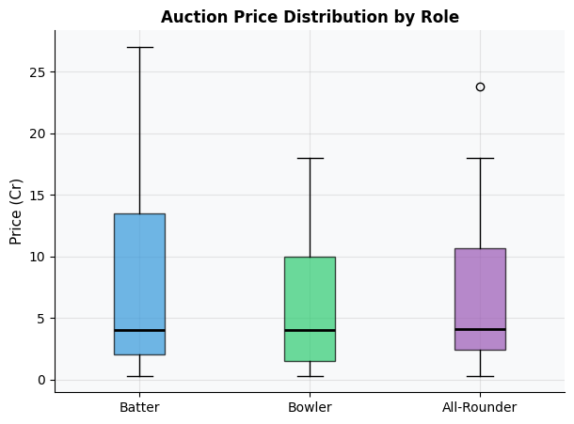
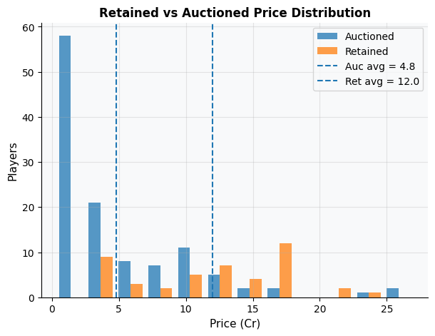
How Does Price Vary by Role and Status?
Auction price distribution by role (batter/bowler/all-rounder) and retained vs auctioned players
Batters command the highest median prices — IPL's batting-centric valuation philosophy is visible in data. Retained players average ₹12Cr vs only ₹4.8Cr for auctioned players. But the auctioned pool had wide spread — if franchises scouted correctly, incredible bargains were available at ₹0.3–₹2Cr. This is where the undervalued gems were hiding.
21

Slide 22
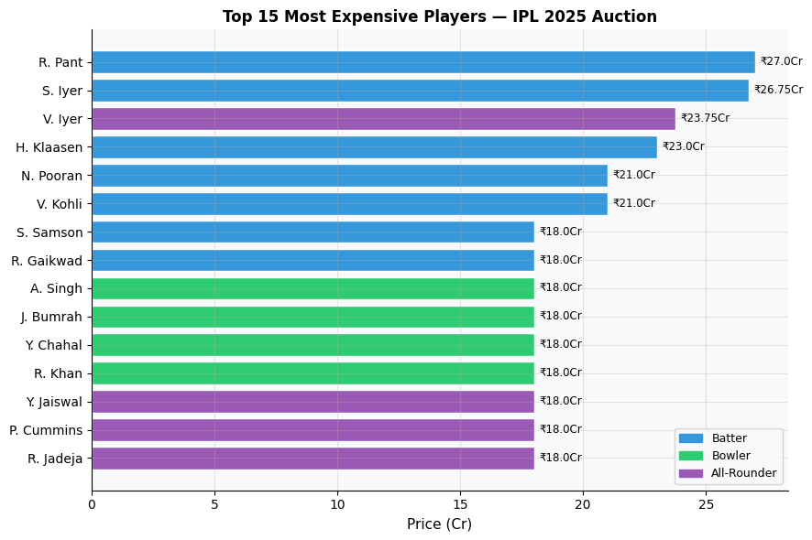
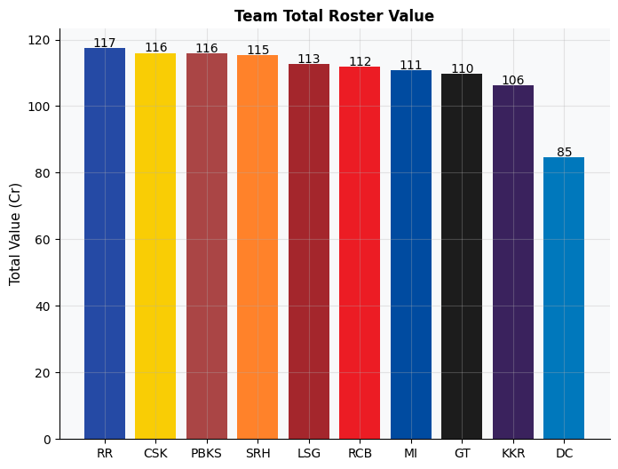
Where Did the Money Go?
Top 15 most expensive players and total team roster value — does squad spend predict results?
12 of 15 most expensive players are batters — confirming batting is systematically overpriced. Team roster chart: RR & CSK spent most (₹117–116Cr) yet finished BOTTOM. DC spent least (₹85Cr) and QUALIFIED for playoffs. Budget allocation and squad depth beat total spend.
22

Slide 23
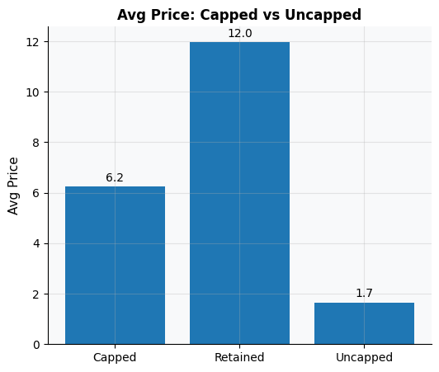
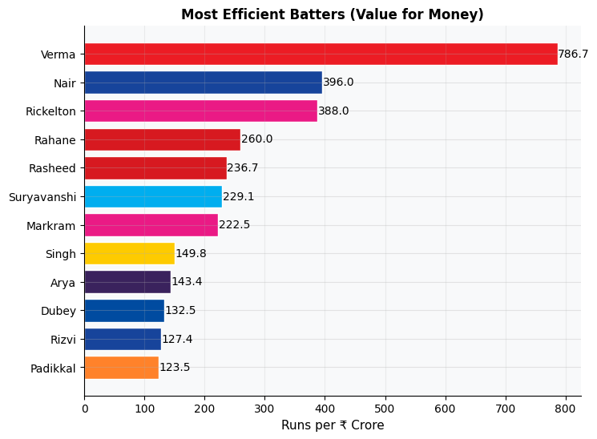
Capped Premium & Most Efficient Batters
Average price by player status (left) | Most efficient batters by Runs per ₹Crore (right)
How this ranking works: Runs ÷ Auction Price (₹Cr). Uncapped players average ₹1.7Cr vs ₹12Cr for retained — 7× premium. Yet A. Verma (786.7 runs/Cr at ₹0.3Cr), K. Nair (396/Cr) and R. Rickelton (388/Cr) massively outperform their price. These are the bargain batters franchises should have fought for.
23

Slide 24
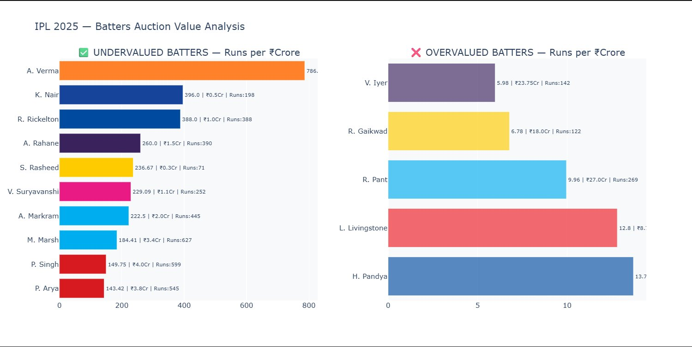
Batting Auction Value: Runs per ₹Crore
Undervalued (left) vs Overvalued (right) — runs delivered per rupee spent at auction
A. Verma at 786.7 runs/Cr (₹0.3Cr) is 130× more efficient than V. Iyer (5.98 runs/Cr at ₹23.75Cr). R. Pant spent ₹27Cr — the most of any player — yet delivered only 9.96 runs/Cr. Brand and anticipation premiums dominated rational performance valuation.
24

Slide 25
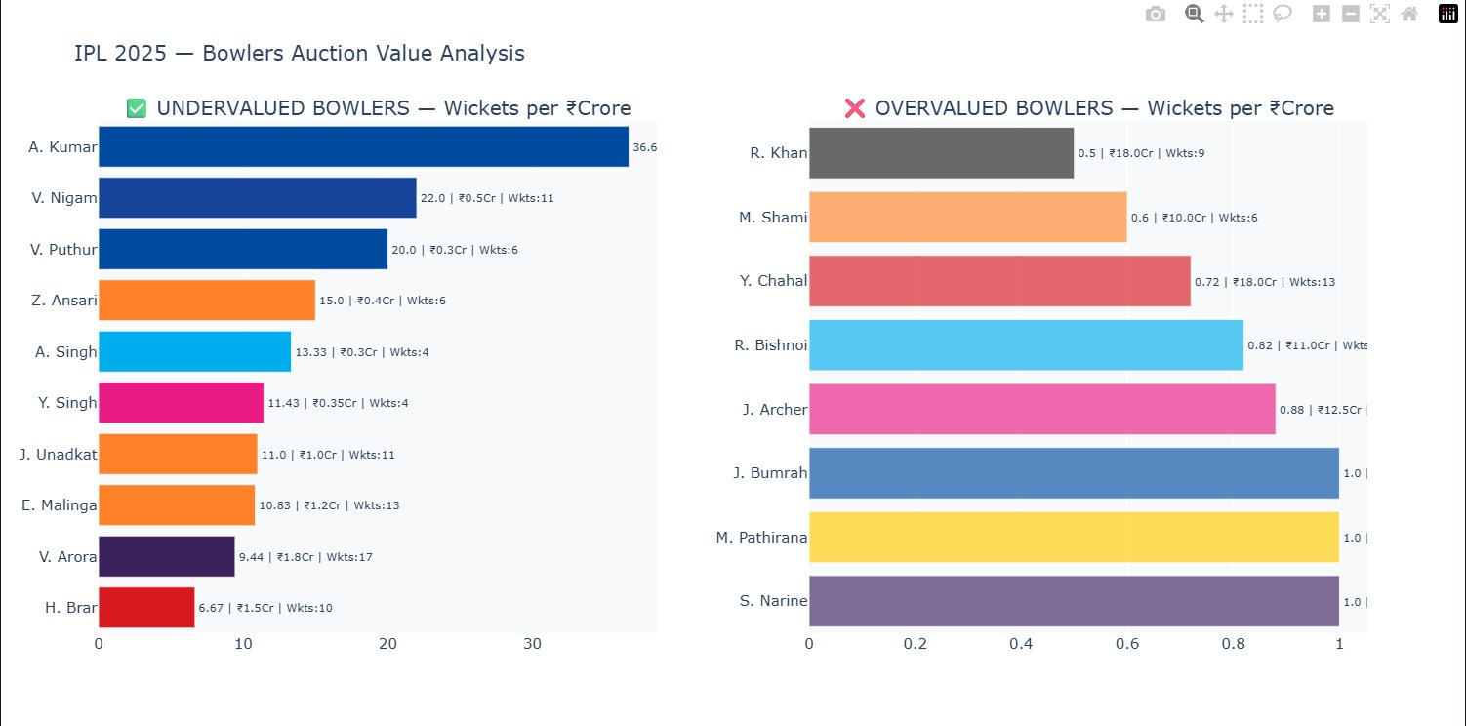
Bowling Auction Value: Wickets per ₹Crore
Undervalued (left) vs Overvalued (right) — wickets delivered per rupee spent at auction
A. Kumar: 36.6 wickets/Cr at ₹0.3Cr — extraordinary market inefficiency. R. Khan: 0.5 wkts/Cr at ₹18Cr — brand premium paid without proportional output. Bumrah, Pathirana, Narine all at 1.0 wkt/Cr — high price, consistent premium output — the only justified expensive bowlers in the dataset.
25

Slide 26
Venues & Pitches
Where matches are won — and how pitch conditions shape strategy

Slide 27
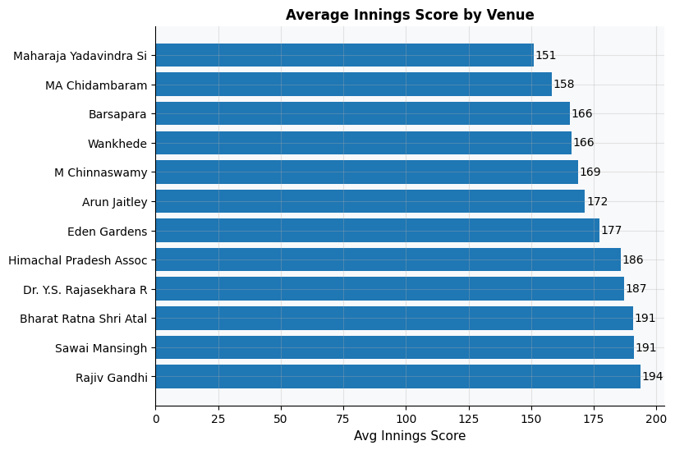
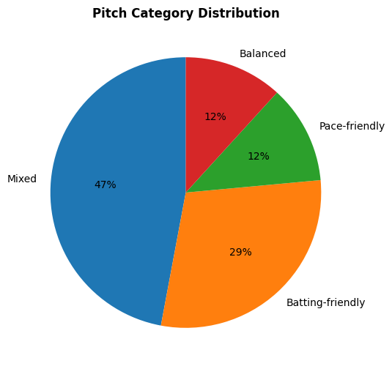
Venues: Run Totals & Pitch Category Breakdown
Avg innings score by venue (left) | Pitch category distribution across all 17 IPL 2025 venues (right)
Rajiv Gandhi Stadium (194) and Sawai Mansingh (191) are the highest-scoring grounds — batters' paradise. Maharaja Yadavindra (151) suppresses totals most. Pitch distribution: 47% Mixed, 29% Batting-friendly, only 12% each Balanced and Pace-friendly. Mixed pitches dominate — franchises need all-round squads, not specialists. Understanding your home pitch type is critical for smart auction targeting.
27

Slide 28
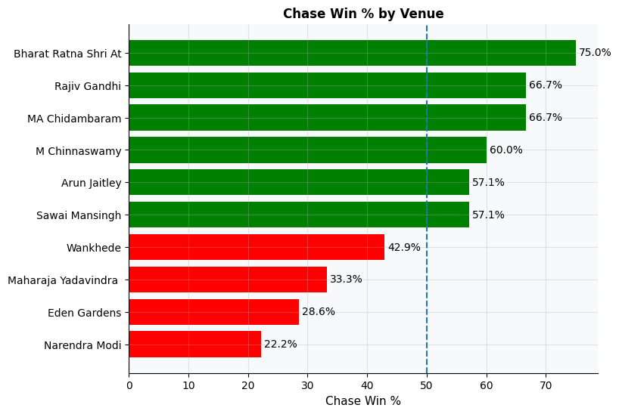
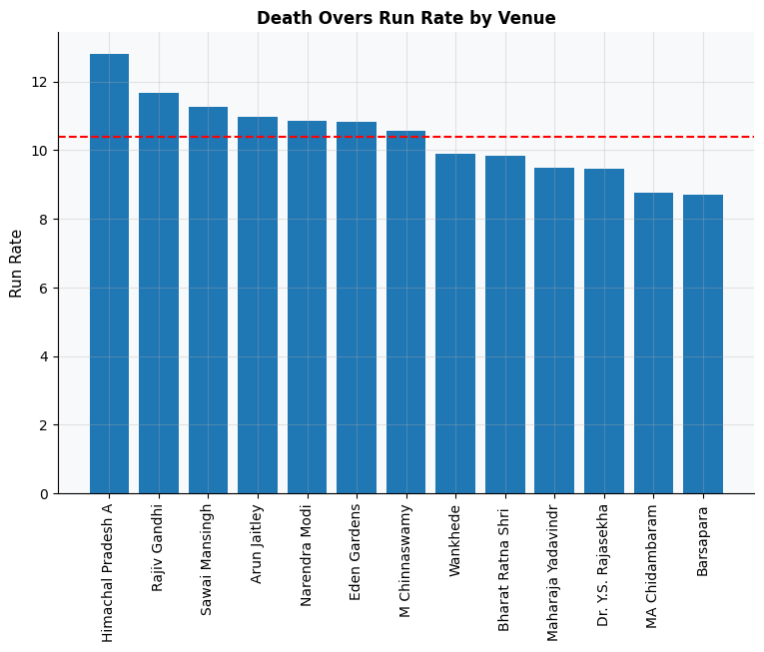
Chase Dynamics & Phase Scoring Across Venues
Chase win% per venue (left) | Powerplay and Death run rates by ground (right)
Green bars = chase wins >50%. Bharat Ratna (75%) and Rajiv Gandhi (66.7%) massively favour chasers — teams with deep batting lineups love these venues. Narendra Modi Stadium (22.2%) is a bat-first fortress. Hyderabad (100% bat-first win rate) is the most extreme — always set a target there.
28

Slide 29
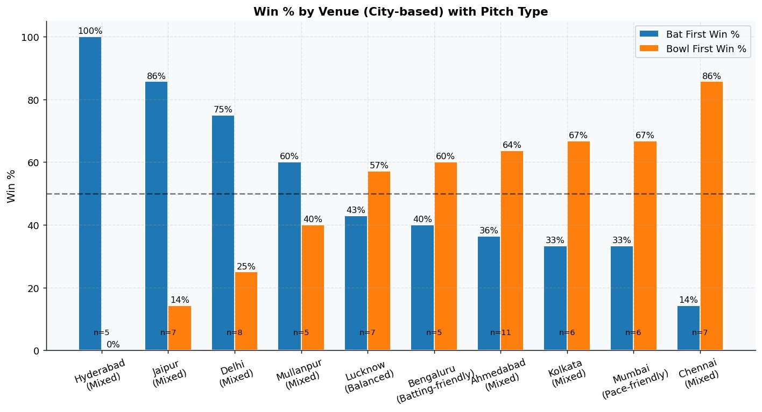
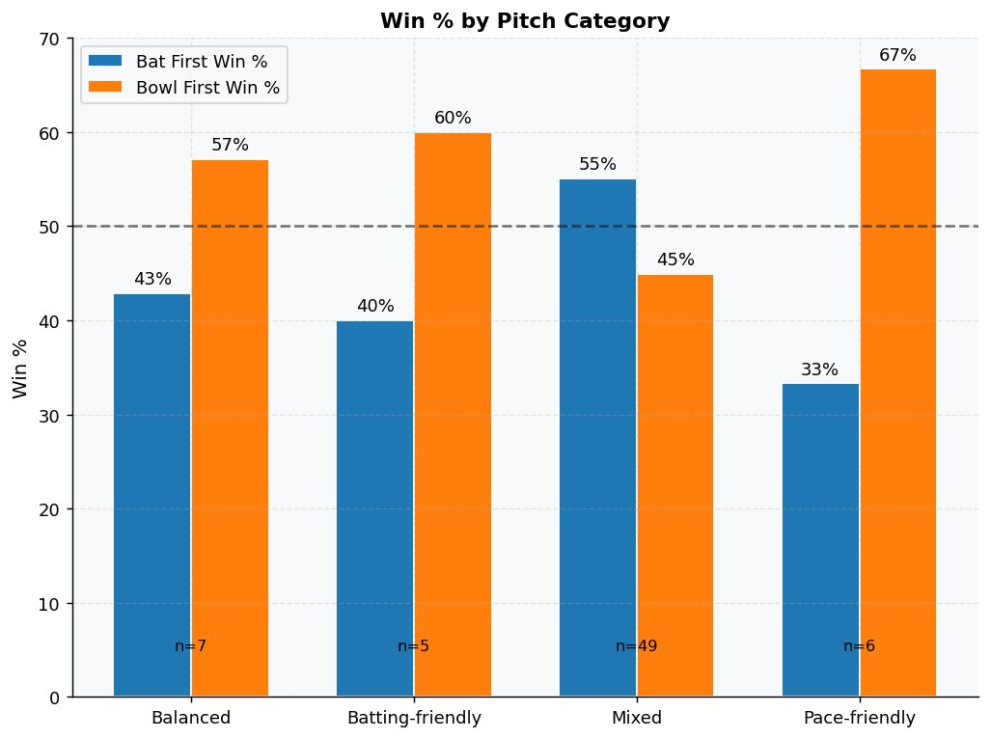
Bat First or Bowl First? The Venue & Pitch Verdict
Win% by venue-city (left) and pitch category (right) — the data-driven toss decision guide
Hyderabad (Mixed): 100% bat-first. Jaipur (86%) and Delhi (75%) — set a target. Chennai: 86% bowl-first — always field there. Pitch verdict: Pace-friendly tracks give bowl-first teams 67% win rate — the clearest pitch advantage. Mixed pitches (n=49, most common) are nearly balanced at 55% bat-first. Smart captains read the pitch category and act accordingly — this data should replace gut instinct entirely.
29

Slide 30
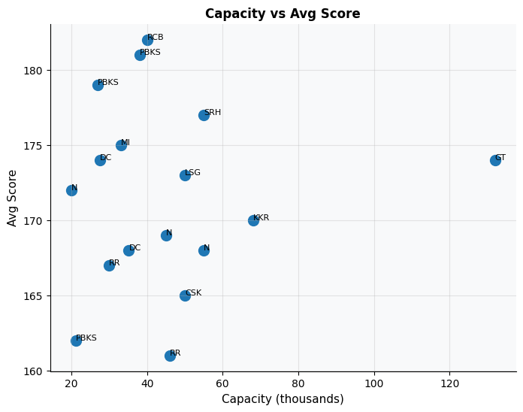
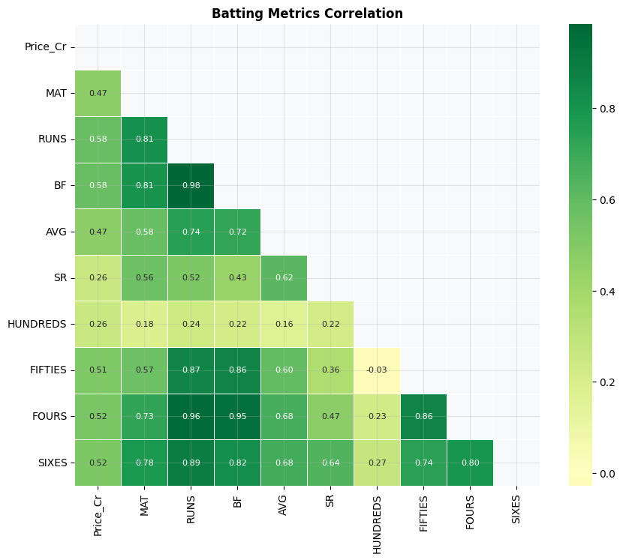
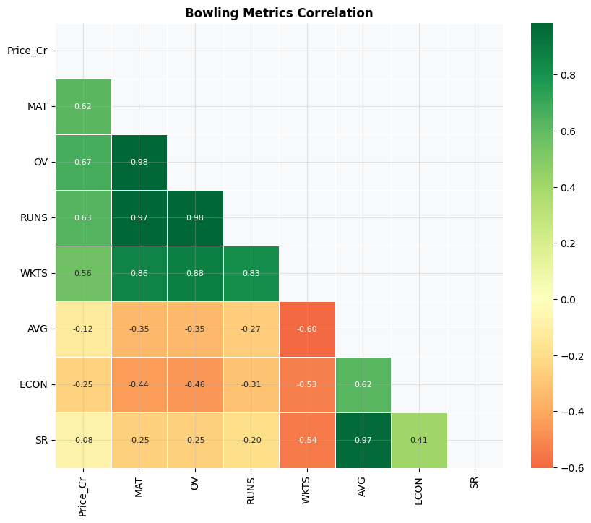
Stadium Capacity & Metric Correlations
Does ground size affect scores? Batting and bowling metric correlation heatmaps
Capacity vs score: NO strong linear relationship — large grounds do not necessarily produce low scores. Geography and pitch preparation matter more. Batting heatmap: Runs, BF, Fours tightly correlated (0.8+). Price_Cr weakly correlates with performance metrics — confirming auction inefficiency. Bowling heatmap: WKTS and MAT correlate (volume bowlers take more wickets). Economy and Average are inversely linked — good bowlers ARE economical.
30

Slide 31
Home Advantage
Does playing at home genuinely help — or is it a myth?

Slide 32
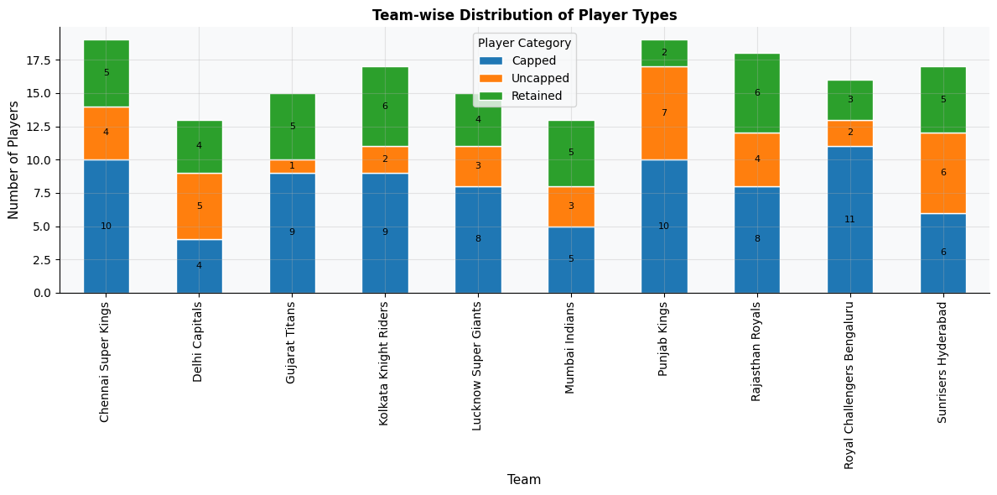
How Did Teams Build Their Squads?
Team-wise distribution of Retained, Capped, and Uncapped players across all 10 franchises
Retained players (green) = highest-paid anchor cohort. Uncapped (orange) = bulk of cheap roster slots. PBKS has the most uncapped players (7) — their strategy of betting on raw talent over established names. RCB and CSK leaned heavily on retained/capped names — a costlier, less flexible approach. Squad construction philosophy visible directly in this chart.
32

Slide 33
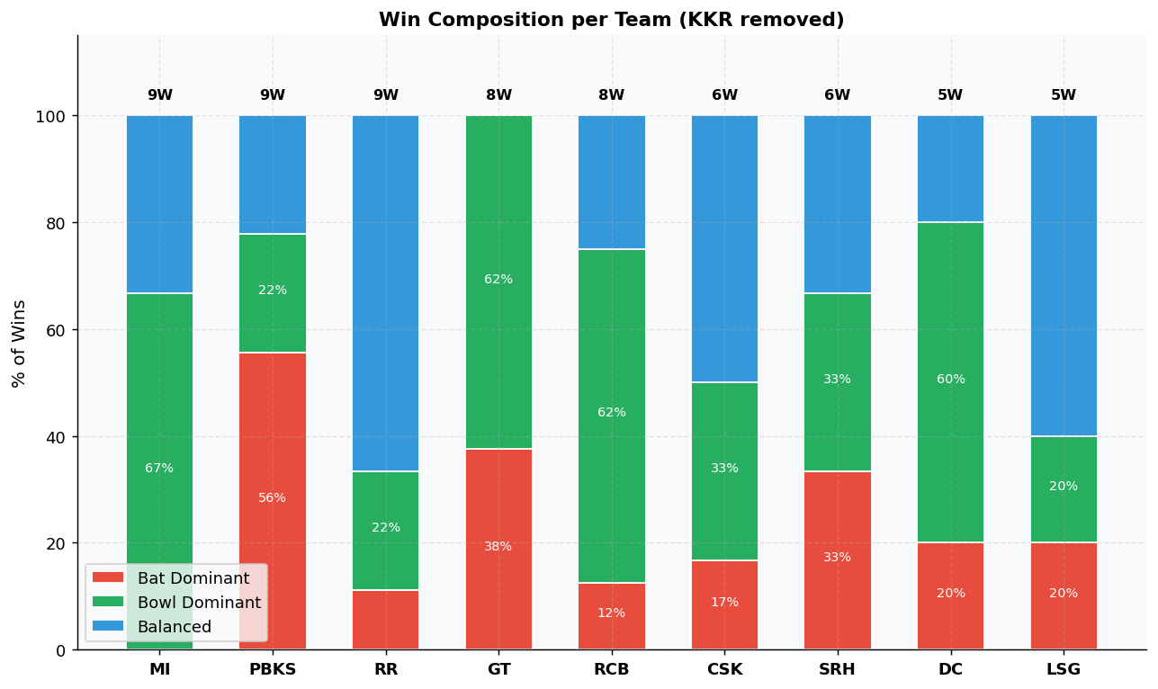
How Teams Win: Batting vs Bowling vs Balanced
Win composition per team — Bat Dominant (red) | Bowl Dominant (green) | Balanced (blue)
MI wins 67% through bowling dominance — their pace attack is their identity. PBKS is 56% bat-dominant — the run-scoring machine. GT (62% bowl-dominant) confirms bowling as their recipe. RCB is 62% bowl-dominant — surprising given their batting stars. CSK shows 33% in each category — balanced but underwhelming (only 6 wins). Balanced wins correlate most with consistent all-round squad depth.
33

Slide 34
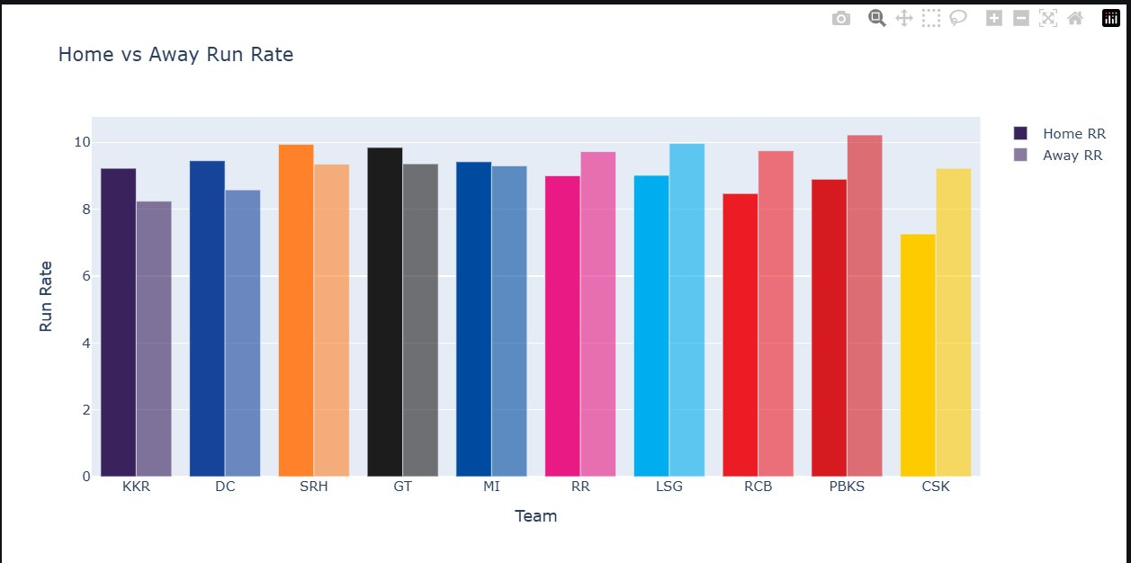
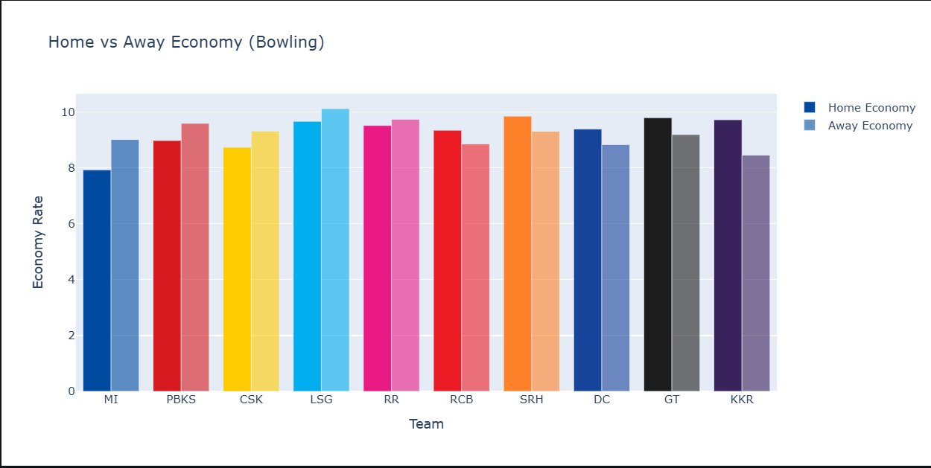
Home vs Away: Batting Run Rate & Bowling Economy
Which teams genuinely benefit from home conditions — in both batting and bowling?
Home advantage is real but varies dramatically by franchise
Batting: KKR, DC, SRH, GT all post clearly higher run rates at home. CSK is the notable exception — they score BETTER away. Their home venue (Chennai) seems to suit opposition more. Bowling: MI's economy jumps from ~8 at home to ~9 away — a 12.5% deterioration on foreign pitches. GT and KKR maintain tight economies even away — signalling true squad depth that transcends home conditions.
34

Slide 35
Value Quadrants
The ultimate question: who was worth their price?

Slide 36
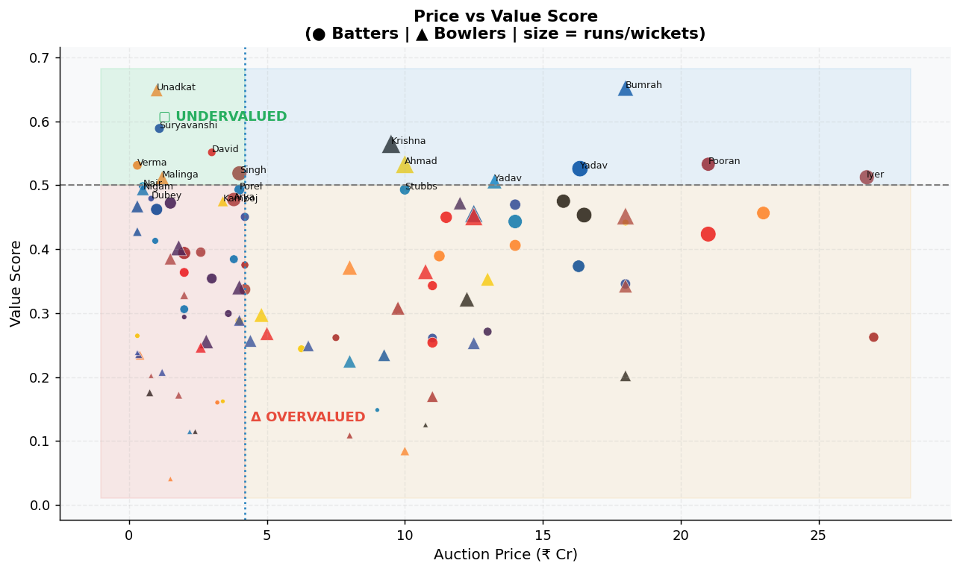
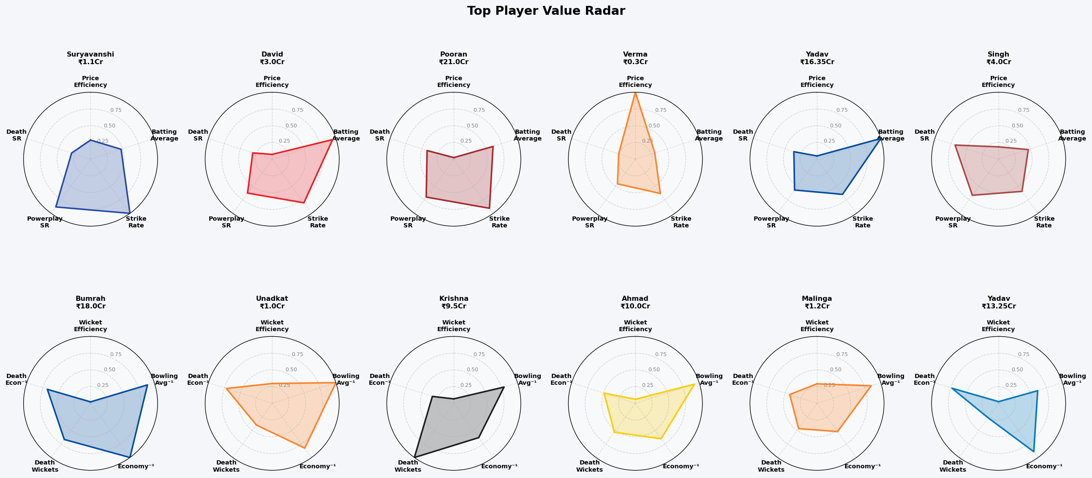
The Ultimate Value Map
Price vs Composite Value Score (batters=circles, bowlers=triangles) | Radar confirms top player profiles
TOP-LEFT GREEN = UNDERVALUED: Unadkat (₹1Cr), Suryavanshi (₹1.1Cr), Verma (₹0.3Cr) — extraordinary buys. BOTTOM-RIGHT ORANGE = OVERVALUED: high price, low value score. Radar charts confirm Bumrah's elite multi-dimensional profile justifying his ₹18Cr.
36

Slide 37
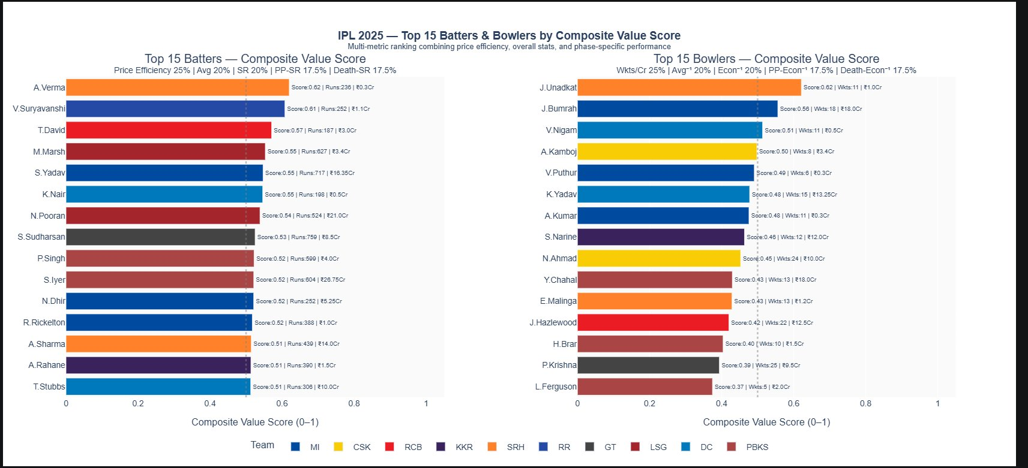
Composite Value Rankings
Multi-metric composite score: Price Efficiency 25% | Avg 20% | SR 20% | PP-SR 17.5% | Death-Econ 17.5%
How Top 15 derived: Composite = weighted sum of 5 normalised metrics. Verma tops batters (0.62) despite scoring 252 runs — extreme price efficiency at ₹0.3Cr drives this. Unadkat tops bowlers (0.62) at ₹1Cr. Bumrah 2nd at 0.59 — the only premium player justifying his spot in top tier.
37

Slide 38
KEY FINDINGS
Toss Is Overrated
Death Overs Are the Real Battleground
01
81% chose to field, yet neither chasing (31.7%) nor batting-first (21.4%) delivered >35% win rate for toss winners. Squad depth matters far more than the coin toss.
02
Run rates spike to 10.96 in overs 16–20 vs 9.62 in powerplay (+14%). Teams with specialist finishers (SR>200) consistently outperformed those without.
03
Price ≠ Performance
Uncapped & Budget Players Are Grossly Undervalued
Correlation between auction price and output: r=0.58 (batters), r=0.56 (bowlers) — both weak. RR & CSK spent ₹117Cr+ and finished bottom. DC spent ₹85Cr and qualified.
04
A. Verma (786.7 runs/Cr at ₹0.3Cr), A. Kumar (36.6 wkts/Cr at ₹0.3Cr), J. Unadkat (0.62 composite score at ₹1Cr) — proof that the auctioned pool held extraordinary value.
Bumrah Remains Elite & Fairly Priced
Home Advantage Is Real But Franchise-Specific
05
Among premium players, Bumrah (₹18Cr) achieved the highest bowling composite value score (0.59) — the only star-priced player in the top tier of value-for-money.
06
Most teams score higher at home. CSK is the anomaly — performing better away. MI's bowling economy worsens 12.5% away — home conditions are a genuine strategic asset.
Winning Teams Win Multiple Ways
07
MI (67% bowl dominant), PBKS (56% bat dominant), RCB (62% bowl dominant) — no single tactical blueprint dominates. Squads adaptable to both phases are hardest to beat.
38

Slide 39
Conclusions
What this analysis means for IPL 2026 auction strategy
💡
Stop Treating the Toss as a Strategic Tool
🎯
Death Overs Are the Most Under-Priced Phase
With both chasing and batting-first win rates below 35%, the toss is a coin flip with a costume. Franchises that obsess over it in team selection are wasting cognitive budget that should go toward squad depth and phase-specific role clarity.
The 14% run-rate surge in overs 16–20 makes finishers the most game-deciding role in T20 cricket. Yet players like Shepherd (SR 278, ₹1.5Cr) and Livingstone (SR 261, ₹8.75Cr) were acquired at prices that do not reflect this impact. The IPL auction systematically underprices death-phase specialists.
📉
High Spend Is Not a Squad-Building Strategy
💎
The Auctioned Pool Hides the Best ROI in the League
RR (₹117Cr, 28.6% win rate) and CSK (₹116Cr, 28.6%) prove that total spend is a vanity metric. DC won a playoff spot for ₹85Cr — ₹32Cr cheaper. The conclusion is unambiguous: efficient allocation of mid-range budgets across phase-specific roles beats concentrated bets on marquee names.
A. Verma (786.7 runs/₹Cr at ₹0.3Cr) is 130× more efficient than V. Iyer (5.98 runs/₹Cr at ₹23.75Cr). A. Kumar (36.6 wkts/₹Cr at ₹0.3Cr) outperforms R. Khan (0.5 wkts/₹Cr at ₹18Cr) by 73×. The uncapped and auctioned pool is where championship-winning value is built — not in the retained or marquee segment.
🏟️
Venue Intelligence Should Drive Squad Composition
🏆
The Blueprint for IPL 2026: Depth Over Stars
Hyderabad (100% bat-first win rate) and Chennai (86% bowl-first) require completely opposite team structures. Franchises building generic all-round squads are leaving tactical wins on the table. Home pitch category should be the starting point of every auction planning meeting — before any player name is discussed.
PBKS won 69.2% of their matches using the highest number of uncapped players (7) in any squad. RCB matched them with a balanced retained core plus smart mid-range buys. The formula is clear: identify 2–3 phase specialists at under ₹3Cr, one world-class anchor, and invest remaining budget in squad depth — not in chasing brand names past ₹20Cr.
39

Slide 40
Thank You
74
38
30+
Matches
Slides
Plots
Thammandra Saketh Ram
B24DS034 · DSL251
Data Analytics and Visualization
"Smart franchises don't spend the most — they spend the best."

