Slide 1
IPL 2025
AUCTION STRATEGY & PLAYER VALUE ANALYSIS
A data-driven story of price, performance, and untapped value
Topics Covered
League Overview · Toss & Phase Dynamics · Team Performance · Batting & Bowling EDA Auction Pricing · Venue & Pitch Analysis · Home Advantage · Value Quadrants · Key Findings
1 / 31

Slide 2
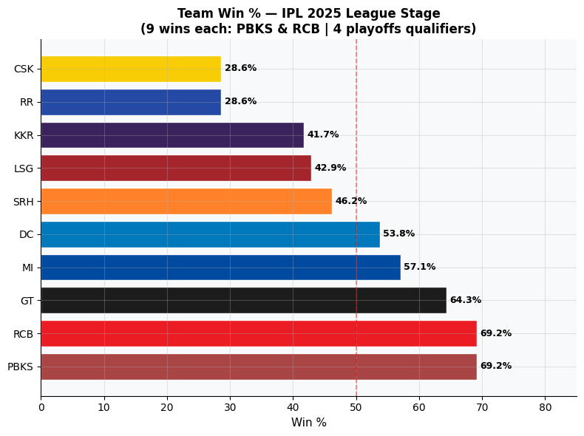
CHAPTER 1 · THE LEAGUE LANDSCAPE
Who Ruled the League Stage?
IPL 2025 Team Win % — League Stage
📊 Interpretation
PBKS and RCB jointly topped the league with a 69.2% win rate — the highest across all 10 teams. GT came in third at 64.3%, followed by MI at 57.1%, confirming the mid-table was competitive. Defending champions KKR (41.7%), RR (28.6%), and CSK (28.6%) had disappointing campaigns, suggesting a poor translation of auction spending into results. The top-4 cutoff of 50% means only 5 teams consistently won more than they lost.
2 / 31

Slide 3
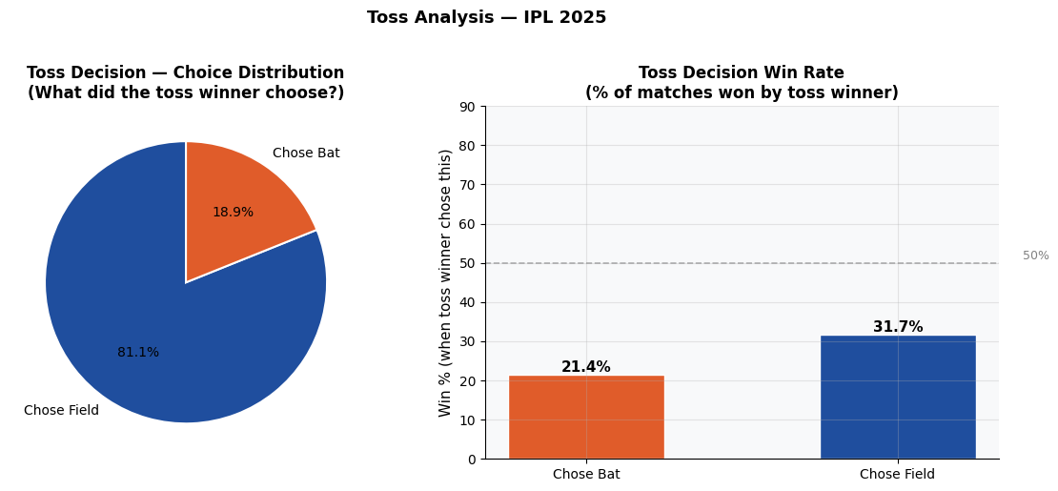
CHAPTER 1 · THE LEAGUE LANDSCAPE
Does Winning the Toss Matter?
Toss Decision Trends & Win Rates
📊 Interpretation
A massive 81.1% of teams chose to field first after winning the toss, confirming that chasing is overwhelmingly preferred in T20 cricket. However, neither strategy delivers a decisive advantage — teams choosing to bat won only 21.4% of the time, while those choosing to field won 31.7%. Both figures are well below the 50% coin-flip baseline, suggesting that toss decisions alone don't determine outcomes — team composition and execution matter far more.
3 / 31

Slide 4
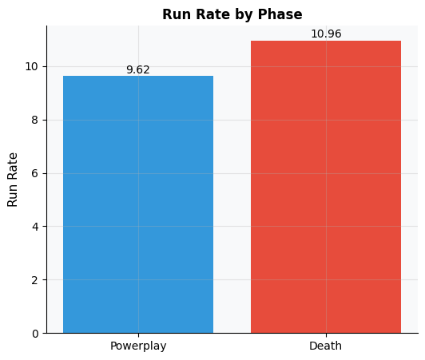
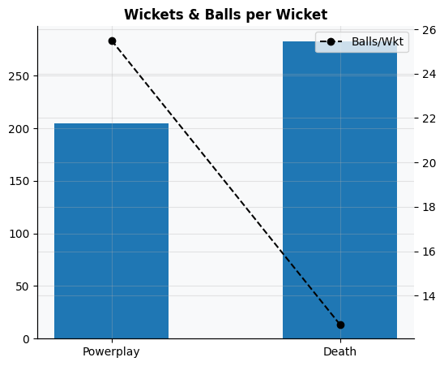
CHAPTER 2 · PHASES OF THE GAME
Powerplay vs Death: Run Rate & Wickets
How the game's momentum shifts over 20 overs
📊 Interpretation
Death overs (overs 16–20) produce a significantly higher run rate than Powerplay (overs 1–6), reflecting the aggressive hitting mindset late in an innings. The wickets chart reinforces this — while death overs see more wickets fall in absolute terms, the balls-per-wicket (dotted line) is actually lower in Powerplay, meaning bowlers strike more frequently per ball during the first 6 overs. This highlights the critical dual value of Powerplay bowlers: they must restrict runs AND take early wickets to derail top orders.
4 / 31

Slide 5
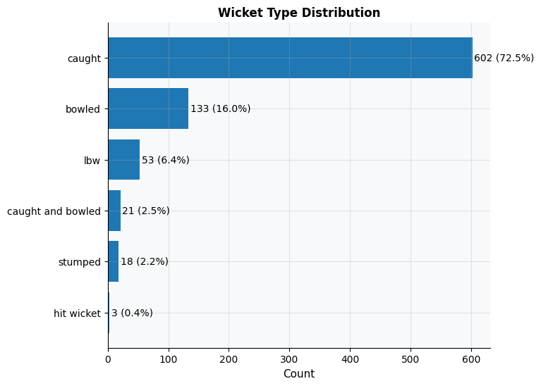
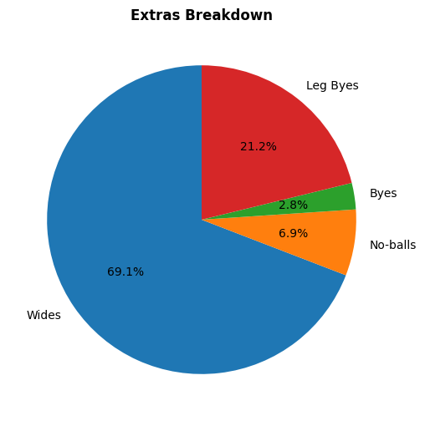
CHAPTER 2 · PHASES OF THE GAME
How Wickets Fall & Extra Costs
📊 Interpretation
Caught is the most dominant dismissal mode, followed by bowled and LBW — reinforcing the importance of wicket-taking bowlers over economy-focused ones. On the extras front, wides dominate, creating easy scoring opportunities for batters. Controlling wides is a simple but high-impact bowling discipline metric.
5 / 31

Slide 6
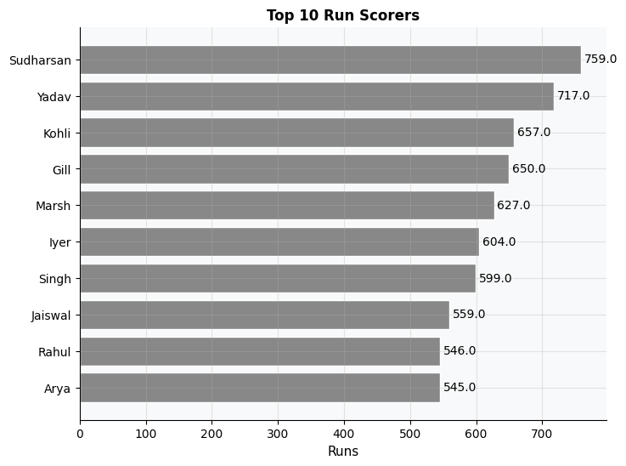
CHAPTER 3 · BATTING DEEP DIVE
Top Run Scorers of IPL 2025
Top 10 run-getters colored by team
📊 Interpretation
The top run-scorers list spans multiple teams, showing IPL 2025 had well-distributed batting talent. Bar widths indicate total runs while colour-coding reveals team identity — no single franchise monopolised the batting charts. Notably, high-ticket retained players appear alongside cheaper or newly auctioned ones, hinting that expensive acquisitions didn't always outperform budget picks. Price labels on bars offer the first visual clue towards value analysis.
6 / 31

Slide 7
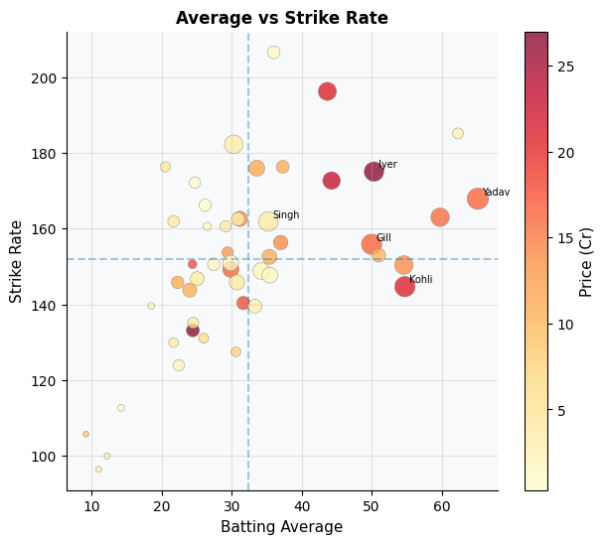
CHAPTER 3 · BATTING DEEP DIVE
Batting Average vs Strike Rate
Do expensive batters actually perform better? Bubble size = runs scored, colour = price
📊 Interpretation
The scatter is divided by dotted crosshair lines at the mean Average and mean Strike Rate — creating four quadrants. Top-Right (ideal): High Avg + High SR — the rarest and most desirable batters. Bottom-Left: Low avg, low SR — consistent underperformers. The colour gradient (YlOrRd = price) reveals a key finding: several low-price players sit in the top-right quadrant, confirming significant undervaluation in the market. Large expensive bubbles appear scattered across all quadrants — money did not reliably buy elite batting performance.
7 / 31

Slide 8
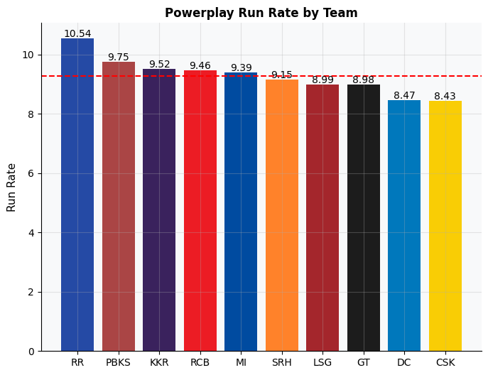
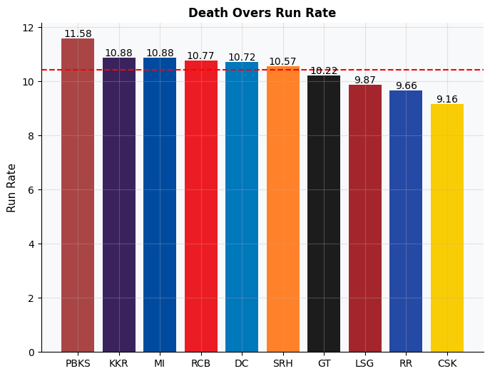
CHAPTER 3 · BATTING DEEP DIVE
Phase-Specific Batting by Team
Powerplay (left) and Death Overs (right) run rates — which teams exploit each phase?
📊 Interpretation
In the Powerplay, certain teams score at significantly higher run rates — revealing which squads have dominant openers. In the Death, the spread is even wider — teams with designated finishers like a powerful No.5 or No.6 clearly outpace others. A team that leads in both phases is almost guaranteed a high total; teams lagging in both face structural batting problems not solved merely by big-name purchases.
8 / 31

Slide 9
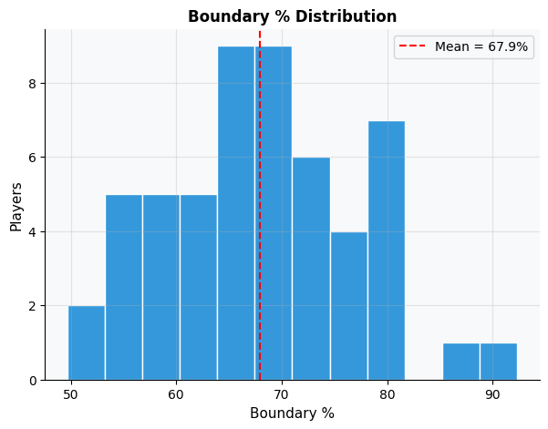
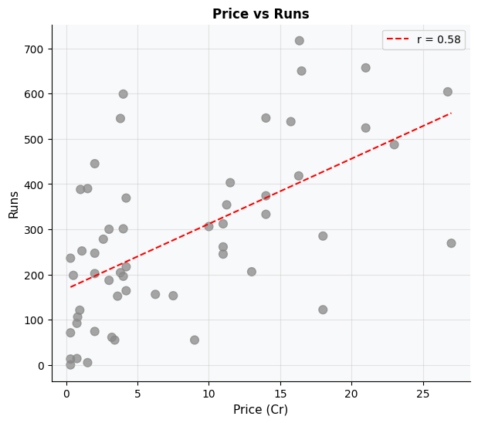
CHAPTER 3 · BATTING DEEP DIVE
Boundary Habits & Price-Performance Link
📊 Interpretation
The boundary % histogram (left) shows most batters hit 35–50% of their runs from boundaries — a healthy norm. Very few exceed 60%, making them explosive match-winners. The price vs runs scatter (right) shows a modest positive correlation (r shown in legend), but the large scatter around the trend line proves that higher price does not reliably predict more runs. Several low-priced players punched well above their valuation — the foundation of our undervalued player finding.
9 / 31

Slide 10
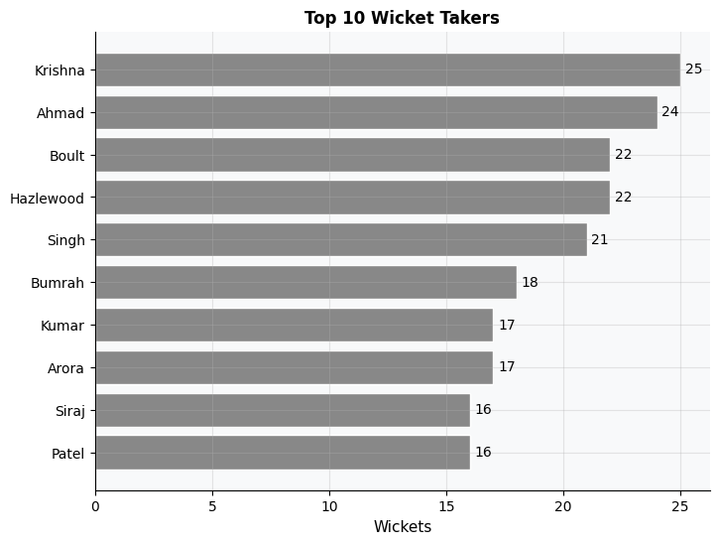
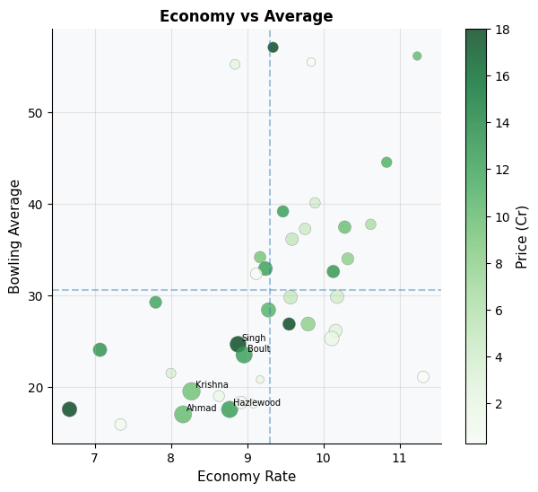
CHAPTER 4 · BOWLING DEEP DIVE
Top Wicket Takers & Bowling Value
📊 Interpretation
The top wicket-takers chart reveals which bowlers dominated the season across teams. The Econ vs Bowling Average scatter (right) — sized by wickets and coloured by price — is key to value detection. Bottom-left quadrant (low avg, low economy) represents the ideal: expensive to score off AND gets wickets. Notably, several high-priced bowlers appear in suboptimal quadrants, confirming overpayment for reputation over current-season form.
10 / 31

Slide 11
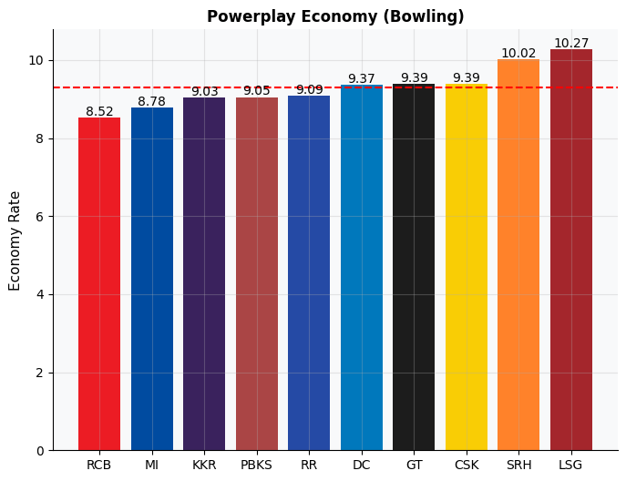
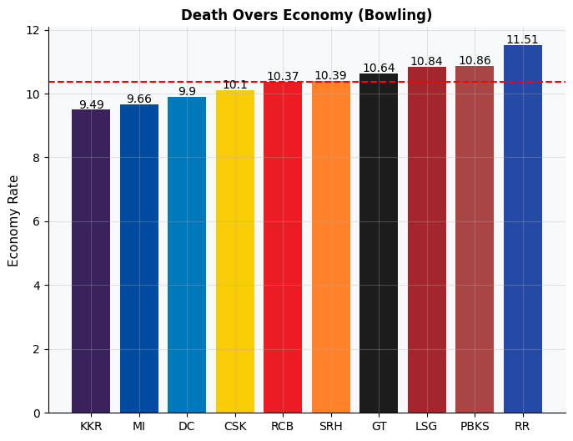
CHAPTER 4 · BOWLING DEEP DIVE
Phase-Specific Bowling by Team
Powerplay economy (left) and Death overs economy (right) — lower = better
📊 Interpretation
Powerplay economy reveals which bowling attacks throttle the opposition early — key in setting up match-winning positions. Death bowling economy (16–20) shows which teams buckle under pressure vs those with specialist death bowlers. Teams performing well in both phases tend to correlate with higher win rates in the league standings, highlighting that bowling unit cohesion matters more than individual superstars.
11 / 31

Slide 12
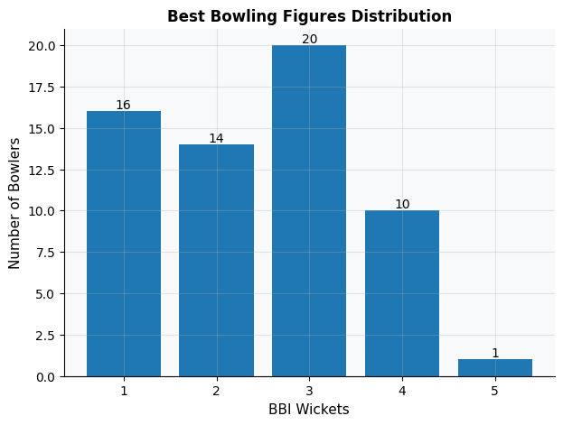
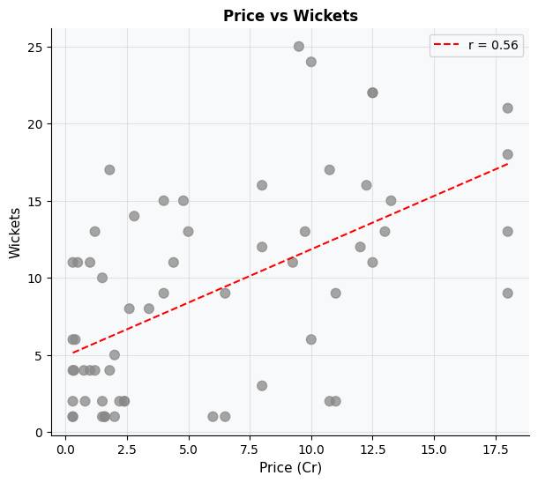
CHAPTER 4 · BOWLING DEEP DIVE
Best Bowling Figures & Price vs Wickets
📊 Interpretation
The BBI distribution shows most bowlers recorded hauls of 2–3 wickets in their best match — 4+ wicket hauls are rare, making those bowlers extremely valuable. The Price vs Wickets scatter (right) shows a weak positive correlation — many high-priced bowlers took similar wickets to far cheaper alternatives. This disconnect between price and output is the core finding driving the overvalued bowler list later.
12 / 31

Slide 13
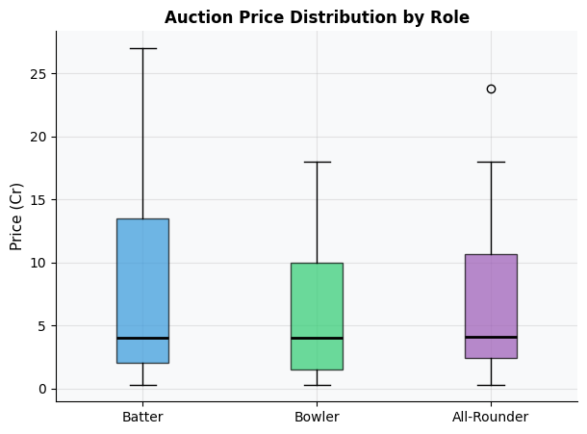
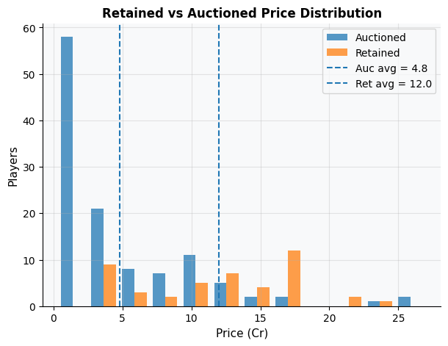
CHAPTER 5 · AUCTION ECONOMICS
The Price of Talent: Role & Status
How does price vary by role and whether a player was retained or auctioned?
📊 Interpretation
Batters command the highest median prices, followed by All-Rounders and Bowlers — reflecting IPL's traditionally batting-centric valuation philosophy. The retained vs auctioned histogram shows retained players have a significantly higher average price, meaning teams allocated their biggest investments to known quantities. However, the auctioned pool had a wide spread, suggesting opportunistic bargains were available if teams scouted correctly.
13 / 31

Slide 14
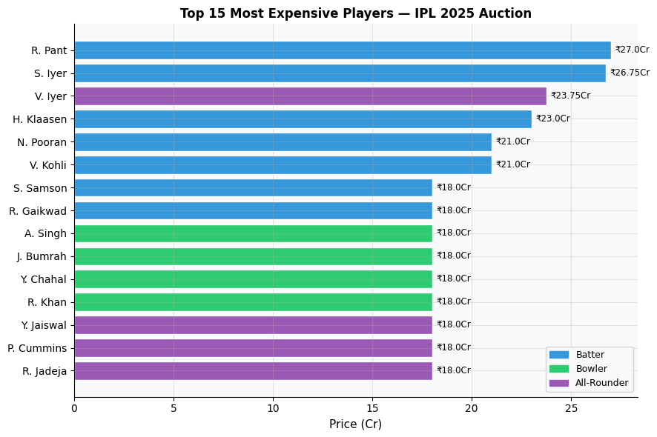
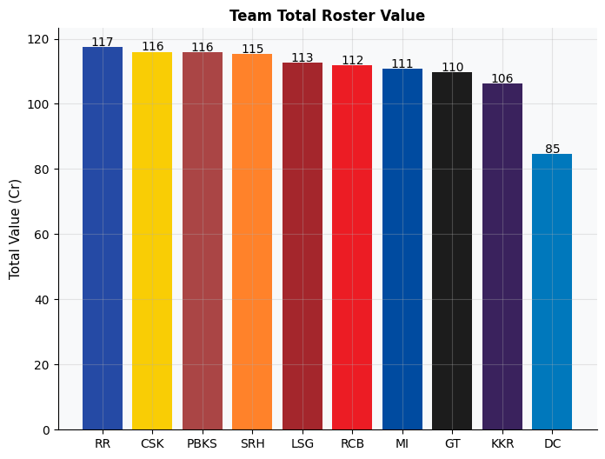
CHAPTER 5 · AUCTION ECONOMICS
Where Did the Money Go?
📊 Interpretation
Top 15 most expensive players span multiple teams and roles, with all-rounders and marquee batters commanding the biggest cheques. The team total roster value chart shows which franchises spent the most in aggregate — higher spend does not always translate to a proportional win rate, as seen when cross-referencing with the league standings (e.g., CSK spent heavily but finished at 28.6% win rate).
14 / 31

Slide 15
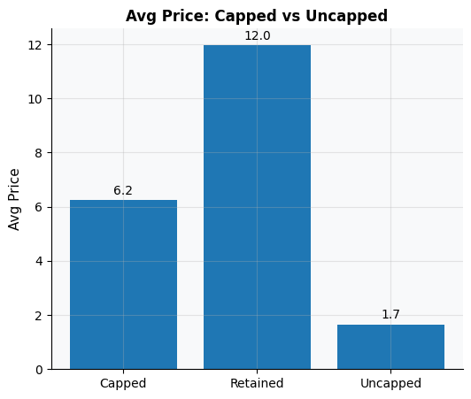
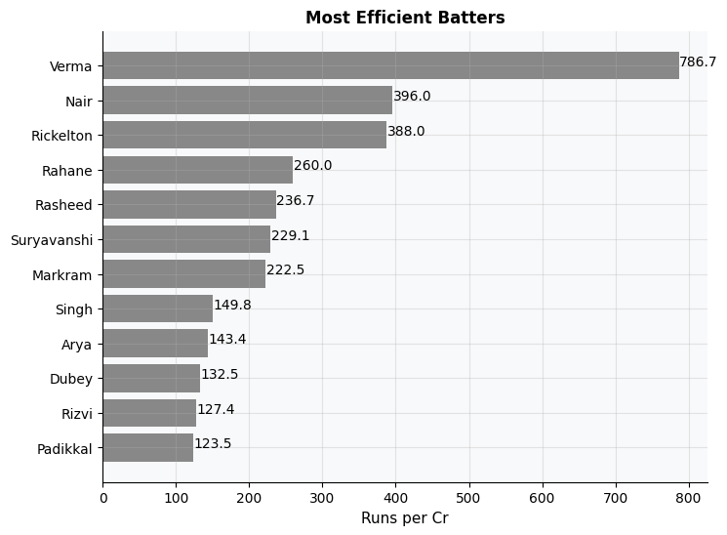
CHAPTER 5 · AUCTION ECONOMICS
Capped Premium & Best Value Batters
📊 Interpretation
Capped players command a significantly higher average auction price than uncapped players. Yet the Runs-per-Crore chart (right) shows that several uncapped or low-cost players delivered far more runs per rupee spent — a direct signal of market inefficiency that smart franchises can exploit.
15 / 31

Slide 16
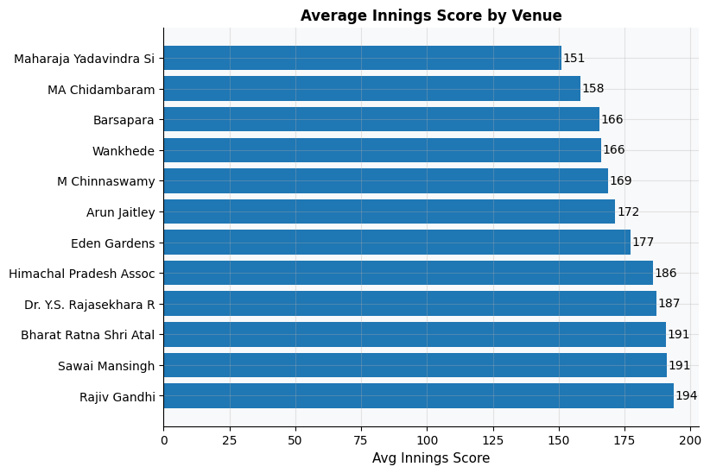
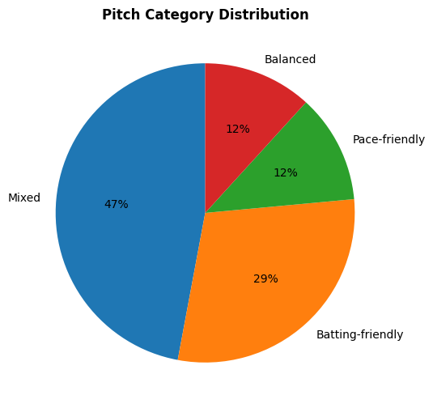
CHAPTER 6 · VENUES & PITCHES
Venues: Runs, Pitches & Ground Sizes
📊 Interpretation
Average innings scores vary considerably across venues — certain grounds consistently produce high-scoring games (batters' paradise), while others suppress totals. The pitch distribution pie shows the majority of pitches lean batting-friendly or balanced, with fewer genuinely seaming or spin tracks. Understanding venue tendencies is critical when selecting team composition for home and away games.
16 / 31

Slide 17
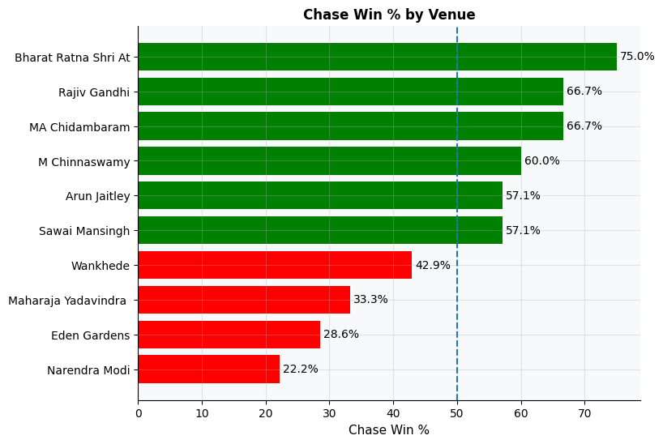
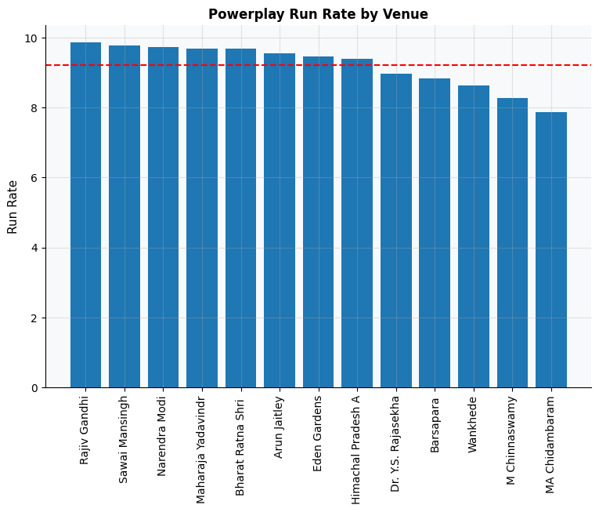
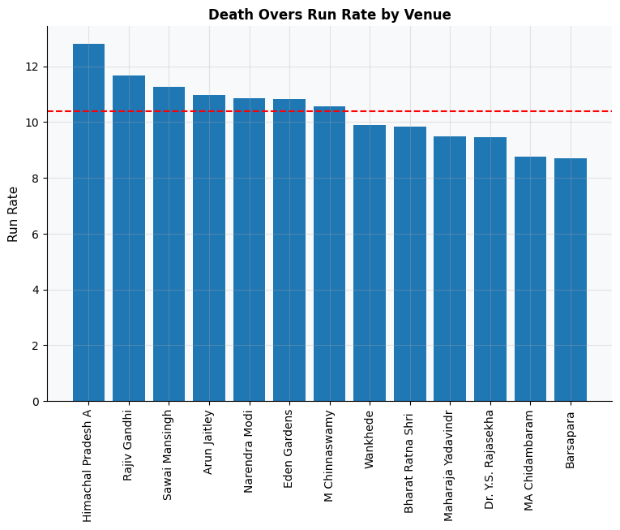
CHAPTER 6 · VENUES & PITCHES
Chase Dynamics & Phase Scoring Across Venues
📊 Interpretation
The Chase Win % chart (left) shows green bars where chasers win >50% of games — these venues favour teams with strong batting line-ups. Red bars signal bat-first advantage, useful for teams with aggressive openers but fragile bowling. The Powerplay and Death run rates by venue (right two charts) reveal which grounds are most explosive in each phase — essential data for selecting whether to include extra pace or spin resources in a squad.
17 / 31

Slide 18
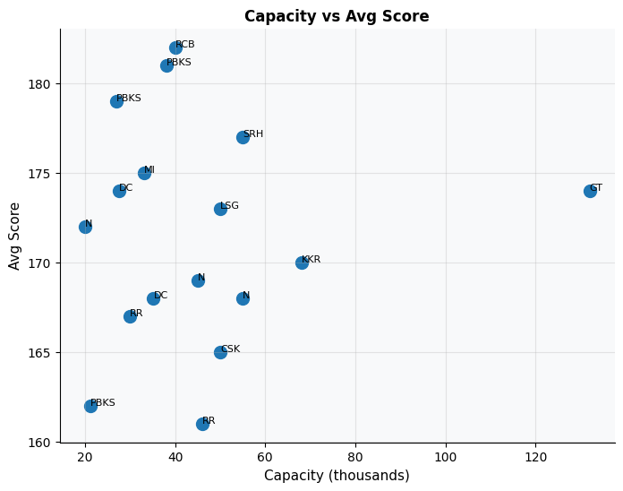
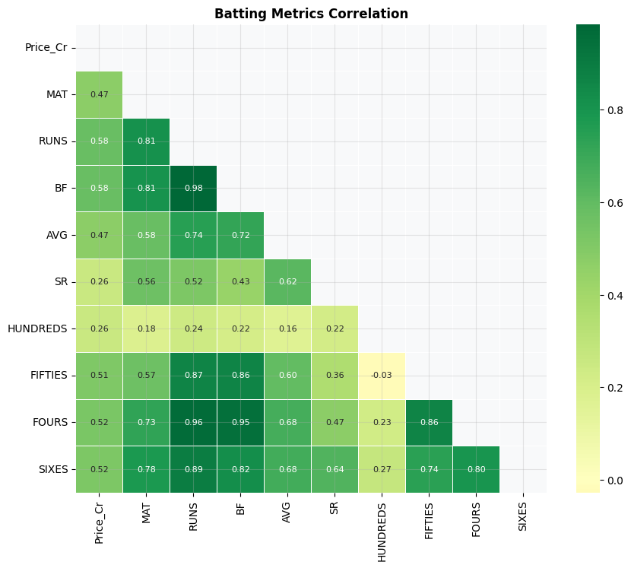
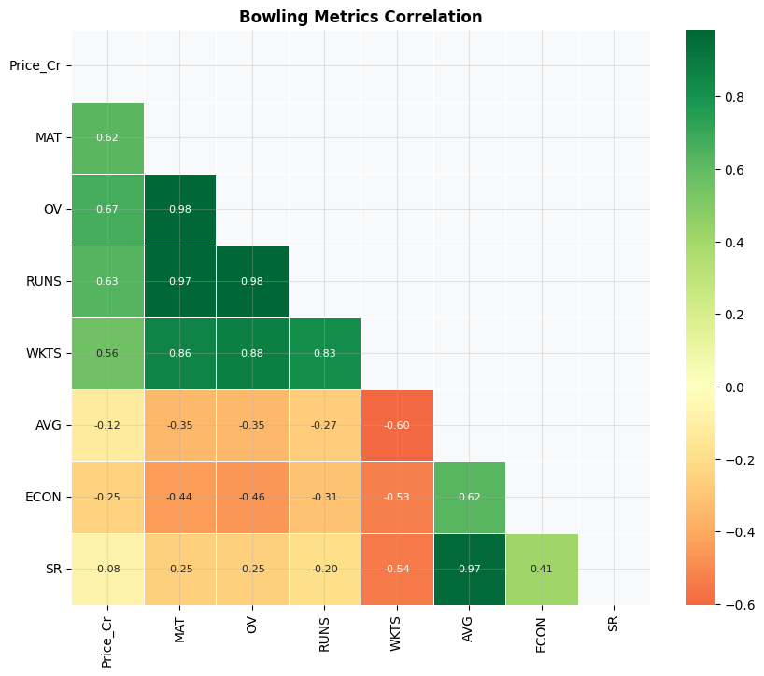
CHAPTER 6 · VENUES & PITCHES
Ground Capacity & Metric Correlations
📊 Interpretation
Stadium capacity vs avg score scatter shows no strong linear relationship — large grounds don't necessarily produce low scores. The batting correlation heatmap reveals Runs, BF and Fours are tightly correlated with each other, but Price_Cr shows weak correlation with performance metrics — confirming auction inefficiencies. The bowling heatmap shows WKTS and MAT correlate well, while Economy and Average are inversely linked — good bowlers take wickets cheaply.
18 / 31

Slide 19
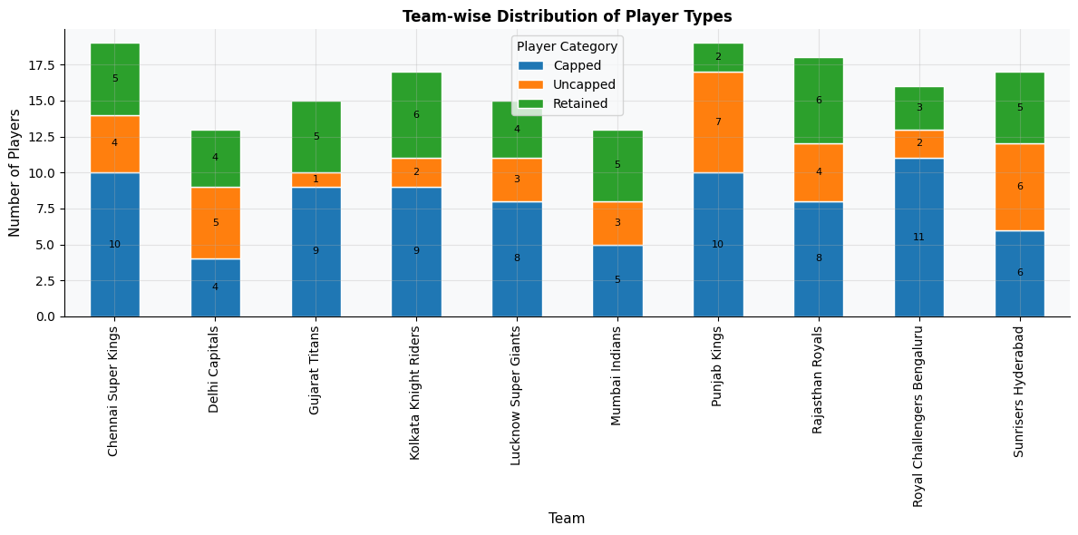
CHAPTER 7 · HOME ADVANTAGE
Home Ground Advantage & Win Composition
📊 Interpretation
The category breakdown shows Retained, Capped, and Uncapped player distributions — Retained players form the highest-paid cohort, while uncapped players represent the bulk of cheaper roster slots, confirming the tiered IPL auction structure.
19 / 31

Slide 20
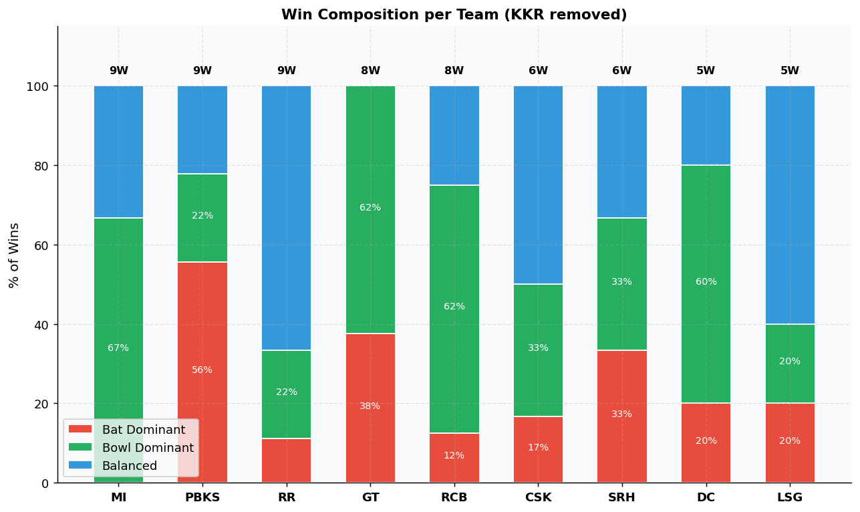
CHAPTER 7 · HOME ADVANTAGE
How Teams Win: Batting vs Bowling Dominance
📊 Interpretation
MI and RR win primarily through bowling-dominant performances (green), while GT splits more evenly. RCB is notably bowling-dominant despite being known as a batting team — a tactical shift. Teams with the highest 'Balanced' wins (blue) suggest superior all-round squads. Franchises whose wins are mostly batting-dominant are vulnerable to bowling-heavy opponents.
20 / 31

Slide 21
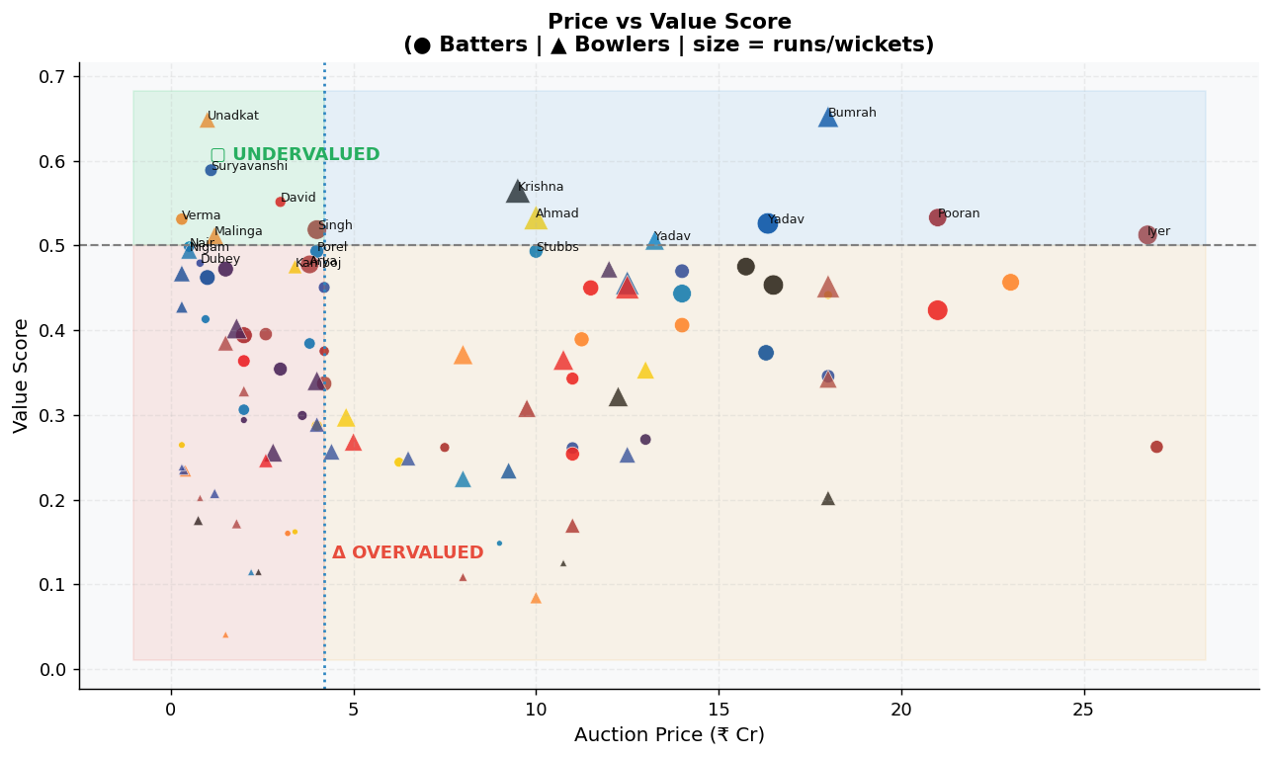
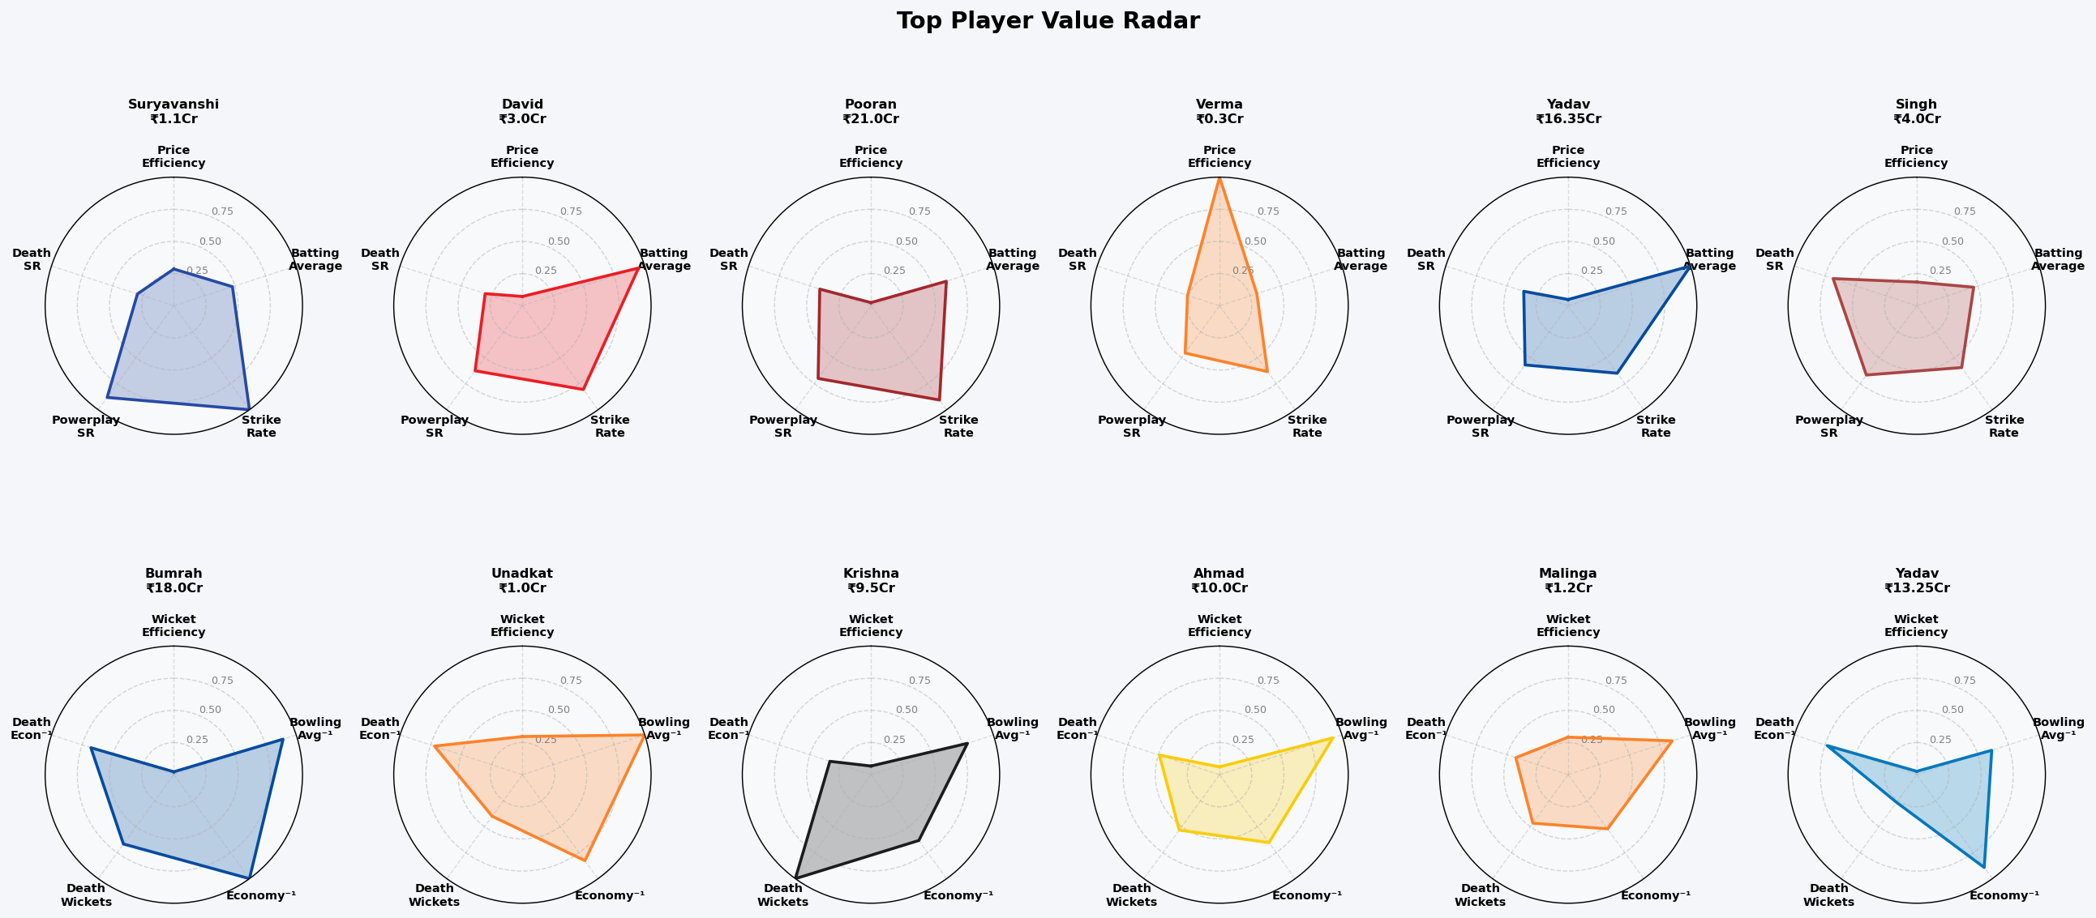
CHAPTER 8 · VALUE QUADRANTS
The Ultimate Value Map: Undervalued & Overvalued Players
📊 Interpretation
The main scatter plots all batters (circles) and bowlers (triangles) on Price vs Value Score axes. Top-left (green) = UNDERVALUED: high value, low price — the hidden gems. Unadkat (₹1Cr), Suryavanshi (₹1.1Cr) and Verma (₹0.3Cr) stand out as incredible buys. Bottom-right (red) = OVERVALUED: high price, low value — questioned investments. The radar charts (right) confirm top players' multi-dimensional strengths across Price Efficiency, Strike Rate, Average, Powerplay SR, and Death SR.
21 / 31

Slide 22
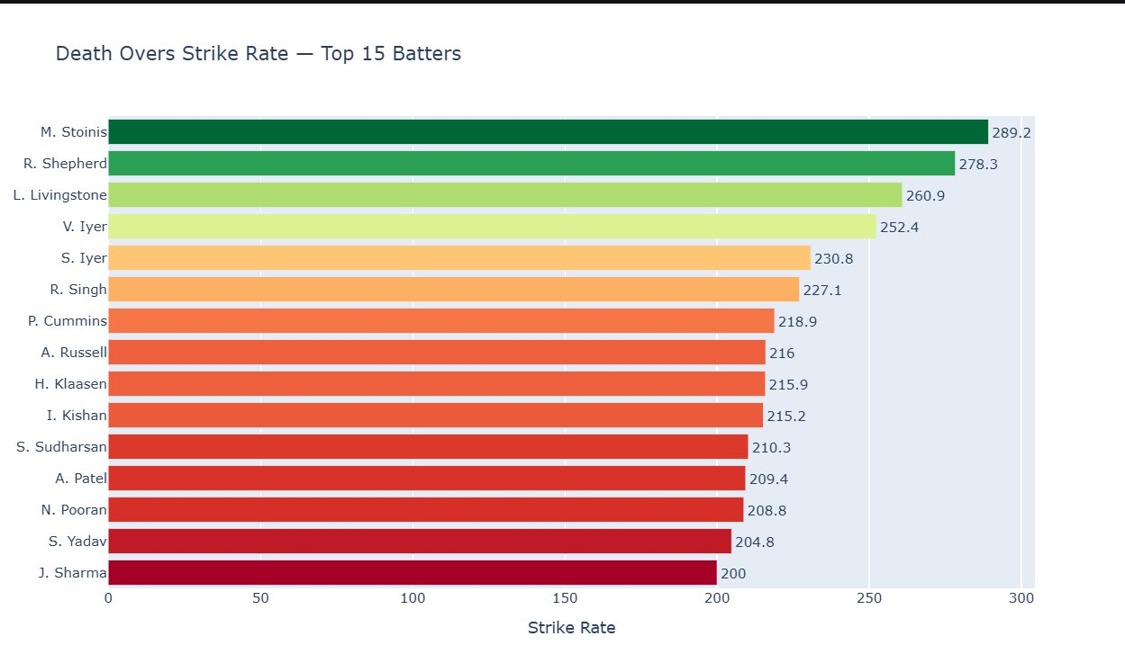
CHAPTER 3 · BATTING DEEP DIVE — PHASE SPECIALISTS
Who Destroys Bowlers in Death Overs?
Death Overs Strike Rate — Top 15 Batters (overs 16–20)
📊 Interpretation
Marcus Stoinis tops the chart at a staggering 289.2 strike rate in death overs — nearly 3 runs per ball — making him the most destructive finisher in IPL 2025. Romario Shepherd (278.3) and Liam Livingstone (260.9) follow closely, both capable of winning matches single-handedly in the final overs. All 15 batters exceed SR 200, confirming that death-over specialists are a distinct class of player. The colour gradient (green → red) shows how strike rate declines down the list. Even the 15th-ranked J. Sharma at 200 is elite by any standard. This list is crucial for franchise targeting — budget options like R. Shepherd offer explosive return on investment.
23 / 31

Slide 23
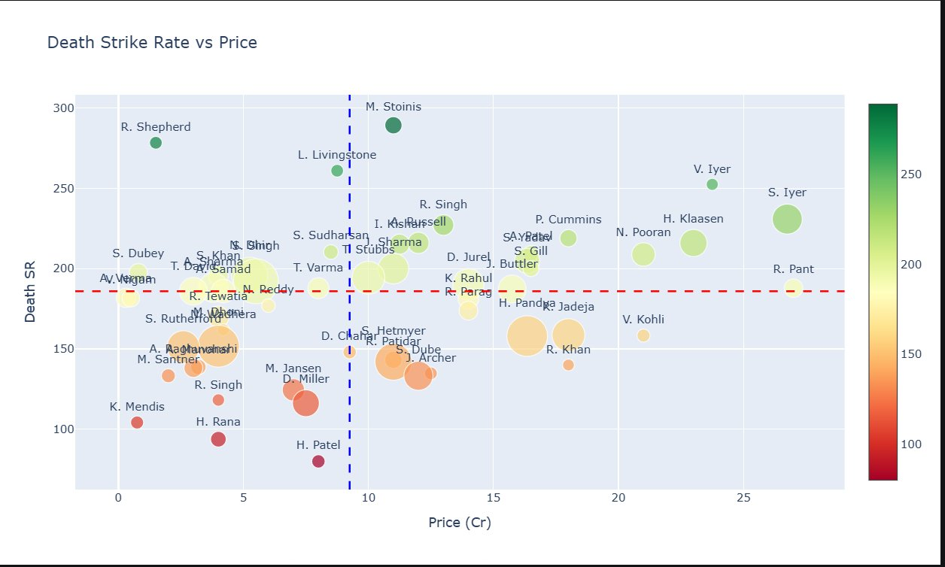
CHAPTER 3 · BATTING DEEP DIVE — PHASE SPECIALISTS
Death SR vs Price — Value in the Final Overs
Bubble size = balls faced in death; colour = death SR (green=high, red=low)
📊 Interpretation
The dashed lines split the chart into 4 quadrants: top-left = UNDERVALUED finishers (low price, high death SR). R. Shepherd and L. Livingstone sit top-left at modest prices — exceptional value for their finishing ability. M. Stoinis stands alone at the very top — the best death-over batter at a mid-range price. Bottom-right cluster: expensive players with average death SR — classic overvaluation. Some marquee names command ₹20Cr+ but score at SR below 180. Bubble size reveals volume of death-over exposure — large green bubbles in the top-right are the true premium finishers justifying their price.
24 / 31

Slide 24
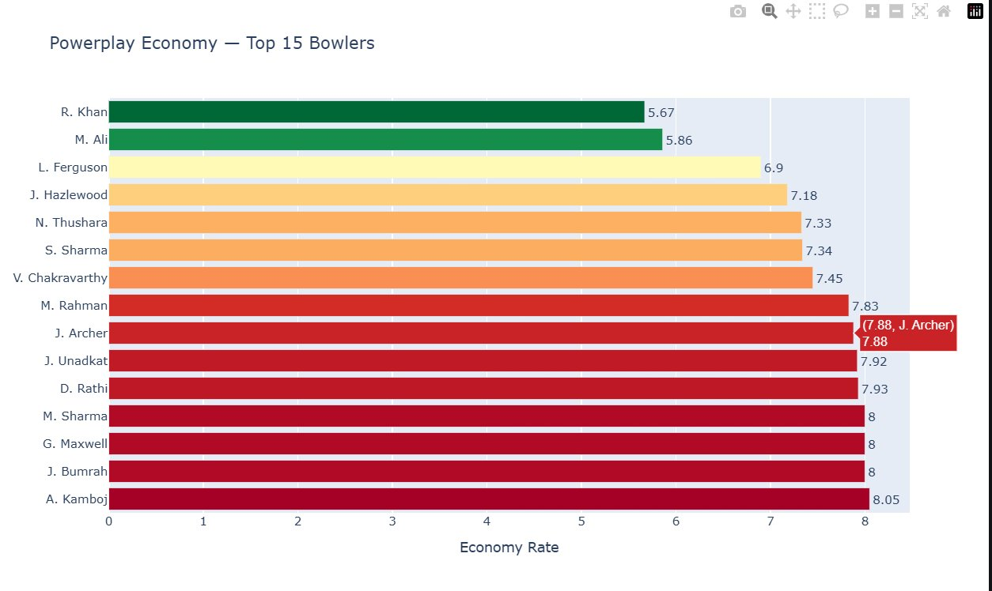
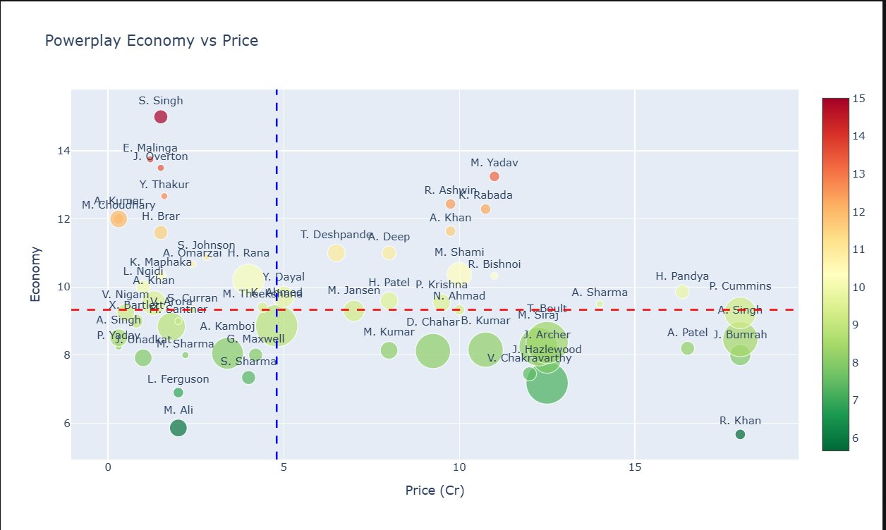
CHAPTER 4 · BOWLING DEEP DIVE — PHASE SPECIALISTS
Powerplay Economy: Best Bowling Restrictors
Top 15 bowlers by PP economy (left) · PP Economy vs Price scatter (right)
R. Khan (5.67) and M. Ali (5.86) are elite Powerplay bowlers — both under ₹5Cr, making them extraordinary value. Top-right PP scatter: R. Khan at ₹18Cr also justifies his cost as the only bowler combining premium price with sub-6 economy — a true star.
25 / 31

Slide 25
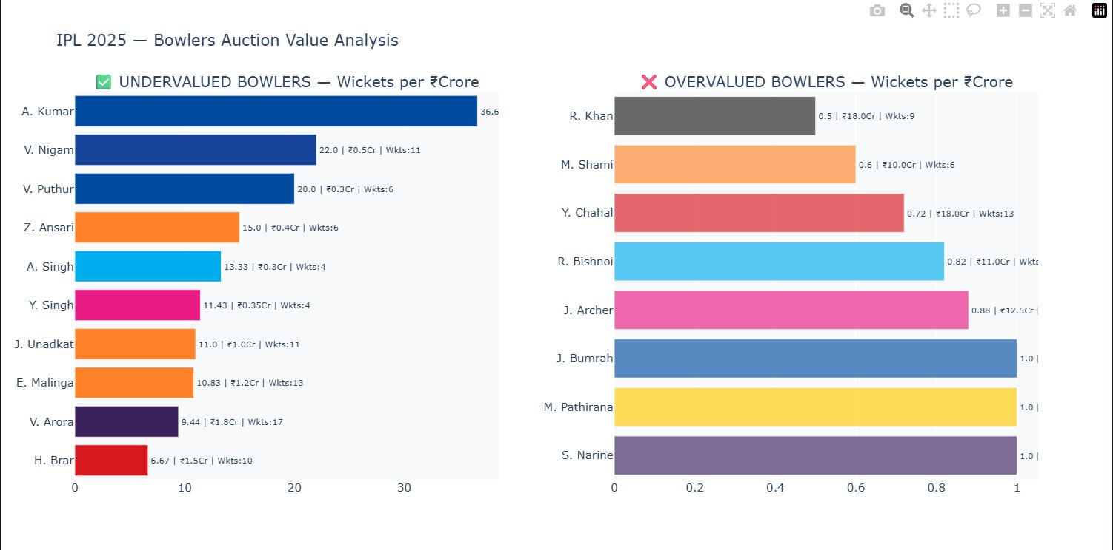
CHAPTER 4 · BOWLING DEEP DIVE — AUCTION VALUE
Bowling Auction Value: Wickets per Crore
Undervalued (left) vs Overvalued (right) — comparing wickets delivered per ₹Crore spent
A. Kumar leads at 36.6 wickets/Cr (₹0.3Cr, 11 wkts) — extraordinary market inefficiency. Contrast: R. Khan at 0.5 wkts/Cr despite ₹18Cr spend. J. Bumrah, M. Pathirana, S. Narine at 1.0 wkts/Cr — high price but consistent premium output at the top end.
26 / 31

Slide 26
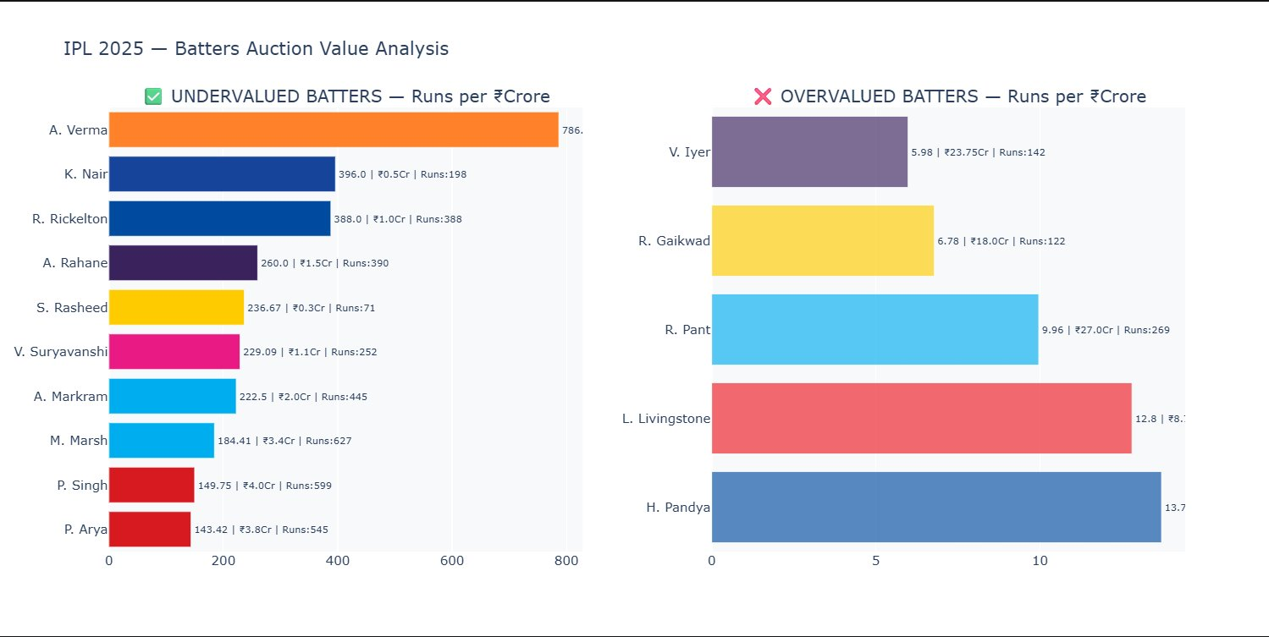
CHAPTER 3 · BATTING DEEP DIVE — AUCTION VALUE
Batting Auction Value: Runs per Crore
Undervalued (left) vs Overvalued (right) — comparing runs delivered per ₹Crore spent
A. Verma (786 runs/Cr at ₹0.3Cr) is the single greatest batting bargain — over 100x more efficient than V. Iyer (5.98 runs/Cr at ₹23.75Cr). K. Nair (396/Cr) and R. Rickelton (388/Cr) also deliver massive value. On the right, R. Pant at ₹27Cr gave only 9.96 runs/Cr — 80x less efficient than Verma.
27 / 31

Slide 27
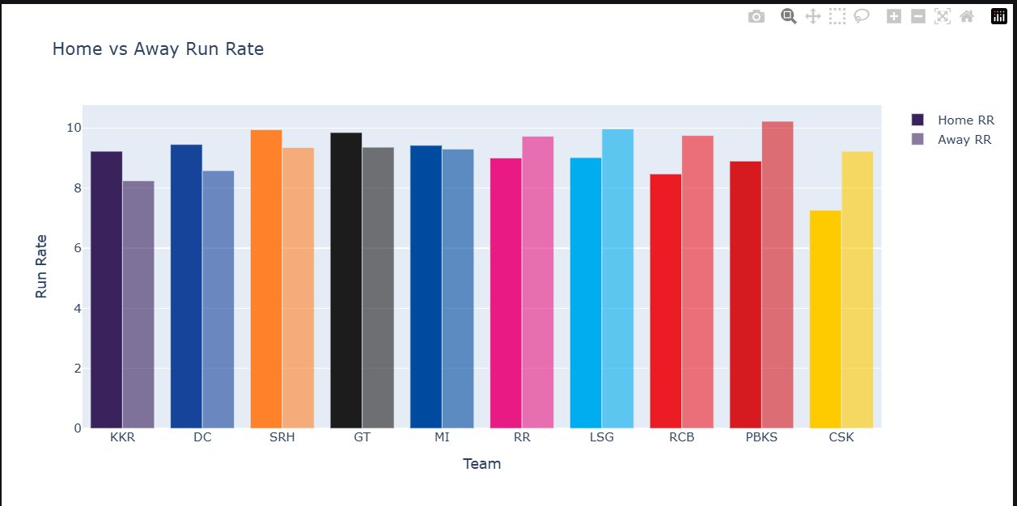
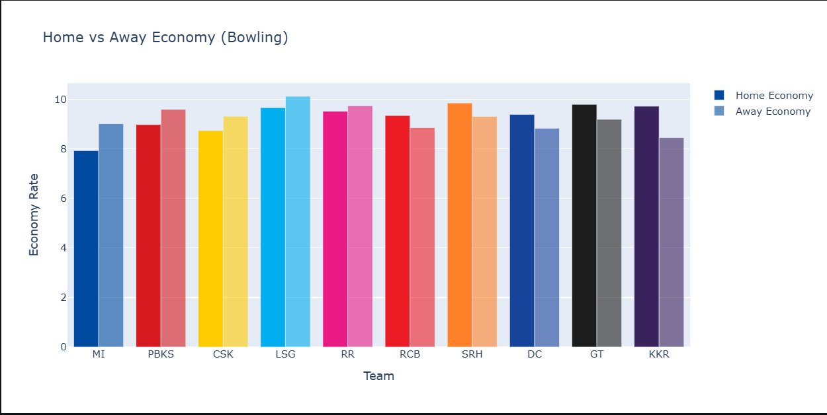
CHAPTER 7 · HOME ADVANTAGE — DETAILED
Home vs Away: Batting Run Rate & Bowling Economy
Which teams genuinely benefit from home conditions?
📊 Interpretation
Batting (left): Most teams score higher at home — KKR, DC, SRH, GT, MI all show clear Home > Away run rates. CSK is a notable exception, scoring better away. Bowling (right): MI has the starkest advantage — economy jumps from ~8 at home to ~9 away. GT and KKR maintain tighter away economies, suggesting squad depth. LSG actually bowl better away — their home conditions may not suit their bowling attack.
28 / 31

Slide 28
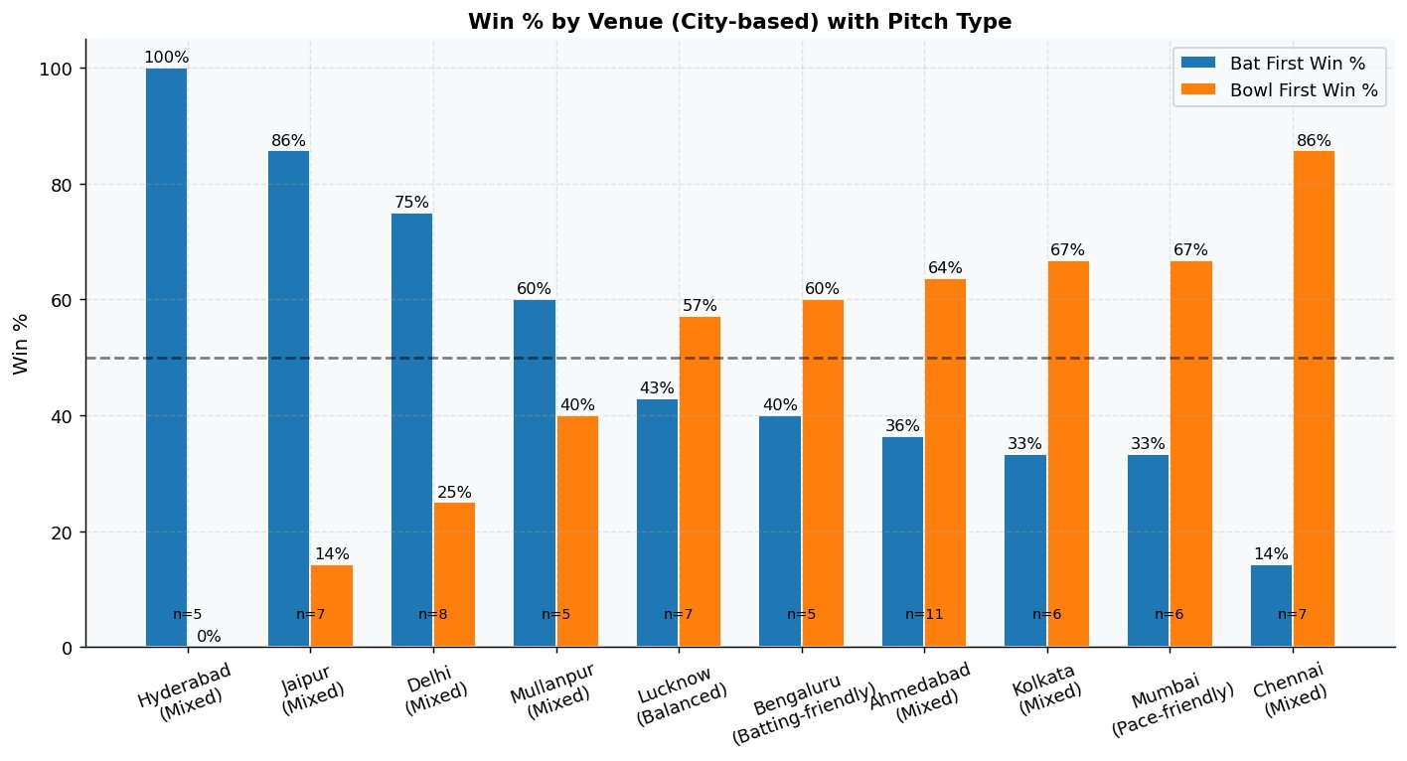
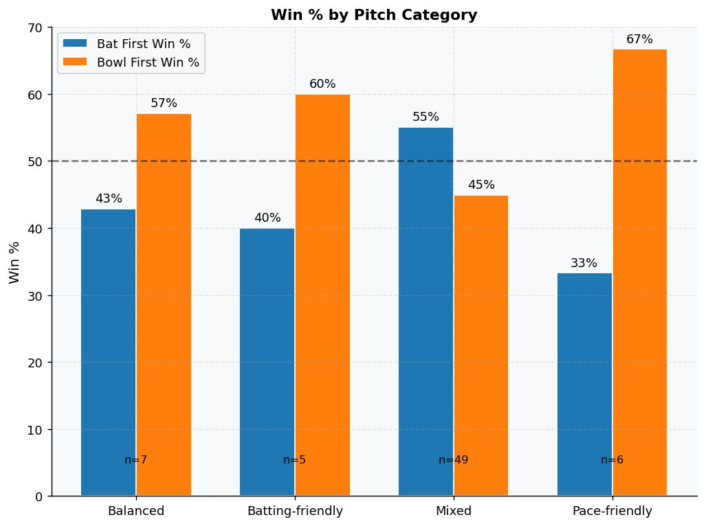
CHAPTER 6 · VENUES & PITCHES — TOSS STRATEGY
Bat First or Bowl First? Venue & Pitch Verdict
Win % by Venue-City (top) and Pitch Category (bottom) — blue=bat first, orange=bowl first
📊 Interpretation
Venue chart: Hyderabad (Mixed) is bat-first dominant — 100% bat-first win rate (n=5). Jaipur and Delhi also heavily favour batting first (86%, 75%). Chennai is the polar opposite — 86% bowl-first win rate, making it the most chase-friendly venue. Pitch category chart: On Pace-friendly pitches, bowling first wins 67% of the time — the clearest advantage. On Batting-friendly tracks, chasing wins 60% — set a big target and defend it. Mixed pitches (most common, n=49) slightly favour batting first at 55%. This data should directly drive toss decisions at each venue — a smart captain reads the surface and acts accordingly.
29 / 31

Slide 29
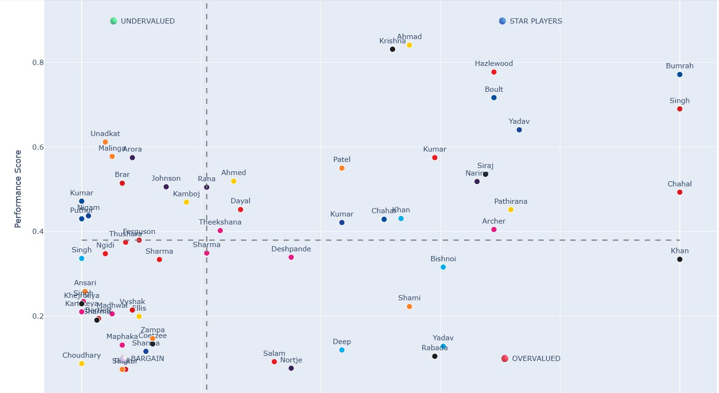
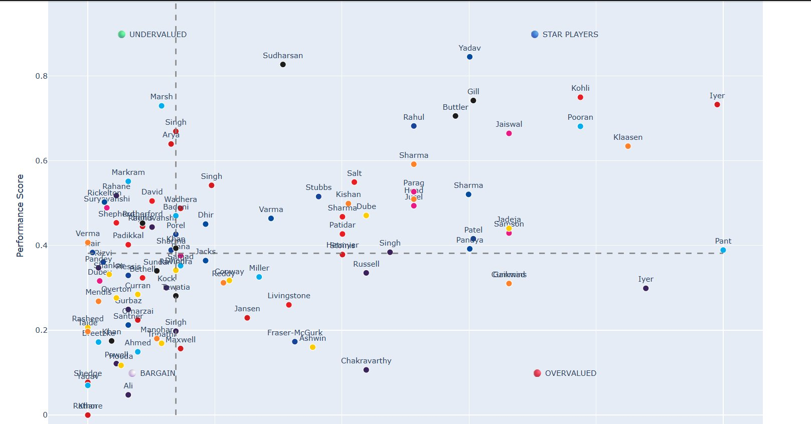
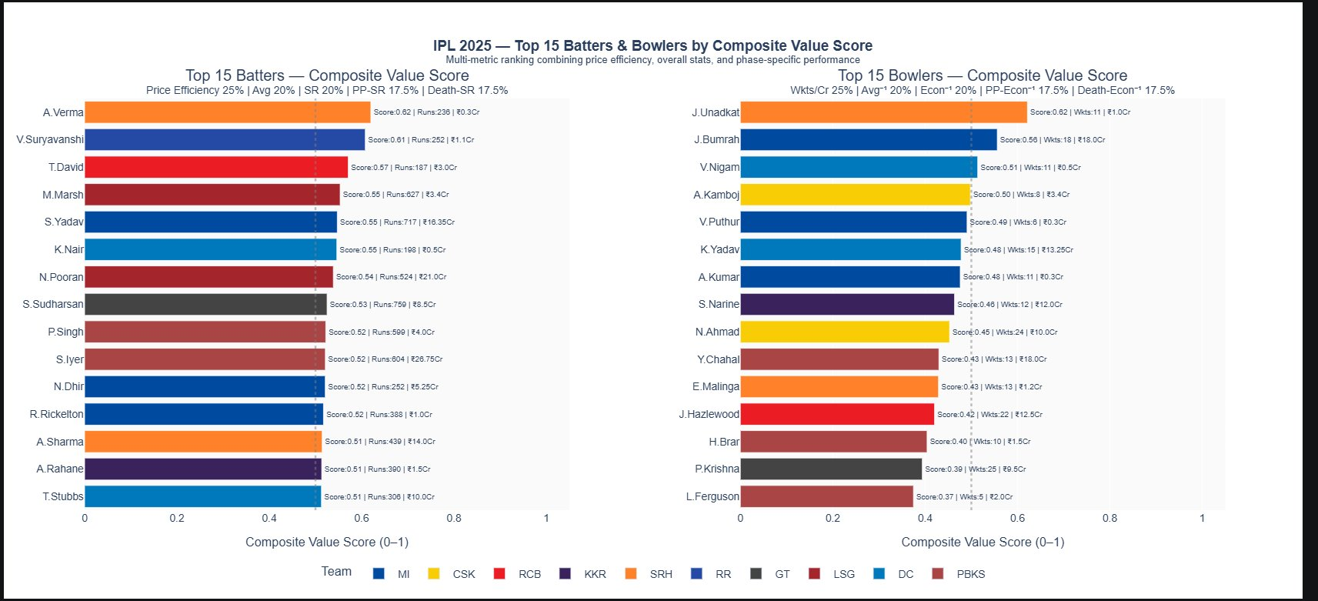
CHAPTER 8 · VALUE QUADRANTS — ADVANCED METRICS
Performance Quadrants & Composite Value Rankings
Bowler quadrant (top-left) · Batter quadrant (top-right) · Composite value rankings (bottom)
30 / 31

Slide 30
🏏 KEY FINDINGS
What IPL 2025 data tells us about auction strategy
1. Toss is overrated
2. Death overs are the real battleground
81% chose to field, yet neither bat-first nor chase delivered >35% win rate for toss winners. Squad depth matters more.
Run rates spike sharply in overs 16–20. Teams with dedicated death batters and bowlers consistently outperform.
3. Price ≠ Performance
4. Uncapped & budget players are undervalued
Correlations of auction price with runs (batters) and wickets (bowlers) are weak. High spend does not guarantee top output.
Suryavanshi (₹1.1Cr), Verma (₹0.3Cr), and Unadkat (₹1Cr) delivered the best value scores — proof of market inefficiency.
5. Bumrah remains elite & fairly priced
6. Home advantage is real but nuanced
Among premium players, Bumrah (₹18Cr) justified his price with the highest value score among all bowlers (0.65).
Most teams post higher run rates at home. Bowling economies also improve at home — familiar conditions are a genuine edge.
7. Winning teams win in multiple ways
Top teams (MI, GT, RCB) show balanced or bowling-dominant win compositions — no single tactical blueprint dominates.
31 / 31

