Slide 1

Department of Computer Science and Engineering
(Cyber Security)
PROJECT DOMAIN: Full-Stack Web Development (FastAPI + React)
PROJECT TITLE: MediCore - Hospital Management System
SUBMISSION: Web Programming Lab Project - 2026
NAME: Sakethram B S
REG NO: 241901094

Slide 2
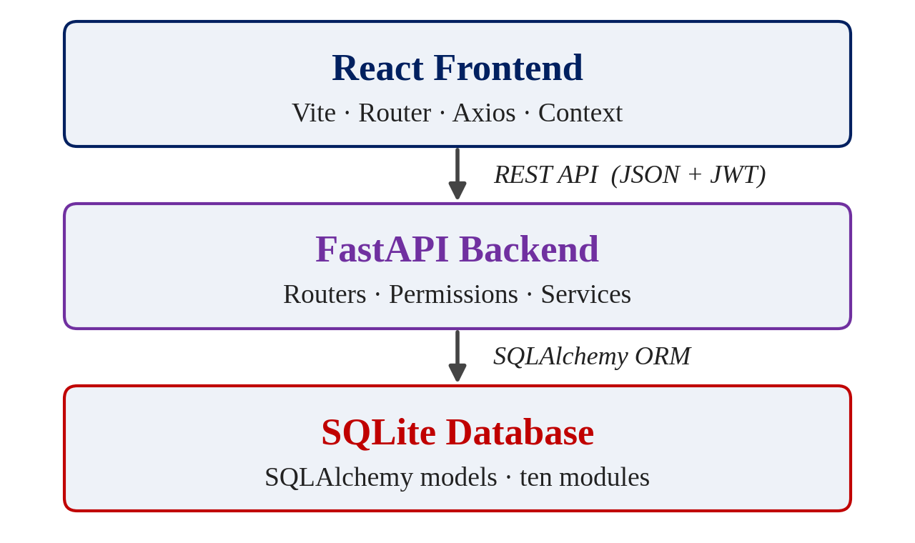
ABOUT THE PROJECT
Abstract: MediCore is a full-stack hospital management system that runs ten connected modules behind one dashboard, built on React, FastAPI and SQLite.
Problem: Hospital work is split across paper files, registers and separate tools, so patient, billing and bed information is slow to find and easy to get wrong.
Solution: One web application where each role signs in and sees only its own modules, from patients and appointments to billing, beds and pharmacy.
Data Integrity: Invoice totals are calculated on the backend with exact decimal money, double-booking is rejected and stock can never go negative.
Security: Argon2 password hashing, JWT login with expiry, and seven roles whose permissions are enforced by the backend, not just hidden in the menu.
Privacy: Only fictional demo data is used; audit logs record key actions without storing passwords, tokens or full clinical records.
Key Takeaway: MediCore is a self-contained, zero-cost college prototype (SQLite, no paid services) and not a production hospital system.
System architecture
10
modules
7
user roles
1
dashboard

Slide 3
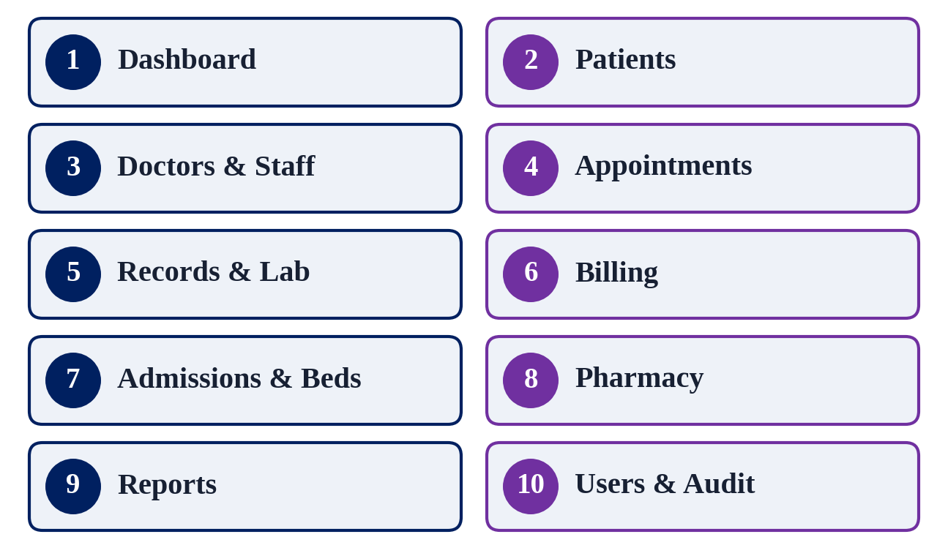
PROBLEM STATEMENT / OBJECTIVE
Problem: Hospital records, appointments, bills, beds and medicines are managed on paper or in disconnected tools, so errors and delays are common.
Defect:
Paper records make a patient's history slow to find and easy to lose.
Manual appointment books allow two bookings for one doctor at the same time.
Hand-written bills and stock registers cause calculation and stock errors.
Beds, lab orders and medicines are tracked in separate places.
Objective:
Unify ten hospital modules behind one dashboard driven by live SQL queries.
Enforce role-based access on the backend for all seven roles.
Keep money, beds and stock consistent using database transactions.
Keep an audit history and state the prototype's limits honestly.
The ten connected modules
Unique IDs: PAT-, APT-, INV-, ADM-
followed by year and number, e.g. PAT-YYYY-0001

Slide 4
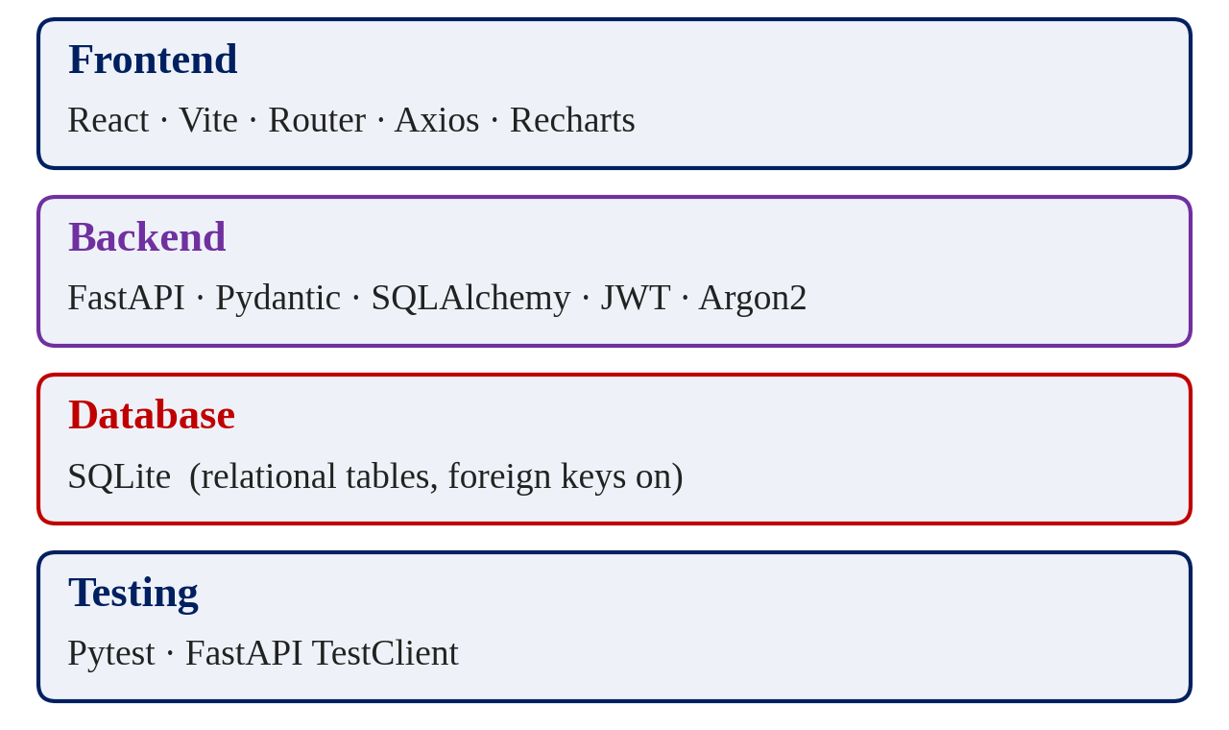
TOOLS, TECHNOLOGIES AND IMPLEMENTATION
Frontend: React with Vite, React Router, Axios, Context API and Recharts, styled with custom CSS variables and responsive layouts.
Backend: FastAPI with Pydantic validation, a service layer for business rules, SQLAlchemy ORM and JWT login with Argon2 hashing.
Database: SQLite relational tables for all ten modules, with foreign keys enforced, UTC timestamps and Decimal-safe money.
Testing: Pytest with FastAPI TestClient checks login, permissions, booking, billing, beds and stock.
Implementation Workflow:
Step 1: The user signs in; the API returns a JWT and React shows only allowed pages.
Step 2: Each Axios call carries the token; FastAPI checks the role before the route runs.
Step 3: Pydantic validates the input and a service function applies the business rules.
Step 4: SQLAlchemy saves the change in one transaction and writes an audit log entry.
Step 5: The dashboard reads fresh SQL totals, so counts update after each action.
Technology stack
Pytest
automated tests
Swagger
API docs at /docs
SQLite
zero-cost storage

Slide 5
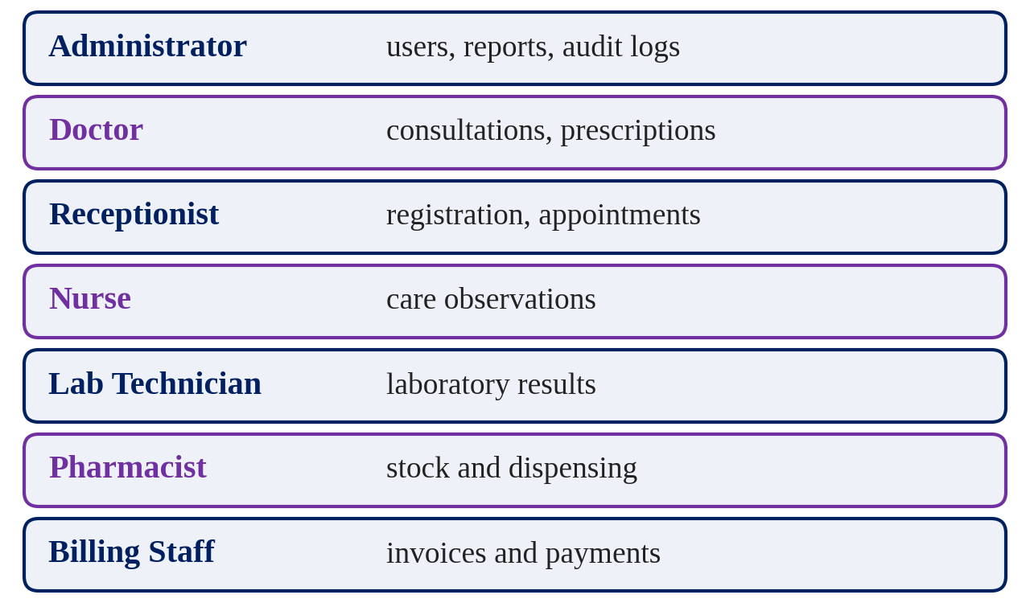
PROJECT OUTCOME
Dashboard: Summary cards, charts and alerts are calculated by backend queries on the database and never hard-coded.
Clinical Flow: Appointments, consultation notes, prescriptions and laboratory orders and results stay linked to the same patient.
Money and Beds: Backend-calculated invoices with partial payments and receipts; admission, transfer and discharge keep beds consistent.
Pharmacy and Reports: Batch stock with expiry and low-stock alerts, dispensing against prescriptions and date-filtered reports.
Access and Audit: Seven roles, in-app notifications and audit logs for logins, payments, lab results and role changes.
Scope and Limitations:
A prototype with fictional data only; not a production hospital system.
Notifications are in-app only; no email, SMS or payment gateway.
SQLite limits heavy concurrent writes, so it suits a single-server demo.
Seven roles with backend permissions
Argon2
password hashing
JWT
login with expiry
401 / 403
backend checks

Slide 6
THANK YOU
MediCore - Hospital Management System
Web Programming Laboratory Project - 2026
PROJECT DEMO
Backend API: http://127.0.0.1:8000 | Swagger docs: http://127.0.0.1:8000/docs
Frontend: Vite address shown in the terminal, usually http://localhost:5173
Demo accounts for all seven roles are seeded with fictional data
Tech Stack: React | Vite | FastAPI | SQLAlchemy | SQLite | JWT
Submitted by: Sakethram B S (241901094), B.E. CSE (Cyber Security)

