Slide 1

Real Time Driver Drowsiness Detection based on Light-Weight CNN Architecture and Attention Mechanism
———————————————
Project Review
Gottiprolu Saketh – 20KB1A3012
Daddolu Praveen – 20KB1A3010
Pavan Kumar – 20KB1A3029
Atmakuru Nithin – 20KB1A3005
Under the guidance of
Mrs. Swarna Latha
Department of IT AND AI&DS,
N.B.K.R Institute of Science and Technology, Vidyanagar
January 25, 2024
Project Review

Slide 2
INTRODUCTION ———————————————————————————
Driving is a set of behaviors that need high concentration. Sometimes these behaviors are dominated by other acts such as smoking, eating, drinking, talking, phone calls, adjusting the radio, or drowsiness.
These are also the main causes of current traffic accidents. Therefore, developing applications to warn drivers in advance is essential.
This project introduces a light-weight convolutional neural network architecture to recognize driver behaviors, helping the warning system to provide accurate information and to minimize traffic collisions.
This network is a combination of feature extraction and classifier modules.
N.B.K.R.I.S.T
Project Review
January 25, 2024

Slide 3
PROBLEM STATEMENT
———————————————————————————
Drowsiness Detection
Given:
X : Represents the feature space derived from sensory inputs (e.g., video or sensor data).
Y : The set of classes where Y = {Active, Drowsy, Yawning}.
The goal is to learn a function f : X → Y that maps the feature space X to the set of classes
Y , where:
X = {x₁, x₂, . . . , x_{n}} denotes the input features derived from sensory data.
Y = {y₁, y₂, . . . , y_{n}} represents the corresponding labels denoting the driver’s state (Active or Drowsy or Yawning).
The objective is to train a deep learning model on a labeled dataset D = {(x_{i}, y_{i} )} where
i = 1, 2, . . . , n to approximate the underlying mapping from input features X to output classes
Y by minimizing a defined loss function L.
Project Review
January 25, 2024

Slide 4
LITERATURE SURVEY
———————————————————————————
Year | Name | Key points | Limitations
2022 | Vision Transformers and YoloV5 based Driver Drowsiness Detection Framework. [arXiv ][1] | A custom YoloV5 pre-trained model and self-trained ViT architecture are proposed for automated face extraction, and binary image classification The proposed system works on a single frame in detecting drowsiness. Hence, frames are extracted from the video dataset and serve as the framework’s input Accuracy: 96.2% on training set and 95.5% on test data | Requires high amount of data with labelled scene conditions for model to be trained Very large number of parameters are generated for ViT approx. 450 Million parameters for given configuration not suitable for edge devices
Project Review

Slide 5
LITERATURE SURVEY
———————————————————————————
Year | Name | Key points | Limitations
2023 | Real-Time Deep Learning-Based Drowsiness Detection: Leveraging Computer-Vision and Eye-Blink Analyses for Enhanced Road Safety. [Sensors][3] | Haar-Cascade is used to detect faces. Mediapipe model is used for locating landmarks. Drowsiness was solely determined by calculating landmark coordinates. Classification depends on facial landmarks and head position. 85% accuracy achieved when eyes and mouth closed. 96% when head leaning. | May not be relevant for drivers who wear sunglasses. Other objects may be present that interrupt the facial landmarks, the model may become confused when tracking and analyzing the state of the driver.
Project Review

Slide 6
Parameters in our project
———————————————————————————
MediaPipe: MediaPipe offers a pre-trained facial landmark model that can detect and track key points on a person's face, such as eyes, nose, mouth.
CBAM: CBAM stands for "Convolutional Block Attention Module," and it's an attention mechanism designed to enhance the representational power of Convolutional Neural Networks (CNNs).
Adaptive Connections (AC): In general, adaptability in neural networks or machine learning models can refer to the ability to adjust and learn from new data.
Classifier Module: The classifier module takes the transformed features from the feature extraction module and assigns them to predefined categories or classes.
Project Review
January 25, 2024

Slide 7
Methodology Architecture
———————————————————————————
The proposed network architecture consists of the feature extractor and classifier modules.
The feature extractor module is designed based on the stem module, adaptive connections (AC), and a CBAM to extract the feature maps.
At the final feature map, the classifier module applies a GAP and a softmax function to calculate the probability of three driver states and then classifies them.
Project Review

Slide 8
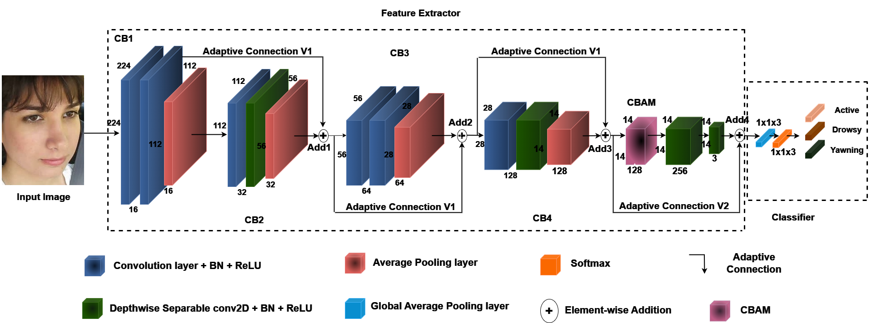
Model Architecture
———————————————————————————
Figure: Light weight CNN with Attention module.
Project Review

Slide 9
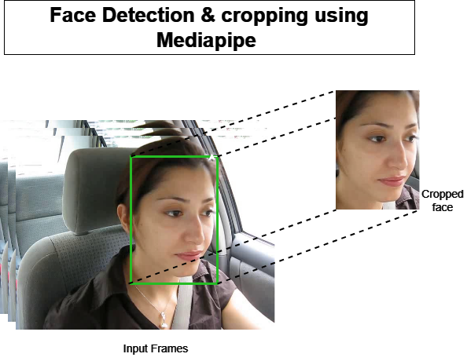
Pre-Processing: Face detection and cropping
———————————————————————————
Using MediaPipe’s capabilities, face detection within images and subsequently crop the detected face regions to focus on the facial features.
Figure: Face cropping using Mediapipe.
Project Review

Slide 10
Conclusion ———————————————————————————
The implementation of a real-time driver drowsiness detection system utilizing a Light-Weight Convolutional Neural Network (CNN) architecture and incorporating an Attention Mechanism holds significant promise for enhancing road safety.
The combination of a lightweight CNN ensures computational efficiency, making it suitable for real-time applications, while the attention mechanism allows the model to focus on relevant features crucial for identifying signs of driver drowsiness.
This innovative solution has the potential to contribute to the reduction of road accidents caused by driver fatigue, ultimately saving lives and preventing injuries..
Project Review
January 25, 2024

