Slide 1


Indian Premier League (IPL) - Analysis
Enugu Saketh Reddy

Slide 2

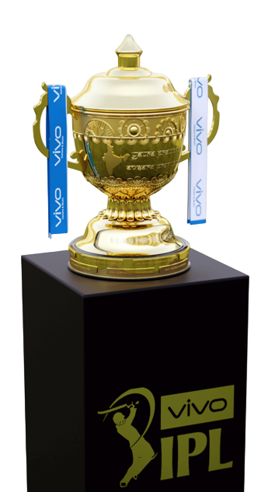
Introduction
The Indian Premier League (IPL) is a professional Twenty20 cricket league in India, founded by the BCCI in 2008. It is one of the world’s most popular and lucrative cricket tournaments, known for its fast-paced games and global fan base. Among its teams, Royal Challengers Bangalore (RCB) stands out for its passionate fans and star players like Virat Kohli and AB de Villiers, earning a strong following despite not yet winning a title.

Slide 3
Problem Statement
RCB is looking to identify top-performing and reliable players who can help the team win upcoming tournaments. The selection process will focus on both on-field performance and the value each player offers for the investment made. Therefore, effective strategies need to be developed to select the best-performing players and optimize player auction investments for the 2017 mega auction.

Slide 4
Objective
The objective of this project is to formulate strategies and recommendations for RCB to select top-performing players and optimize auction investments in the 2017 mega auction. The analysis is based on assessing players’ on-field performance and value for money using data from previous IPL seasons. This approach will help RCB build a balanced and competitive squad capable of achieving consistent success in future tournaments.

Slide 5
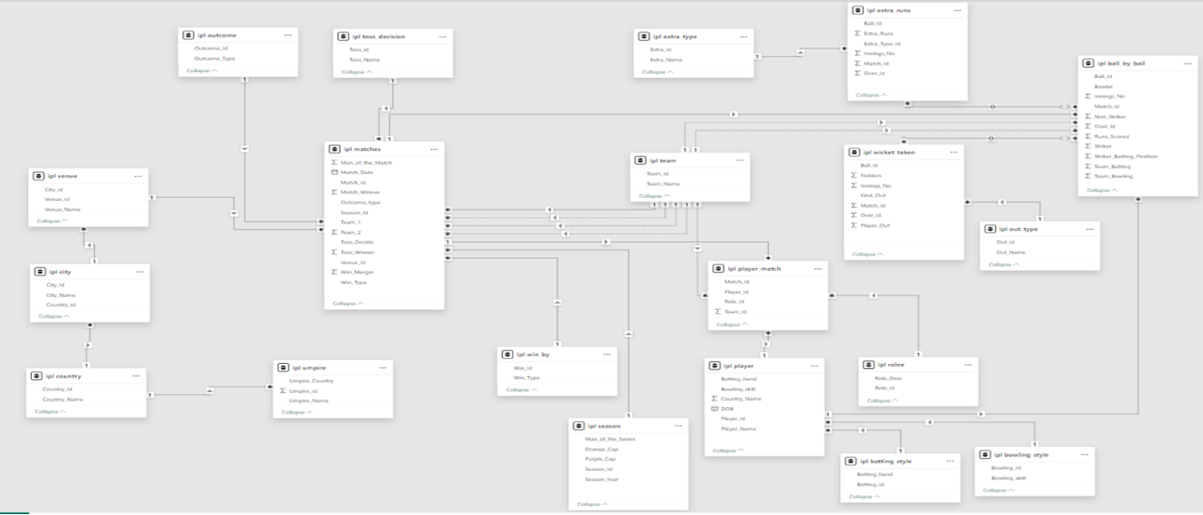
Database Schema

Slide 6
IPL Dataset Overview
Ball_by_Ball Match_Id: Unique ID for each match Over_Id: Unique ID for each over Ball_Id: Unique ID for each ball Innings_No: Innings number in the match Team_Batting: Team currently batting Team_Bowling: Team currently bowling Striker_Batting_Position: Batting position of the striker Striker: Batsman on strike Non_Striker: Batsman at the non-striker’s end Bowler: Bowler delivering the ball Runs_Scored: Runs scored on that ball
Batting_Style Batting_Id: Unique ID for each batting record Batting_hand: Batting hand of the player (right or left)
Bowling_Style Bowling_Id: Unique ID for each bowling record Bowling_skill: Type of bowling (e.g., right-arm)
City City_Id: Unique ID for each city City_Name: Name of the city Country_Id: Unique ID for the country where the city is located

Slide 7
IPL Dataset Overview
Out_Type Out_Id: Unique ID for each type of dismissal Out_Name: Type of dismissal (e.g., caught, bowled, lbw, run out)
Umpire Umpire_Id: Unique ID for each umpire Umpire_Name: Name of the umpire Umpire_Country: Country or nationality of the umpire
Venue Venue_Id: Unique ID for each venue or stadium
Venue_Name: Name of the venue or stadium City_Id: Unique ID of the city where the venue is located
Rolee Role_Id: Unique ID for each player’s role Role_Desc: Description of the player’s role (e.g., batsman, bowler, all-rounder)
Toss_Decision Toss_Id: Unique ID for each toss event Toss_Name: Description or outcome of the toss (e.g., heads, tails)

Slide 8
IPL Dataset Overview
Extra_Type Extra_Id: Unique ID for each type of extra run Extra_Name: Type or name of the extra (e.g., byes, wides, no-balls)
Season Season_Id: Unique ID for each season Man_of_the_Series: Player awarded Man of the Series Orange_Cap: Player with the most runs in the season Purple_Cap: Player with the most wickets in the season
Season_Year: Year in which the season took place
Wicket_Taken Match_Id: Unique ID of the match Over_Id: Unique ID of the over Ball_Id: Unique ID of the ball Player_Out: ID of the player who got out Kind_Out: Type of dismissal (e.g., caught, bowled, run out) Fielders: Player(s) involved in the dismissal Innings_No: Innings number in which the wicket fell

Slide 9
IPL Dataset Overview
Team Team_Id: Unique ID for each team Team_Name: Name of the team
Extra_Runs Match_Id: Unique ID of the match Over_Id: Unique ID of the over Ball_Id: Unique ID of the ball Extra_Type_Id: Type of extra (e.g., wide, no-ball) Extra_Runs: Number of extra runs scored Innings_No: Innings number
Win_By Win_Id: Unique ID for each win record
Win_Type: Type of win (e.g., runs, wickets)
Player Player_Id: Unique ID for each player Player_Name: Name of the player DOB: Date of birth of the player Batting_hand: Batting style (right or left hand) Bowling_skill: Bowling type or style Country_Name: Country the player represents
Country Country_Id: Unique ID for each country Country_Name: Name of the country

Slide 10
IPL Dataset Overview
Matches Match_Id: Unique ID for each match Team_1: Name or ID of the first team Team_2: Name or ID of the second team Match_Date: Date when the match was played Season_Id: Unique ID of the season Venue_Id: Unique ID of the venue or stadium Toss_Winner: Team that won the toss Toss_Decide: Decision (e.g., bat or bowl) Win_Type: Type of win (e.g., runs, wickets) Win_Margin: Margin by which the team won Outcome_type: Result (e.g., win, loss etc.,)
Match_Winner: Team that won the match Man_of_the_Match: Player of the Match
Player_Match Match_Id: Unique ID of the match Player_Id: Unique ID of the player Role_Id: Unique ID representing the player’s role Team_Id: Unique ID of the team
Outcome Outcome_Id: Unique ID for each match outcome Outcome_Type: Type of result (e.g., win_

Slide 11
Analysis & Insights
Overall Team Performance Overview :
Total runs scored by rcb in season 1 including extra runs are 2601 and rcb finished 7 in that season.
RCB took only 66 wickets in 1st season which is their lowest among all seasons.
RCB won only 4 matches in season 1 .
There were 79 players in season 2 who were above the age of 25 at that time.
Consistency (Key Performers Across Seasons) :
Consistent batsmen: V. Kohli, D.A. Warner, A.B. de Villiers.
Consistent bowlers: D.J. Bravo, B. Kumar, M. Sharma.
These players show stable averages & high impact across seasons.

Slide 12
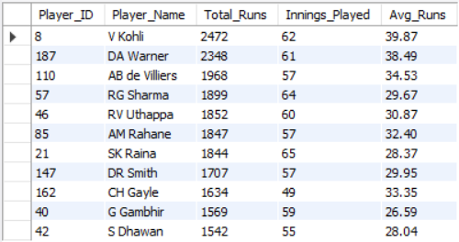
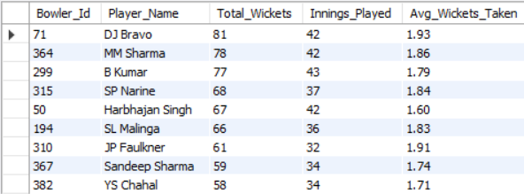
Analysis & Insights
Consistent Batsmen :
Consistent Bowlers :

Slide 13
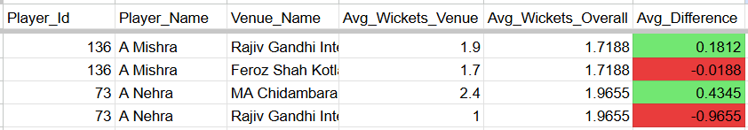
Analysis & Insights
Venue Suitability :
Identify players who perform better at specific venues.
Example: A.R. Patel best at Punjab Stadium (+0.46 wickets), A. Nehra worst at RGI Stadium (−0.96).
Player performance varies by ground – use this to plan venue-specific selection.

Slide 14
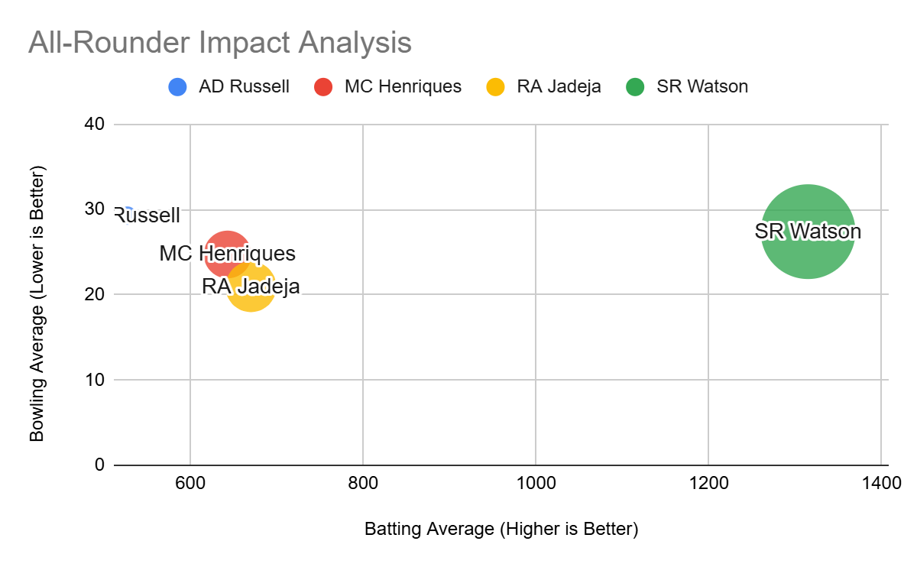
Analysis & Insights
All-Rounder Impact :
Identify players with >500 runs & >20 wickets.
Top dual contributors: Watson, Jadeja, Russell.
All-rounders enhance team flexibility & auction value.
Investing in versatile players maximizes RCB’s
return on investment (ROI).

Slide 15
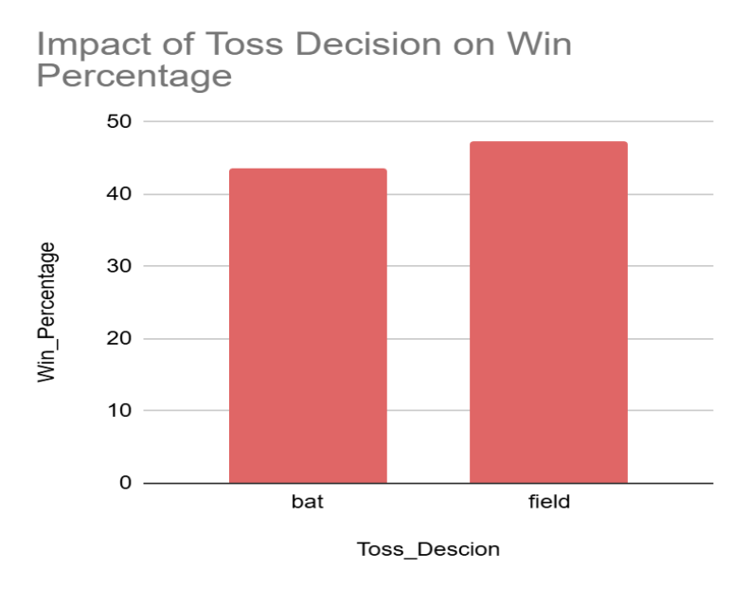
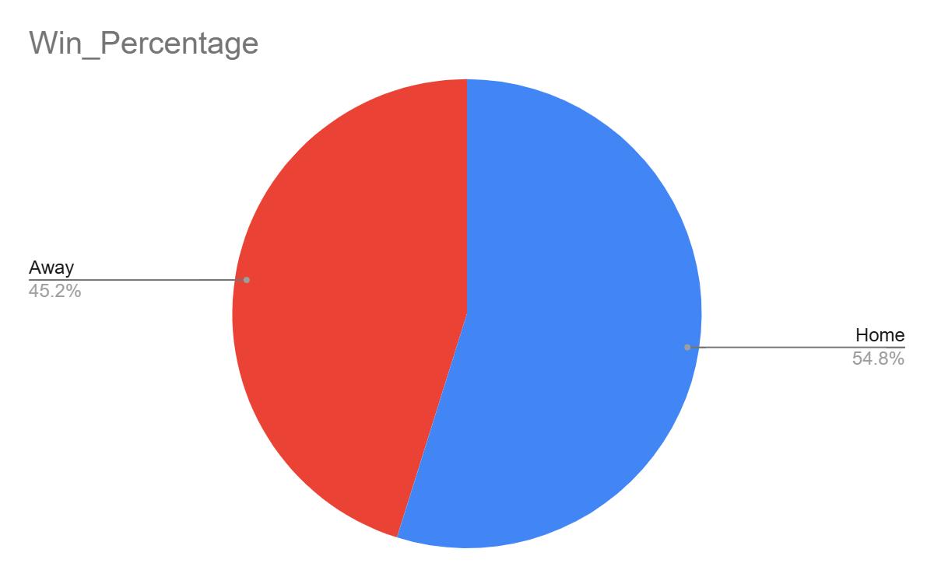
Analysis & Insights
Toss & Match Impact & Home Advantage:
Toss winners choosing to field first have higher Win %.
RCB performs better at home (M. Chinnaswamy) – high morale, short boundaries, crowd support.
Match strategy should adapt to venue + toss outcome.

Slide 16
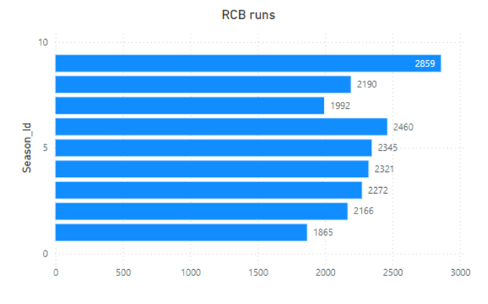
Analysis & Insights
Total Runs Scored by RCB :
RCB showed an overall increasing trend in total runs, peaking at 2859 runs in Season 9 (2016) — the same season they reached the finals.
Significant decline in Season 7 (a drop of ~500 runs) highlights inconsistency in batting performance across seasons.
Seasons where RCB scored below 2000 runs (Seasons 1 & 7) correspond to bottom-four finishes, proving that batting inconsistency directly impacted overall results.

Slide 17
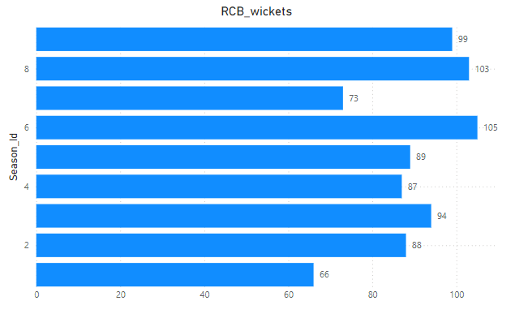
Analysis & Insights
Total Wickets Taken by RCB:
RCB’s highest wicket tally was 105 wickets in Season 6, but this performance could not be maintained consistently in later seasons.
Fluctuating bowling performance — with fewer than 80 wickets in weaker seasons — exposed their lack of reliable strike bowlers.
Inconsistent bowling across seasons prevented RCB from sustaining match-winning momentum, making it a key reason behind trophy failures.

Slide 18
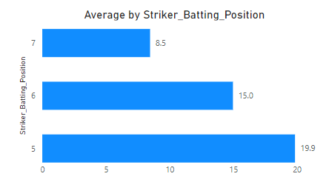
Analysis & Insights
Batting Positions 5, 6, and 7 (Middle Order) :
RCB’s lower middle order lacks stability and finishing strength, leading to frequent collapses when the top order fails.
Over-dependence on top-order players like Kohli, ABD, and Gayle leaves the middle order exposed in high-pressure chases.
The absence of impactful all-rounders or finishers means there’s no one to anchor innings or accelerate scoring in the death overs, a major gap in RCB’s squad balance.

Slide 19
RCB Auction Strategy – Key Recommendations
Target reliable lower middle-order batters (positions 5, 6, 7) who can stabilize the innings and finish strong in death overs.
Focus on bowlers who can swing and seam the ball in the powerplay to provide early breakthroughs.
Include quality spinners who can control the run rate and take wickets regularly in the middle overs.
Pick bowlers with strong death-over variations like yorkers, cutters, and slower balls to finish games effectively.
Build a fit and agile squad to improve fielding standards while combining young talent with experienced players for team balance.

Slide 20
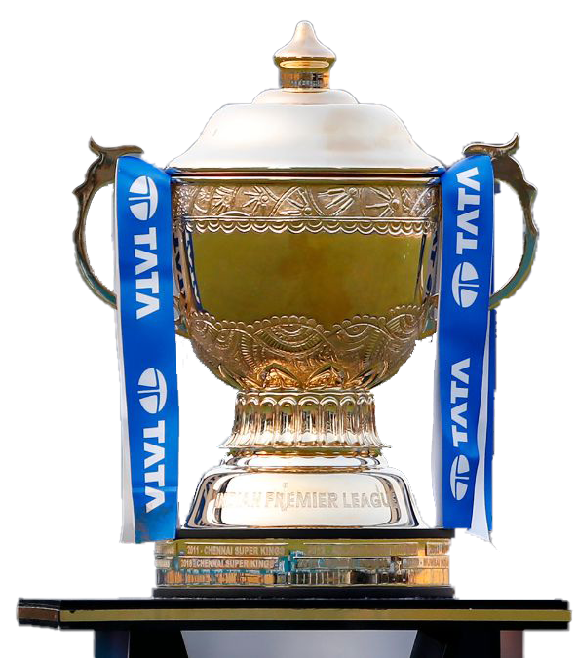
Conclusion
RCB has been inconsistent with their overall performance, often struggling to deliver as a cohesive unit. At times, the team performs well with the bat or the ball, but rarely both in the same match. To address this, RCB should focus on recruiting more young talents, economical death bowlers, and powerful hitters, while also strengthening their lower middle order. By implementing these strategies, the team can enhance its balance and significantly improve its overall performance in future tournaments.

Slide 21
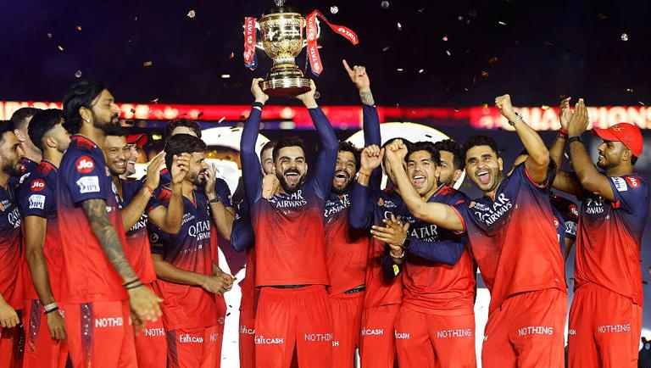
Thank You!
- Slide Egg

Slide 22
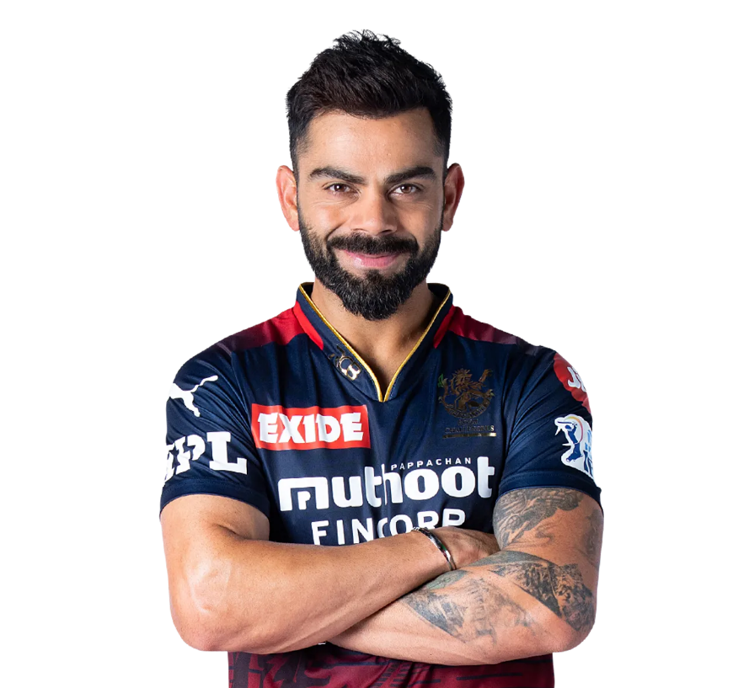
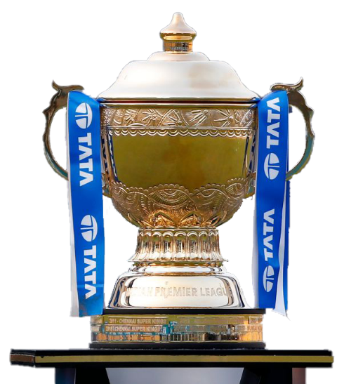

IPL Winner 2025
Royal Challengers Bangalore

