Slide 1


Web Crawler
Under the Guidance of
Ms. Jimsha
Assistant Professor
Department of AI & ML
NHCE
Presented By
C. Rohith kumar 1NH20AI124 R. Roopam Chowdary 1NH20AI085
P. Saketh Sree Ram 1NH20AI075

Slide 2
Introduction
hat uses
Web search engines and some other websites use Web crawling or spidering software to update their web content or indices of other sites' web content. Web crawlers copy pages for processing by a search engine, which indexes the downloaded pages so that users can search more efficiently.
These search engines uses web crawling and scraping to gather data and store them in a order which helps a search engine to retrieve relevant web pages.
A Web crawler, sometimes called as spider bot and often shortened to crawler, is an Internet bot that systematically browses the World Wide Web and that is typically operated by search engines for the purpose of Web indexing.
It involves creating a bot that can automatically collect data from various webpages.
It is a technique used parsing the HTML or XML response to extract the desired information.
Web scraping involves creating a bot that can automatically collect data from various webpages without permission. While web crawlers follow links continuously based on hyperlinks, web scraping is usually a much more targeted process -- and may only be after specific pages.
Notes:
we

Slide 3
Objectives
The main objective of web crawler or web spider is to develop a computer program that's used to search and automatically index website content and other information over the internet. These programs, or bots, are most used to create entries for a search engine index.
Web crawlers systematically browse webpages to learn what each page on the website is about, so this information can be indexed, updated and retrieved when a user makes a search query. Other websites use web crawling bots while updating their own web content.
Search engines like Google or Bing apply a search algorithm to the data collected by web crawlers to display relevant information and websites in response to user searches.

Slide 4
Literature Survey
Survey Title | Reference | Methodology | Outcome/Results
"Scrapy: A Fast and Powerful Scraping and Web Crawling Framework" | Author: Pablo Hoffman (2021) | Introduces the Scrapy web crawling and scraping library and discusses more complex issues including managing cookies, logging into websites, and integrating Scrapy with other Python libraries. | A thorough introduction to web collecting and indexing by using Scrapy library
"Web Scraping with Python and Beautiful Soup" | Author: Ryan Mitchell (2021) | A step-by-step manual for using the Beautiful Soup library to scrape the web. explains the fundamentals of HTML and CSS and demonstrates how to utilise Beautiful Soup to extract information from web pages. | It provides information on how to use the Beautiful Soup library to extract data from web pages.
"Data Crawling and Processing with Apache Nutch and Apache Tika" | Author: Lewis John McGibbney (2017) | An overview of how to use the Apache Tika and Nutch libraries for data processing and web crawling. explains the fundamentals of utilising Nutch and Tika and demonstrates how to use them to collect data from websites and utilise it in Hadoop processing. | A demonstration on how to use the Nutch and Tika libraries to collect data from website urls and analyze it in Hadoop.
"Web scraping with Python: A practical guide" | Author: Ahmed Rafik (2022) | It explains the fundamentals of online scraping and demonstrates how to collect data from web pages using Python packages like Requests, Beautiful Soup, and Selenium. | It gives brief basics of scraping data from web pages using python libraries.

Slide 5
Proposed System
Web crawlers systematically browse webpages to learn what each page on the website is about, so this information can be indexed, updated and retrieved when a user makes a search query.
The project is to extracts data from Amazon's website for a specific search query and saves the data in a CSV file.
The program uses the requests and BeautifulSoup libraries to scrape data from the website and extract information such as the product name, rating, rating count, price, and product URL for each item returned in the search results.
The program also utilizes the plotly library to create various visualizations of the data such as line plots, scatter plots, bar plots, histograms, and box plots.

Slide 6
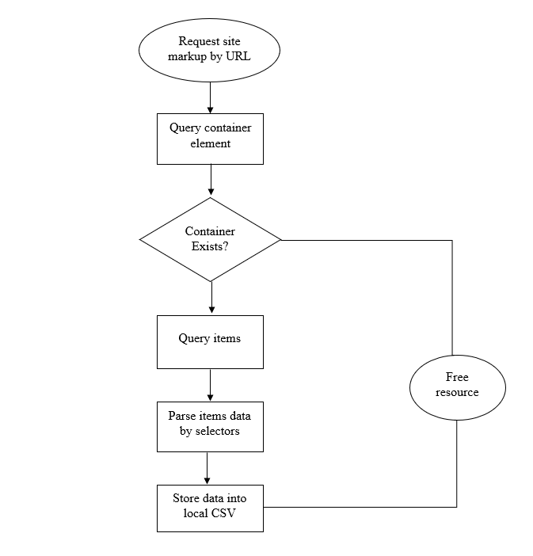
Flow Chart

Slide 7
Implementation
The script starts by defining the necessary headers for the requests and setting the search query to “Dell".
The script then uses a for loop to iterate through multiple pages of search results.
For each iteration, the script uses the requests library to send a GET request to the URL of the current page of the search results.
The response received from the website is then passed to the BeautifulSoup library, which is used to parse the HTML and extract the desired data such as product name, rating, rating count, price, and product URL.
The script then uses the extracted data to create a pandas dataframe.
The dataframe is then saved as a CSV file.
The script then uses the plotly library to create various visualizations of the data such as line plots, scatter plots, bar plots, histograms, and box plots.
Additionally, the script uses matplotlib and seaborn to create additional visualizations.
Finally, the script uses the pyspark library to create a Spark session and load the data into a Spark dataframe for further analysis.

Slide 8
Results
Systematically browsing the web to index content for search engines. Web crawlers copy pages for processing by a search engine, which indexes the downloaded pages for easier retrieval so that users can get search results faster. This was the original meaning of web crawler.
Automatically retrieving content from any web page. This is more commonly called web scraping. This meaning of web crawler came about as companies other than search engines started using web scrapers to retrieve web information.
For example, e-commerce companies rely on their competitors’ prices for dynamic pricing.
Finally, the script would also create a Spark dataframe containing the extracted data, this dataframe can be further used for advanced analysis with the help of Spark's built-in functions and tools.

Slide 9
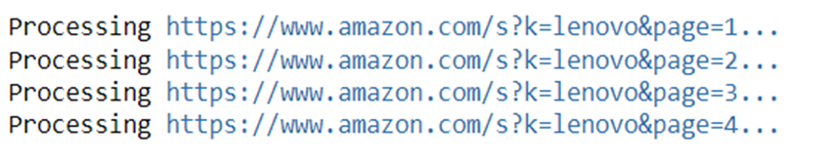
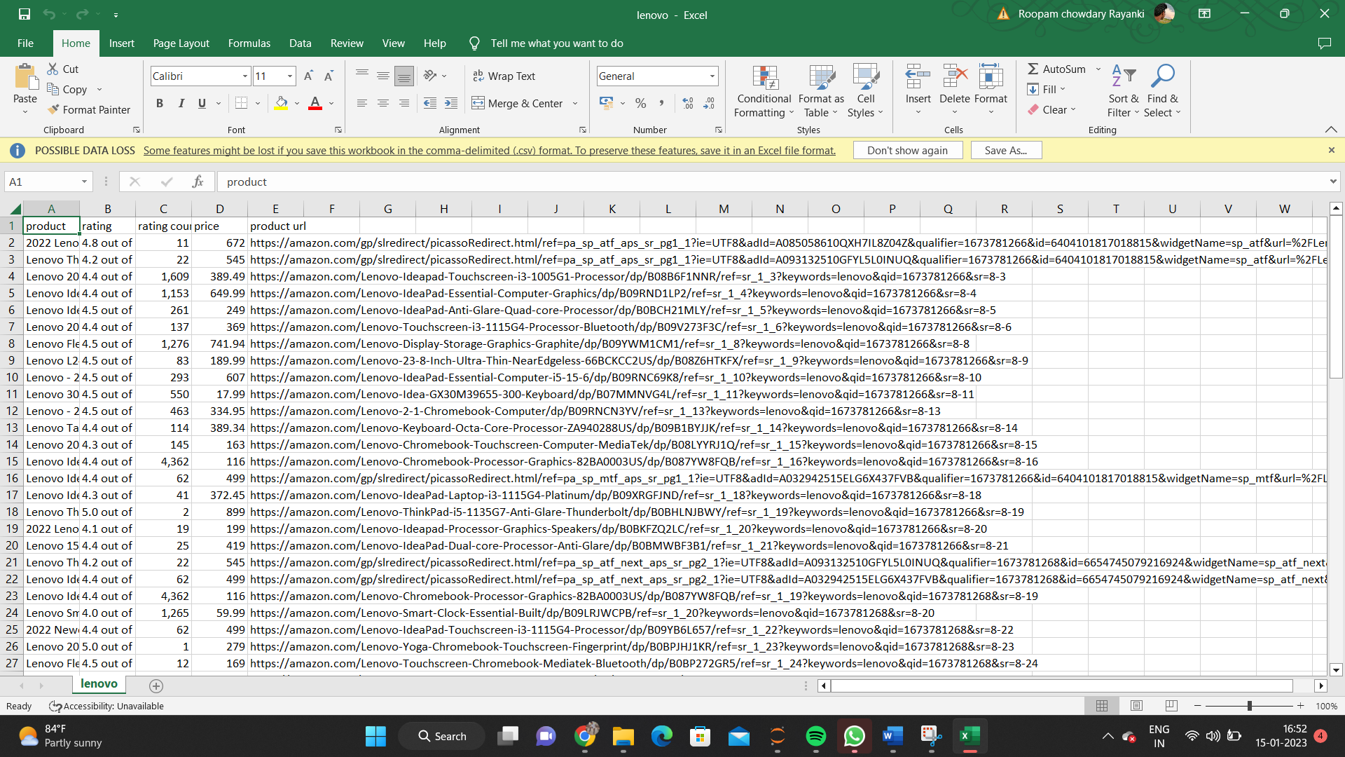
Results

Slide 10
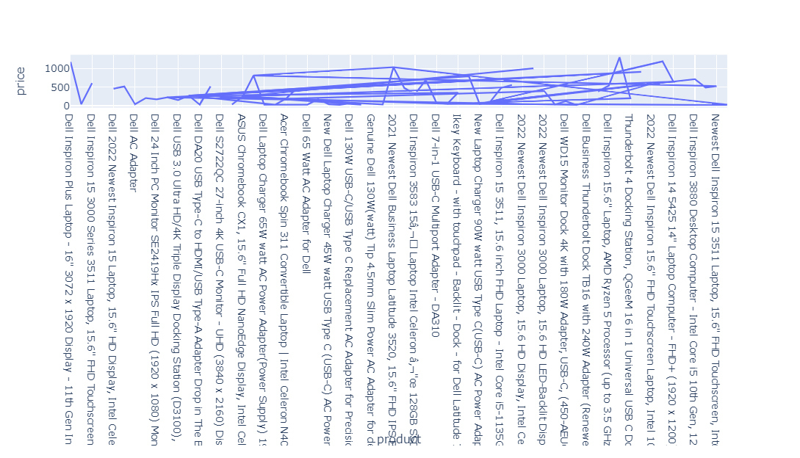
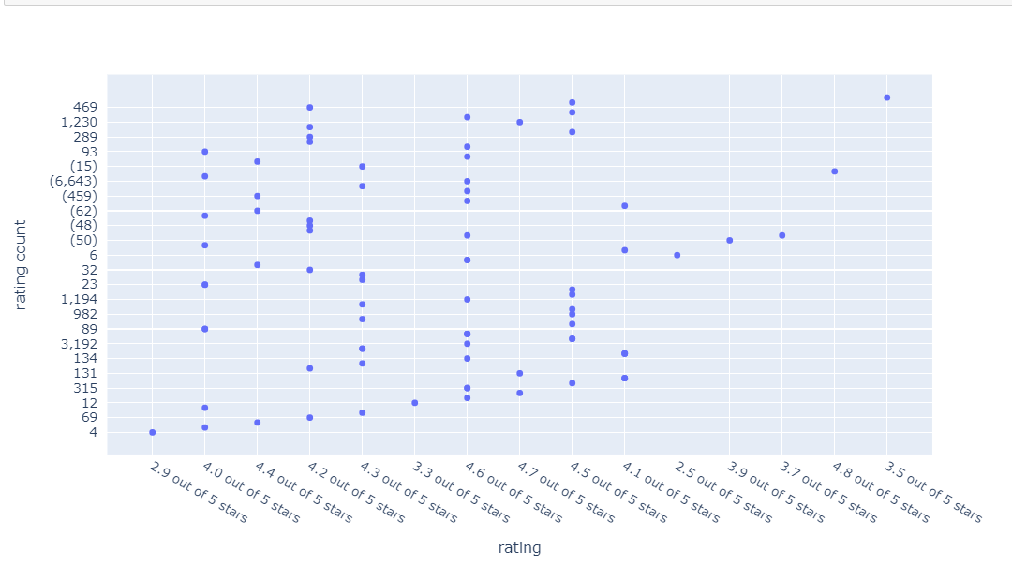
Line chart
Scatter plot

Slide 11
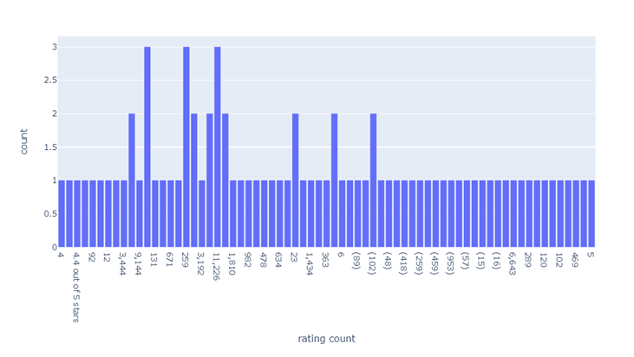
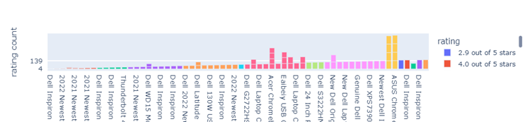
Bar chart
PX bar

Slide 12
Conclusion
The crawlers are being used to collect and update the central repository of the search engine. But it fails somewhere to do its task effectively.
So in this paper authors try to identify these challenges in the field of parallel crawler, focused crawler, parallel focused crawler which are based on the parameters namely -Distribution, Scalability, Load balancing and reliability. Furthermore, authors also suggest the possible solution to these problems.
Overall, the results and visualizations provided by the script can be used to gain insights into the products, pricing, and customer reviews for the search query “DELL" on Amazon's website.
In conclusion, the above program is a useful tool for extracting and analyzing data from Amazon's website for a specific search query.

Slide 13
Future Enhancement
There are several potential enhancements that could be made to the program in the future.
One enhancement could be to add functionality to scrape data from multiple websites, such as other e-commerce platforms or review websites, to gather a more comprehensive dataset.
Another enhancement could be to add machine learning capabilities to the program to analyze the data and make predictions or recommendations based on the results.
Additionally, the script could be adjusted to scrape data on a regular basis, to provide an up-to-date analysis of the market trends.

Slide 14
Thank You

