Slide 1
Healthcare Analytics
Why the J2250 Cannibalization Play Failed
and How to Recover
BIA 810
Health Care Data & Analytics
Final Project
J-FIVE
Team Healthcare Commercial Analytics
Notes:
presentation

Slide 2
Today's Agenda
Time
Topic
[Min 0 to 5]
Context, Stakes, and the Strategic Reframe
[Min 5 to 10]
Methodology and Q1 Market Dynamics
[Min 10 to 18]
Q2 Market Drivers and Strategic Analytics
[Min 18 to 25]
Recommendations, Q4 Data Gaps, and Path Forward

Slide 3






Meet the Team!
Aditya Patel
Aneesh Vishnu
Nikhil Sonawane
Professor: Sanjiv Koshal
Market Research Lead
Execution Lead
Strategy Lead
Saket Kachchhi
William Reccoppa
Project Lead
Lead Analyst, Market Drivers

Slide 4
PROBLEM STATEMENT:
Variant brand J2250 was launched to absorb the share of declining leader J1885. Cannibalization has failed. Competitor J3010 is capturing that share, and J2250 is losing ground.
BUSINESS SOLUTION
We propose a four-priority strategic reset: fix writer retention, convert Trialists to Rising Stars, declare four emergency territories, and ring fence the Anesthesiology base
BUSINESS IMPACT
This solution will
Lift J2250 writer retention from 46.4% to 65% in 12 months
Recover approximately 150 lost claims annually
Equip the field force with named NPI lists, sized targets, and 30/60/90 day plans
Reposition J2250 against its true competitive set: J2704 and J3010
Executive Summary

Slide 5
Executive Summary
The Cannibalization Play Failed. Here Is Why.
1. Wrong Substitute
2. Retention Crisis
3. Direct Displacement
Midazolam (J2250) is a sedative. Ketorolac (J1885) is an NSAID for pain. Different drug classes. Never clinically substitutable.
J2250 loses 54 percent of its writers every year. Zero High Volume prescribers. No acquisition program survives this churn rate.
58 percent of J2250 patients have also received J3010. The competitor is not just winning new patients. It is treating our patients.
minus 30%
plus 165%
46.4%
J2250 CLAIM DECLINE 2016 TO 2018
J3010 CLAIM GROWTH 2016 TO 2018
J2250 WRITER RETENTION 2017 TO 2018

Slide 6
The Pharmacological Reframe
Why Cannibalization Was Always Going to Fail
WHAT WAS ASSUMED
WHAT THE DATA SHOWS
J2250 (midazolam) would absorb patients dropping from J1885 (ketorolac).
J2250 and J1885 are different drug classes. Real competitive set: J2704 (propofol) and J3010 (fentanyl).
HCPCS | Generic Name | Drug Class | Clinical Role
J1885 | Ketorolac | NSAID | Post operative pain relief (analgesic)
J2250 | Midazolam | Benzodiazepine | Sedation and induction of anesthesia
J3010 | Fentanyl | Synthetic opioid | Analgesia during anesthesia
J2704 | Propofol | IV anesthetic | Sedation and induction
Strategic Reset: J2250 must compete against J3010 and J2704. Not against J1885.

Slide 7
Methodology
How We Built the Analysis Ready Dataset
RAW INPUT
FILTER AND MERGE
ANALYSIS READY
Five compressed Medicare CCLF claim parts. HCP demographics file. Patient demographics file. ZIP to territory mapping. ICD 10 specialty mapping.
Procedure code mapping.
Brand basket: J1885, J2250, J2704, J3010. Window: 2016 to 2018 (drops 17 records from 2015). ZIP cast to 5 digit zero padded. Date formats normalized.
28,368 line items in scope. 15,262 brand line items. 15,139 unique claim IDs. 22 territories, 4 regions. 3,396 J1885, 982 J2250, 636 J2704, 2,079 J3010 patients.
QUALITY CHECKS VERIFIED AT RUNTIME
• Total dataset: 28,369 rows verified via assertion
• Records excluded: 17 from 2015 (out of analysis window)
• Brand line items in scope: 15,262 across 15,139 unique claim IDs
• Share columns sum to 100 percent per year within float tolerance
• Date format inconsistencies in clm_thru_dt resolved during preparation

Slide 8
01
SECTION 1
Q1 Market Dynamics
How the Four Brands Are Trending
Aditya Patel

Slide 9
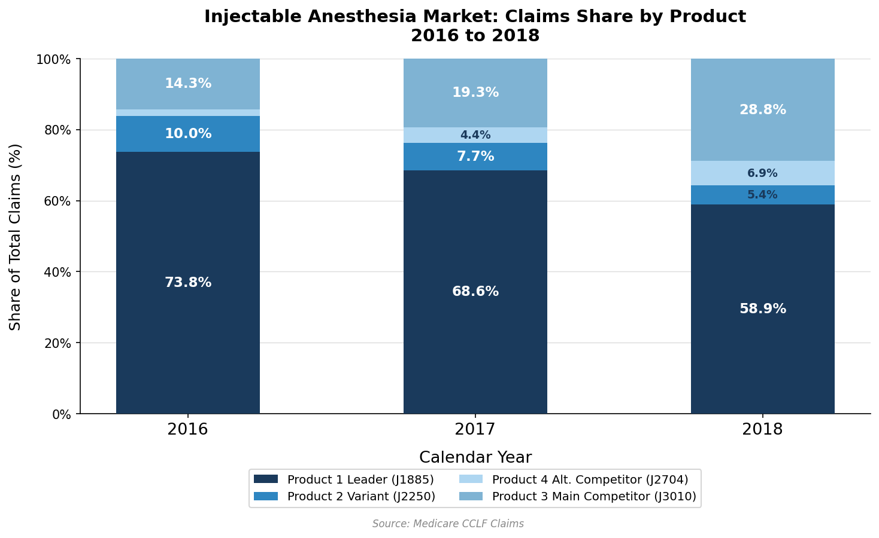
Q1 Market Dynamics
Product 3 Is Capturing What Product 1 Loses
Insight:
Every share point Product 1 lost went to Product 3, not to our variant. P1 fell 73.8% to 58.9%. P3 grew 14.3% to 28.8%. P2 fell 10.0% to 5.4%. Cannibalization has failed.

Slide 10
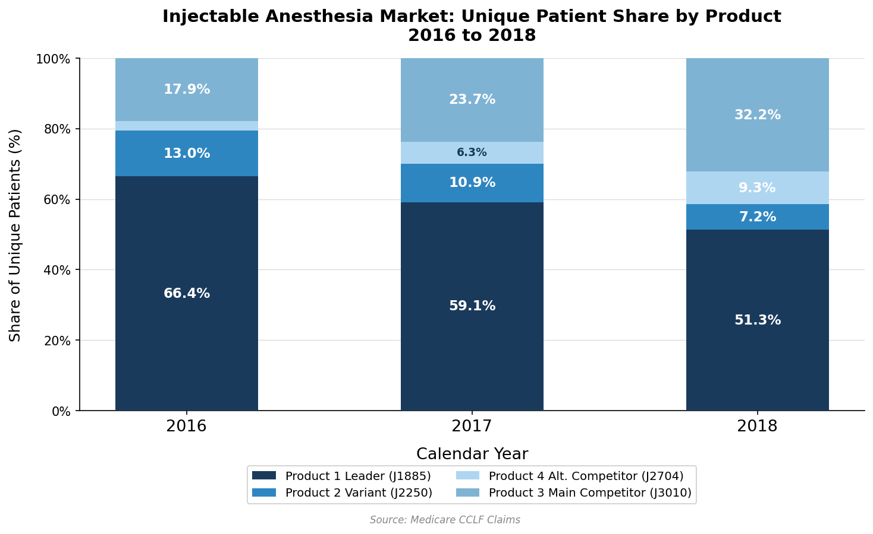
Q1 Market Dynamics
Patient Share Is Slipping Faster Than Claims
Insight:
P1 patient share fell 66.4% to 51.3%. P3 grew 17.9% to 32.2%. At current rate, P3 will surpass P1 in patient share within 1 to 2 years.

Slide 11
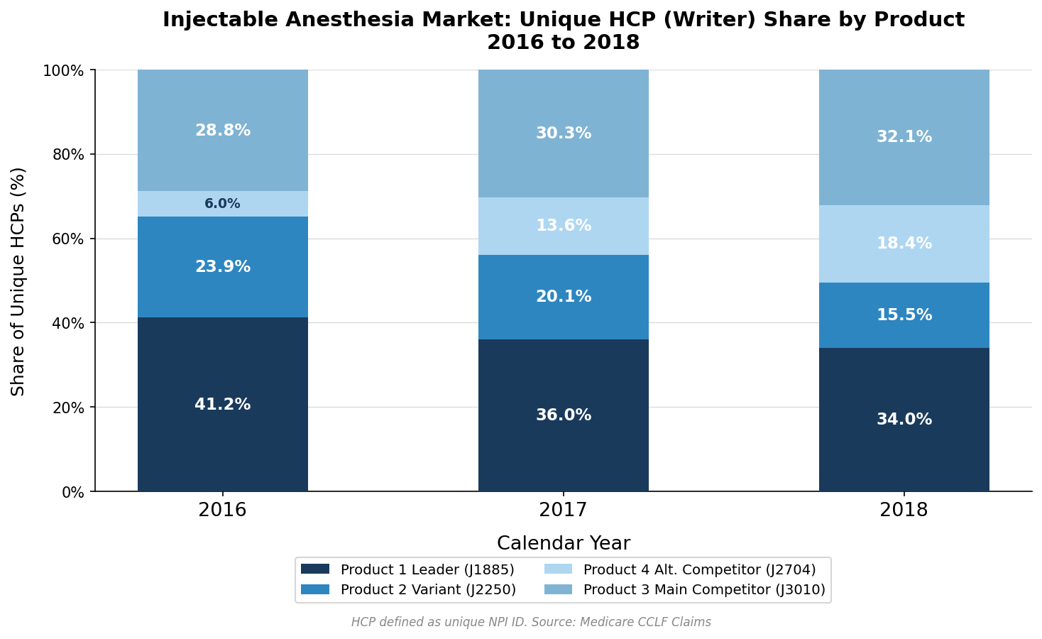
Q1 Market Dynamics
The Writer Base Is Collapsing. A Leading Indicator.
Insight:
J2250 writer share fell 23.9% to 15.5%. We are losing HCPs faster than patients. When doctors stop writing a brand, patients follow shortly after.

Slide 12
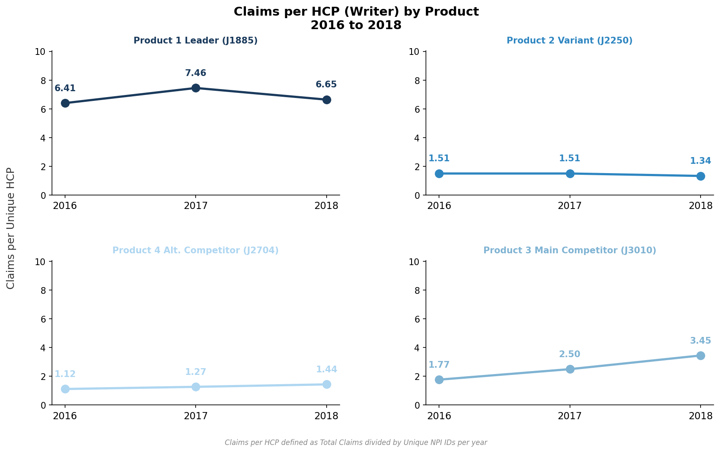
Q1 Market Dynamics
P3 Writers Are Now 2.3x More Productive Than Ours
Insight:
P3 climbed 1.77 to 3.45 claims per HCP. P2 stuck at about 1.4. P2 writers try once and stop. P3 writers are deepening clinical adoption.

Slide 13
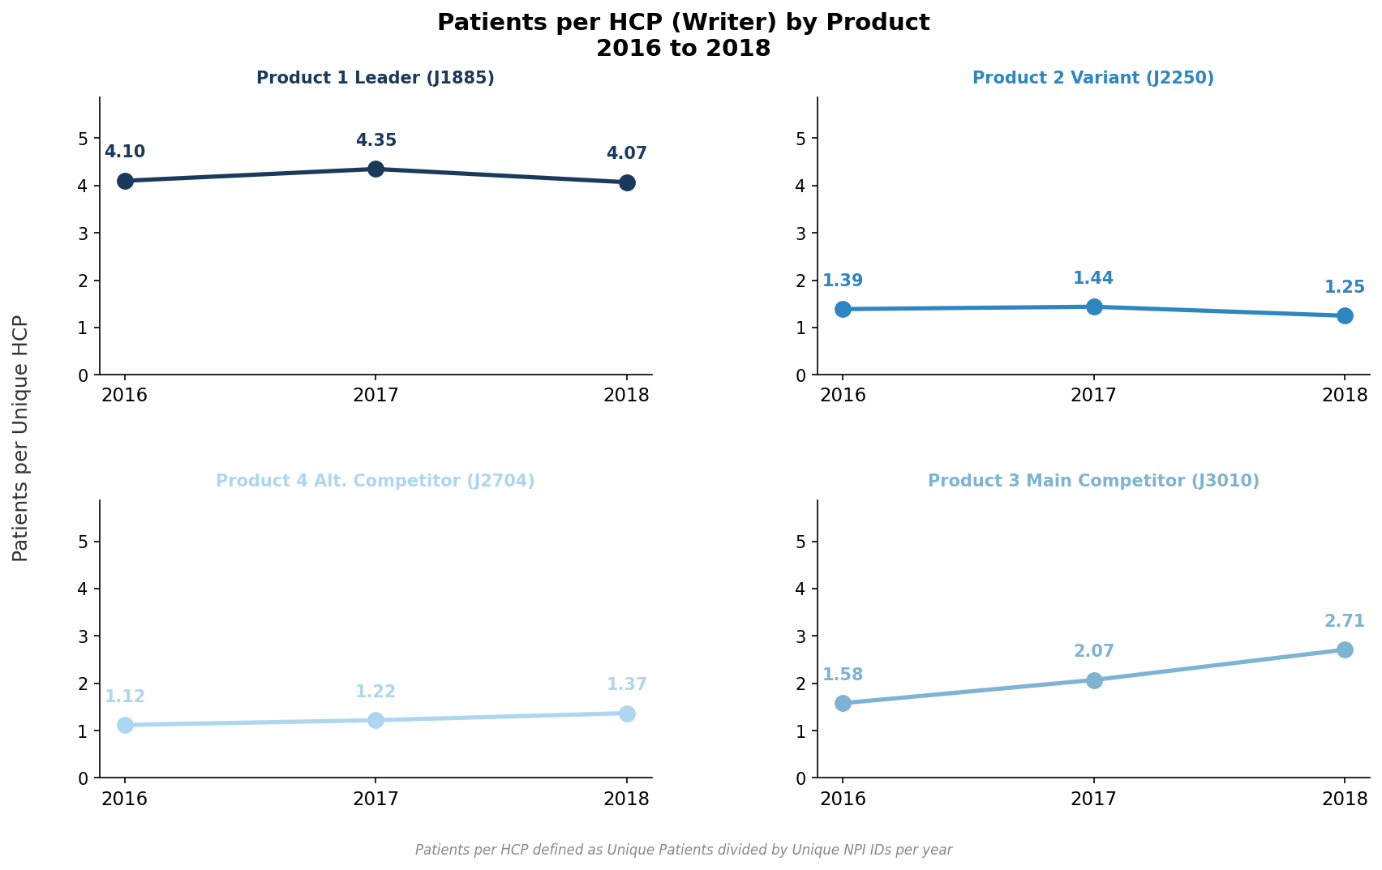
Q1 Market Dynamics
P3 Doctors Build Patient Panels. P2 Doctors Do Not.
Insight:
P3 patients per HCP grew 1.58 to 2.71. P2 stuck at 1.22 and falling. Multi patient panels embed a brand into clinical routine.

Slide 14
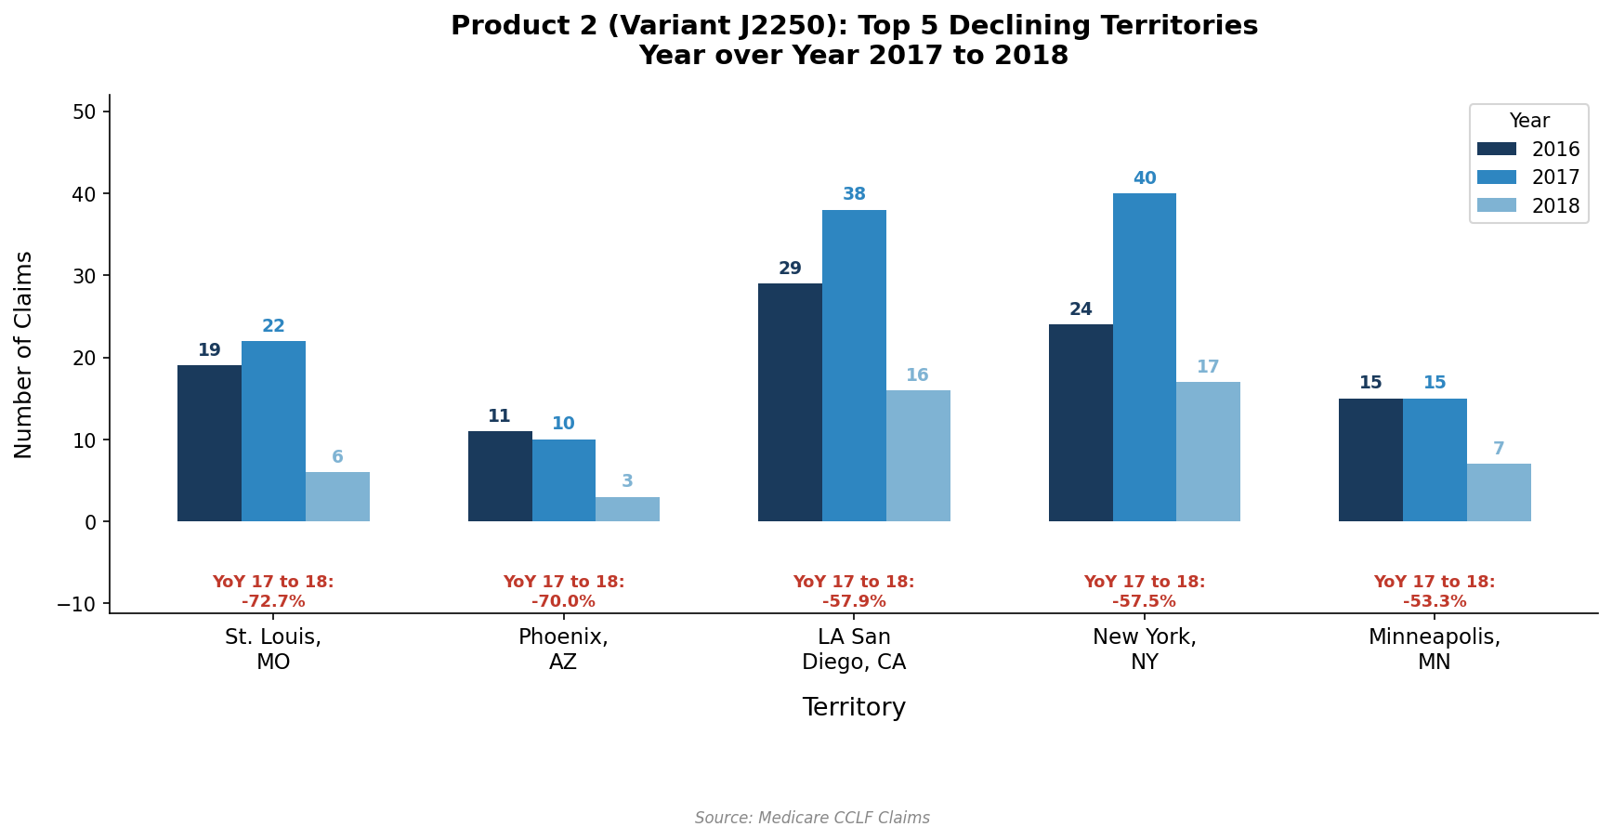
Q1 Market Dynamics
Five Territories Lost Over Half Their J2250 Volume in One Year
Insight:
St. Louis (minus 72.7%), Phoenix (minus 70%), LA San Diego (minus 57.9%), New York (minus 57.5%), Minneapolis (minus 53.3%). All collapsed in 2017 to 2018.

Slide 15
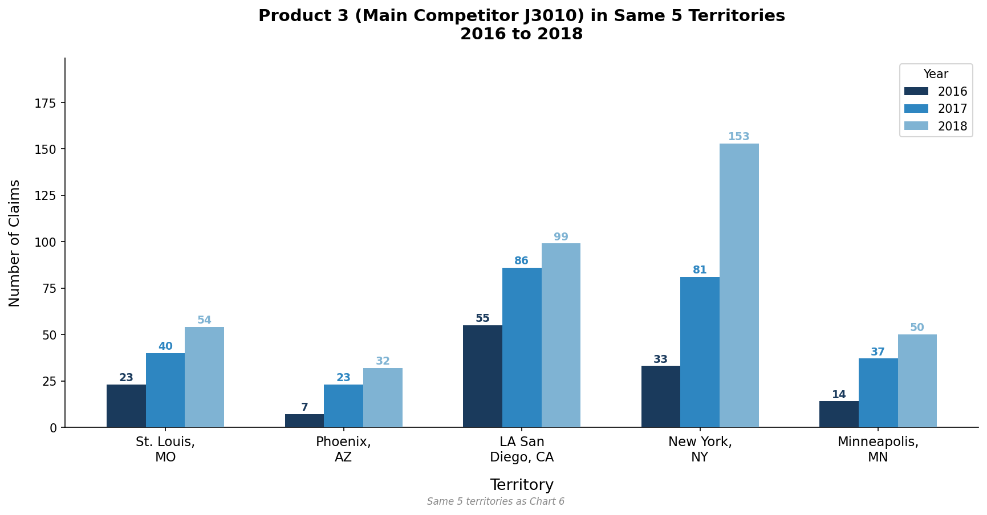
Q1 Market Dynamics
J3010 Grew in Every Single One of Those Territories
Insight:
New York: 33 to 153 claims (plus 364%). LA San Diego: 55 to 99 (plus 80%). Direct competitive capture, not market shrinkage.

Slide 16
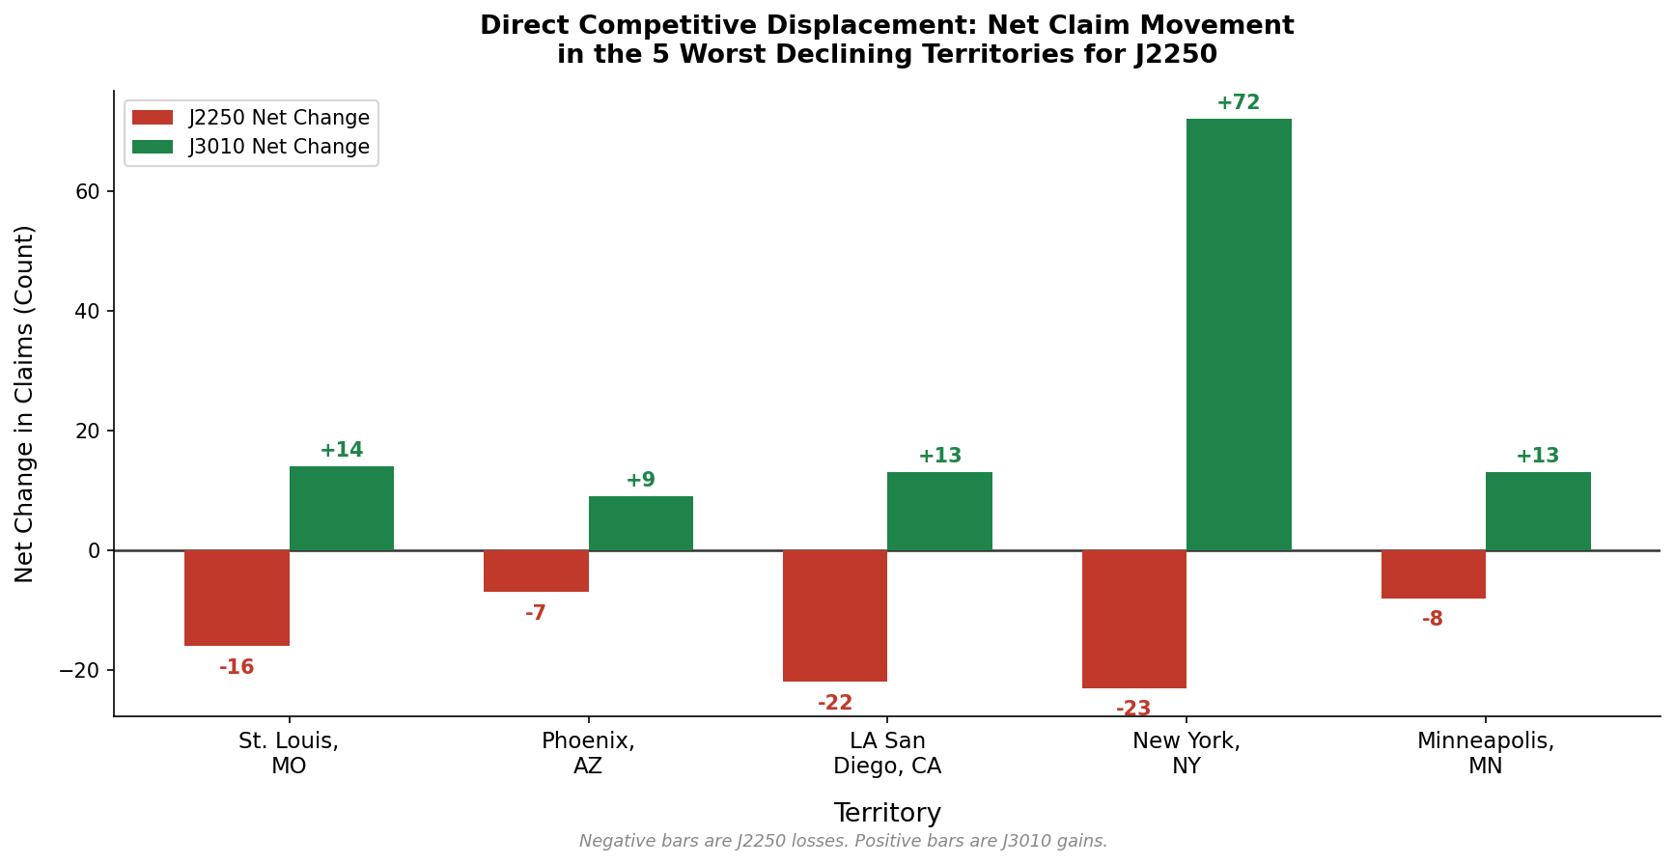
Q1 Market Dynamics
Direct Competitive Displacement, Proven Territory by Territory
Insight:
J2250 lost 76 claims across the five territories in 2017 to 2018. J3010 gained 121 in the same markets. The transfer is direct, asymmetric, and accelerating.

Slide 17
02
SECTION 2
Q2 Market Drivers
What Is Pulling the Market
William Reccoppa

Slide 18
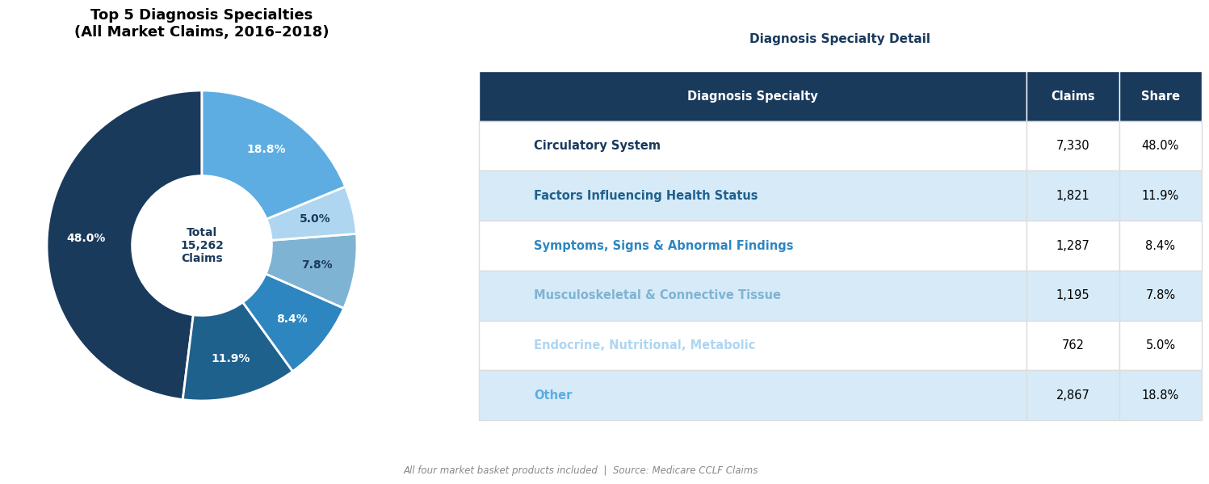
Q2 Market Drivers
48% of Claims Are Tied to Circulatory Diagnoses
Insight:
This is a cardiovascular dominant market. Anchor every clinical detail aid for J2250 in cardiovascular outcomes. If differentiated CV evidence is missing, generate it.

Slide 19
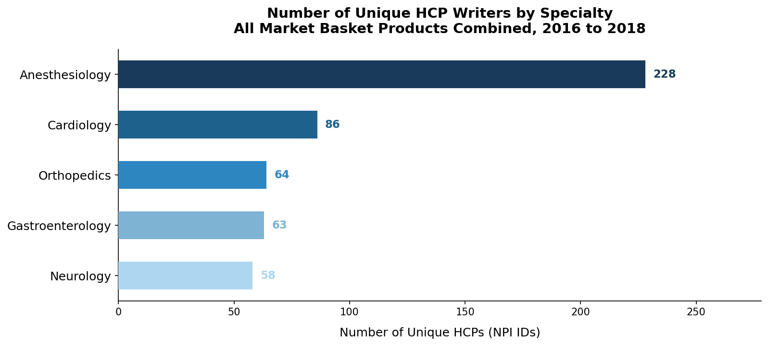
Q2 Market Drivers
Anesthesiologists Are 2.5x the Next Specialty. A Must Win Segment.
Insight:
228 anesthesiologists versus 86 cardiologists, 64 orthopedics, 63 GI, 58 neurology. Losing one anesthesiology group can move whole brand volume.

Slide 20
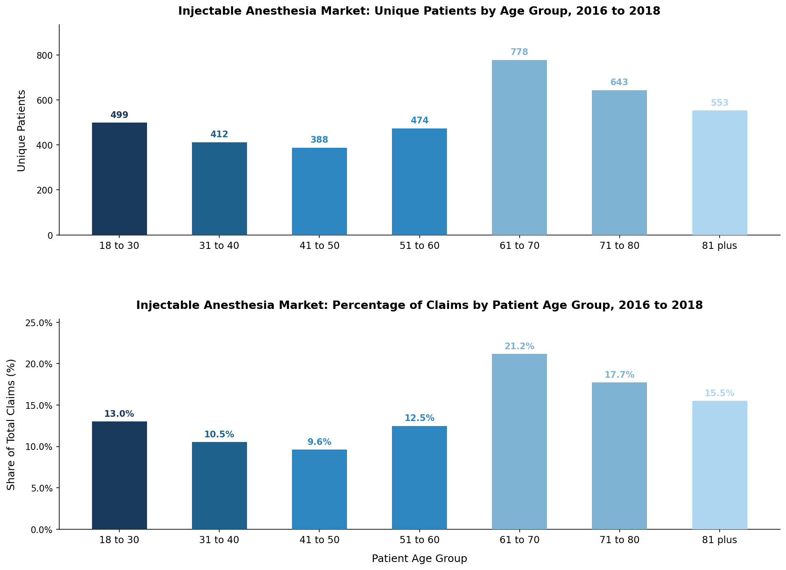
Q2 Market Drivers
The Core Patient Is 61 to 70. Design Everything Around Them.
Insight:
61 to 70 age group: 778 unique patients, 21.2% of all claims. Patients 61 plus generate 54% of total claims. Target older adults first. They generate the most treatment volume.

Slide 21
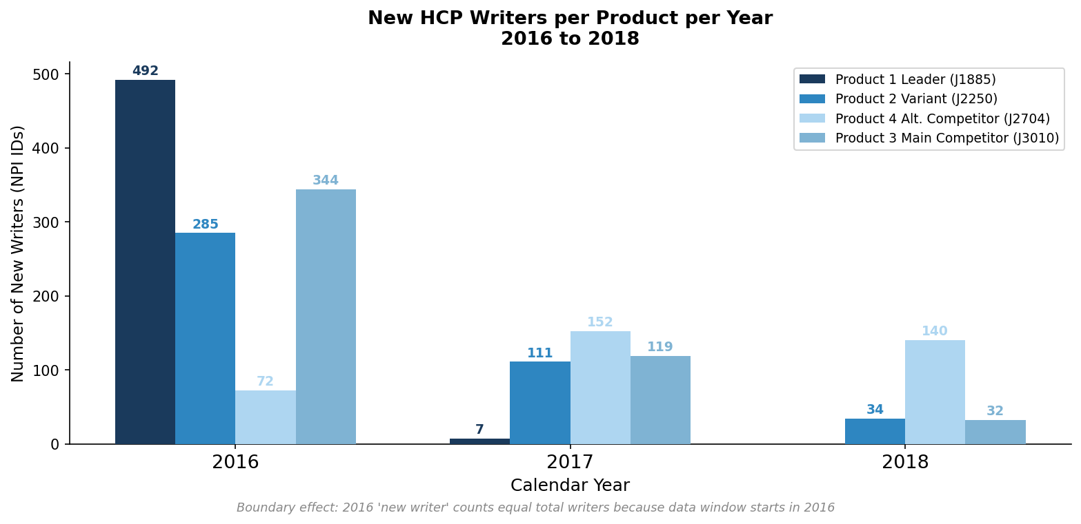
Q2 Market Drivers
J2250's New Writer Pipeline Has Nearly Collapsed
Insight:
New writers per year: 285 to 111 to 34. One year from zero acquisitions. Read 2017 and 2018 only. 2016 reflects a data window boundary effect.

Slide 22
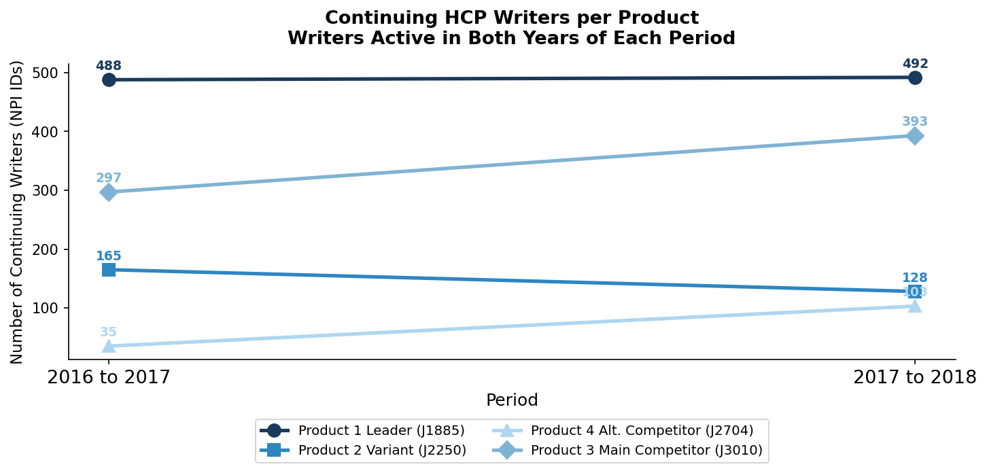
Q2 Market Drivers
Continuing Writers: J3010 Up 32%. J2250 Down 22%.
Insight:
J2250 is bleeding writers from both ends. Fewer joining and more leaving. Re-engage the 37 writers who left in 2017 to 2018.

Slide 23
03
SECTION 3
Extended Strategic Analytics
Nikhil Sonawane

Slide 24
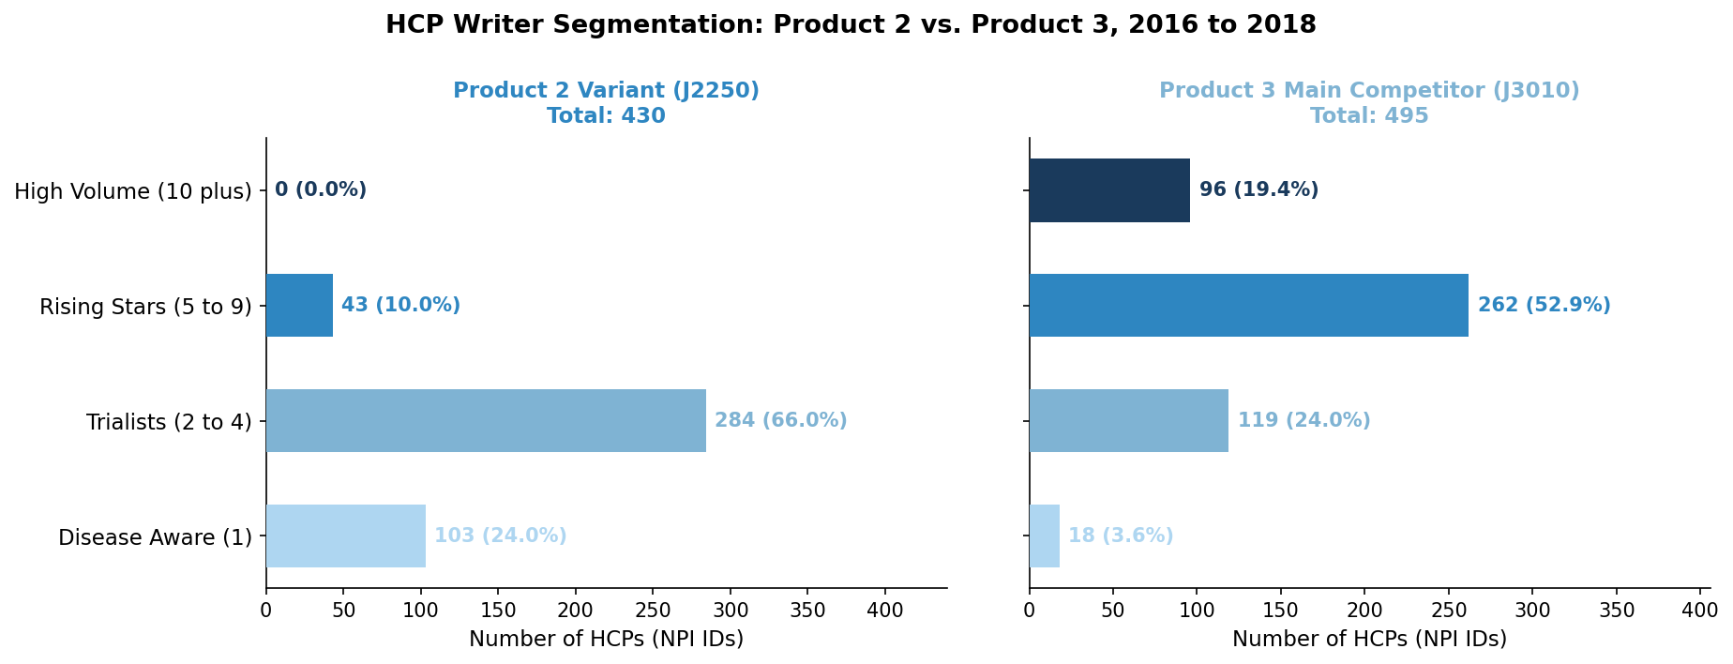
Strategic Analytics
J2250 Has Zero High Volume Writers. J3010 Has 96.
Insight:
The Prize: Convert 20% of J2250's 284 Trialists into Rising Stars. Plus 170 incremental claims per year at zero acquisition cost.

Slide 25
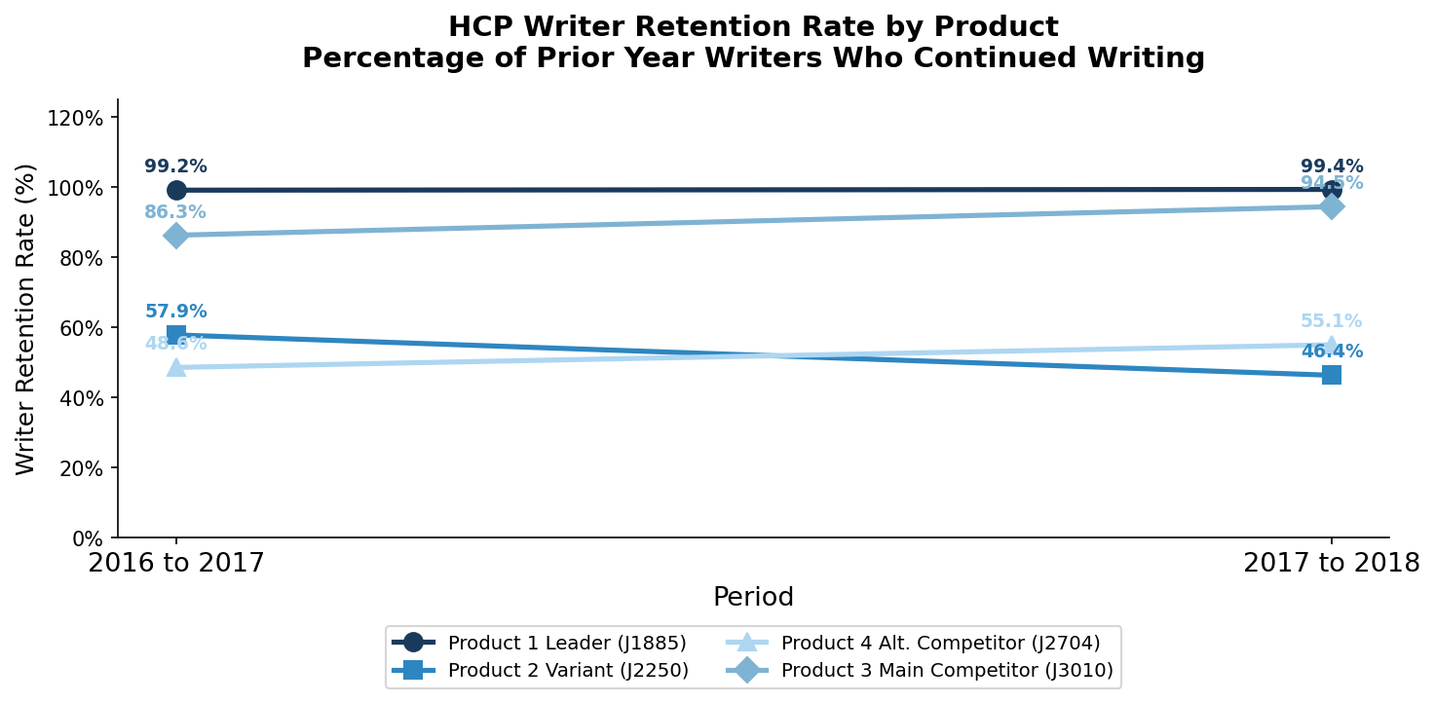
Strategic Analytics
Less Than Half of J2250 Writers Continue Year to Year
Insight:
Critical Finding: J2250 retention 57.9% to 46.4%. J3010 at 94.5% is building compounding loyalty. Set 70% retention as a non-negotiable KPI tied to leadership compensation.

Slide 26
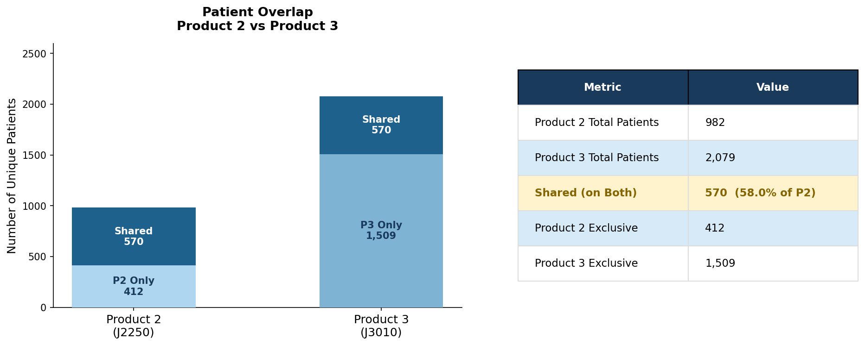
Strategic Analytics
58% of J2250 Patients Are Already Shared With J3010
Insight:
570 of 982 J2250 patients also receive J3010. The HCPs treating these shared patients are the highest single conversion lever. These doctors have not made a clinical preference yet.

Slide 27
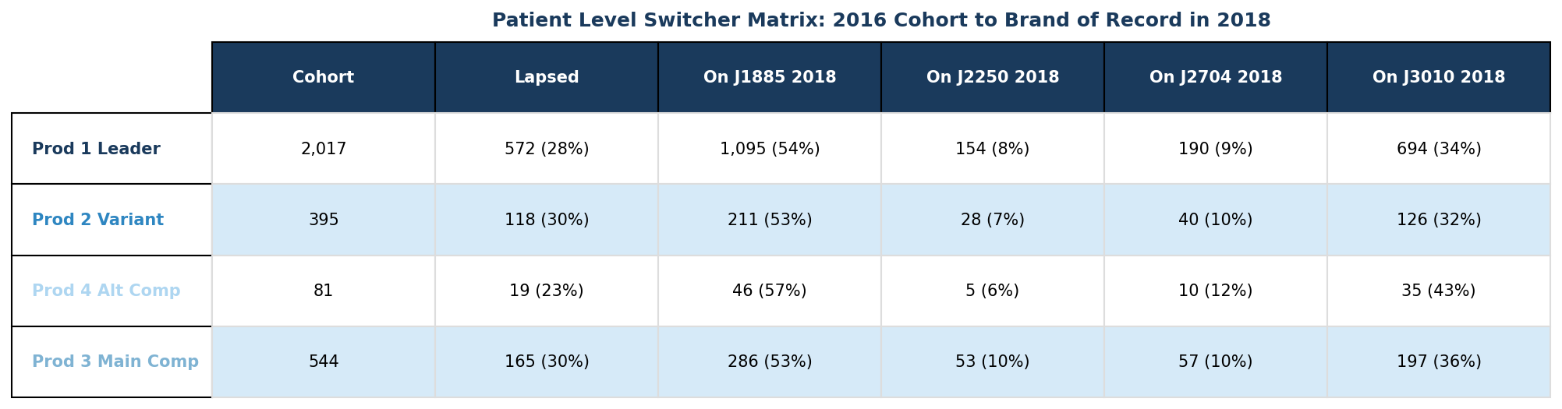
Strategic Analytics
J3010 Is the Destination Brand for J1885 Patients (Not J2250)
Insight:
Of 2,017 J1885 patients in 2016, only 6% had moved to J2250 by 2018. About 34% had moved to J3010. Cannibalization failed at the patient flow level, not just the share level.

Slide 28
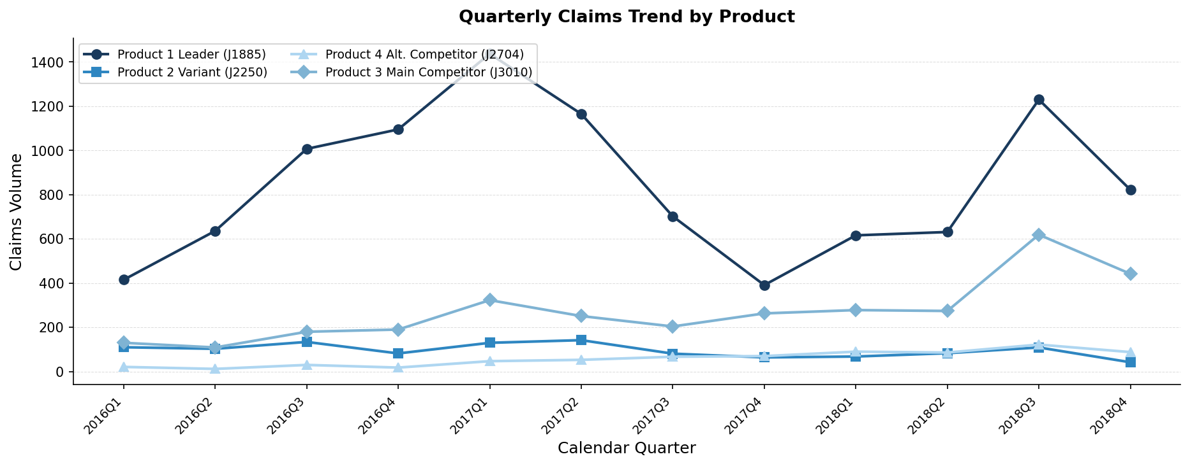
Strategic Analytics
The Competitive Event Window: Q3 2017 to Q1 2018
Insight:
J3010's most pronounced acceleration of the entire window. Likely formulary win, sales force expansion, or KOL launch. Brief field intel to investigate this six-month window.

Slide 29
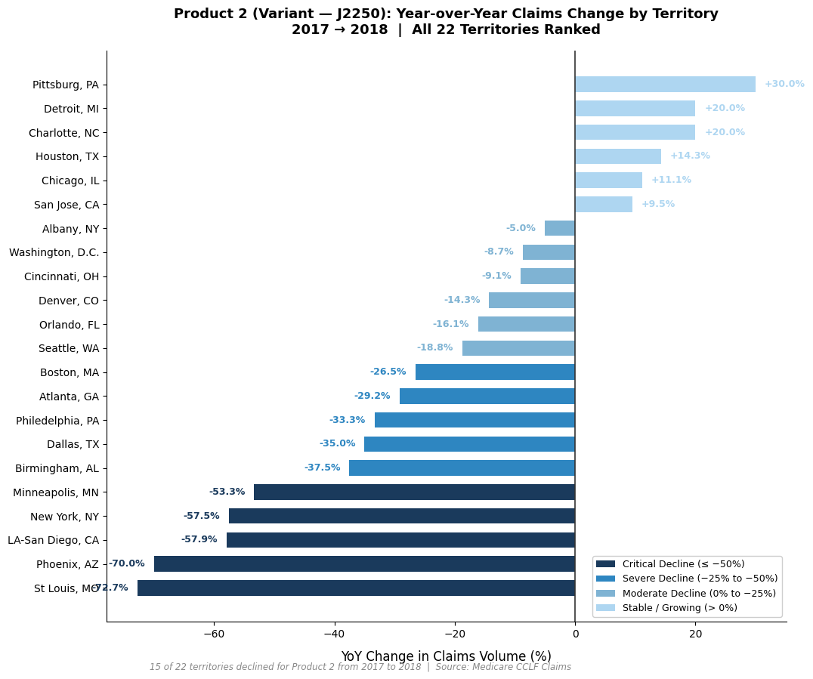
Strategic Analytics
15 of 22 Territories Declining. But 6 Are Growing.
Insight:
Pittsburg plus 30%, Detroit plus 20%, Charlotte plus 20%. These six territories are commercial excellence benchmarks. Extract their playbook and deploy in the four emergency territories.

Slide 30
04
SECTION 4
Recommendations
and the Path Forward
Aneesh Vishnu

Slide 31
Q3 Strategic Recommendations
Four Priorities. Sequenced. Sized. Actionable.
01 FIX WRITER RETENTION
02 CONVERT TRIALISTS TO RISING STARS
03 DECLARE 4 EMERGENCY TERRITORIES
04 DEFEND THE ANESTHESIOLOGY BASE
ACTION
ACTION
ACTION
ACTION
Re engage 148 lapsed J2250 writers. Personal rep outreach, samples, peer programs.
Clinical case studies, dosing flexibility aids, peer speaker events for the 284 Trialists.
Audit St. Louis, Phoenix, LA San Diego, New York within 30 days. Formulary, rep coverage, competitive intel.
Named NPI ring fence around top 30 anesthesiology writers. KOL programs, advisory boards, real world evidence.
TARGET
TARGET
TARGET
TARGET
Lift retention from 46% to 65% in 12 months
20% of Trialists (about 57 HCPs) double their volume
Recover 50% of 2018 lost volume in these four
Hold the segment at 2017 share
PRIZE
PRIZE
PRIZE
PRIZE
Plus 120 to 200 incremental claims per year
Plus 170 incremental claims per year. Zero acquisition cost.
Plus 30 short term claims plus writer base protection
Avoid leaking about 150 claims per year to J3010

Slide 32
Q3 Execution Plan
30, 60, 90 Day Plan. Sequence and Trade Offs Made Explicit.
DAYS 0 TO 30
DAYS 31 TO 60
DAYS 61 TO 90
DIAGNOSE
INTERVENE
MEASURE AND SCALE
• Extract NPI list of 148 lapsed J2250 writers
• Define Trialist target list per territory
• Audit rep activity and formulary status
• Build named NPI list of top 30 KOLs
• First touch re engagement to 100% of lapsed list
• Deploy detail aids and Trialist case studies
• Launch corrective action in emergency territories
• Begin KOL advisory boards for anesthesiology
• Track re engagement conversion rate
• Measure Trialist to Rising Star migration
• Review territory trajectory and escalate as needed
• Refresh playbook based on early signal
WHAT WE WILL NOT PURSUE: DISCIPLINE LIST
• Net new HCP recruitment until retention is above 65 percent. Acquiring writers we cannot retain is wasted spend
• National brand campaigns. The data is geographic and HCP specific. Broadcast spend dilutes return on investment
• Repositioning against J1885. The pharmacological reframe makes this competitive frame obsolete

Slide 33
Q4 Data Exploration Opportunities
What We Know. What We Need. What It Would Unlock.
Xponent / Rx Data
DDD Channel Data
CRM and Call Activity
Identify exactly which HCPs switched from J2250 to J3010, when, and at what volume.
Reveal formulary wins. If J3010 has preferred status in J2250 hospitals, it is an access problem, not a detailing problem.
Calculate calls to claims conversion rate. Determine if decline is a coverage or message failure.
NPA: National Audit
Speaker and Samples
Payer and Formulary
True total market share across all payers. Medicare only analysis may over or understate competitive position.
Explain J3010's 344 new writers in 2016. Likely a pre window medical education push.
A single formulary win at a major regional health system can explain an entire territory collapse.
Closing the data gaps moves subsequent decisions from inferred to verified.

Slide 34
Conclusion
From Cannibalization Failure to Strategic Reset
STRUCTURAL TRUTH 1
The cannibalization assumption was pharmacologically unfounded. J2250 (sedative) and J1885 (NSAID) are not substitutes.
STRUCTURAL TRUTH 2
J2250's failure is a retention crisis, not an acquisition crisis. 90 percent of writers sit at one to four claims per year.
STRUCTURAL TRUTH 3
Patients are not greenfield. The 58 percent J2250 and J3010 patient overlap shows direct displacement.
THE PATH FORWARD
Reset the brand against its real competitive set (J2704 and J3010, not J1885). Fix retention before investing in acquisition. Convert Trialists into Rising Stars at zero acquisition cost. Declare four emergency territories. Ring fence the Anesthesiology KOL base. Close the data gaps to move from inferred to verified.

Slide 35
Q&A

Slide 36
Thank you!

