Slide 1
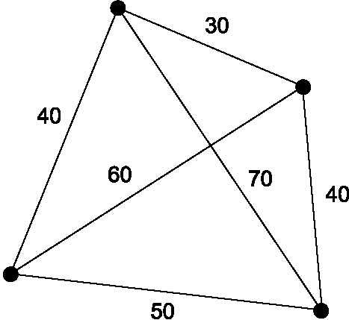
Ant Colony Optimization to solve Traveling Salesman Problem
Md. Forhad Hossain

Slide 2
We are going to discuss….
Here, We are going to discuss about the following things
History of Ant Colony Optimization (ACO)
Real Ant’s Behavior
The Concept of Ant System
ACO System Concept
Pheromone Update Formula
Ant Colony Optimization Algorithm
Apply Ant Colony Optimization Algorithm to solve Traveling Salesman Problem
Example of a Simple AS to solve TSP
Application of ACO
Advantage and Disadvantages

Slide 3
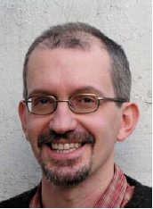
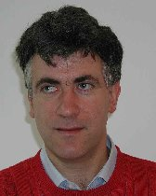
History of Ant Colony Optimization
The first ACO system was introduced by Marco Dorigo in his Ph.D. thesis (1992),
It was called Ant System (AS).
AS was initially applied to the traveling salesman problem.
Applied later to various hard optimization problems
Macro Dorigo
Gambardella

Slide 4
Real Ant’s Behavior
Natural behavior of ants have inspired scientists to mimic insect operational methods to solve real-life complex problems.
By observing ant behavior, scientists have begun to understand their means of communication.
Ants choose paths depending on pheromone
After collecting food, paths are marked
Pheromone accumulation is faster on the shorter path
After some time, the shortest path has the highest probability

Slide 5

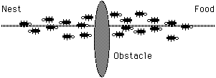
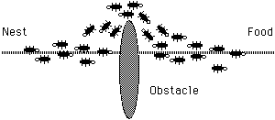
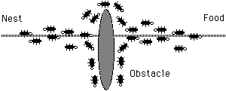
Real Ant’s Behavior
pheromone

Slide 6
The Concept of Ant System
Ants (blind) navigate from nest to food source
Shortest path is discovered via pheromone trails
each ant moves at random
pheromone is deposited on path
ants detect lead ant’s path, inclined to follow
more pheromone on path increases the probability of path being followed
These pheromones evaporate with time.

Slide 7
The Concept of Ant System
The shorter path will be reinforced by the pheromones further.
Finally , the ants arrive at the shortest path.
Starting node selected at random
Path selected at random
based on amount of “trail” present on possible paths from starting node
higher probability for paths with more “trail”
Ant reaches next node, selects next path
Continues until reaches starting node
Finished “tour” is a solution

Slide 8
The Concept of Ant System
A completed tour is analyzed for optimality
“Trail” amount adjusted to favor better solutions
better solutions receive more trail
worse solutions receive less trail
higher probability of ant selecting path that is part of a better-performing tour
New cycle is performed
Repeated until most ants select the same tour on every cycle

Slide 9
Ant Colony Algorithms
Algorithm was inspired by observation of real ant colonies.
Ants are essentially blind, deaf and dumb.
Q: how can ants find the shortest path to food sources?
Ants deposit pheromones on ground that form a trail. The trail attracts other ants.
The ants evaluate the cost of the paths they have traversed.
The shorter paths will receive a greater deposit of pheromones.
An evaporation rule will be tied with the pheromones, which will reduce the chance for poor quality solutions.

Slide 10
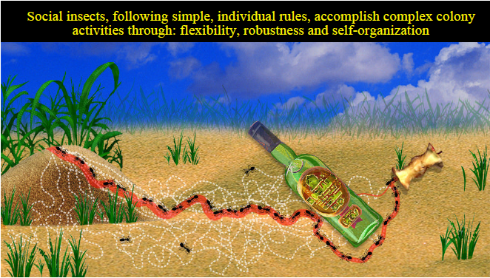
How Ants find foods

Slide 11
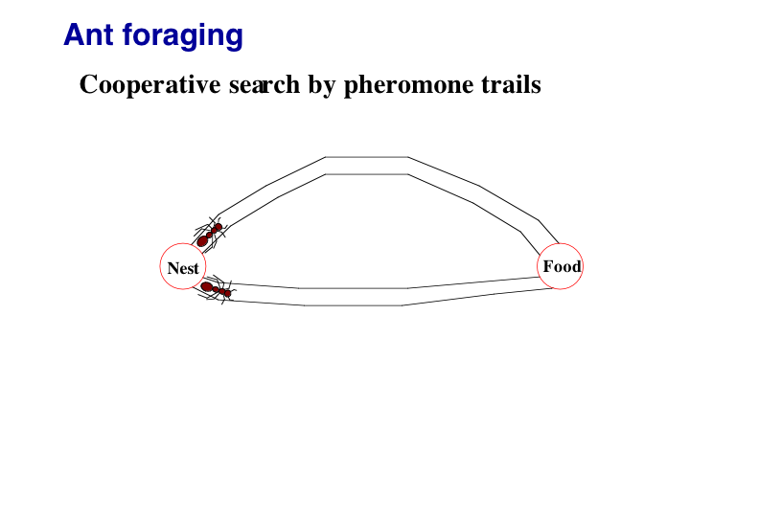
How Ants find foods

Slide 12
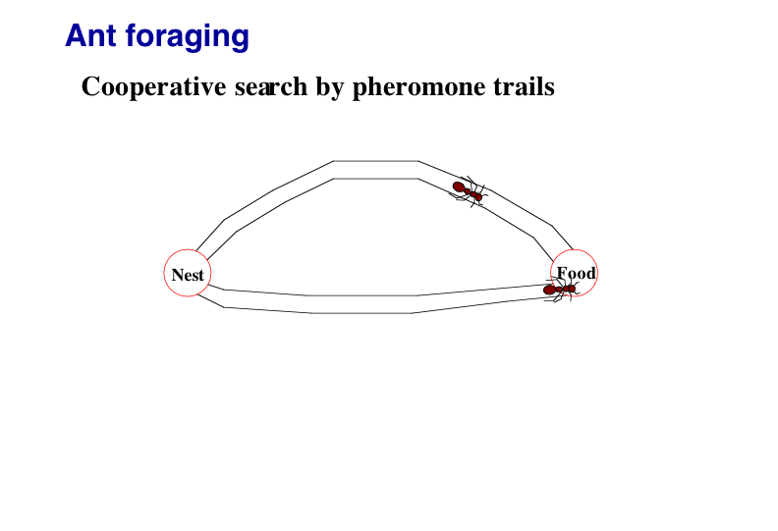
How Ants find foods

Slide 13
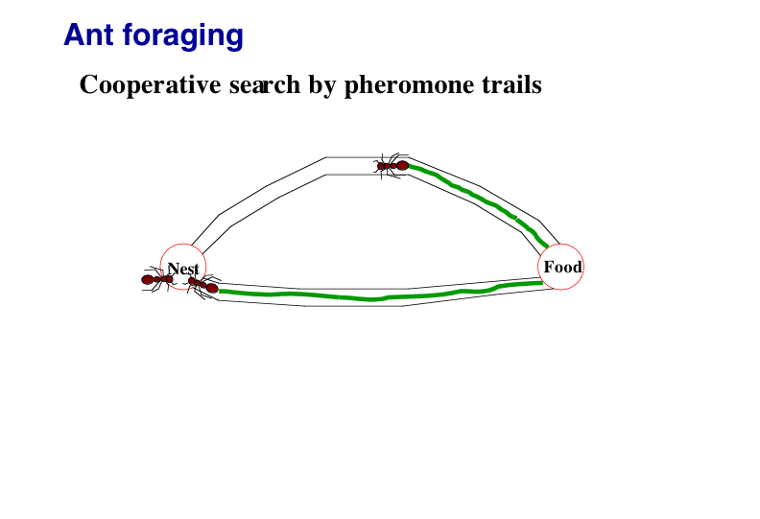
How Ants find foods

Slide 14
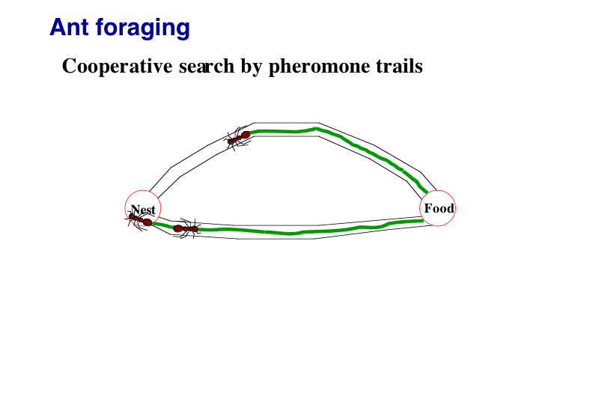
How Ants find foods

Slide 15
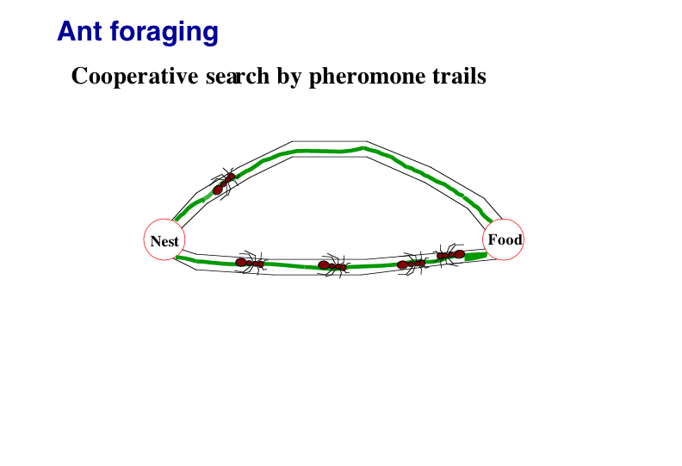
How Ants find foods

Slide 16
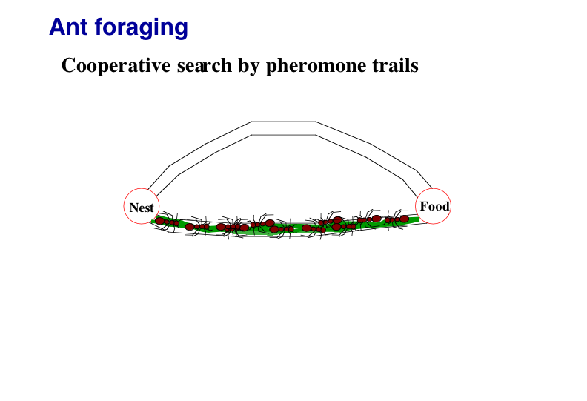
How Ants find foods

Slide 17
Ant System (AS)
Three different versions are proposed:
Ant Density
Ant quantity
Ant cycle
Pheromone updated after each move of ant from one city to another
Pheromone updates after all ants construct tour
Ant cycle in performed mush better than other two.
We will present Ant-cycle algorithm

Slide 18
Ant Systems (AS)
Ant Systems for TSP:
Graph (N,E): where N = cities/nodes, E = edges
= the tour cost from city i to city j (edge weight)
Ant move from one city i to the next j with some transition probability.
B
A
D
C

Slide 19
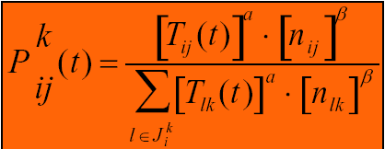
Tour Construction
1. Initially, each ant is put on some randomly chosen city.
2. Tabu list: set of all cities that ant k has not visited
= , visibility: Heuristic desirability of choosing city j when in city i.
3. Pheromone trail: This is a global type of information
Transition probability: Ant k, currently at city i, chooses to go to city j at t th iteration is:
If j Є
Closest cities are selected based on pheromone and distance.

Slide 20
Trail pheromone in AS
α,β determines relative influence of pheromone trail and heuristic information
If α=0, closest cities are more likely to be selected. Approaches to greedy algorithm
If β=0, only pheromone amplification is at work

Slide 21
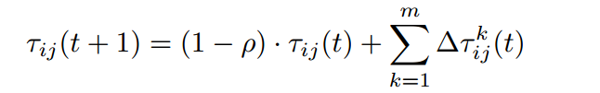
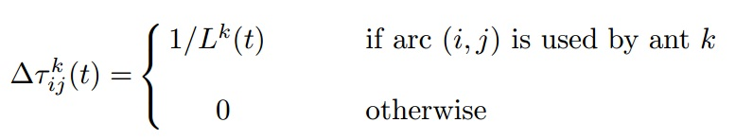

Pheromone Update Rule
After all ants constructed their tours, pheromone trails are updated.
It is done by
Firstly, lowering the pheromone strength on all arcs by a constant factor
Secondly, allowing each ant to add pheromone on the arcs it has visited.
Trail pheromone decay =
is length of kth ant’s tour. 0 < ρ <= 1 is pheromone trail evaporation.

Slide 22
Pheromone Update Rule
The better the ant’s tour is, more pheromone is received by arcs belonging to the tour.
In general, arcs used by many ants and contained in shorter tours will receive more pheromone.

Slide 23
Key Parameters
Trail intensity is given by value of τ_{ij} which indicates the intensity of the pheromone on the trail segment, (ij)
Trail visibility is η_{ij} = 1/d_{ij} : a heuristic function of the desirability of adding edge (d_{ij} is distance from i to j)
importance of the intensity in the probabilistic transition is α
The importance of the visibility of the trail segment is β
The trail persistence or evaporation rate is given as ρ
Q is a constant and the amount of pheromone laid on a trail segment employed by an ant
Initial pheromone is a small amount on all edges

Slide 24

Example of a Simple AS to solve TSP
[]
A
B
1
[]
[]
4
C
2
[]
[]
5
3
D
E
d_{AB} =100;d_{BC} = 60…;d_{DE} =150

Slide 25
Example of a Simple AS to solve TSP
[A]
[B]
1
A
2
B
[C]
3
C
[D]
[E]
D
5
4
E

Slide 26
Example of a Simple AS to solve TSP
[A]
1
A
B
[A]
1
[A]
C
1
[A,D]
[A]
1
1
D
E

Slide 27
Example of a Simple AS to solve TSP
[E,A]
[C,B]
5
A
3
B
[B,C]
2
C
[A,D]
[D,E]
1
D
4
E

Slide 28
Example of a Simple AS to solve TSP
[D,E,A]
[E,A,B]
4
5
A
B
[A,D,C]
1
C
[B,C,D]
[C,B,E]
2
D
3
E

Slide 29
Example of a Simple AS to solve TSP
[B,C,D,A]
[D,E,A,B]
2
A
4
B
[E,A,B,C]
5
C
[C,B,E,D]
[A,DCE]
D
3
1
E

Slide 30
Example of a Simple AS to solve TSP
[C,B,E,D,A]
[A,D,C,E,B]
3
1
A
B
[D,E,A,B,C]
4
C
[E,A,B,C,D]
[B,C,D,A,E]
D
5
E
2

Slide 31
Example of a Simple AS to solve TSP
[A,D,C,E,B]
L₁ =300
[B,C,D,A,E]
1
L₂ =450
2
[C,B,E,D,A]
L₃ =260
3
[D,E,A,B,C]
L₄ =280
4
[E,A,B,C,D]
L₅ =420
5
31

Slide 32
Application of ACO
Traveling Salesman Problem (TSP)
Class Scheduling Problem (CSP)
Function Optimization
Vehicle Routing
Sequential Ordering
Graph Coloring
Frequency Assignment
Train Time Scheduling
Water Distribution Network
Quadratic assignment problems (QAP)
Dynamic routing problems in networks and so on…

Slide 33
Ant Systems Algorithm for TSP
Initialize
Place each ant in a randomly chosen city
For Each Ant
Choose NextCity(For Each Ant)
yes
more cities
to visit
No
Return to the initial cities
Update pheromone level using the tour cost for each ant
No
Stopping
criteria
yes
Print Best tour

Slide 34
Another ACO Flowchart for TSP
START ACO
Locate an ant
randomly in a city,
and store the
current city
in a tabu list
Have K
Iterations been
performed?
NO
YES
STOP
ACO
Determine probabilistically
as to which city to visit next
NO
Update Pheromone:
Add according to tour
length, and evaporate
Have all
cities been
visited?
Move to next city and
place this city in the
tabu list
Record the length of
tour and clear tabu list
YES
Repeat for the M ants in the colony

Slide 35
ACO Algorithm for TSP

Slide 36
Advantage and Disadvantages
For TSPs (Traveling Salesman Problem), relatively efficient
for a small number of nodes, TSPs can be solved by exhaustive search
for a large number of nodes, TSPs are very computationally difficult to solve (NP-hard) – exponential time to convergence
Performs better against other global optimization techniques for TSP (neural net, genetic algorithms, simulated annealing)
Compared to GAs (Genetic Algorithms):
retains memory of entire colony instead of previous generation only
less affected by poor initial solutions (due to combination of random path selection and colony memory)

Slide 37
Advantage and Disadvantages
Can be used in dynamic applications (adapts to changes such as new distances, etc.)
Has been applied to a wide variety of applications
As with GAs, good choice for constrained discrete problems (not a gradient-based algorithm)
Theoretical analysis is difficult:
Due to sequences of random decisions (not independent)
Probability distribution changes by iteration
Research is experimental rather than theoretical
Convergence is guaranteed, but time to convergence uncertain

Slide 38
Advantage and Disadvantages
Tradeoffs in evaluating convergence:
In NP-hard problems, need high-quality solutions quickly – focus is on quality of solutions
In dynamic network routing problems, need solutions for changing conditions – focus is on effective evaluation of alternative paths
Coding is somewhat complicated, not straightforward
Pheromone “trail” additions/deletions, global updates and local updates
Large number of different ACO algorithms to exploit different problem characteristics

Slide 39
References
Thomas STÄUTZLEz and Marco DORIGO. ACO Algorithms for the Traveling Salesman Problem
Marco Dorigo. The Ant Colony Optimization Metaheuristic: Algorithms, Applications, and Advances, Technical Report IRIDIA-2000-32
Eric Bonabeau , Marco Dorigo, Guy Theraulaz. Swarm Intelligence - From Natural to Artificial Systems
Prasanna BALAPRAKASH. Ant Colony Optimization under Uncertainty. IRIDIA – Technical Report Series,Technical Report No.TR/IRIDIA/2005-028 November 2005
Marco Dorigo, Member, IEEE, Vittorio Maniezzo and Alberto Colorni. The Ant System:Optimization by a colony of cooperating agents
Michael Guntsch Jürgen Branke. Hand book of Bio-inspired Algorithm and Application: Ant Colony Optimization
Mohamed Belal, Jafaar Gaber, Hoda El-Sayed,Abdullah Almojel. Hand book of Bio-inspired Algorithm and Application: Swarm Intelligence
M. Dorigo and Gianni Di Caro. The Ant colony optimization Meta-heuristic

