Slide 1
Advanced Data Structure (using c#)
Md. Shakil Ahmed
Software Engineer
Astha it research & consultancy ltd.
Dhaka, Bangladesh

Slide 2
Introduction
Topic Focus:
Trie Tree
Segment Tree
lowest common ancestor (LCA)

Slide 3
Trie Tree
A trie is an ordered tree data structure that is used to store an associative array where the keys are usually strings.

Slide 4
Trie Tree
Use:
Count Prefixes: This function will count the number of words in the dictionary that have a string prefix as prefix.
Count Words: This function will count the number of words in the dictionary that match exactly with a given string word.
Dictionary: It could be a good data structure for building a memory-efficient dictionary with fast lookups.
Faster Than Hash Table: Looking up data in a trie is faster in the worst case, O(m) time, compared to an imperfect hash table.

Slide 5
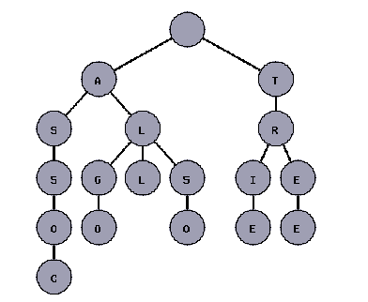
The next figure shows a trie with the words "tree", "trie", "algo", "assoc", "all", and "also."
Trie Tree

Slide 6
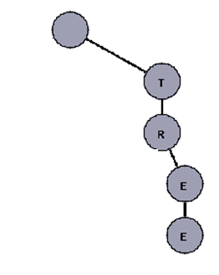

Trie Tree
1st word => tree

Slide 7
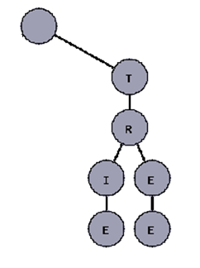
Trie Tree
2nd word => trie

Slide 8
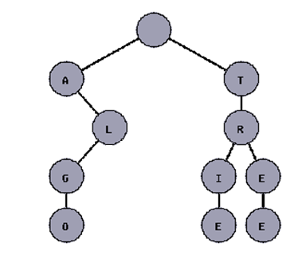
Trie Tree
3rd word => algo

Slide 9
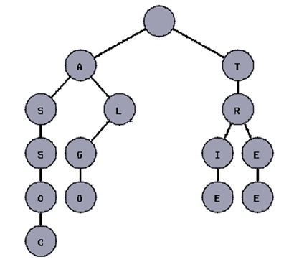
Trie Tree
4th word => assoc

Slide 10
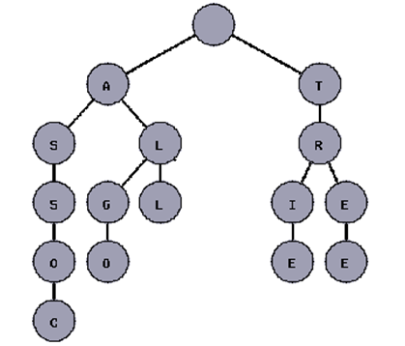
Trie Tree
5th word => all

Slide 11
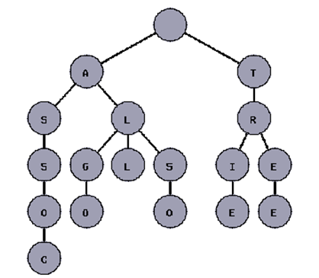
Trie Tree
6th word => also

Slide 12
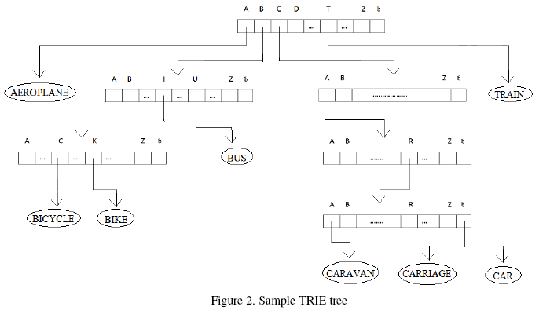
Trie Tree

Slide 13
Problem
We have some Human name, we can add, delete & search some name.
=> If number of name is n = 10,00,000, we want to search or delete a name(k is the length of the name), then
If we use array, we need O(n*k) complexity.
If we sort the array & using binary search then, for search we need O(k * log n) but for delete we need O(n) complexity.
If we use trie, we need O(k) complexity for add, search & delete.

Slide 14
Solution
static int[] _count = new int[1000009];
static int[][] _child = new int[1000009][];static int N = 0;
static int AddElement(int root, string element, int position)
{ if (element.Length == position)
{ _count[root]++;
return _count[root]; }
else
{ if (_child[root][element[position] - 'a'] == -1)
{ _count[N] = 0;_child[N] = new int[26];
for (int i = 0; i < 26; i++)
_child[N][i] = -1;
_child[root][element[position] - 'a'] = N;
N++;
}
return AddElement(_child[root][element[position] - 'a'], element, position + 1);
}
}

Slide 15
Solution
static void Main(string[] args)
{
_count[0] = 0;
_child[0] = new int[26];
for (int i = 0; i < 26; i++)
_child[0][i] = -1;
N = 1;
while (true)
{
string input = Console.ReadLine();
if (input == null)
break;
Console.WriteLine(AddElement(0, input.ToLower(), 0));
}
}

Slide 16
Segment Tree
A segment tree is a heap-like data structure that can be used for making update/query operations upon array intervals in logarithmical time.
Query time: O(log n)
Initialize time: O(2 * n)
Update time: O(log n)

Slide 17
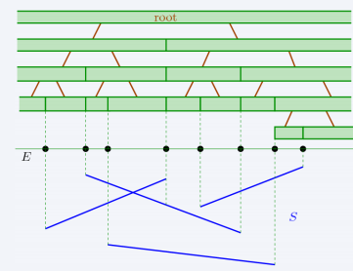
Segment Tree

Slide 18
Segment Tree
We define the segment tree for the interval [i, j] in the following recursive manner:
the first node will hold the information for the interval [i, j]
if i<j the left and right son will hold the information for the intervals [i, (i+j)/2] and [(i+j)/2+1, j]

Slide 19
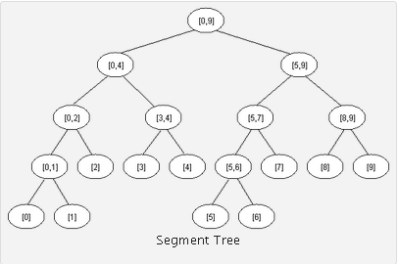
Segment Tree

Slide 20
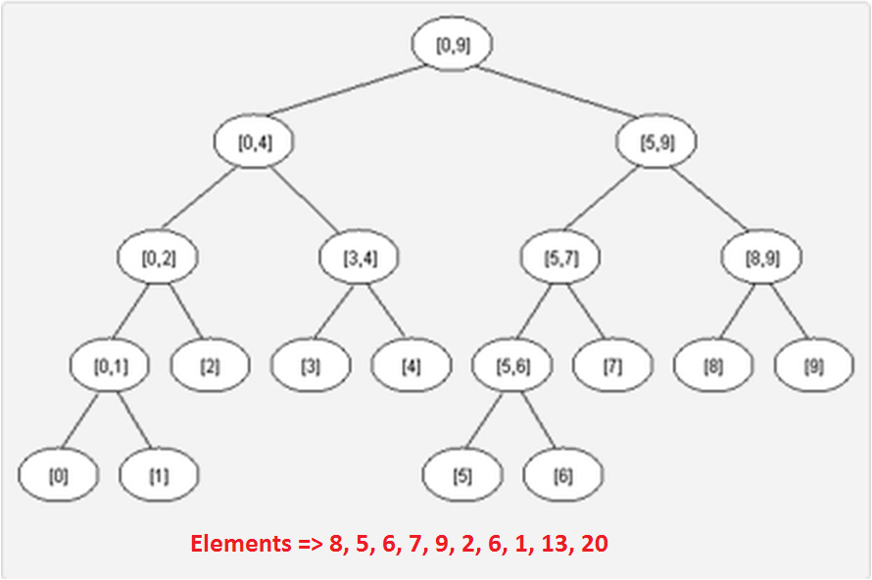
Segment Tree

Slide 21
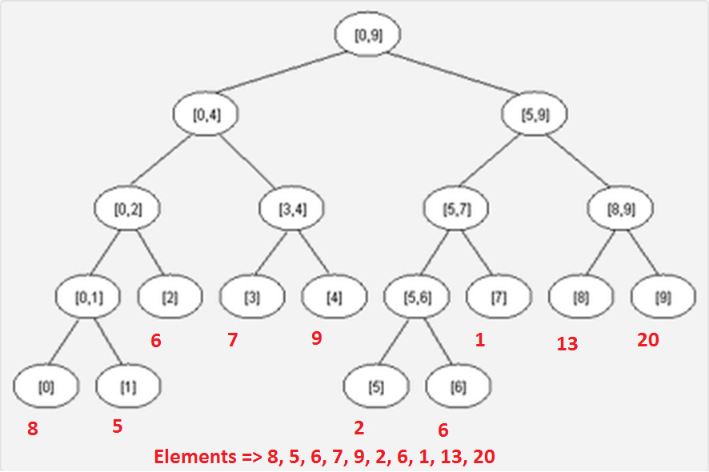
Segment Tree

Slide 22
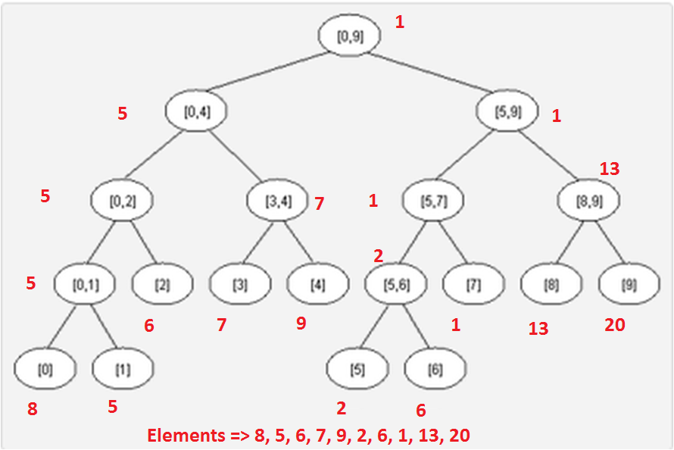
Segment Tree
Initialize

Slide 23
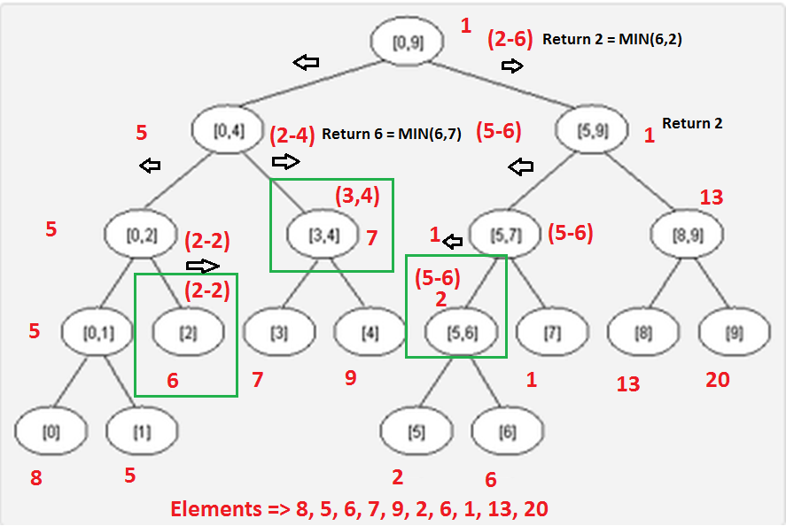
Segment Tree
Query For 2 to 6

Slide 24
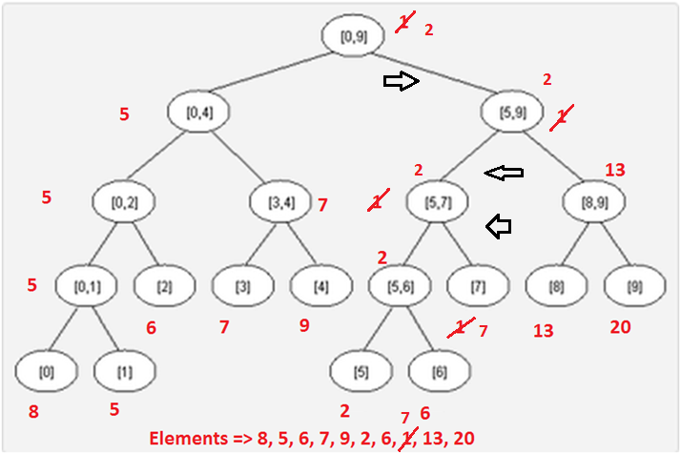
Segment Tree
Update Element 7 value to 7

Slide 25
Problem
You are given n (1<=n<=100000) integers & 100000 query. Each query you have to change a value of an element Or you have to given the minimum value of a range.
=> If we use array, then complexity q * n. For the above case it will take, 10000000000 operation, that means 100 sec.
=> If we use segment tree then complexity is q * log (n). It will take 0.01 sec.

Slide 26
Solution
static int[] element = new int[100009];
static int[] mini = new int[200009];static int[] left = new int[200009];static int[] right = new int[200009];
static int N = 0;
static int Init(int start, int end)
{
if (start == end)
{ left[N] = -1;right[N] = -1;
mini[N] = element[start];N++;
return N - 1; }
else
{ int temp = N; N++;
left[temp] = Init(start, (start + end) / 2);
right[temp] = Init((start + end) / 2 + 1, end);
mini[temp] = mini[left[temp]];
if (mini[temp] > mini[right[temp]])
mini[temp] = mini[right[temp]];
return temp; } }

Slide 27
Solution
static int RMQ(int root, int start, int end, int rootStart, int rootEnd)
{
if (start == rootStart && end == rootEnd)
return mini[root];
else if (end <= (rootStart + rootEnd) / 2)
return RMQ(left[root], start, end, rootStart, (rootStart + rootEnd) / 2);
else if ((rootStart + rootEnd) / 2 < start)
return RMQ(right[root], start, end, (rootStart + rootEnd) / 2 + 1, rootEnd);
else
{
int temp1 = RMQ(left[root], start, (rootStart + rootEnd) / 2, rootStart, (rootStart + rootEnd) / 2);
int temp2 = RMQ(right[root], (rootStart + rootEnd) / 2 + 1, end, (rootStart + rootEnd) / 2 + 1, rootEnd);
if (temp1 > temp2)
temp1 = temp2;
return temp1;
} }

Slide 28
Solution
static void Update(int root, int index, int value, int rootStart, int rootEnd)
{
if (rootStart == index && rootEnd == index)
mini[root] = value;
else
{
if (index <= (rootStart + rootEnd) / 2)
Update(left[root], index, value, rootStart, (rootStart + rootEnd) / 2);
else
Update(right[root], index, value, (rootStart + rootEnd) / 2 + 1, rootEnd);
mini[root] = mini[left[root]];
if (mini[root] > mini[right[root]])
mini[root] = mini[right[root]];
}
}

Slide 29
Solution
static void Main(string[] args)
{
string input = Console.ReadLine();
int n = Convert.ToInt32(input);
for (int i = 0; i < n; i++)
{
input = Console.ReadLine();
element[i] = Convert.ToInt32(input);
}
N = 0;
Init(0, n - 1);
input = Console.ReadLine();
int q = Convert.ToInt32(input);
for (int q1 = 1; q1 <= q; q1++)
{
input = Console.ReadLine();
string[] inputs = input.Split(' ');
int x = Convert.ToInt32(inputs[0]);
int y = Convert.ToInt32(inputs[1]);
int z = Convert.ToInt32(inputs[2]);
if (x == 1)
Console.WriteLine(RMQ(0, y, z, 0, n - 1));
else
Update(0, y, z, 0, n - 1);
}
}

Slide 30
Segment Tree
Segment trees are very powerful, not only because they can be used for RMQ(Range Minimum Query). They are a very flexible data structure, can solve even the dynamic version of RMQ problem, and have numerous applications in range searching problems.

Slide 31
lowest common ancestor (LCA)
The lowest common ancestor (LCA) is a concept in graph theory and computer science. Let T be a rooted tree with n nodes. The lowest common ancestor is defined between two nodes v and w as the lowest node in T that has both v and w as descendants (where we allow a node to be a descendant of itself).

Slide 32
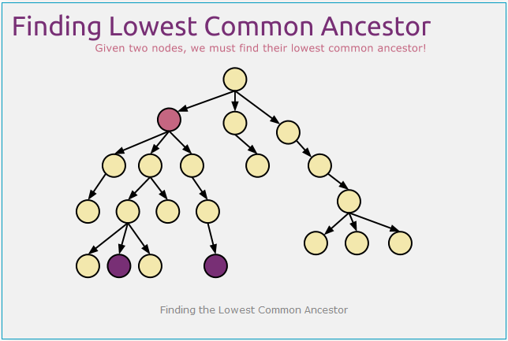
lowest common ancestor (LCA)

Slide 33
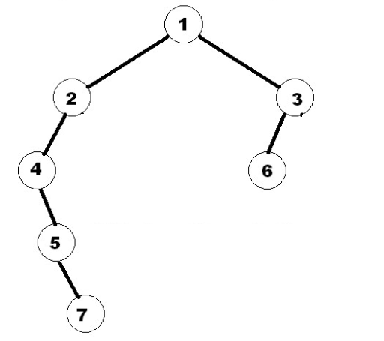
lowest common ancestor (LCA)
We generate a table.

Slide 34
lowest common ancestor (LCA)
Node | 2^0 Parent | 2^1 Parent | 2^2Parent
1 | -1 | -1 | -1
2 | 1 | -1 | -1
3 | 1 | -1 | -1
4 | 2 | 1 | -1
5 | 4 | 2 | -1
6 | 3 | 1 | -1
7 | 5 | 4 | 1

Slide 35
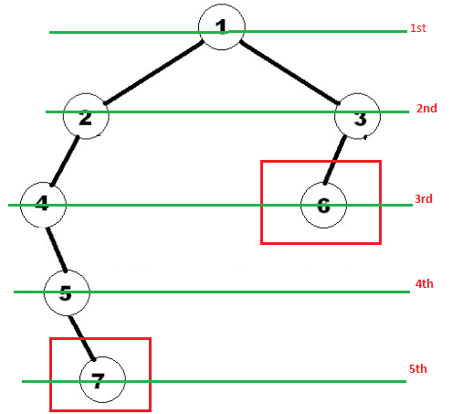
lowest common ancestor (LCA)
Node | Label
1 | 1
2 | 2
3 | 2
4 | 3
5 | 4
6 | 3
7 | 5

Slide 36
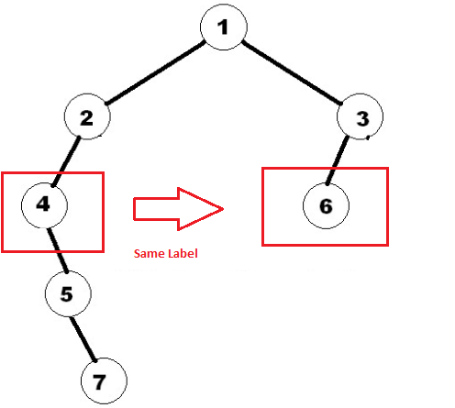
lowest common ancestor (LCA)

Slide 37
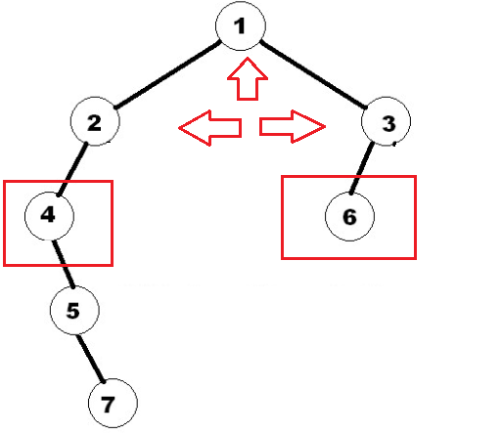
lowest common ancestor (LCA)

Slide 38
Problem
You live in a Big country where there are many bi-directional roads connecting the cities. Since the people of the country are quite intelligent, they designed the country such that there is exactly one path to go from one city to another. A path consists of one or more connected roads.
Here cities are denoted by integers and each road has a cost of traveling. Now you are given the information about the Country. And you are given some queries, each consists of two cities. You have to find the longest road in the path from one city to another.
Input:
n (2 ≤ n ≤ 10⁵) denoting the number of cities. Then there will be n-1 lines containing three integers each. They will be given in the form u v w (1 ≤ u, v ≤ n, 0 < w ≤ 10⁵, u ≠ v) meaning that there is a road between u and v and the cost of the road is w.
The next line contains an integer q (1 ≤ q ≤ 25000) denoting the number of queries. Each of the next q lines contains two integers x and y (1 ≤ x, y ≤ n, x ≠ y).

Slide 39
Problem
Input:
6
3 6 50
2 5 30
2 4 300
1 2 100
1 3 200
4
1 4
4 6
2 5
3 5
Output:
300
300
30
200
If we solve it only by parent up, then for easy query, we will need O(n) complexity.
If we solve it by LCA, then for each query, we will need O(log n) complexity.

Slide 40
Solution
public class Edge
{ public int node; public int cost;}
static List<Edge>[] _connectedNodes = null;
static int[] _dfsNumber = null;
static int[][] _parent = null;
static int[][] _maxCost = null;
static void DFS(int node, int parent, int edgeCost, int dfsNumber)
{
_parent[node][0] = parent;
_maxCost[node][0] = edgeCost;
_dfsNumber[node] = dfsNumber;
for (int i = 0; i < _connectedNodes[node].Count; i++)
if (_dfsNumber[_connectedNodes[node][i].node] == -1)
DFS(_connectedNodes[node][i].node, node, _connectedNodes[node][i].cost, dfsNumber + 1);
}

Slide 41
Solution
static void Main(string[] args)
{
string input = Console.ReadLine();
int n = Convert.ToInt32(input);
_connectedNodes = new List<Edge>[n + 1];
_dfsNumber = new int[n + 1];
_parent = new int[n + 1][];
_maxCost = new int[n + 1][];
for (int i = 1; i <= n; i++)
{
_dfsNumber[i] = -1;
_parent[i] = new int[18];
_maxCost[i] = new int[18];
_connectedNodes[i] = new List<Edge>();
}
for (int i = 1; i < n; i++)
{
input = Console.ReadLine();
string[] inputs = input.Split(' ');
int x = Convert.ToInt32(inputs[0]);
int y = Convert.ToInt32(inputs[1]);
int z = Convert.ToInt32(inputs[2]);
_connectedNodes[x].Add(new Edge { node = y, cost = z });
_connectedNodes[y].Add(new Edge { node = x, cost = z });
}
DFS(1, -1, 0, 1);

Slide 42
Solution
for (int j = 1; ; j++)
{
bool flag = false;
for (int i = 1; i <= n; i++)
{
if (_parent[i][j - 1] != -1 && _parent[_parent[i][j - 1]][j - 1] != -1)
{
_parent[i][j] = _parent[_parent[i][j - 1]][j - 1];
_maxCost[i][j] = _maxCost[i][j - 1];
if (_maxCost[i][j] < _maxCost[_parent[i][j - 1]][j - 1])
_maxCost[i][j] = _maxCost[_parent[i][j - 1]][j - 1];
flag = true;
}
else
_parent[i][j] = -1;
}
if (!flag)break;
}

Slide 43
Solution
input = Console.ReadLine();
int q = Convert.ToInt32(input);
for (int q1 = 1; q1 <= q; q1++)
{
input = Console.ReadLine();
string[] inputs = input.Split(' ');
int x = Convert.ToInt32(inputs[0]);
int y = Convert.ToInt32(inputs[1]);
int max = 0;
if (_dfsNumber[x] > _dfsNumber[y])
{
int z = x;
x = y;
y = z;
}

Slide 44
Solution
while (_dfsNumber[x] != _dfsNumber[y])
{
for (int i = 0; ; i++)
{
if (_parent[y][i] == -1 || _dfsNumber[_parent[y][i]] < _dfsNumber[x])
{
y = _parent[y][i - 1];
break;
}
else
{
if (_maxCost[y][i] > max)
max = _maxCost[y][i];
}
}
}

Slide 45
Solution
while (x != y)
{
for (int i = 0; i < 18; i++)
{
if (_parent[x][i] == _parent[y][i])
{
if (i == 0)
{
if (_maxCost[x][i] > max)
max = _maxCost[x][i];
if (_maxCost[y][i] > max)
max = _maxCost[y][i];
x = _parent[x][i];
y = _parent[y][i];
}
else
{
x = _parent[x][i - 1];
y = _parent[y][i - 1];
}
break;
}
else
{
if (_maxCost[x][i] > max)
max = _maxCost[x][i];
if (_maxCost[y][i] > max)
max = _maxCost[y][i];
}
}
}
Console.WriteLine(max);
}
}

Slide 46
Thanks!

