Slide 1
FreeFall
Atease
Focus on the important

Slide 2
Problem
Current process of textbook purchasing on campus is time consuming.
Second hand merchants do not have a platform for the management of selling their books.
Students have to physically go from merchant to merchant to compare prices and acquire quotes.

Slide 3
Our solution Introducing “The AtEase Sytem.
Compare Prices
Acquire Quotes
Initiates Communication

Slide 4
How it works

Slide 5

User Registration

Slide 6
Student Features

Slide 7


Prescribed and Recommended Books
Search Bar

Slide 8




Compare Prices
Add to Quote / Download / Donations

Slide 9
Merchant Features

Slide 10
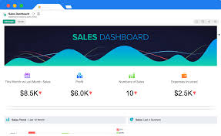
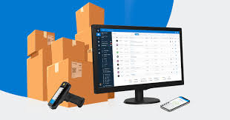
Merchant Dashboard
Stock Management

Slide 11
Admin Features

Slide 12

Admin Dashboard

Slide 13
End of Sytem

