Slide 1
Mr.C
Developed and created by:
Stuti Sakhi and Yerania Hernandez

Slide 2

Problem
Challenge: Machine Reading Comprehension
Read, process, and understand natural language text
Complex model necessary for interactions between query and context
Multiple approaches, promising results?
Used attention weights on summarized context
Computed weights from query to context (unidirectional)
Used word embeddings compared to character embeddings
Different networks: LSTM vs. GRU

Slide 3
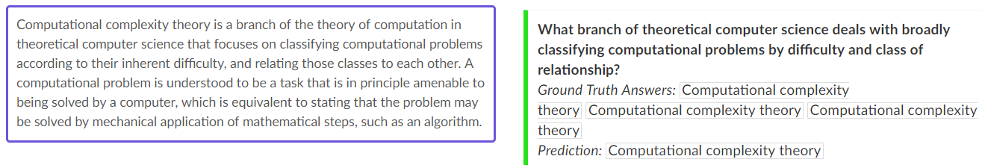
SQuAD Dataset
Over 100,000 question and answer pairs
Created with crowd workers on Wikipedia articles
Answers always found within context
Diversity of questions and topics
Notes:
Stanford Question Answering Dataset

Slide 4
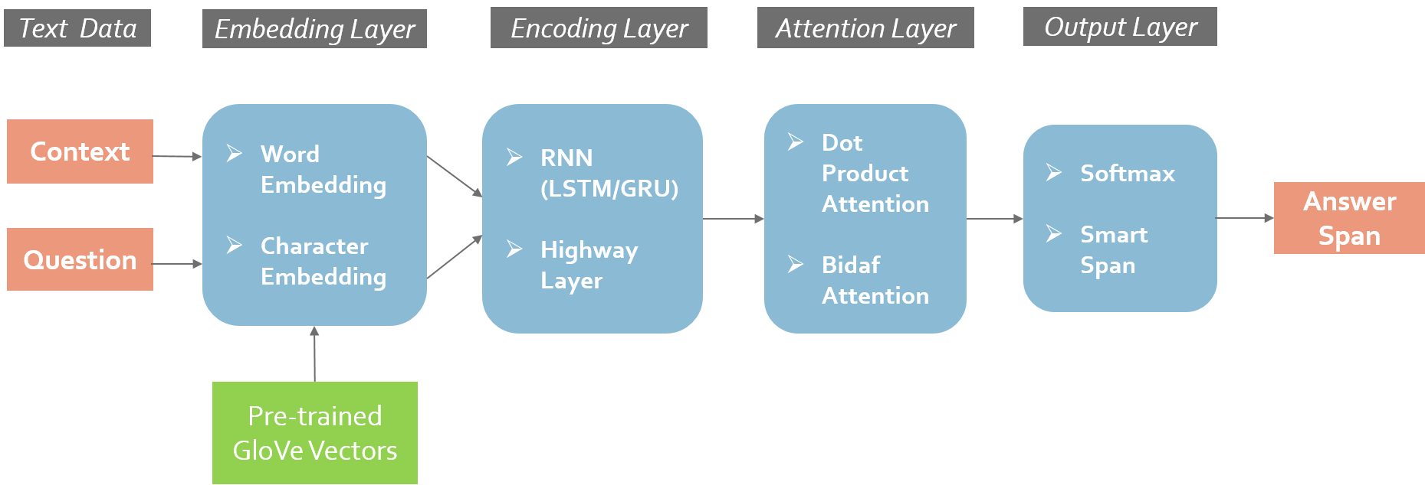
Approach Overview

Slide 5

Embedding Layer
Purpose : To convert data to numerical vectors
Two Embedding Methods:
Word Embedding : Pre-trained GloVe Vectors
Character Embedding : Char level CNN was trained
Used concatenation of both the embedding

Slide 6

Encoding Layer
Purpose : Generate encoding of the context embedding and answer embedding so that each word in them is aware of the words before it and after it.
Compared the performance of 2 Recurrent Neural Networks
Long Short Term Memory (LSTM)
Gated Recurrent Unit (GRU)
Also tested by adding a Highway Layer to increase the complexity of model.

Slide 7

Attention Layer
Purpose: To blend the context and question embedding in order to find the words relevant to the question in the context.
Compared Performance of two Attention Mechanisms:
Dot Product Attention : Primitive context to question attention
Bidirectional Attention Flow : Both context to question and question to context learning based attention

Slide 8

Output Layer
Purpose: Predict span of answer, start and end index
Uses softmax to calculate probability distribution
Two span methods
Maximum Span: Highest probability for each vector
Smart Span: Maximum probability between span of 15 words

Slide 9
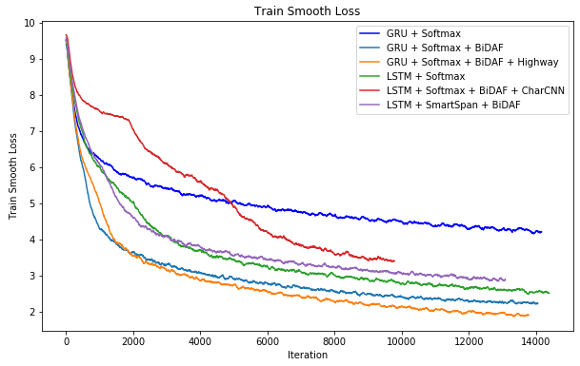
Results

Slide 10
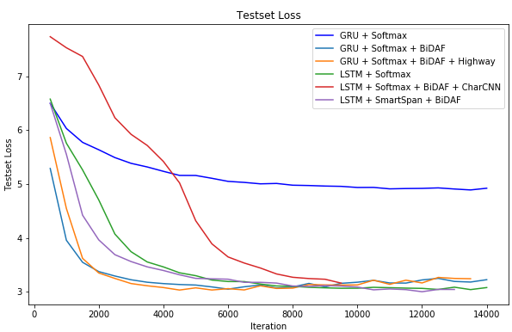
Results

Slide 11
Results
Embedding Layer | Encoding Layer | Attention Layer | Output Layer | Dropout | F1 Score |  | EM Score
 |  |  |  |  | Train | Test | Train | Test
Glove | GRU | Dot Product | Softmax | 0.85 | 57.41 | 36.47 | 45.30 | 25.95
Glove | GRU | BiDAF | Softmax | 0.85 | 85.01 | 64.28 | 72.70 | 49.11
Glove | GRU + Highway | BiDAF | Softmax | 0.85 | 89.41 | 65.47 | 77.30 | 50.46
Glove | LSTM | BiDAF | Softmax | 0.75 | 81.29 | 64.83 | 66.70 | 50.18
Glove + Char CNN | LSTM | BiDAF | Softmax | 0.70 | 69.07 | 61.95 | 55.50 | 46.89
Glove | LSTM | BiDAF | Smart Span | 0.75 | 77.66 | 66.43 | 64.90 | 50.56

Slide 12


Final Model

Slide 13

Conclusion
Improvements
Google Collab GPU
Running Time
Various feature combinations
Best Model Results
Test F1 Score: 66.43
Test EM Score: 50.56

Slide 14
Thank you!
Any questions?

