Slide 1
Zero Shot Learning
Prateek Shroff
Stuti Sakhi

Slide 2
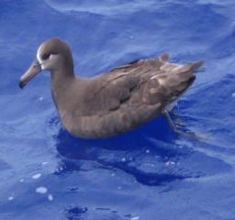
TRAINING
(Seen Classes)
TESTING
(Unseen Classes)
Semantic Features
Semantic features
Model
Visual Features
Model
KNN
Visual Features
Output Label

Slide 3
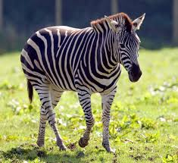
Long
tail
Stripes
Mean Square
4 legs
Cosine
Zebras have horse like bodies, their tails are tufted at the tip and their coats have distinctive white and black stripes.

Slide 4
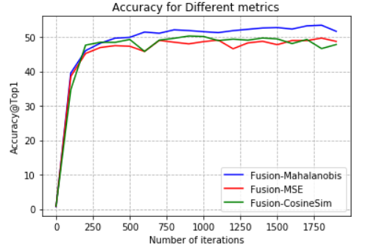
54.1%
51.1%
50.2%

Slide 5
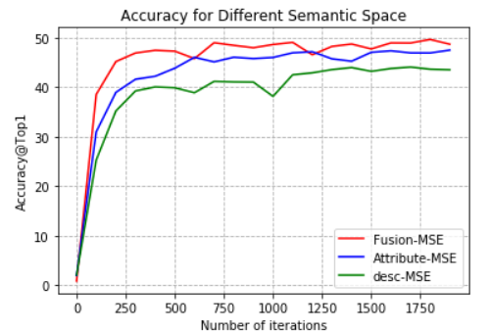
51.1%
48.9%
44.6%

