Slide 1
Manual Video Editing is Slow, Expensive & Ignores Local Languages
Current workflow bottlenecks for regional talking-head creators and educators
Slow & Expensive Manual Process
Talking-head creators and educators spend hours cleaning messy takes filled with pauses and fillers. Hiring help is costly, with Malayalam short-form editors earning ₹3–5 lakh annually.
₹3–5 Lakh
Annual cost for Malayalam short-form editors
Initial Focus Market
Solving for Regional Creators
Our initial focus is solving this for Malayalam and Manglish creators, educators, and local businesses.
Existing AI Tools Fail Regional Needs
Meanwhile, global AI editors are English-first, CapCut is banned in India, and code-mixed Manglish breaks existing caption tools.

Slide 2
Automated, Localized Editing via Video-as-Code
Market & Tech Drivers
Why Now?
Core Insight
"Video-as-Code"
The AI never directly touches pixels.
Instead, it reads transcripts and generates a lightweight JSON edit plan for cuts and graphics.
Final rendering is executed cleanly and cheaply via FFmpeg.
Speech-to-Text Progress
Modern STT models accurately capture complex, code-mixed speech across diverse regional dialects.
Advanced LLMs
Current models reliably output structured execution plans in a single, fast API call.
Rapid Indian Creator Growth
As local creator ecosystems explode, our code-driven tools directly bridge the existing technology gap.

Slide 3
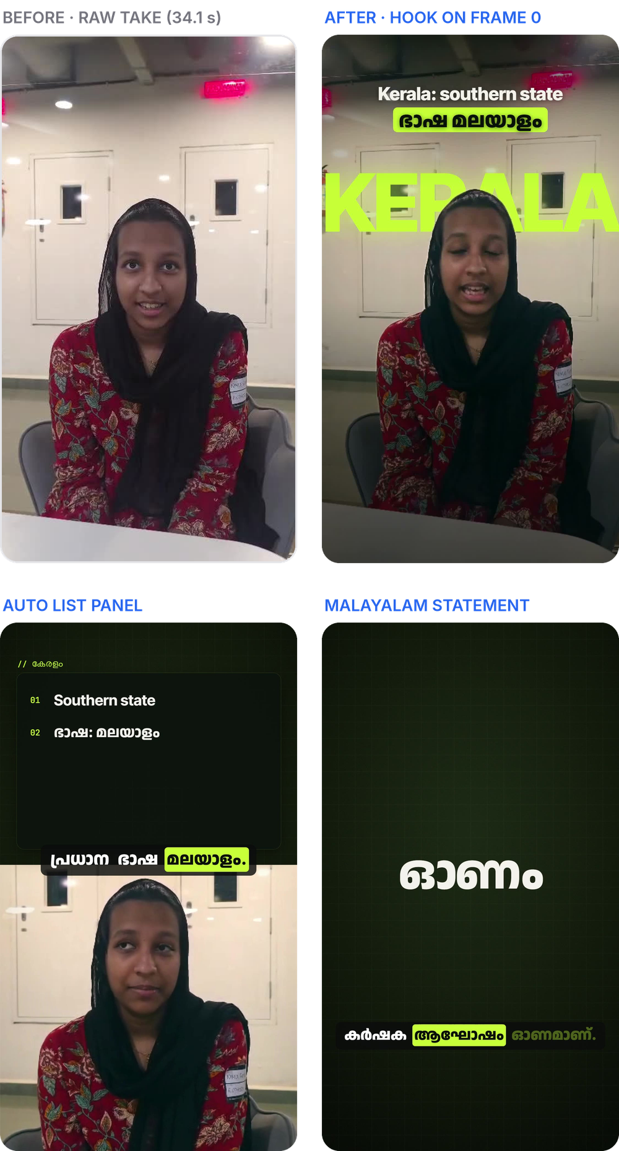
From Raw Clip to Reel-Ready in Minutes
Real frames from our MVP: raw take to finished reel.
STEP 01
Upload Clip
Upload raw video and select caption language.
STEP 02
AI Edit Plan
Cuts pauses, fixes captions & adds graphics (Malayalam summary).
STEP 03
Polished Reel
Optimized 9:16 video with IG-ready loudness.
TEST RESULTS & PERFORMANCE METRICS
27.1s
~10s
~6K
Tightened Duration
Down from 34.1s (8 pauses removed)
Transcription Time
gpt-4o-transcribe, per clip
Tokens / Reel
One Claude call; retries reuse it

Slide 4
A Deterministic Pipeline Powered by a Single AI Call
One Claude AI decision engine structures the edit plan; deterministic services handle execution.
STAGE 01
Normalize
STAGE 02
Transcribe
STAGE 03
Word Align
STAGE 04 (AI)
Claude Plan
STAGE 05
Render
INTAKE
FFmpeg
Initial video & audio normalization and format standardisation.
STT ENGINES
Speech-to-Text
• OpenAI gpt-4o-transcribe
• Offline faster-whisper (Malayalam)
TIMING
Custom Aligner
Generates precise word-level timestamping for accurate edit points.
SINGLE AI CALL
OUTPUT
FFmpeg Render
• HTML overlay graphics templates
• Synthesized sound effects (SFX)
Claude AI
Generates a strict JSON edit plan in one single pass.
Guarantees downstream determinism.
SYSTEM BACKEND: Fully orchestrated and managed via a high-performance Python / FastAPI service layer.

Slide 5
Monetizing Time Saved for Creators and Institutes
Value Proposition & Savings
₹3–5L / yr
Replacing Traditional Video Editors
Transforms hours of tedious editing into minutes of effortless review, at a fraction of an editor’s salary.
Go-To-Market Strategy
"Done-for-You" Kerala Seeding
Begins with high-touch "done-for-you" editing for Kerala creators to establish product value and build strong local proof points.
Community Word-of-Mouth
Leverages close creator networks and organic advocate referral channels for expansion.
Monetization Model
• Freemium Model for Creators
Free monthly minutes, then a paid creator plan priced for India.
• Scaled Team Plans
Tailored recurring plans engineered for educators, institutes, and agencies.
Differentiation vs Submagic & Cardboard
• Native Manglish Processing
Seamlessly handles Manglish natively, breaking away from English-first constraints.
• Closed-Loop Analytics (Roadmap)
Will feed audience retention data back into future edits.

Slide 6
Evolving from an Editor to an AI Growth Partner
Product Roadmap
Risk & Mitigation Matrix
NOW
Talking-Head Reels MVP
Working MVP today for Malayalam/Manglish talking-head content.
Risk Factor
Mitigation Strategy
Transcription Errors
Vernacular speech & accent gaps
Offline Models + Human Review
Offline local models as fallback with AI caption fixes & human verification.
NEXT
Retention-Driven Editing
Use analytics drop-off points to fix future cuts.
Render Speed
~15 min per short clip on CPU
Dedicated GPU Hosting
GPU hosting, plus fast draft renders for quick review.
THEN
AI Growth Coach
Compare stats with top niche creators; explain gaps in the creator’s language.
Cloud Cost
Scaling compute overhead
Hybrid Local Fallback
Utilizing local models for transcription tasks to reduce API dependence.
LATER
Regional Expansion
Hindi and Tamil next (transcription prompts already written).
Platform Limits
Instagram API gives averages only
Screenshot Reading First
Read the in-app retention graph; add APIs as access allows.

