Slide 1
Surface Crack Detection Using Deep Convolutional Neural Network

Slide 2
Rajshahi University Of Engineering & Technology
Department of Computer Science & Engineering
Presented By
Sadman Sakib Radh
Roll: 1503007
Dept. of CSE, RUET
Supervised By
Prof. Dr. Md. Al Mamun
Professor
Dept. of CSE, RUET

Slide 3
Outline
Introduction
Motivation
Literature Review
Dataset
Methodology
Implementation
Result Analysis
Conclusion

Slide 4
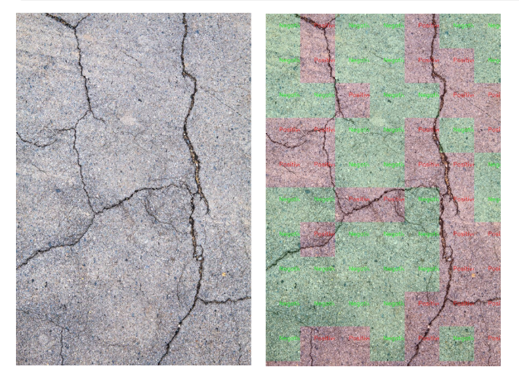
Introduction
Measurement of the extent of cracks on the surface of a material (usually a solid material such as metals, plastics and ceramics).
Fig 1: Surface Crack [1]

Slide 5
Motivation
Concrete surface cracks are major defect in civil structures
Detecting Crack of surfaces more accurately
More accuracy ensures less accident in highway
Inspecting, finding the cracks and determining the building health

Slide 6
Literature Review
Autonomous concrete crack detection using deep fully convolutional neural network [2]
Applied Method - VGG16, Inception V3, ResNet50
Dataset - 40,000
Accuracy - 0.998, 0.997, 0.975

Slide 7
Literature Review
2. Road Crack Detection Using Deep Convolutional
Neural Network [3]
Applied Method - ConvNets
Dataset - 40,000
Accuracy - 0.8965

Slide 8
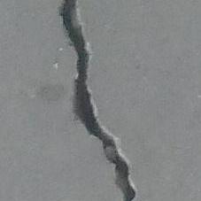

Dataset
The dataset is created from 458 (4032x3024 pixel) high-resolution images using the method proposed by Zhang et al (2016) [3]
Consists of 40,000 images of 227 x 227 in RGB
20,000 positive images (Crack)
20,000 negative images (Non Crack)
Fig 2: Crack Image [3]
Fig 3: Non Crack Image [3]

Slide 9
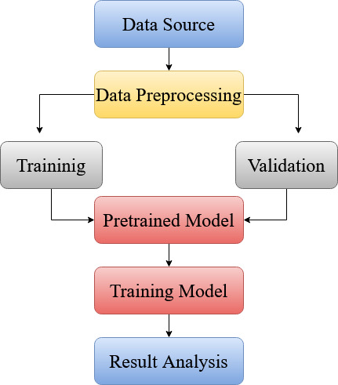
Methodology
Fig 4: Workflow

Slide 10
Implementation
Data Preprocessing:
Image Resize: Images are resized into 150 x 150 (RGB) to make all image size uniform for VGG16 model [4] (pretrained model)
Normalization: Images are rescaled between 0 to 1 by dividing each pixel value by 255
2. Data Split:
Datasets are splitted into ‘Training’ and ‘Validation’ (30
percent randomly) sets

Slide 11
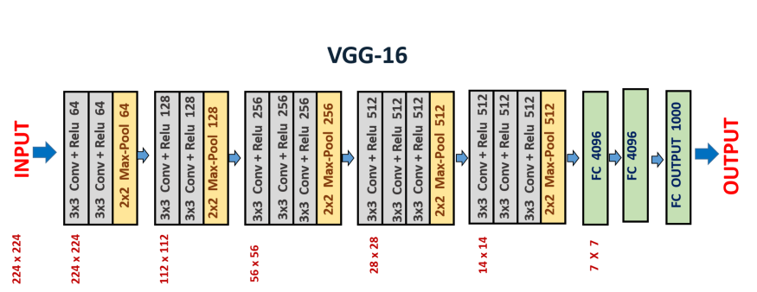
Implementation
3. Model Architecture:
Fig 5: VGG16 Model [4]

Slide 12
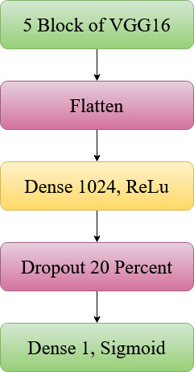
Implementation
Parameters:
Epoch: 20
Batch Size: 64
Optimizer: Adam [5]
Loss Function: binary_crossentropy [6]
Dropout: 20 percent
Learning rate: 0.001
Fig 6: Model Architecture

Slide 13
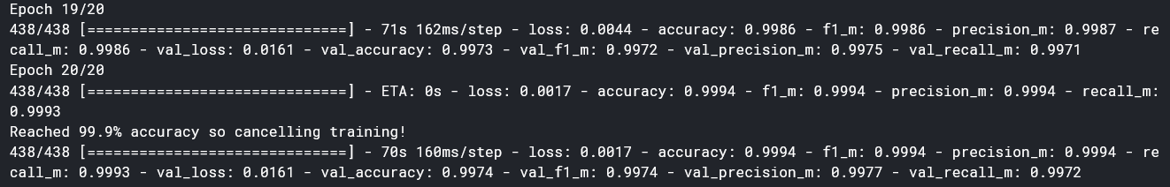
Result Analysis
Fig 7: Model Accuracy

Slide 14
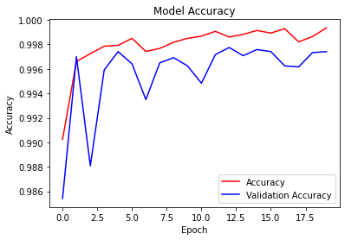
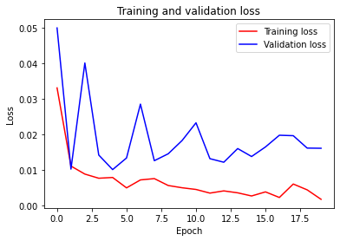
Result Analysis
Fig 7: Accuracy vs Epoch Curve (lr=0.001)
Fig 8: Loss vs Epoch Curve (lr=0.001)

Slide 15
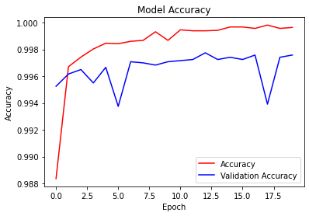
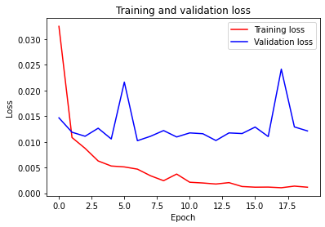
Result Analysis
Fig 7: Accuracy vs Epoch Curve (lr=0.0001)
Fig 8: Loss vs Epoch Curve (lr=0.0001)

Slide 16
Result Analysis
Performance of Different Methods:
Method | Accuracy | Recall | Precision | F1 Score
VGG16 [2] | 0.998 | 0.999 | 0.998 | 0.998
Inception V3 [2] | 0.997 | 0.997 | 0.998 | 0.997
ResNet [2] | 0.975 | 0.945 | 0.994 | 0.968
Proposed Method | 0.999 | 0.9993 | 0.999 | 0.999
Table 1: Performance of Different Methods

Slide 17
Conclusion
The dataset was preprocessed before feeding the network
VGG16 was successfully implemented and validated
Performance analysis was done
Future Works:
Extend the dataset using augmentation
Performance comparison of different neural network models

Slide 18
References
[1] Deep learning analytics, 2020. Detection of Surface Cracks in Concrete Structures using Deep Learning. https://deeplearninganalytics.org/detection-of-surface-cracks-in-concrete-structures-using-deep-learning.
[2] Dung, C.V., 2019. Autonomous concrete crack detection using deep fully convolutional neural network. Automation in Construction, 99, pp.52-58.
[3] Zhang, L., Yang, F., Zhang, Y.D. and Zhu, Y.J., 2016, September. Road crack detection using deep convolutional neural network. In 2016 IEEE international conference on image processing (ICIP) (pp. 3708-3712). IEEE.
[4] Vaibhav Khandelwal, 2020. The Architecture and Implementation of VGG-16. https://medium.com/towards-artificial-intelligence/the-architecture-and-implementation-of-vgg-16-b050e5a5920b.
[5] https://towardsdatascience.com/adam-latest-trends-in-deep-learning-optimization-6be9a291375c
[6] https://keras.io/api/preprocessing/image/

Slide 19
THANK YOU

