Slide 1

Stop Sign Detection Using Machine Learning
Group :09
Members:
Ismot Jahan Moni (2112399642)
Md Shariful Islam Sakib (2011716042)
Muhammad Imam Hassan (2013362042)
Iktear alam (2111577642)

Slide 2

Why Stop Sign Detection?
Helps prevent accidents by improving road safety
Crucial for autonomous vehicles & driver assistance systems
Group :09 ( Ismot jahan moni ) ( Muhammad Imam Hassan ) ( Iktear alam ) ( Md Shariful Islam Sakib )

Slide 3
Approach
Machine Learning-Based
Dataset: 50 images (25 stop signs, 25 no stop signs)
Feature Extraction: Grayscale, Resizing, HOG features
Group :09 ( Ismot jahan moni ) ( Muhammad Imam Hassan ) ( Iktear alam ) ( Md Shariful Islam Sakib )

Slide 4
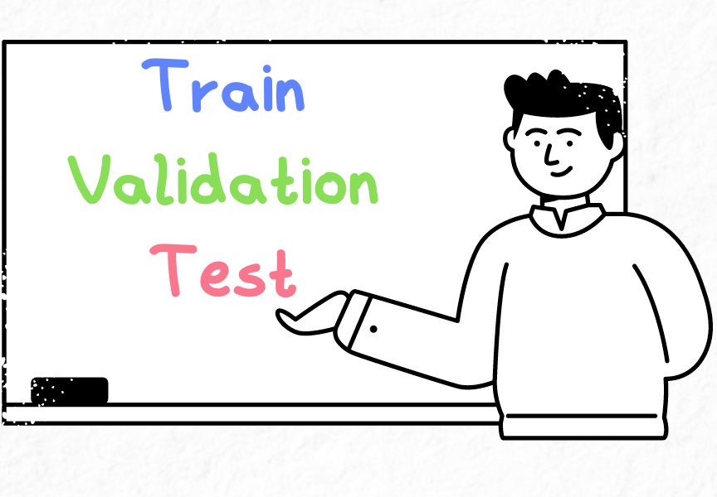
Dataset & Preprocessing
Dataset split:
Dataset & Preprocessing
70% Training (18 images/class)
20% Testing (5 images/class)
10% Validation (2 images/class)
Preprocessing Steps:
Convert to grayscale
Resize to 64x64 pixels
Flatten for feature extraction
Normalize pixel values
Group :09 ( Ismot jahan moni ) ( Muhammad Imam Hassan ) ( Iktear alam ) ( Md Shariful Islam Sakib )

Slide 5
Feature Extraction & Model Training
Feature Extraction: Histogram of Oriented Gradients (HOG)
Model: Support Vector Machine (SVM)
Training Details: Used Scikit-learn, Linear Kernel
Group :09 ( Ismot jahan moni ) ( Muhammad Imam Hassan ) ( Iktear alam ) ( Md Shariful Islam Sakib )

Slide 6

Results & Discussion
Test Accuracy: 80%
Validation Accuracy: 50%
Key Issues:
Overfitting: High training accuracy (100%)
but lower validation accuracy
Limited dataset: Small sample size affects generalization
Misclassification: "No stop sign" images are harder to classify
Group :09 ( Ismot jahan moni ) ( Muhammad Imam Hassan ) ( Iktear alam ) ( Md Shariful Islam Sakib )

Slide 7

Conclusion
.
SVM effectively detects stop signs with limited data.
Model performs well but faces overfitting challenges
Future Improvements:
Expand dataset for better generalization
Explore hybrid ML approaches for optimization
Group :09 ( Ismot jahan moni ) ( Muhammad Imam Hassan ) ( Iktear alam ) ( Md Shariful Islam Sakib )

Slide 8

Thank You!!

