Slide 1


STOP SIGN DETECTION USING MACHINE LEARNING
GROUP :09
Members:
Ismot Jahan Moni (2112399642)
Md Shariful Islam Sakib (2011716042)
Muhammad Imam Hassan (2013362042)
Iktear alam (2111577642)

Slide 2
OVERVIEW
INTRODUCTION
APPROACH
METHODOLOGY
DATASET AND SPLITTING
FEATURE PROCESSING
MODEL TRAINING
Model Outputs & Confusion Matrices
Discussion & Challenges
Future Solutions
Conclusion
GROUP :09 ( ISMOT JAHAN MONI ) ( MUHAMMAD IMAM HASSAN ) ( IKTEAR ALAM ) ( MD SHARIFUL ISLAM SAKIB )

Slide 3
WHY STOP SIGN DETECTION?
AIM: TO DEVELOP A MACHINE LEARNING SYSTEM CAPABLE OF CLASSIFYING STOP SIGN IMAGES.
Real-world Application: Useful in autonomous vehicles, traffic monitoring systems.
Motivation: Automate traffic sign detection to enhance road safety.
GROUP :09 ( ISMOT JAHAN MONI ) ( MUHAMMAD IMAM HASSAN ) ( IKTEAR ALAM ) ( MD SHARIFUL ISLAM SAKIB )

Slide 4
APPROACH
USE OF PCA FOR DIMENSIONALITY REDUCTION
Comparison between three models: Logistic Regression, Random Forest, SVM
Evaluation via confusion matrix and accuracy score
Predict output for a new unseen image
GROUP :09 ( ISMOT JAHAN MONI ) ( MUHAMMAD IMAM HASSAN ) ( IKTEAR ALAM ) ( MD SHARIFUL ISLAM SAKIB )

Slide 5
METHODOLOGY
LOAD AND PREPROCESS IMAGE DATA
Convert images to grayscale and resize
Apply PCA for dimensionality reduction
Train models using scikit-learn
Evaluate using test data
Visualize confusion matrix
GROUP :09 ( ISMOT JAHAN MONI ) ( MUHAMMAD IMAM HASSAN ) ( IKTEAR ALAM ) ( MD SHARIFUL ISLAM SAKIB )

Slide 6
DATASET AND SPLITTING
DATASET: CUSTOM SET OF STOP SIGN AND NON-STOP SIGN IMAGES
Total Images: [50 fOR STOP SIGN , 50 FOR NON-STOP SIGN IMAGES]
SPLIT: 60% TRAIN (30 FOR EACH SET), 20% VAL (10), 20% TEST (10)
PREPROCESSING: GRAYSCALE CONVERSION, RESIZING TO (64,64)
GROUP :09 ( ISMOT JAHAN MONI ) ( MUHAMMAD IMAM HASSAN ) ( IKTEAR ALAM ) ( MD SHARIFUL ISLAM SAKIB )

Slide 7
PROCESSING OF FEATURES
GRAYSCALE PIXEL FLATTENING
PCA TRANSFORMATION TO 100 COMPONENTS
NORMALIZATION OF FEATURES
GROUP :09 ( ISMOT JAHAN MONI ) ( MUHAMMAD IMAM HASSAN ) ( IKTEAR ALAM ) ( MD SHARIFUL ISLAM SAKIB )

Slide 8
MODEL TRAINING
LOGISTIC REGRESSION
LOGREG = LOGISTICREGRESSION(C=0.1, MAX_ITER=1000, RANDOM_STATE=42)
RANDOM FOREST
RF_MODEL = RANDOMFORESTCLASSIFIER(N_ESTIMATORS=100, RANDOM_STATE=42)
SVM
SVM_MODEL = SVC(KERNEL="RBF", PROBABILITY=TRUE)
GROUP :09 ( ISMOT JAHAN MONI ) ( MUHAMMAD IMAM HASSAN ) ( IKTEAR ALAM ) ( MD SHARIFUL ISLAM SAKIB )

Slide 9
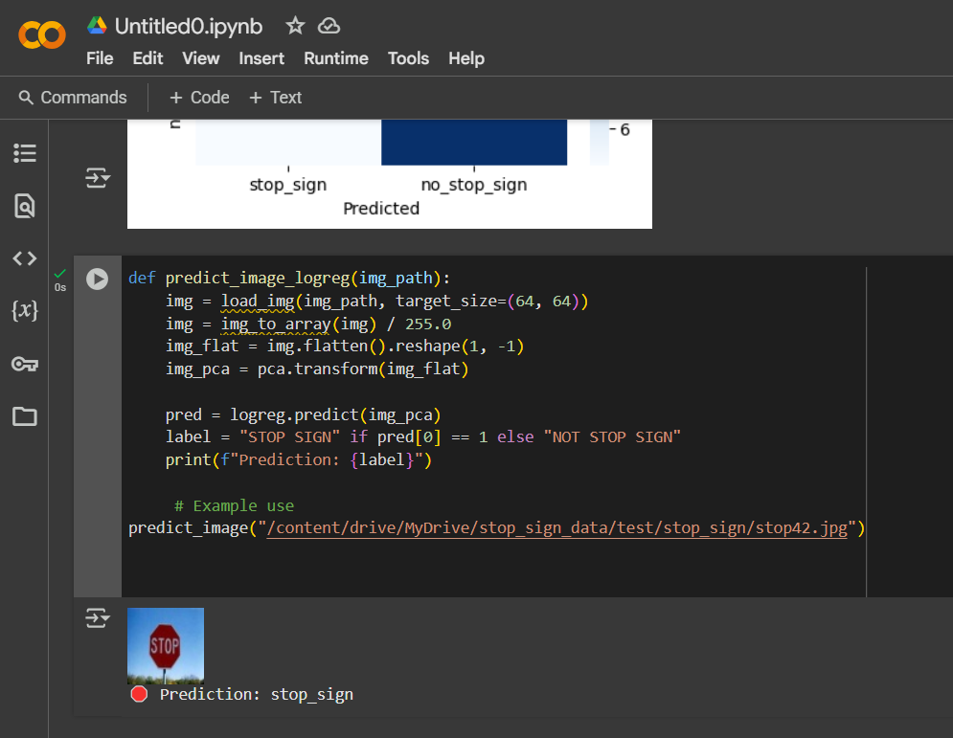
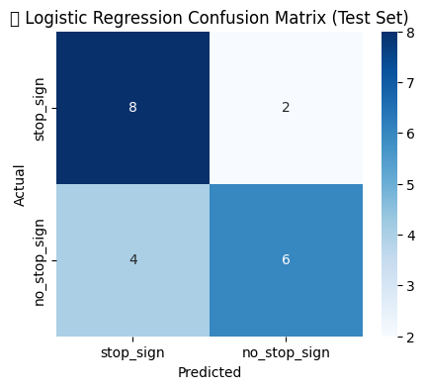
OUTPUTS & CONFUSION MATRICES
LOGISTIC REGRESSION
📌 LOGISTIC REGRESSION TRAIN ACCURACY: 1.00
📌 LOGISTIC REGRESSION VALIDATION ACCURACY: 0.75
📌 LOGISTIC REGRESSION TEST ACCURACY: 0.7
CONFUSION MATRIX:

Slide 10
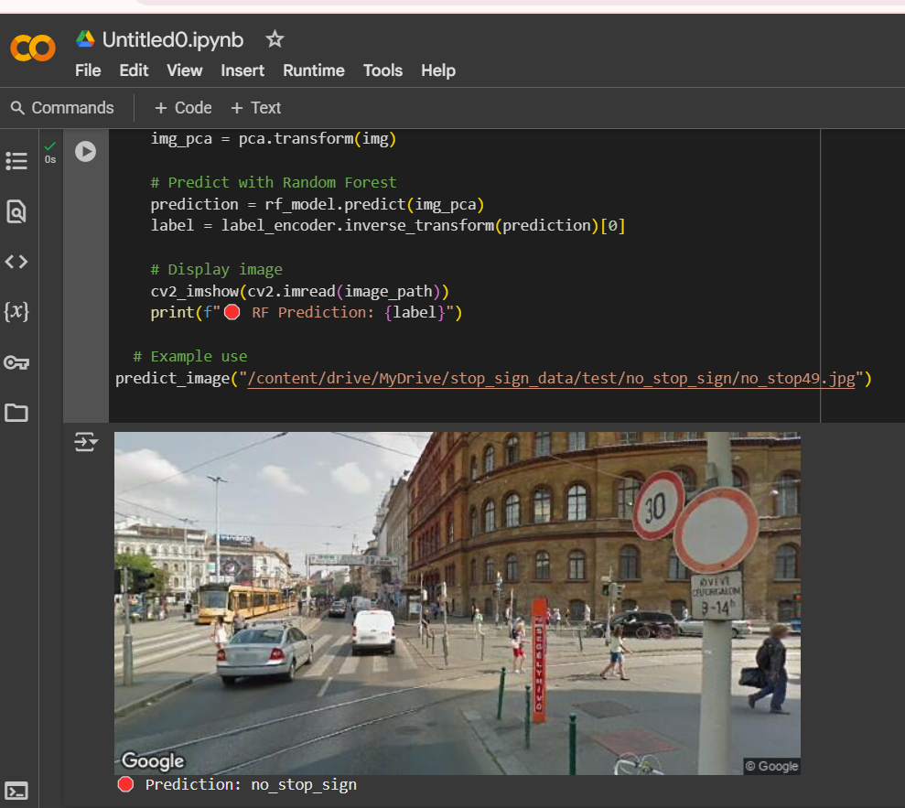
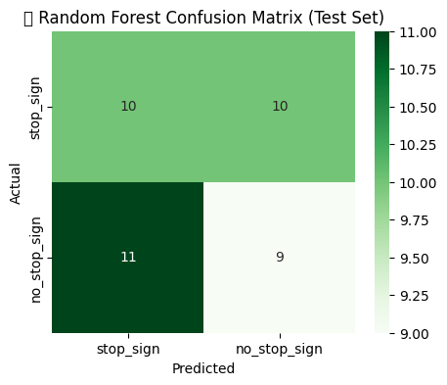
OUTPUTS & CONFUSION MATRICES
RANDOM FOREST
📌 RF Train Accuracy: 1.00
📌 RF Validation Accuracy: 0.55
📌 RF Test Accuracy: 0.47
CONFUSION MATRIX:

Slide 11
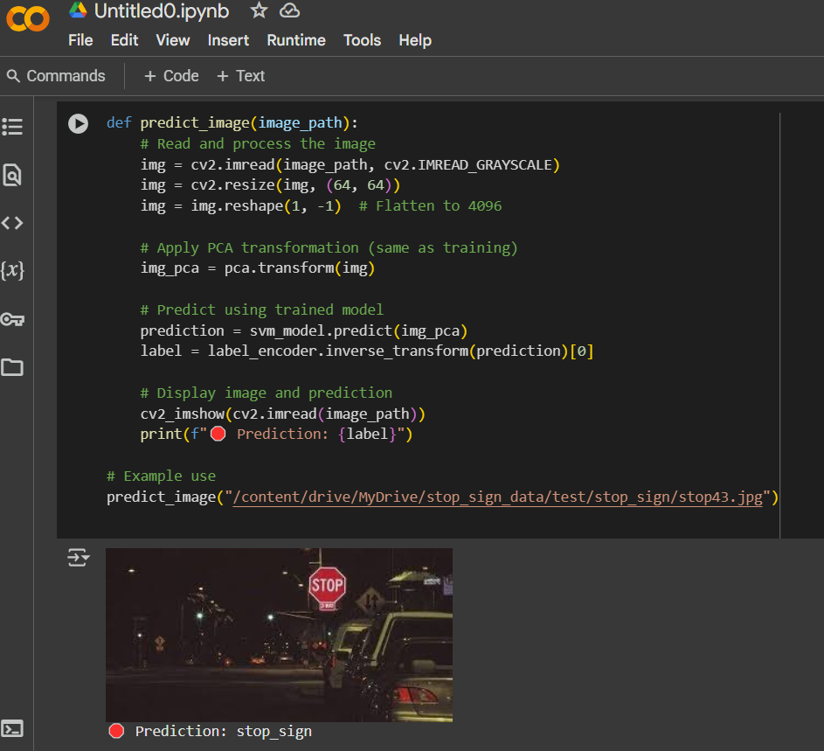
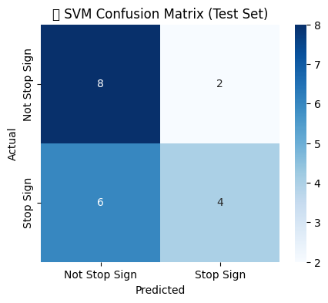
OUTPUTS & CONFUSION MATRICES
SVM
📌 SVM Train Accuracy: 0.95
📌 SVM Validation Accuracy: 0.65
📌 SVM Test Accuracy: 0.6
CONFUSION MATRIX:

Slide 12
CHALLENGES
IMBALANCED CLASSES
Sensitivity to image noise
Model overfitting on small datasets
PCA component selection trade-offs
GROUP :09 ( ISMOT JAHAN MONI ) ( MUHAMMAD IMAM HASSAN ) ( IKTEAR ALAM ) ( MD SHARIFUL ISLAM SAKIB )

Slide 13
FUTURE IMPROVEMENTS
USE OF CNNS FOR BETTER FEATURE EXTRACTION
DATA AUGMENTATION FOR MORE ROBUST TRAINING
USE TRANSFER LEARNING FROM PRE-TRAINED MODELS (E.G., VGG, RESNET)
GROUP :09 ( ISMOT JAHAN MONI ) ( MUHAMMAD IMAM HASSAN ) ( IKTEAR ALAM ) ( MD SHARIFUL ISLAM SAKIB )

Slide 14
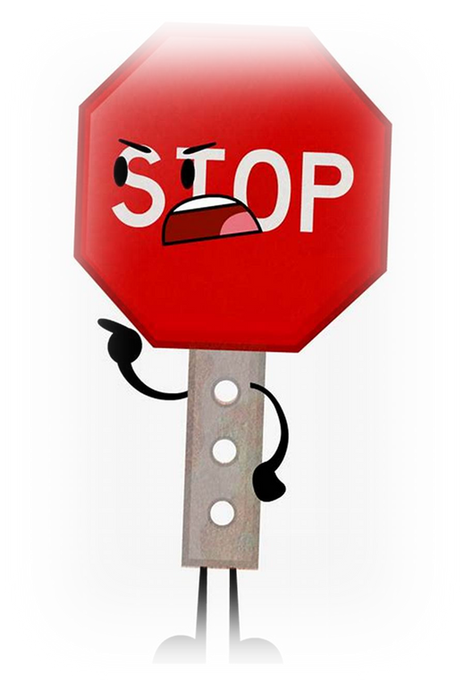
CONCLUSION
SUCCESSFULLY IMPLEMENTED THREE MODELS FOR IMAGE CLASSIFICATION
LOGISTIC REGRESSION SHOWED BEST RESULTS
FURTHER IMPROVEMENTS CAN BE MADE WITH DEEP LEARNING AND LARGER DATASETS
GROUP :09 ( ISMOT JAHAN MONI ) ( MUHAMMAD IMAM HASSAN ) ( IKTEAR ALAM ) ( MD SHARIFUL ISLAM SAKIB )

Slide 15

Thank You

