Slide 1

Plant Disease Detection Using Digital Image Processing
Presented By Team:Zero_Splash
Supervised By: Dr. Md. Zulfiker Mahmud Professor Dept. of CSE Jagannath University
Presented By:
Md. Sakibul Islam
Id: B190305035
Shabikun Nahar
Id: B190305013
Department Of Computer Science and Engineering
Jagannath University
Notes:
Assalamu alaikum, Thanks to our honorable Professor Dr. Zulfiqure mahmud sir, for giving us the opportunity to present our project here.
So , here we are going to present “Plant Disease detection using Dip. Which is Supervised by Dr. Zulfiqure mahmud sir and presented by our team zerosplash

Slide 2
CONTENTS
INTRODUCTION
OBJECTIVE
DATA COLLECTION
PROJECT WORKFLOW
USE CASE DIAGRAM
TECHNIQUES OF DIP
IMPLEMENTATION
PROJECT CALCULATION RISK ANALYSIS
Gantt Chart
FINANCIAL AND PRICING STRATEGY
RESULT & ACCURACY
CONCLUSION
Overview
2
Notes:
Here, we divided our presentation in some contents , where we describe all of this section in this presentation

Slide 3

INTRODUCTION
Plant diseases are a major threat to global agriculture, leading to significant crop losses. Early detection is vital for effective management. However, with advancements in technology, Digital Image Processing now offers an efficient and accurate solution, automating disease detection and enabling faster, more reliable results for farmers.
3

Slide 4
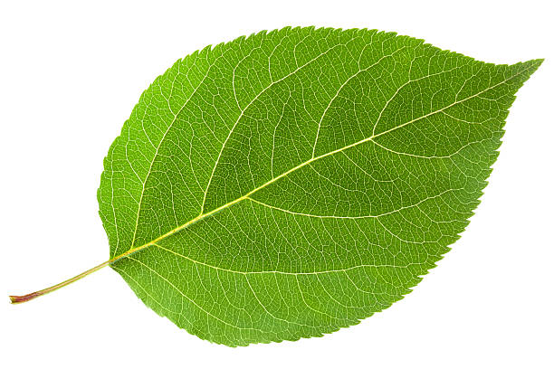
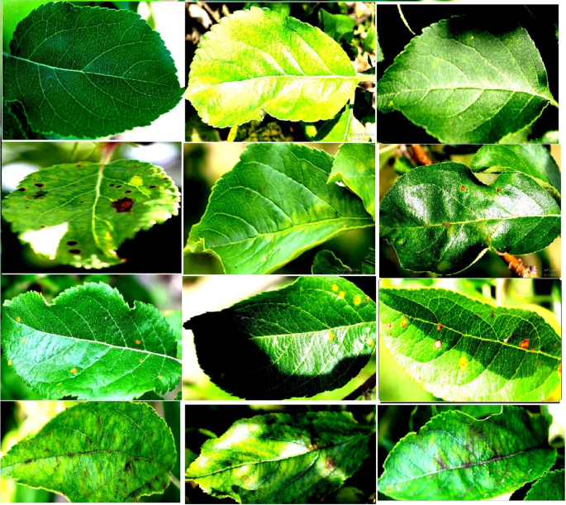
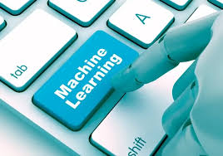
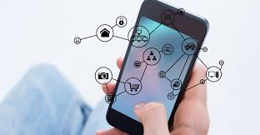
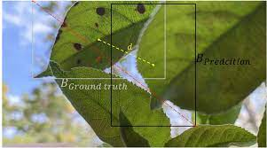
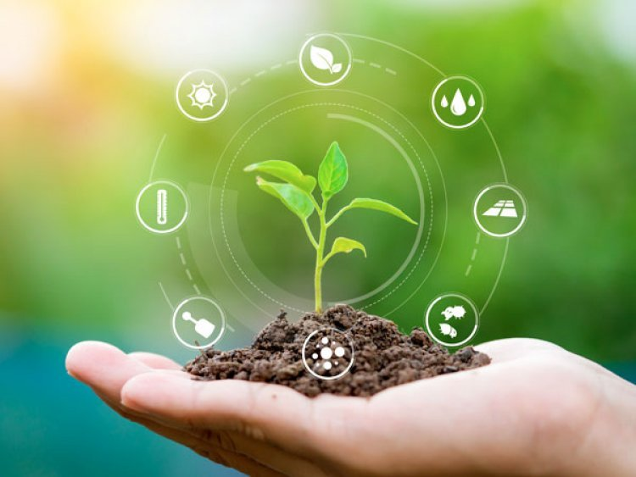
OBJECTIVES
Capture High Quality Images
Preprocess and Analyze Images
Apply Machine Learning Algorithm
Develop a user-friendly interface
Improve the Accurecy & Speed
Contribute to Sustainable Agriculture
4
Notes:
WE use the objectives here

Slide 5
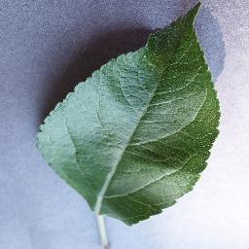
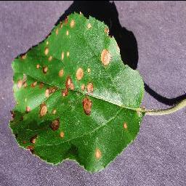
DATA COLLECTION
Data set:This dataset consists of about 87K rgb images of healthy and diseased crop leaves which is categorized into 38 different classes. The total dataset is divided into 80/20 ratio of training and validation set preserving the directory structure. A new directory containing 33 test images is created later for prediction purpose.
Sample Images:
Healthy Apple Leaf
Apple leaf with Black Rot disease
5
Notes:
For this plant disease detection we collect the data set and use , which contain about 87k rgb images of healthy and diseased crop leaves, leaves which is categorized into 38 different classes. The total dataset is divided into 80/20 ratio of training and validation set preserving the directory structure. A new directory containing 33 test images is created later for prediction purpose.
Here is the sample of healthy and diseased of Apple leaf

Slide 6
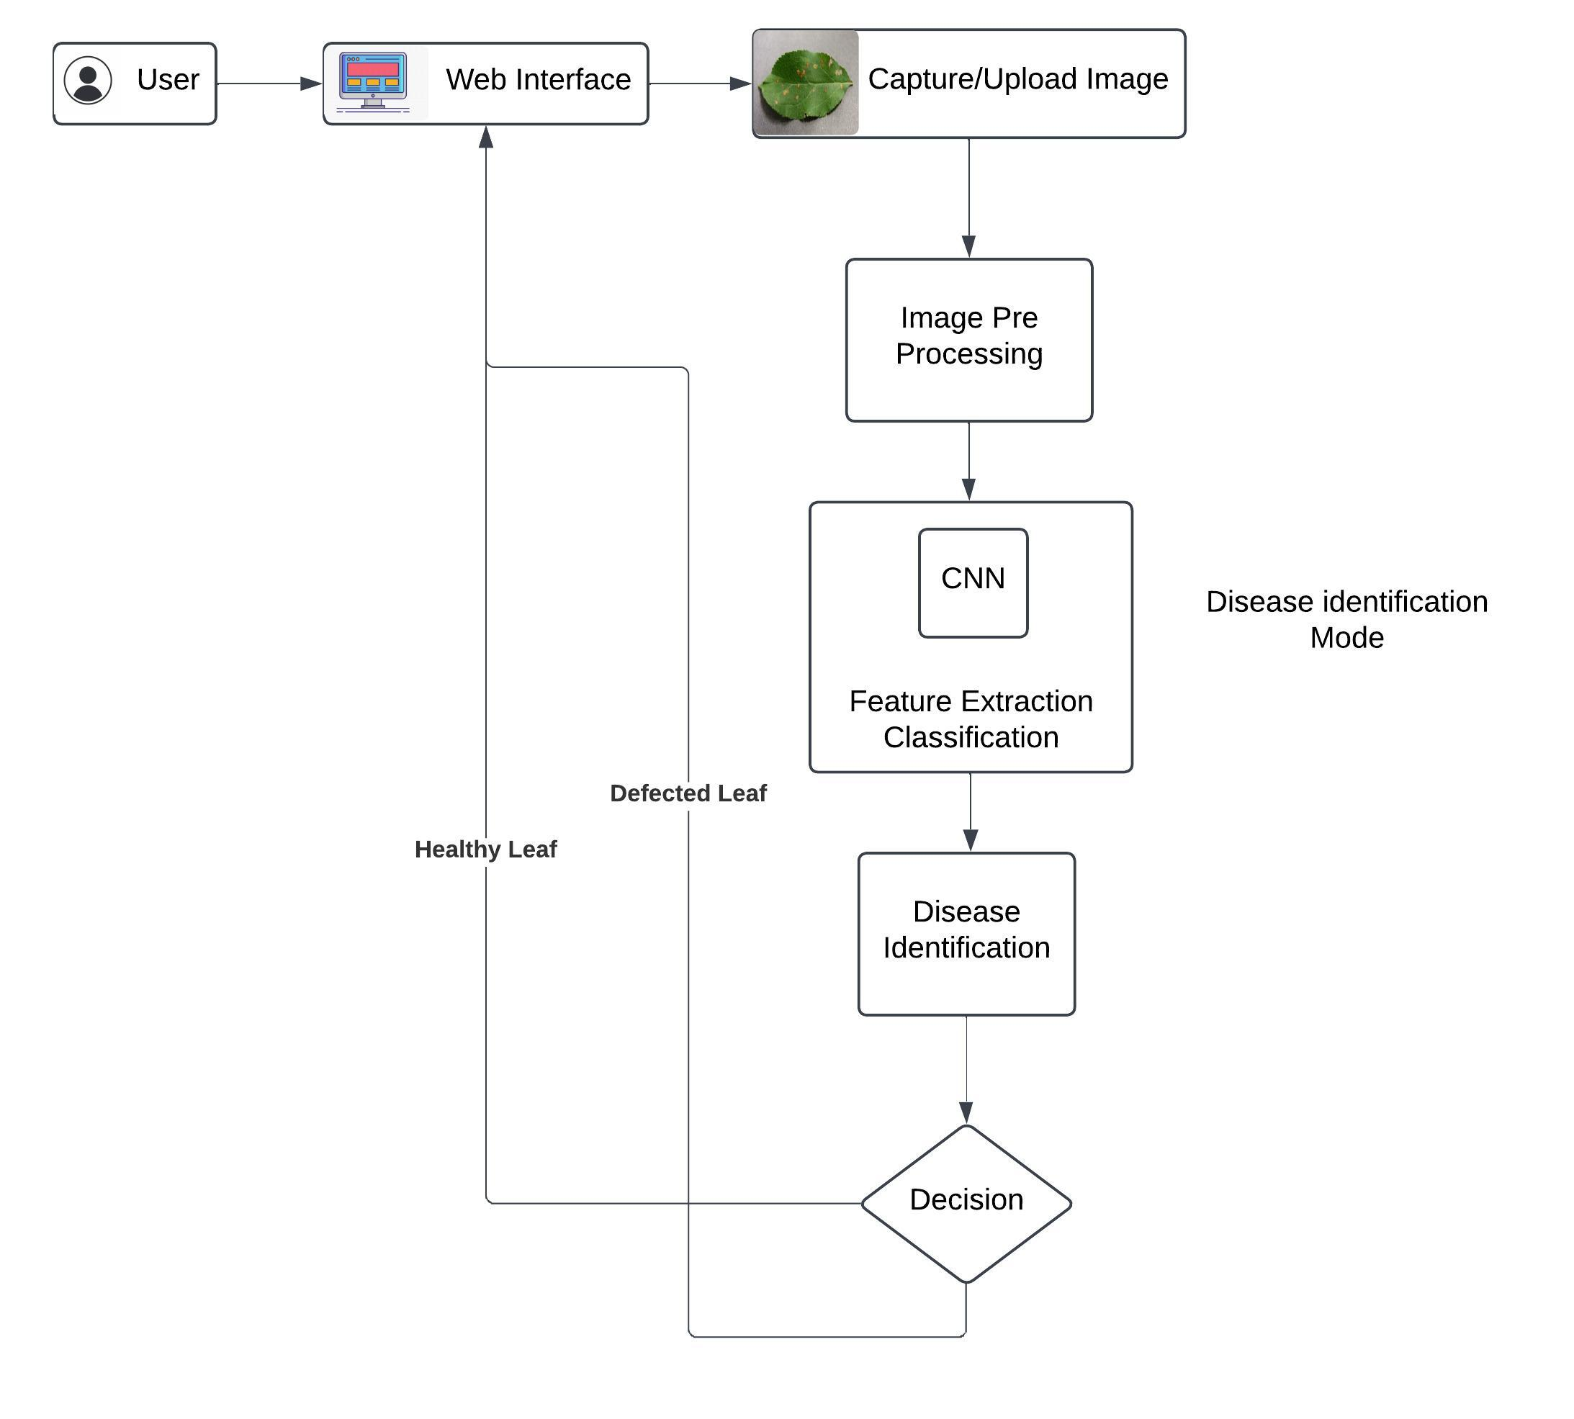
PROJRCT WORKFLOW
mm
6
Notes:
Project Workflow, the user can go to the interface then capture or upload the leaves image then the image is preprocessing which is under the digital image processing, then go to the model and identify the disease by comparing its train test dataset and gives the decision to the user, healthy or defeated leaf

Slide 7
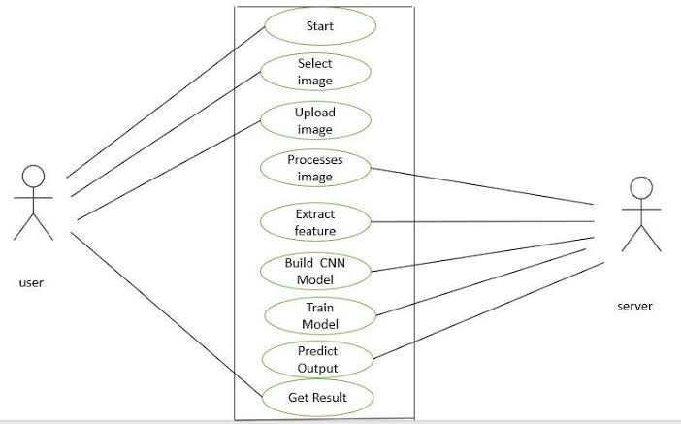
USE CASE DIAGRAM
7
Notes:
The usecase diagram of our project shows here user can select the image upload it and get the result wher the server works in backend process the image, build,train and then predict the output for the user.

Slide 8
TECHNIQUES OF DIP
Resizing: image_size=(128, 128)
In the project all the images of dataset to a fixed size of 128x128 pixels.
Resizing is important because neural networks typically require input images to have a fixed size. It ensures that all images are standardized to the same dimensions, allowing the network to process them consistently.
Color Mode (RGB): color_mode="rgb"
If the dataset contains images in different color modes (e.g., grayscale), this ensures that they are converted to a consistent RGB format.
8
Notes:
We implement our project on the basis of Digital image processing. Techniques which use here are , Resizing,Color model, image interpolation shuffling and batching

Slide 9
TECHNIQUES OF DIP
Image Interpolation: interpolation="bilinear"
When resizing images, bilinear interpolation is used to preserve image quality, which is important for maintaining the integrity of image features.
Shuffling: shuffle=True
This ensures that the images are shuffled before being processed, which is typically used during model training to prevent overfitting and ensure the model sees the data in a randomized order.
Batching: batch_size=32
The images are loaded in batches of 32. This is crucial for training, as it allows for more efficient memory usage and faster computation compared to processing one image at a time.
9

Slide 10
IMPLEMENTATION
Technology Stack:
Python (as programming language)
Jupyter Notebook, Annaconda
Visual Studio Code
TensorFlow Lite
CNN model
Use Streamlit for web app
Google Chrome
Implementation:
1. Data Collection & Preprocessing
2. Model Selection
3. Training the Model
4. Testing & Validation
5. Web Application Development
6. Prediction Pipeline
10
Department Of Computer Science and Engineering
Jagannath University
Notes:
Technology stack for implementing this project is :…
The implementation process we apply as first Data collection , model selection training the model testing ,webapplication development and prediction pipeline

Slide 11
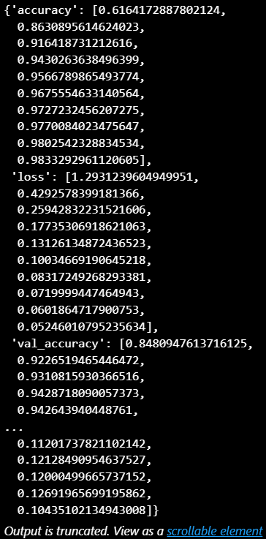
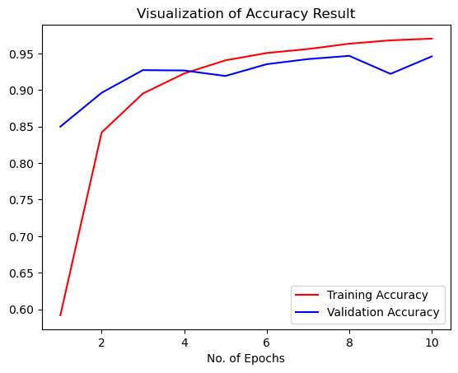
RESULT & ACCURECY
11
Notes:
From the data set as we use a model selected by 80/20 data for train and test we have the accuracy,loss,validation accuracy for 10 epochs. And with that we have the result as the picture graph .

Slide 12
PROJECT CALCULATION RISK ANALYSIS
Risk Area | Primary Risk | Mitigation Strategy
Data Quality and Imbalance | Low-quality or imbalanced data impacting model learning | Data preprocessing and quality checks
Model Complexity | Overfitting due to high parameter count | Regularization, early stopping, use of simpler models first
Training Data Limitations | Inadequate images for rare diseases | Data augmentation, focal loss, balanced cross-validation
Evaluation Metrics | Misleading metrics that don't reflect minority class performance | Use F1-score, per-class precision and recall, ROC-AUC
Deployment Risks | Model fails on real-world variations or rare edge cases | Iterative retraining, hybrid models, scenario simulation
Hardware Constraints | High computational requirements for training and inference | Model optimization, cloud resources for training, efficient models
Regulatory/Ethical Concerns | Misclassification leading to incorrect treatments or ethical/legal issues | Set high-confidence thresholds, transparency, privacy policies
12
Notes:
Now , in the term of risk, we gathered the risk area for our project here and gathered this into two phases as: Primary risk and Mitigation Risk. The main Risk area for our web apps are:

Slide 13
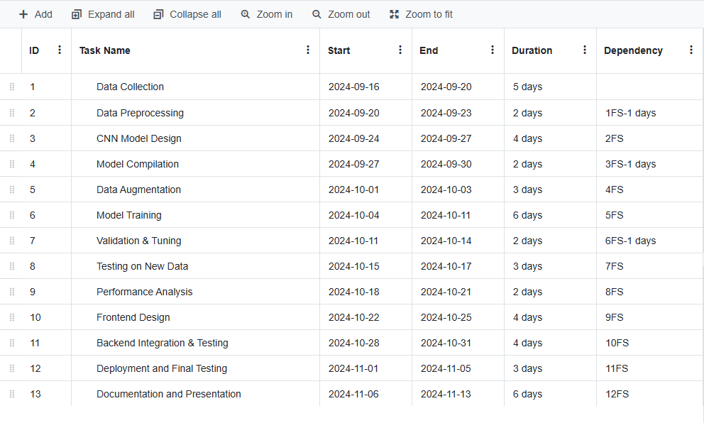
Gantt Chart
13
Notes:
We devided our tasks by planning with the task name , start and end time and trying to complete all the task intime,. Also here we show the dependency of our tasks in gantt chart.

Slide 14
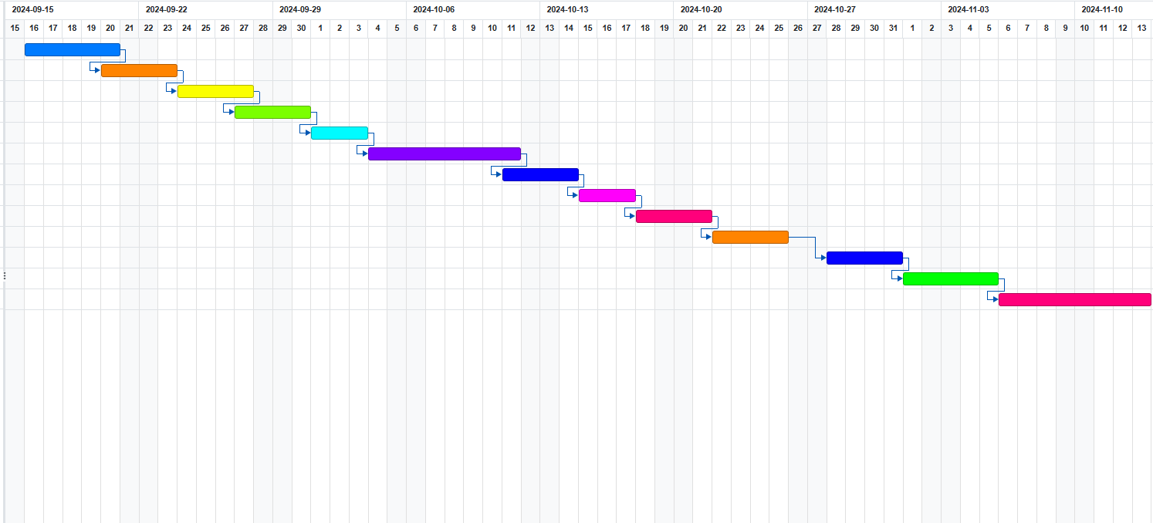
Gantt Chart
14
Notes:
Here is the gantt chart visualization according to the tasks start and end date with their dependencies

Slide 15
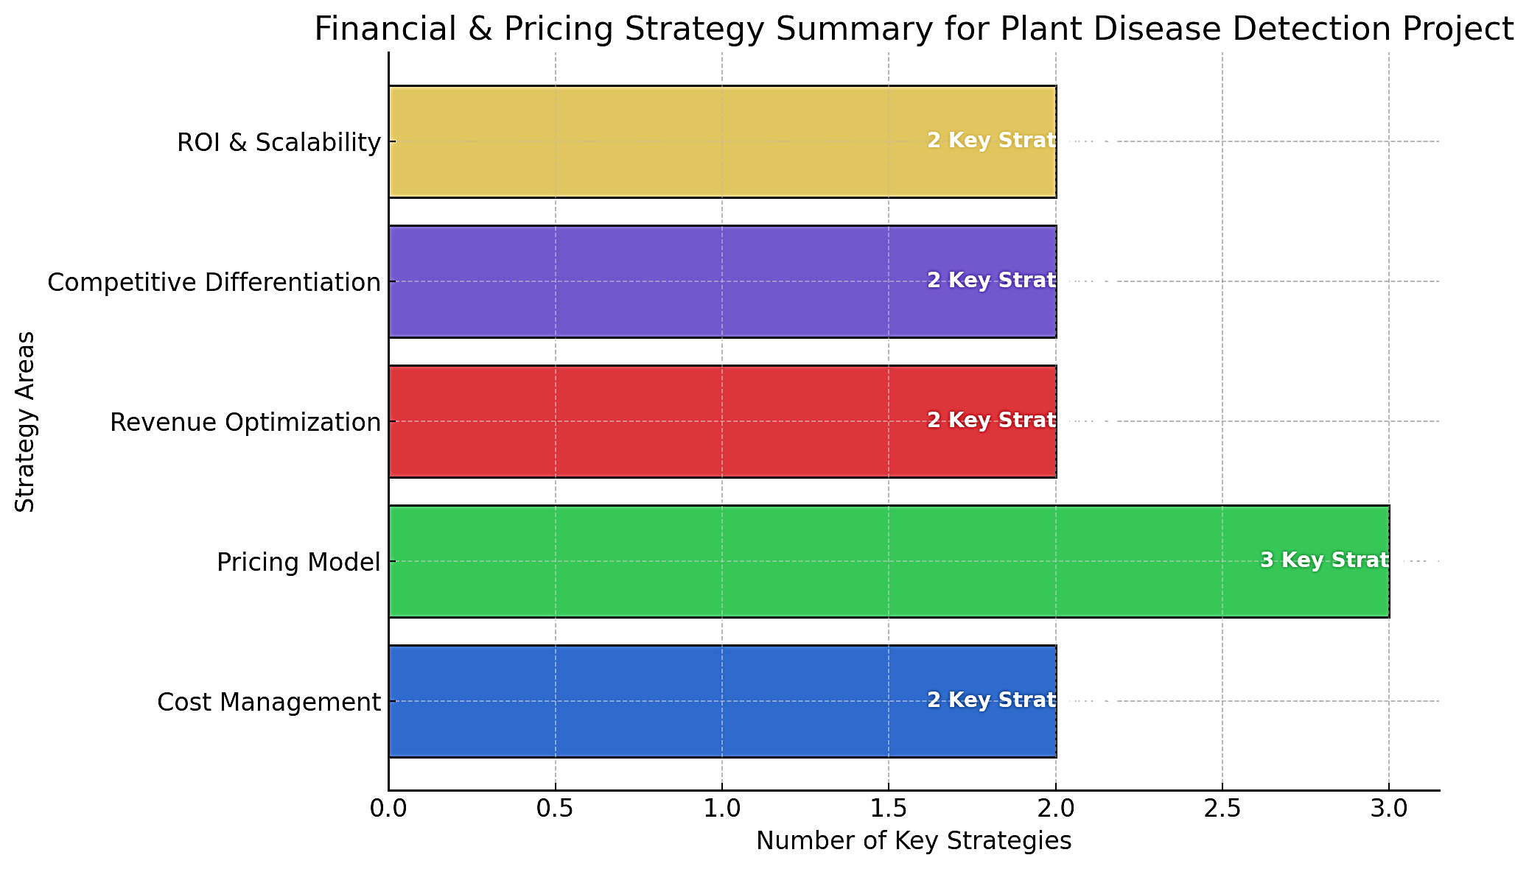
FINANCIAL AND PRICING STATEGY
1. Cost Management
Development Costs: Open-source tools, cloud storage/hosting fees.
Computing Resources: On-demand cloud GPU for training.
Maintenance: Model updates and website upkeep.
2. Pricing Strategy
Freemium Model: Basic free tier; premium for advanced features.
One-Time Purchase: One-time fee option for full access.
Enterprise Pricing: Bulk options for large clients.
3. Revenue Model
Subscription-Based: Monthly or annual plans.
Ad-Supported: Ads for free users.
Data Partnerships: Insights for research and agricultural partners.
4. Marketing Strategy
Direct-to-Consumer: Target farmers/agri-businesses.
Partnerships: Collaborate with agricultural services.
Educational Content: Articles to attract traffic.
15
Department Of Computer Science and Engineering
Jagannath University

Slide 16
CONCLUSION
An effective method for quickly and precisely identifying plant health problems across 36 disease classes is the digital image processing approach to plant disease detection.
This research is to build a high-precision model that can help farmers, agronomists, and agricultural stakeholders diagnose plant diseases efficiently by utilizing a strong dataset of 86,000 photos.
16

Slide 17
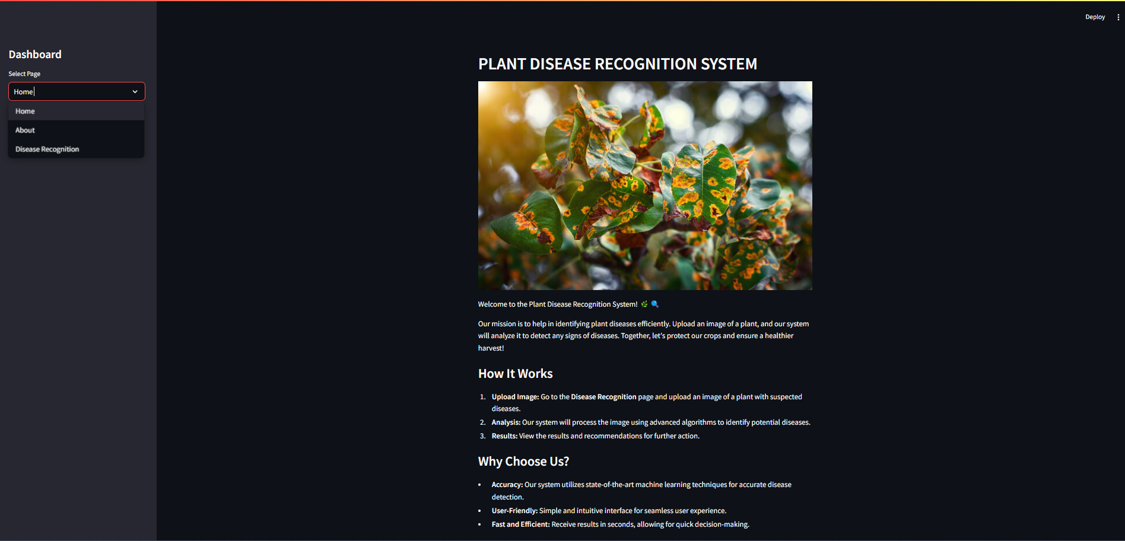
Overview
17
Notes:
Overview of our webapps here, homepage

Slide 18
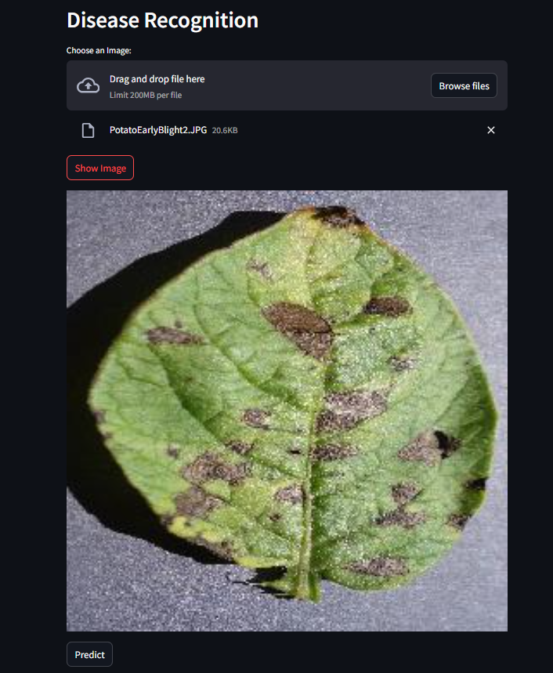
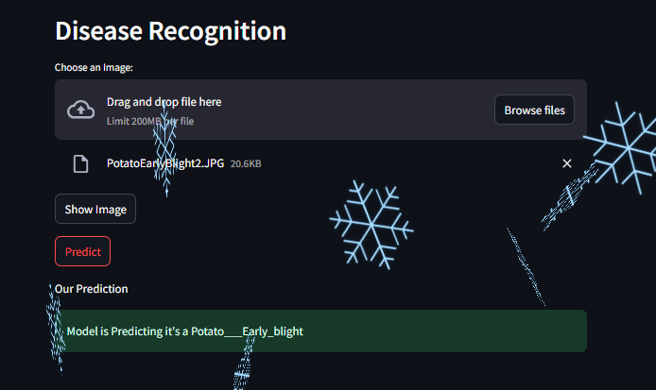
Overview
18
Notes:
Browse the picture from device and upload it , show the picture and then predict the results in output

Slide 19
Thank you

