Slide 1
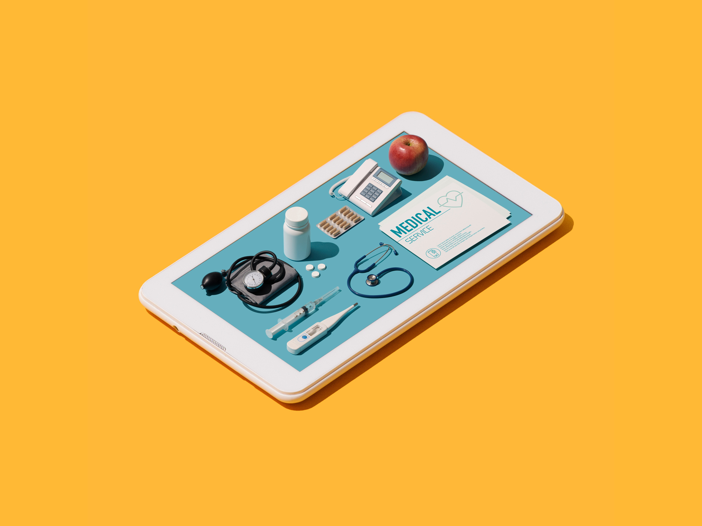
MediCareHub
Online Medicine and
Doctor Visiting Management System
medicarehub.com
1
Notes:
Assalamu alaikum everyone and thank you our honorable dr. zulfiqur mahmud sir for giving us the opportunity. My name is Asifuzzaman and I am here to give presentation about medicare hub.

Slide 2
Table of contents
01
03
02
04
05
ABOUT US
WHY MEDICAREHUB
USEFULNESS
ER-DIAGRAM
CLASS DIAGRAM
06
USE CASE DIAGRAM
07
08
09
BUSINESS MODEL
PROJECT MANAGEMENT PLAN
SWOT
3
10
13
11
HEALTHCARE IN ECOMMERCE
PROJECT RISKS
GANTT CHART
12
MITIGATION
14
15
PROJECT PRICING
FINAL FINANCIAL
2

Slide 3


ABOUT US
.
Team: Zeros_Splash
Md. Sakibul Islam
Asifuzzaman
Id: B190305035
mdsakibulislam736@gmail.com
Id: B190305023
asifuzzamanasif001@gmail.com
3
Notes:
Here is our team .

Slide 4
WHY
MEDICAREHUB?
Can bridge the gap between patients and healthcare providers
1
2
Embracing real-time prescription validation,
4
3
Doorstep delivery of medications
4
Online consultations
Contemporary expectations of efficiency, accessibility, and reliability in healthcare services
5
4
Notes:
The motivation behind this project lies in the belief that technology can bridge the gap between patients and healthcare providers, significantly improving the overall healthcare journey. By embracing real-time prescription validation, doorstep delivery of medications, and online consultations, we aim to offer a transformative solution that aligns with the contemporary expectations of efficiency, accessibility, and reliability in healthcare services. Through the integration of cutting-edge technology, our project aspires to contribute to a healthcare landscape where patient satisfaction is paramount, and the delivery of services is optimized for the digital age.

Slide 5
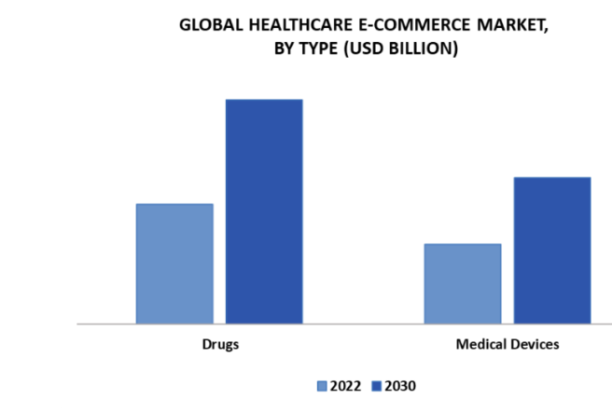
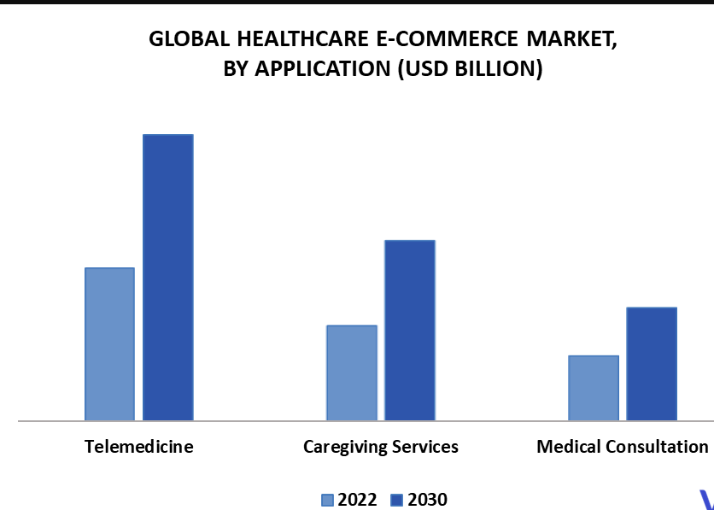
Usefulness
6
Empowerment of Patients
7
Data-driven Decision Making
1
Convenience
8
Streamline Medicine Ordering
2
Time-saving
9
Doorstep Medication Delivery
3
Enhanced Access
10
Real-Time Prescription Validation
4
Improved Patient Outcomes
11
Improve User Experience
5
Cost-effectiveness
5
Notes:
To increase efficiency and improve services provided to the customers , users through better application of technology in daily operations.

Slide 6
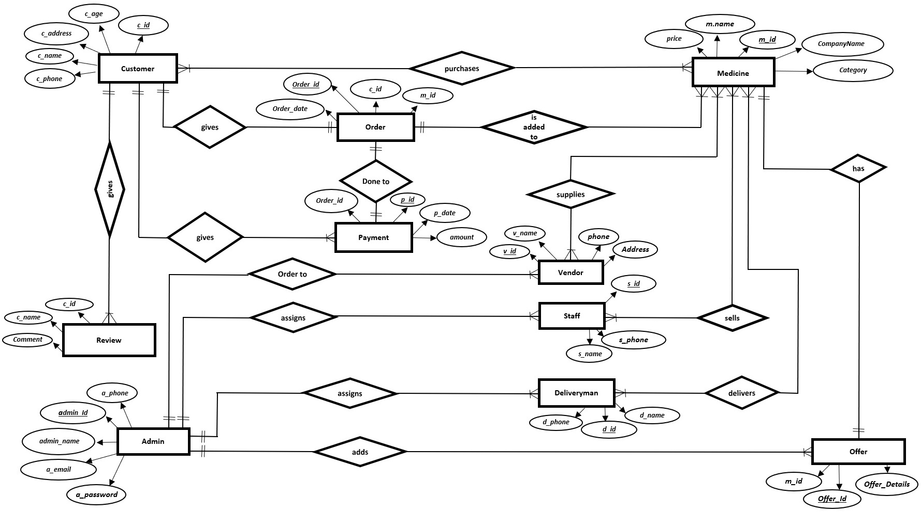
E-R DIAGRAM
6

Slide 7
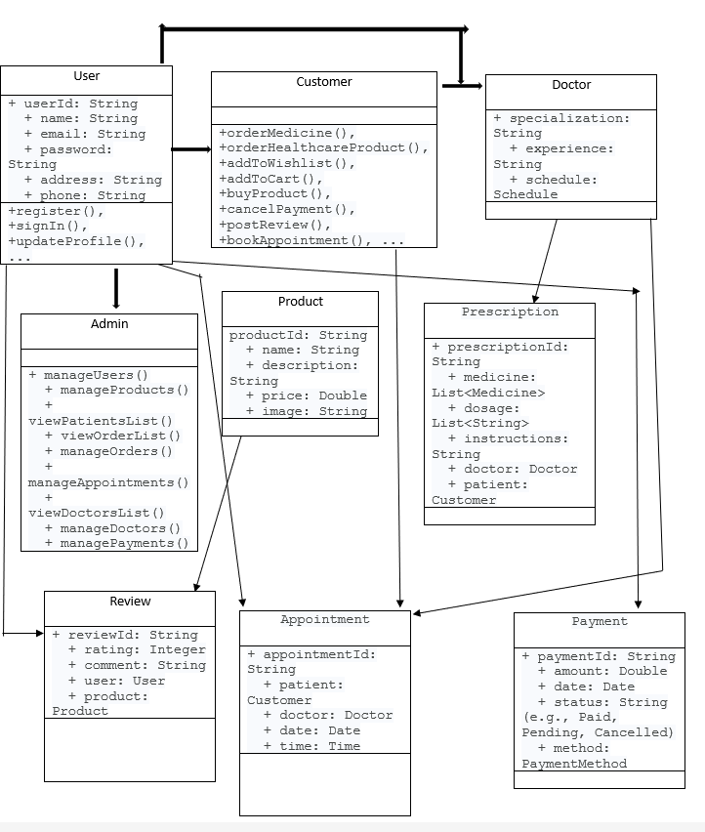
CLASS DIAGRAM
7

Slide 8
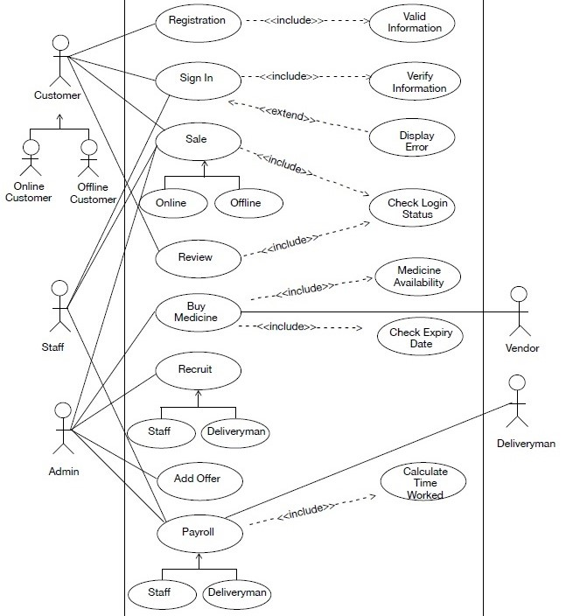
UseCase DIAGRAM
8

Slide 9
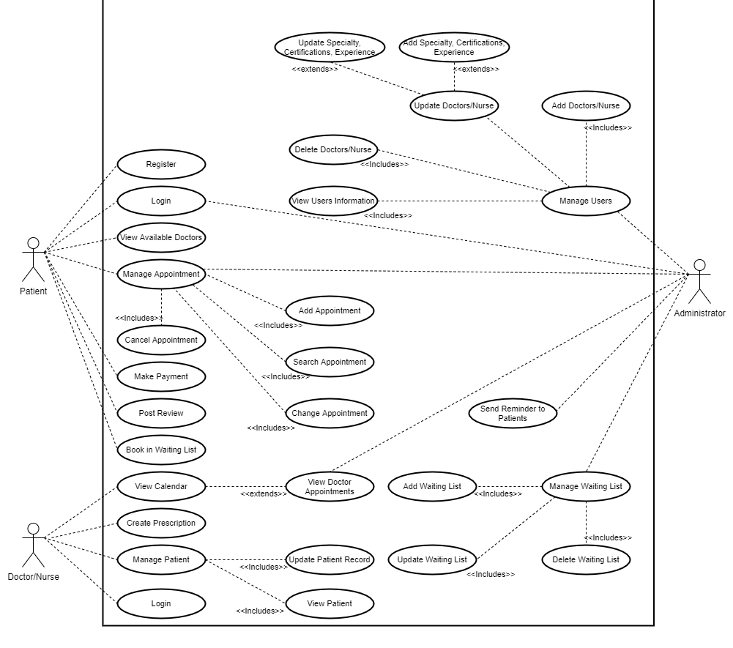
UseCase DIAGRAM
9

Slide 10
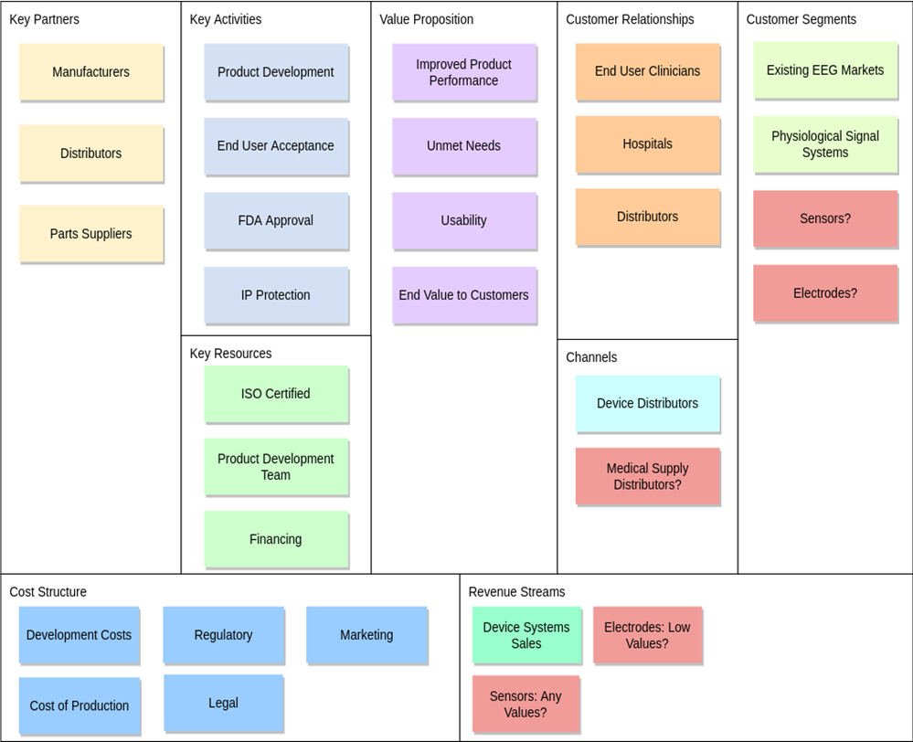
BUSINESS MODEL CANVAS
1
Customer Relationships
2
Revenue Streams
3
Cost Structure
4
Customer Segments
5
Value Propositions
10
Notes:
MedicareHub's business model is centered around providing a comprehensive online platform for healthcare services. By facilitating convenient access to medicine purchase, doctor consultations, and healthcare product procurement, MedicareHub aims to streamline the healthcare experience for users. Revenue streams include sales commissions from medicine and product sales, consultation fees, and subscription-based premium services.

Slide 11
PROJECT MANAGEMENT
PLAN
6
Communication Management
7
Procurement Management
1
Project Scope Management
8
Budget Management
2
Project Schedule
9
Project Closure
3
Resource Management
10
Project Organization
4
Risk Management
11
Change Management
5
Quality Management
11
Notes:
The Project Management Plan outlines the scope, objectives, and approach for the MedicareHub application project. It includes key elements such as project organization, schedule, budget, risk management, and communication strategies.

Slide 12

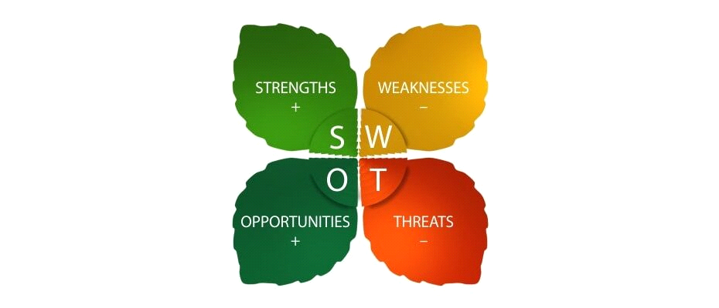
SWOT ANALYSIS
What does “SWOT” mean?
“S” stands for Strengths
“W” stands for Weaknesses
“O” stands for Opportunities
“T” stands for Threat
12
Notes:
SWOT Analysis assesses the strengths, weaknesses, opportunities, and threats of the MedicareHub application project. It identifies internal strengths and weaknesses and external opportunities and threats, providing insights for strategic planning and risk management. Now my teammate will give the presentation from here till the end

Slide 13
HEALTHCARE IN
E-COMMERCE
For MedicareHub, the integration of e-commerce in healthcare presents significant opportunities and risks. On the positive side, it enhances user accessibility, allowing for the seamless purchase of medications and healthcare products, along with scheduling online doctor consultations.
Objective: Transforming healthcare through online innovation.
Focus: Enhancing accessibility, convenience, and efficiency.
Key Message: Seamlessly integrate e-commerce into healthcare for a brighter and healthier tomorrow.
13
Notes:
Thanks Asifuzzaman for giving me the chance here,
So, Healthcare in ecommerce, we can easily see that , the healthcare in ecommerce is increasing rapidly day by day, Beacause , it enhances user accessibility, allowing for the seamless purchase of medications and health care products, along with taking online doctor consultations.
So it’s a big opportunity for our medicarehub.

Slide 14

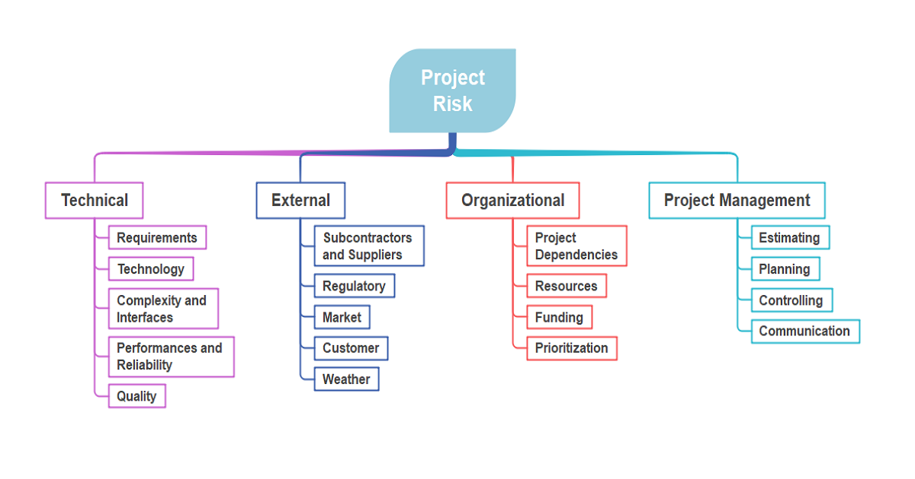




Project Risk
14
Notes:
With opportunities There are also some project risks here, which could be happened during project completion. Some of them are very common such as Technical, External , Organizational, project management etc.

Slide 15

Project Risk
Integration Challenges with Third-Party APIs
• Risk: Potential issues during the integration of third-party APIs.
Scope and Requirement Risks: Scope Creep
• Risk: Scope creep due to evolving client requirements.
Team Risks: Resource Challenges
• Risk: Key developers or designers leaving the project.
External Risks: Market Shifts
• Risk: Shifts in market trends impacting system relevance.

Slide 16
Mitigation of Risks
1
Proactive API Management:
Establish regular communication with API providers.
Develop fallback mechanisms for API issues.
Conduct early and extensive testing of API integrations.
4
Agile Development Practices:
• Embrace Agile for continuous adaptation.
• Conduct regular sprint reviews for process improvement.
2
Change Control Mechanism:
Implement a change control board for scope changes.
Regularly communicate with stakeholders to manage expectations.
5
Comprehensive Testing Approach:
3
Adaptive System Design:
• Design the system to be modular and adaptable.
• Regularly assess and update features based on industry demands.
• Develop and adhere to a detailed testing plan.
• Include end-users in user acceptance testing for feedback.
Notes:
We have also some mitigations to solve the project risks. Some of them are: To use proactive API Management, Changing the Control Mechanism, Adaptive System Design, Most Useful Agile Development Practice and Comprehensive Testing Approach.

Slide 17
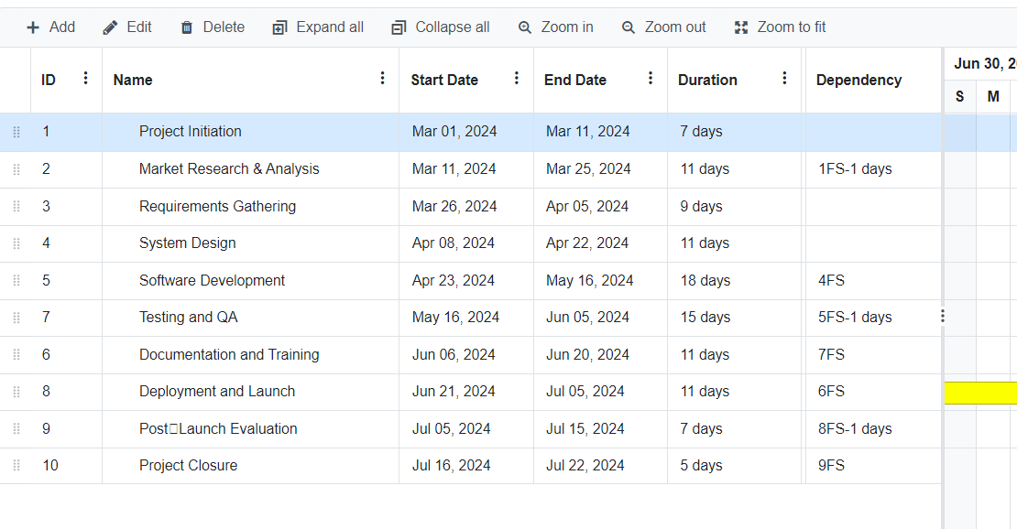
Gantt Chart
Notes:
Next we are going to see our Project Detailed gantt chart, here we divide our project in 10 different part of tasks for complete our projects done perfectly . We include our starting time and ending time with duration and dependencies.

Slide 18
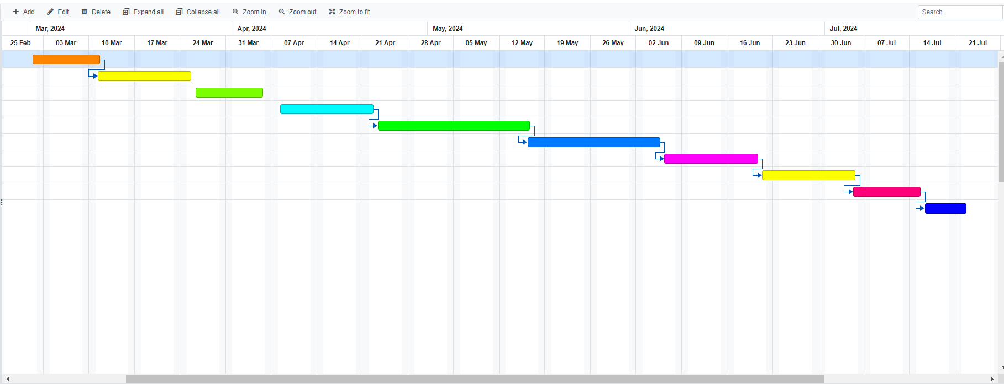
Gantt Chart
Notes:
Here is the gantt chart for our project. We can easily notice the dependency in the picture

Slide 19
PRICING STRATEGY
Overview of Pricing Strategy
Flexibility, Scalability, and Value: Crafted for diverse healthcare platform needs.
Transparency, Simplicity, Adaptability: Prioritize ease for healthcare providers of all sizes.
Tiered Pricing Plans
Essential Plan ($39.99/month): Small clinics, basic features.
Standard Plan ($79.99/month): Medium-sized facilities, advanced features.
Premium Plan ($129.99/month): Large-scale hospitals, comprehensive features.
Notes:
Lets, talk about pricing strategy, We pricing our project on different category depends on flexibility, scalability, sizes and values.
Like here , tired pricing are divided in 3 category Essential plan,standard plan and premium which costs 39,79 and 123 dollar per month.

Slide 20
PRICING STRATEGY
Additional Services
Mobile App for Patients: $249 (one-time) + $14.99/month (maintenance).
Onsite Training and Support: $399 (initial) + $24.99/month per user.
Customization and Integration: Fees starting at $800.
Dummy Pricing Example
Standard Plan (3 users): $239.97/month.
Mobile App: $249 (one-time) + $14.99/month.
Onsite Training: $399 (initial) + $74.97/month (support for 3 users).
Total Monthly Cost: $729.93.
Notes:
Also here Additional services and Dummy Pricing are divided on different criteria,

Slide 21
PREPARING BASIC FINANCIAL FOR OUR PROJECT
Revenue:
Software Licensing Fees: $400,000
Transaction Fees: $200,000
Total Revenue: $600,000
Cost of Goods Sold (COGS):
Development Costs: $250,000
Infrastructure Costs: $80,000
Marketing and Promotion: $40,000
Customer Support: $30,000
Total COGS: $400,000
• Gross Profit = Total Revenue - Total COGS
= $600,000 - $400,000
= $200,000
Gross Profit =$200,000
Notes:
Finally preparing Basic Financial for our project Medicarehub are here,
We assume for our revenue, The estimated revenue from licensing the MedicareHub platform : $400000 and Revenue from payment associated with ordering medicine, health products or other transactions process through the system : 200000$ so total revenue: 600000
Also the cost of goods sold:
Development Costs: 2500000
We know the laws of Gross Profit is the difference of total revenue and total cogs; here the gross profit for our projects are 2000000.

Slide 22

THANK YOU
Notes:
These are all for our project , thank you everyone.

