Slide 1
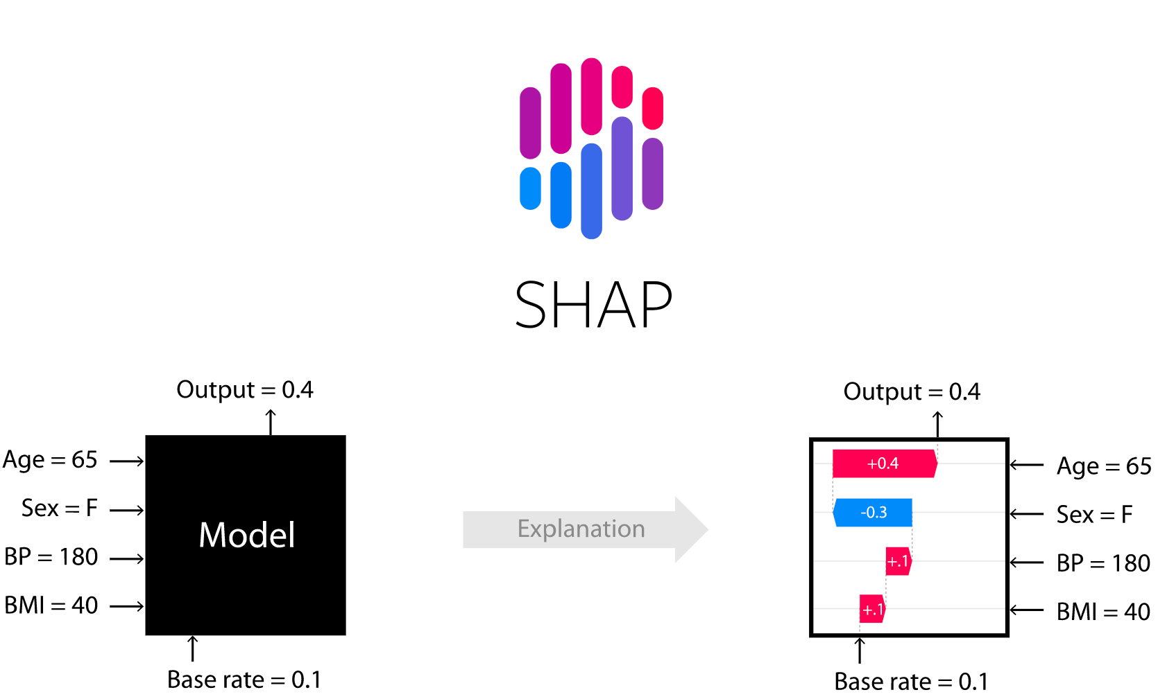
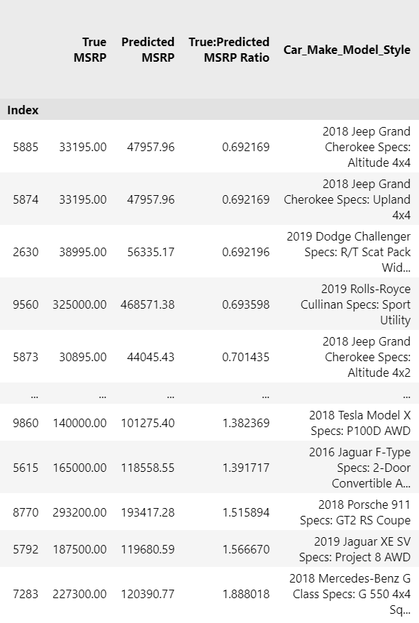
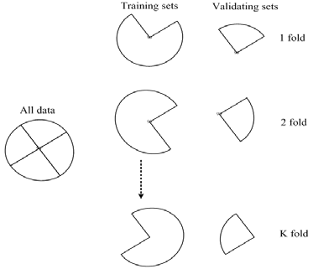
Method
Exploratory Data Analysis
Clean Data
XGBoost Regressor with 5-Fold Cross-Validation
Under/Over-priced Car Ranking per Fold
XGBoost Regressor on Top/Bottom 50 in Ranking
SHapley Additive exPlanations (SHAP)

Slide 2
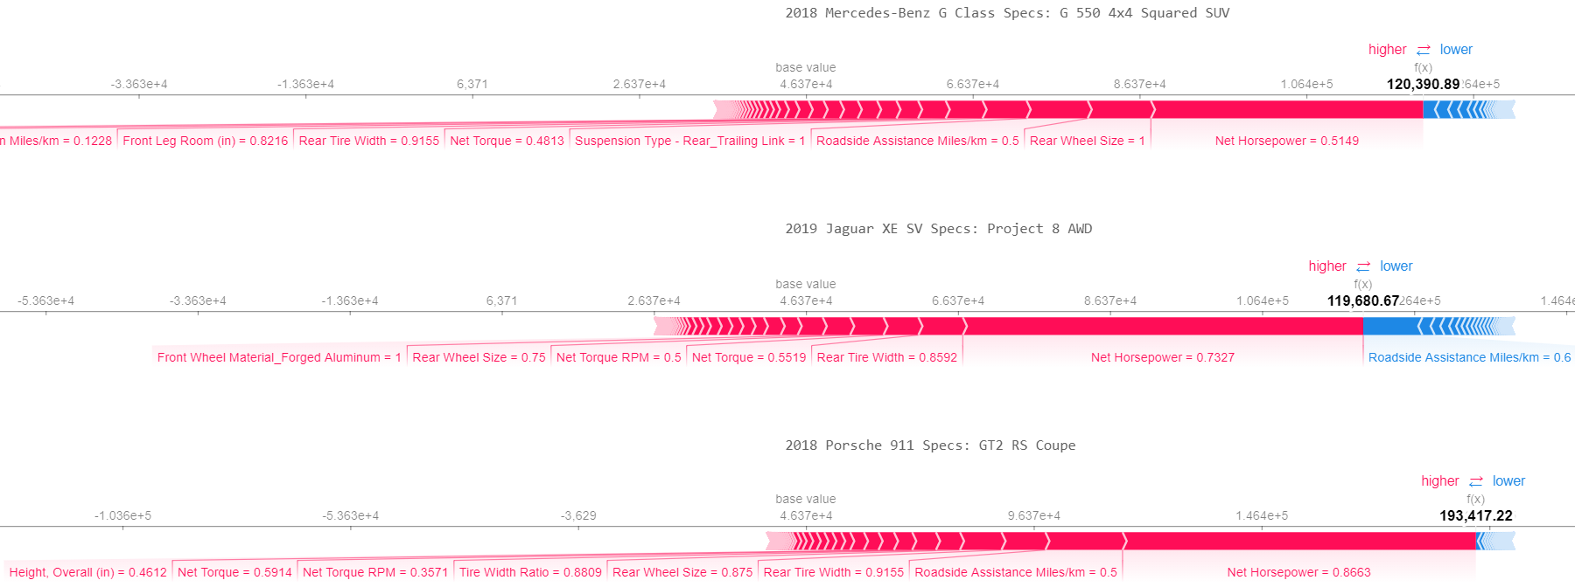
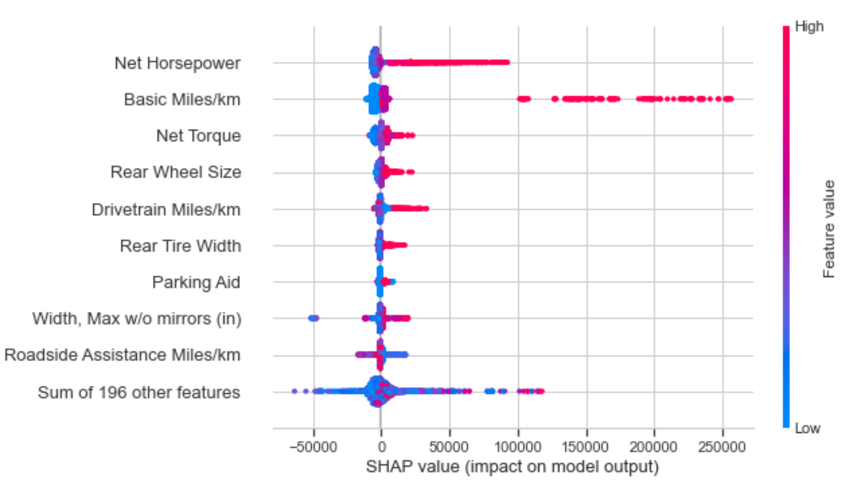
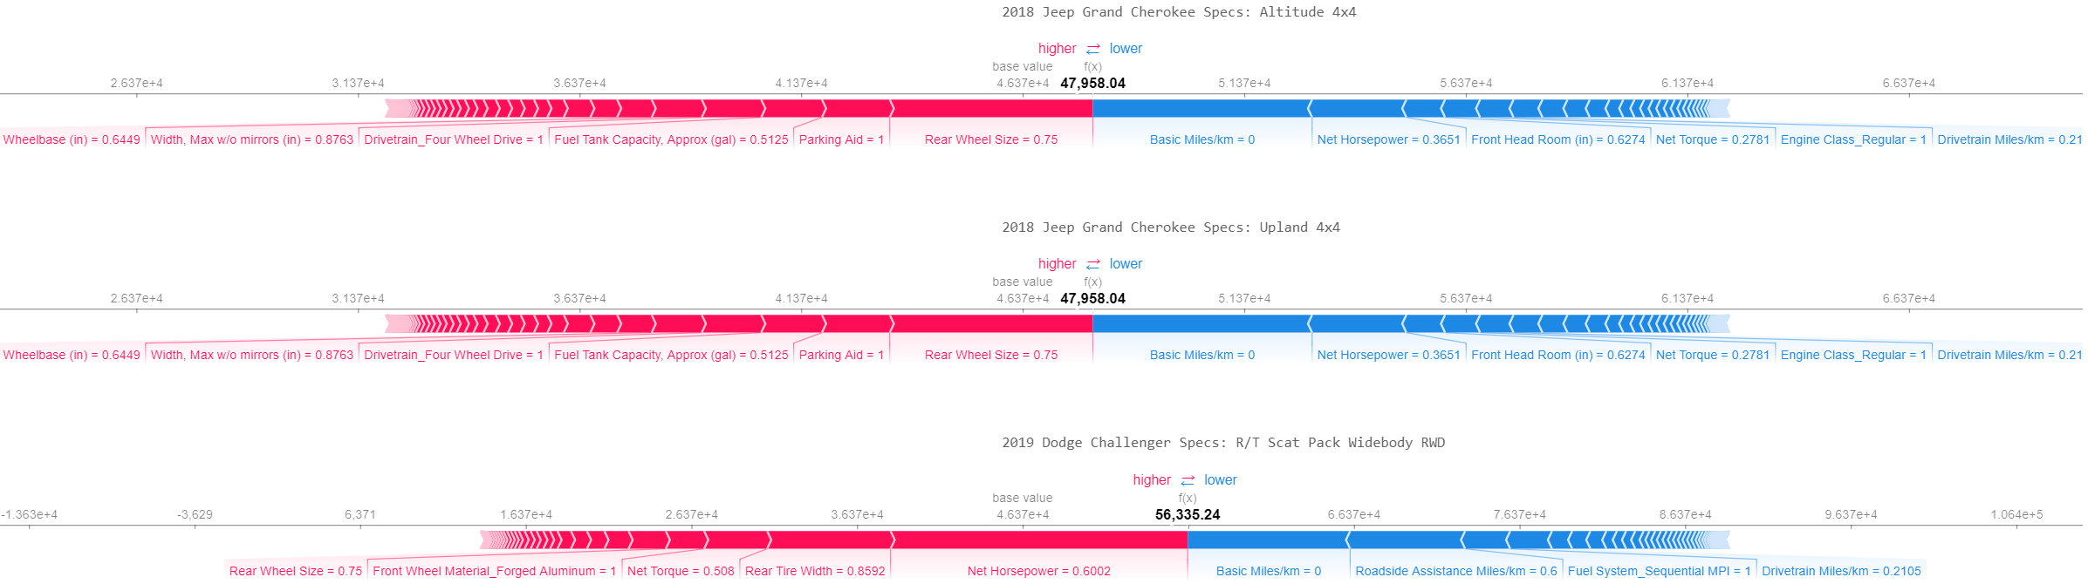
Results
Top 3 Most Over-Priced Cars
2018 Mercedes-Benz G Class Specs: G550 4x4 Squared, True MSRP = 227 300, Predicted MSRP = 120 390.77, Ratio (True/Predicted) = 1.888
2019 Jaguar XE SV Specs: Project 8 AWD, True MSRP = 187 500, Predicted MSRP = 119 680.59, Ratio (True/Predicted) = 1.566
2018 Porsche 911 Specs: GT2 RS Coupe, True MSRP = 293 200, Predicted MSRP = 193 417.28, Ratio (True/Predicted) = 1.515
Top 3 Most Under-Priced Cars
2018 Jeep Grand Cherokee Specs: Altitude 4x4, True MSRP = 33 195, Predicted MSRP = 47 957.96, Ratio (True/Predicted) = 0.692
2018 Jeep Grand Cherokee Specs: Upland 4x4, True MSRP = 33 195, Predicted MSRP = 47 957.96, Ratio (True/Predicted) = 0.692
2019 Dodge Challenger Specs: R/T Scat Pack Widebody RWD, True MSRP = 38 995, Predicted MSRP = 56 335.17, Ratio (True/Predicted) = 0.692

Slide 3
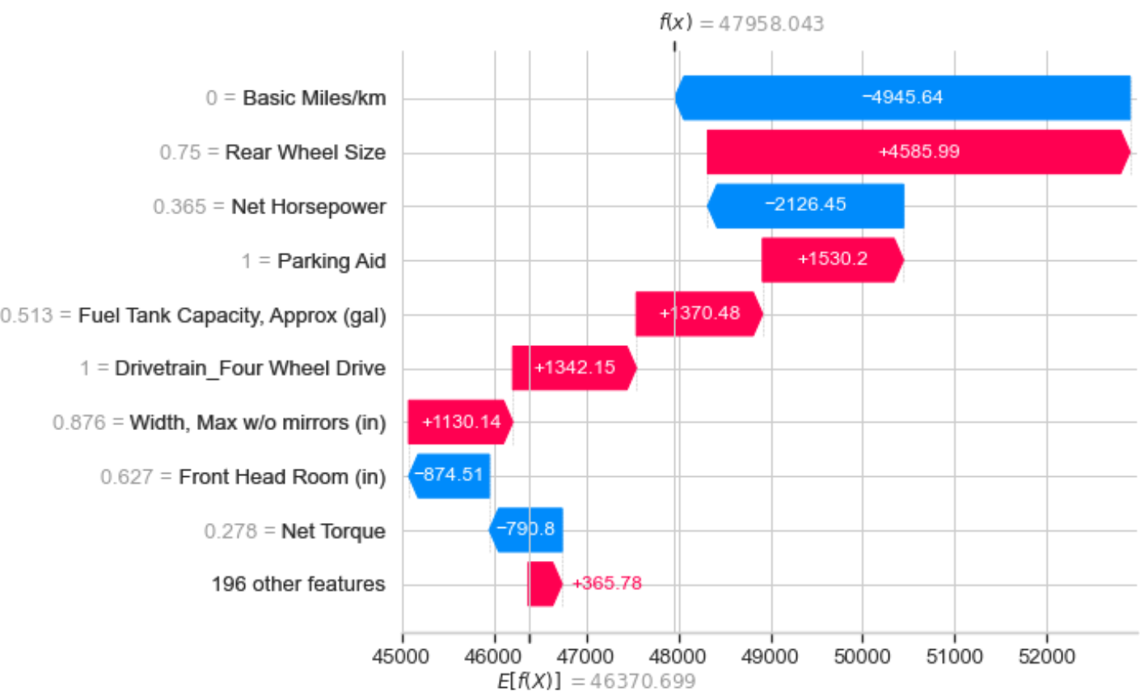
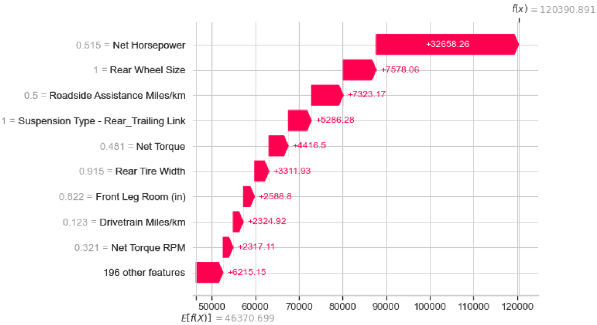
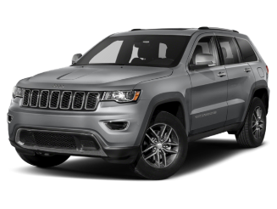
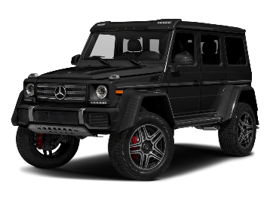
Graphs show WHY model predicted what it did compared to mean prediction
Y-axis values are percentiles:
0 = 0th percentile
1 = 100th percentile
e.g. Net Horsepower = 0.515 implies above average Net Horsepower
Conclusion
SHAP Waterfall Plot for 2018 Jeep Grand Cherokee Specs: Altitude 4x4
SHAP Waterfall Plot for 2018 Mercedes-Benz G Class Specs: G 550 4x4 Squared SUV
Predicted MSRP
Predicted MSRP

