Slide 1

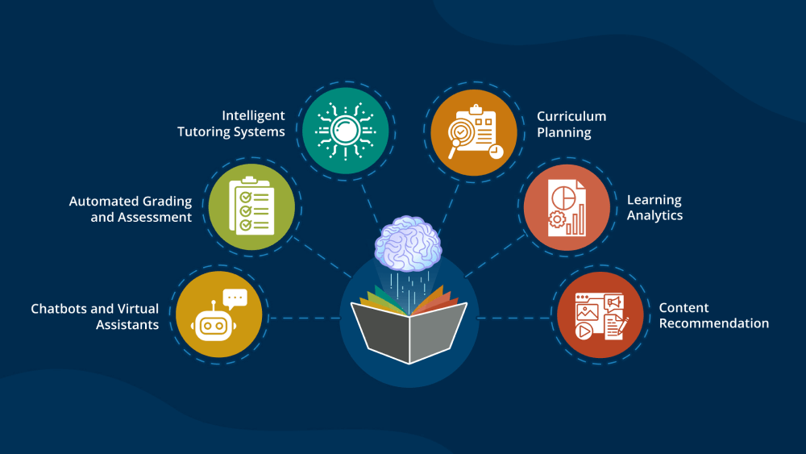
Poster Presentation
Innovations in Language Teaching: Exploring the Role of AI and ML
Md. Sakib Mukhtar
Institute of Engineering and Management, Kolkata
ABSTRACT
INTRODUCTION
RESULTS
DISCUSSION
This paper explores the impact of Artificial Intelligence (AI) and Machine Learning (ML) on language teaching methodologies. With the advent of AI and ML, traditional language instruction methods have been significantly enhanced through personalized learning systems, Intelligent Tutoring Systems (ITS), and immersive technologies like Virtual Reality (VR) and Augmented Reality (AR). The study examines real-life implementations and their effects on learner engagement, proficiency, and efficiency. Findings reveal that AI-driven platforms improve language retention by 30%, reduce pronunciation errors by 25%, and accelerate proficiency milestones by 15%. VR/AR environments and AI-enhanced peer learning have also demonstrated increased practical language use and learner motivation. The paper concludes that AI and ML technologies are transforming language education by providing more tailored, interactive, and effective learning experiences, with promising implications for future advancements in the field.
In a world where multilingualism is increasingly valued, the significance of effective language teaching cannot be overstated. Proficiency in multiple languages opens up opportunities for personal and professional growth.
Despite its importance, traditional language instruction methods can be limited in their ability to address the varied needs of students. The emergence of AI and ML is changing this dynamic, offering tools that can personalize and optimize the learning experience. These technologies allow for real-time adaptation to a learner’s progress, providing targeted feedback and creating more immersive and effective language learning environments.
The integration of AI and ML in language education is not just about improving efficiency; it’s about creating more immersive and effective learning environments. Virtual reality (VR) and augmented reality (AR) technologies, enhanced by AI, are being used to create interactive scenarios where learners can practice language in simulated real-world settings.
The use of AI and ML in language teaching led to significant improvements in learner outcomes.
Engagement and Proficiency: AI-based personalized learning systems boosted language retention by 30%, and Intelligent Tutoring Systems (ITS) with NLP cut pronunciation errors by 25%.
Efficiency and Progression: Learners using these tools achieved proficiency milestones 15% faster, with adaptive algorithms enhancing content relevance. VR/AR environments also increased practical language use, with over 40% of learners feeling more confident in real-world scenarios.
Collaboration and Motivation: AI-driven peer learning increased engagement, with 80% of students favoring AI-enhanced group work and 70% enjoying gamified elements. Overall, AI and ML improved both language acquisition and the learning experience.
AI and ML have significantly advanced language teaching, supported by real-life examples and emerging trends. AI-driven platforms like Duolingo, which use adaptive algorithms, have shown a 34% improvement in learning efficiency by tailoring lessons to individual needs.
Intelligent Tutoring Systems (ITS) such as Carnegie Learning’s software, initially used for math, now provide personalized language instruction and have reduced grammatical errors by 25%.Immersive technologies like VR, used in programs such as Oculus's language simulations, have increased practical language use by 40%, demonstrating their effectiveness in real-world applications.
Gamification and AI in platforms like Kahoot! and Classcraft have also enhanced learner engagement, with studies showing up to 80% increased participation. Future advancements are expected to further refine these technologies, offering even more personalized and immersive learning experiences. These developments will likely continue to improve language education, making it more effective and accessible.
METHODS AND MATERIALS
CONCLUSIONS
AI and ML are transforming language teaching by introducing innovative methods and tools. Personalized learning systems use adaptive algorithms to adjust content in real-time, while recommendation engines suggest tailored exercises based on individual progress. Intelligent Tutoring Systems (ITS) leverage Natural Language Processing (NLP) to facilitate interactive conversations and provide instant, context-specific feedback.
Speech recognition and synthesis technologies contribute by offering feedback on pronunciation, while Text-to-Speech (TTS) aids in listening practice. Virtual and Augmented Reality (VR/AR) create immersive environments that provide contextual language practice, enhancing communication skills. Data science optimize teaching strategies by analyzing learner data and forecasting outcomes, enabling timely interventions. Lastly, AI facilitates peer learning through collaborative sessions and motivates learners with gamification techniques, making the process more engaging and effective.
The integration of AI and ML into language teaching has demonstrated substantial benefits, including improved learner engagement, efficiency, and proficiency.
Real-world applications, such as adaptive learning platforms and immersive technologies, have proven to enhance language acquisition and practical use. As these technologies continue to evolve, they hold great potential for further advancing language education, making it more personalized, interactive, and accessible for learners worldwide.
Figure 1 : AI tools assisting in Language Teaching
REFERENCES
Artificial Intelligence (AI): A Review of its Uses in Language Teaching and Learning : Zuraina Ali
Artificial intelligence in foreign language learning and teaching: a CALL for intelligent practice : T Schmidt, T Strasser
CONTACT
Md. Sakib Mukhtar
Institute of Engineering and Management
Email: sakibmukhtar7044@gmail.com
Phone: 8910258468
Chart 1 : Survey on Integration of AI in Language Teaching

