Slide 1

DIGITAL CONTENT DESIGN AND DEVELOPMENT

Slide 2
SUBMITTED TO
Munira Akter Lata
Lecturer
Department of Educational Technology
Bangabandhu Sheikh Mujibur Rahman Digital University, Bangladesh.
SUBMITTED BY
Tarekul Islam; ID: 2002019
Session: 2020-21

Slide 3

Design a travel planner dashboard for a digital experience.

Slide 4




Slide 5
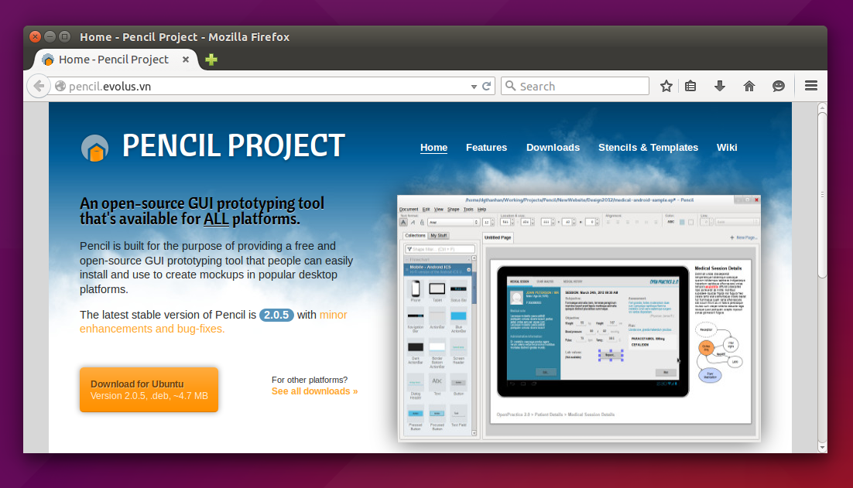
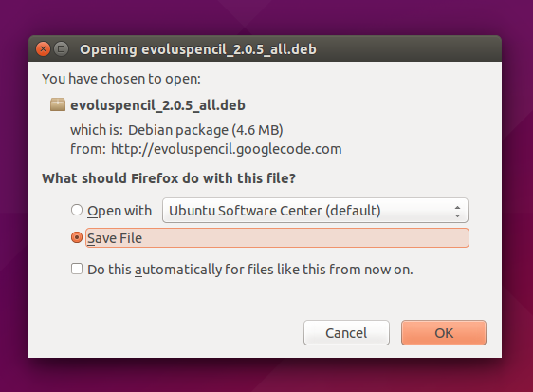

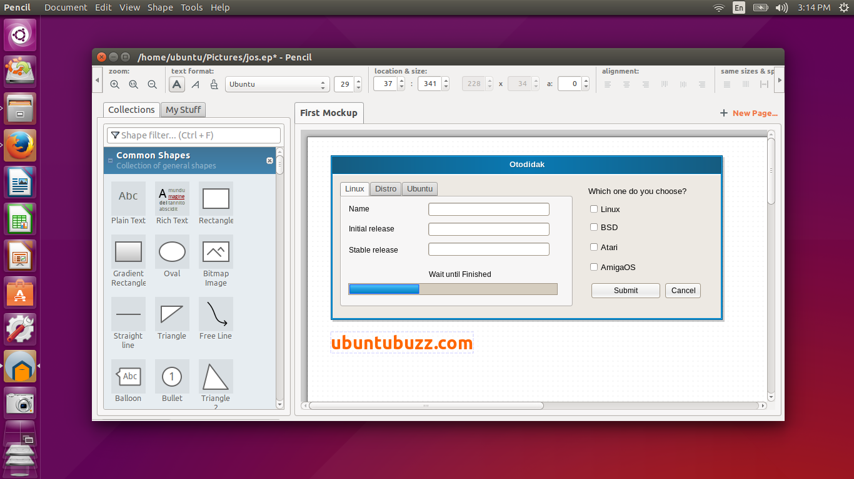
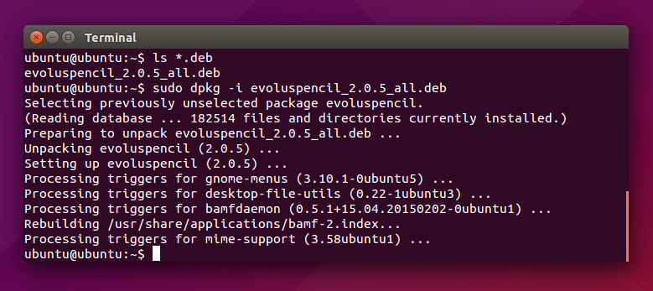
Download and install of Pencil project:

Slide 6

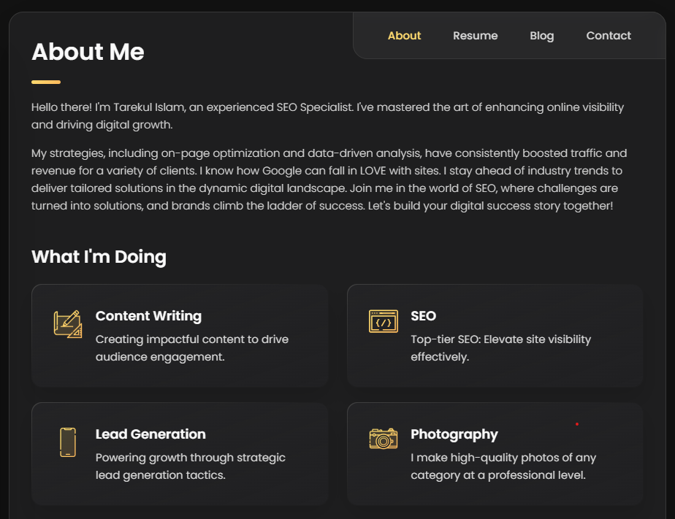
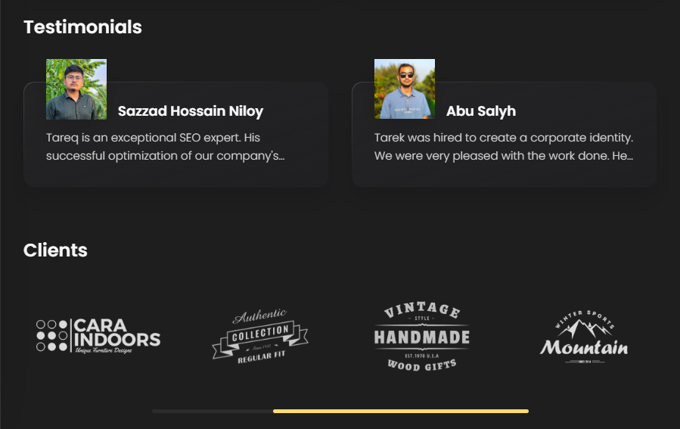
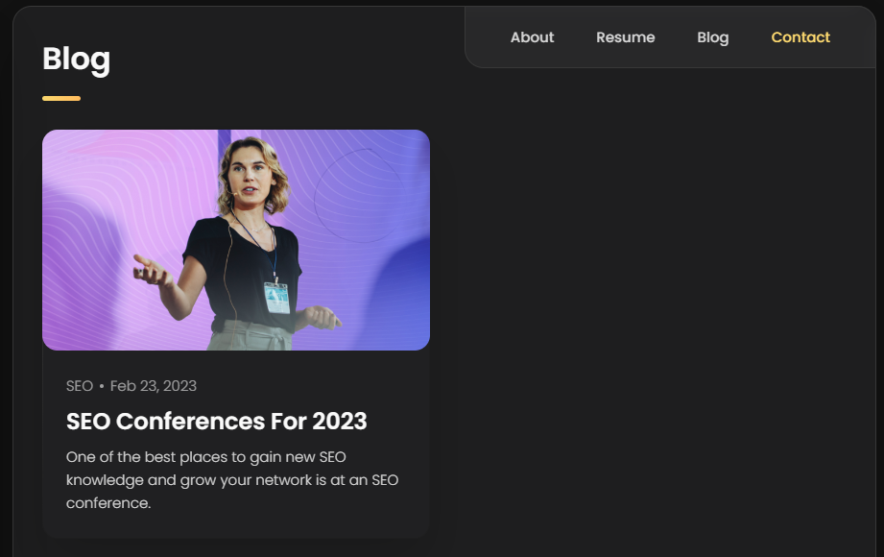
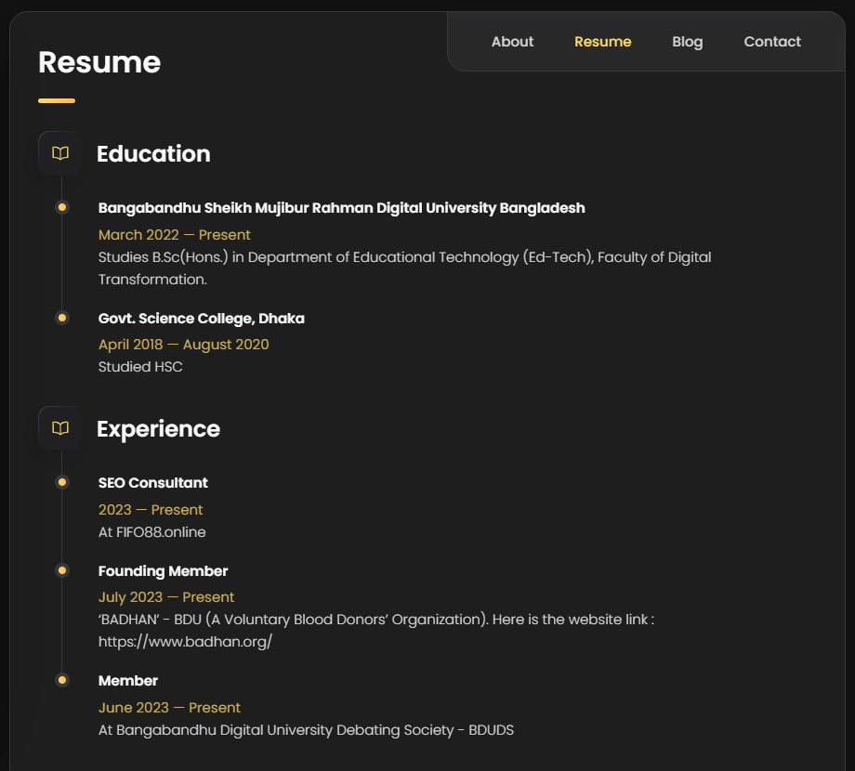
Create a personal website: https://tarekportfolio2002019.000webhostapp.com/

Slide 7
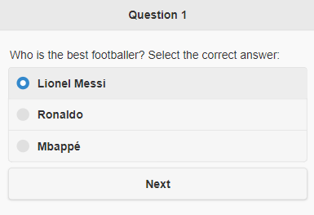
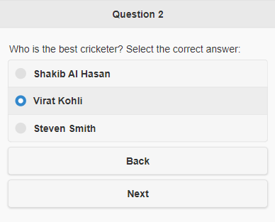
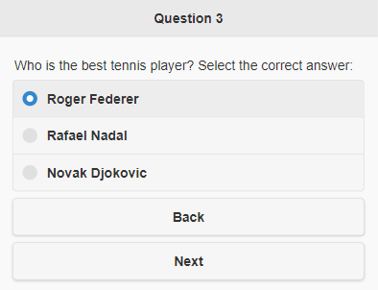
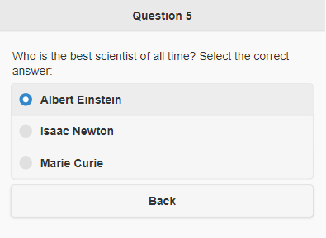
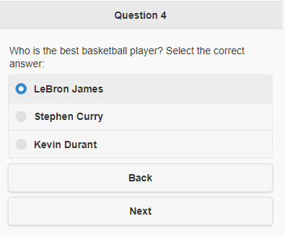
Write an MCQ quiz system of 5 questions:

Slide 8

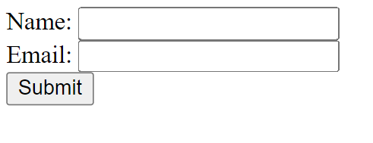
Bootstrap
Bootstrap
Question 1: Design a Bootstrap card with an image at the top, a title, and a paragraph of text.
Question-2: Construct a Bootstrap form with fields for "Name", "Email", and a "Submit" button.
Question-3: Design a Bootstrap alert that shows a success message with a green background.

Slide 9
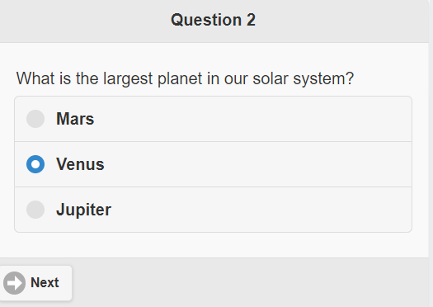
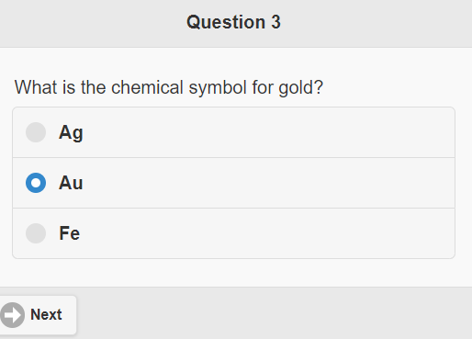
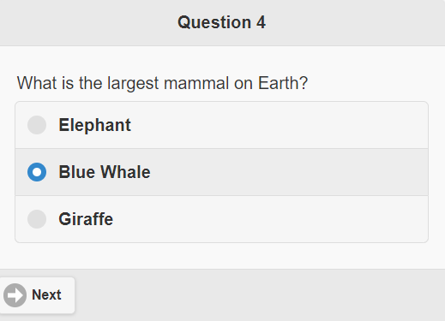
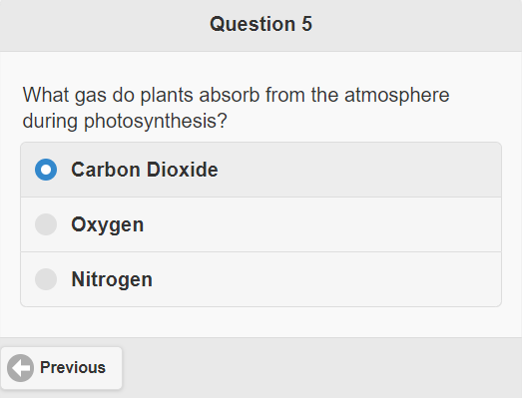
jQuery
Can you make a UI for MCQ tests (5 questions in 5 separate pages) using jQuery Mobile?

Slide 10
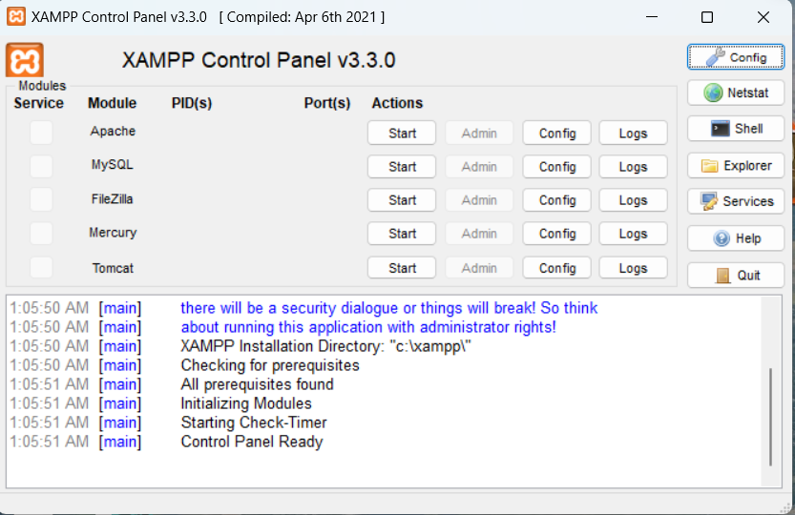
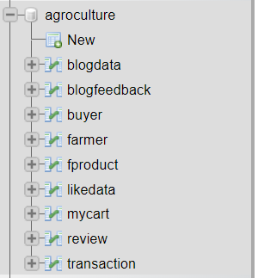
XAMPP
Xampp control panel:
Create a project:

Slide 11
Q1: suppose you want to take input from students via an online poll. How can you develop it using MYSQL and PHP? Just Give the idea.
Database Setup: First, create a MySQL database to store poll questions, answer options, and responses. You'll need tables for polls, questions, answer options, and responses. The structure of your database will depend on the specific requirements of your poll system.
2. PHP Backend: Create a PHP backend to interact with the database. You'll need PHP scripts to:
  Retrieve poll questions and answer options from the database.
  Store student responses in the database.
  Calculate and display poll results.

Slide 12
Digital Learning Technologies
Learning Management Systems (LMS):
Moodle:
  Pros: Open-source, highly customizable, supports various content types, extensive community and resources.
  Cons: Requires technical expertise for advanced customization.
Canvas by Instructure:
  Pros: User-friendly interface, mobile app, supports collaboration, analytics, and assessment tools.
  Cons: Costly for some institutions, limited free version.
Blackboard Learn:
  Pros: Robust features, assessment tools, integration options, analytics.
  Cons: Can be complex, costly, mixed user experiences.

Slide 13
Digital Learning Technologies
Synchronous Technologies:
Zoom:
  Pros: Easy to use, screen sharing, breakout rooms, recording, widespread adoption.
  Cons: Privacy and security concerns, limited free meetings.
Microsoft Teams:
  Pros: Integration with Office 365, chat, video conferencing, file sharing.
  Cons: Learning curve, complex for beginners.
Adobe Connect:
  Pros: Virtual classrooms, interactive features, content sharing, recording.
  Cons: Requires Adobe Flash, can be expensive.

Slide 14
Digital Learning Technologies
Multimedia Applications:
Adobe Captivate:
  Pros: Authoring tool, responsive design, multimedia support, interactive content.
  Cons: Learning curve, licensing cost.
Articulate Storyline:
  Pros: User-friendly, e-learning interactivity, templates, responsive output.
  Cons: Licensing cost, can be resource-intensive.
Camtasia:
  Pros: Screen recording, video editing, easy-to-use, rich editing features.
  Cons: Limited animation, not suitable for complex e-learning.

Slide 15
Digital Learning Technologies
Collaborative Applications:
Google Workspace (formerly G Suite):
  Pros: Collaboration, real-time editing, a cloud-based, suite of productivity tools.
  Cons: Limited offline access, and data privacy concerns.
Slack:
  Pros: Team communication, channels, integrations, file sharing.
  Cons: Can be distracting, learning curve.
Trello:
  Pros: Project management, visual boards, task assignment, flexible.
  Cons: May lack advanced features, better for certain use cases.

Slide 16
Digital Learning Technologies
Cloud-Based Technologies:
Amazon Web Services (AWS):
  Pros: Scalability, wide range of services, cost-effective.
  Cons: Steeper learning curve, pricing complexity.
Microsoft Azure:
  Pros: Integration with Microsoft products, global reach, hybrid cloud options.
  Cons: Pricing, complexity.
Google Cloud Platform (GCP):
  Pros: Data analytics, machine learning, data storage, developer-friendly.
  Cons: Smaller market share compared to AWS and Azure.

Slide 17
Digital Learning Technologies
Emerging Technologies:
Artificial Intelligence (AI) in Education:
  Pros: Personalized learning, automation, data analytics, chatbots.
  Cons: Ethical and privacy concerns, expensive to implement.
Virtual Reality (VR) and Augmented Reality (AR) in Education:
  Pros: Immersive learning experiences, engagement, simulations.
  Cons: Cost of hardware, limited content, potential distraction.
Blockchain in Education:
  Pros: Secure credentials, verification, transparency, fraud prevention.
  Cons: Emerging technology, scalability challenges, complexity.

Slide 18
THANK YOU

