Slide 1

Chapter 11
Data Link Control
11.<number>
Copyright © The McGraw-Hill Companies, Inc. Permission required for reproduction or display.

Slide 2
11-1 FRAMING
The data link layer needs to pack bits into frames, so that each frame is distinguishable from another. Our postal system practices a type of framing. The simple act of inserting a letter into an envelope separates one piece of information from another; the envelope serves as the delimiter.
Topics discussed in this section:
Fixed-Size Framing
Variable-Size Framing
11.<number>

Slide 3
OSI data link layer
OSI model layer 2
TCP/IP model part of Network Access layer
Application
HTTP, FTP, TFTP, SMTP etc
Presentation
Data stream
Application
Session
Transport
Segment
TCP, UDP
Transport
Network
Packet
IP
Internet
Data link
Frame
Ethernet, WAN technologies
Network Access
Physical
Bits

Slide 4

Data Link Layer Functions
Framing

Slide 5
Hops
There may be a different layer 2 protocol in use on each hop of a journey.
Different media, different types of link, different bandwidths, LAN/WAN affect the choice of protocol.
Different protocols have different frames.
The router removes the old frame and adds a new header and trailer for the next hop.

Slide 6
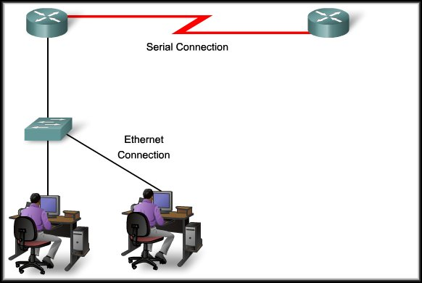
Controlling Transfer Across Local Media
WAN Header
WAN Trailer
LAN Header
LAN Header
Packet
Packet
LAN Trailer
LAN Trailer
Different media…
Different characteristics…
Different MAC method…

Slide 7
The Frame
However, each Data Link Layer protocol is constructed using the same basic format.
  It’s the contents that differ….
Header | Data | Trailer
Role of the Header
        Contains the control information required by the protocol.

Slide 8
Frames
Flags and Byte/Bit Stuffing

Slide 9

A frame in a character-oriented protocol

Slide 10

Byte stuffing
Note
Byte stuffing is the process of adding 1 extra byte whenever there is a flag or escape character in the text.

Slide 11

Byte stuffing and unstuffing

Slide 12

A frame in a bit-oriented protocol

Slide 13
Bit stuffing
Note
Bit stuffing is the process of adding one extra 0 whenever five consecutive 1s follow a 0 in the data, so that the receiver does not mistake
the pattern 0111110 for a flag.

Slide 14

Bit stuffing and unstuffing

Slide 15
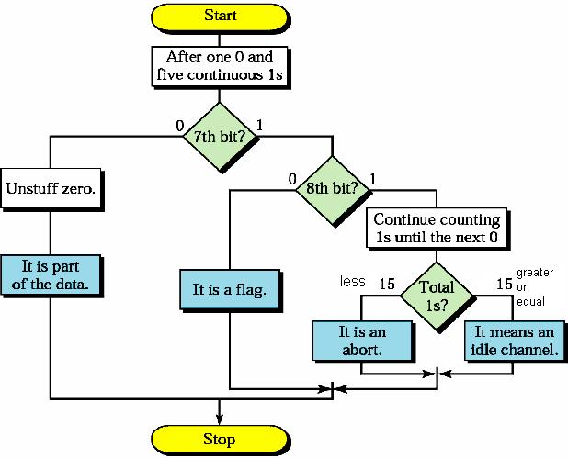
Flow Diagram- Receiver Side

Slide 16
Three exceptions
With 3 exceptions bit stuffing is required whenever five 1s occur consecutively:
  Bit sequence really is a flag
  The transmission is being aborted
  The channel is being put into idle

Slide 17
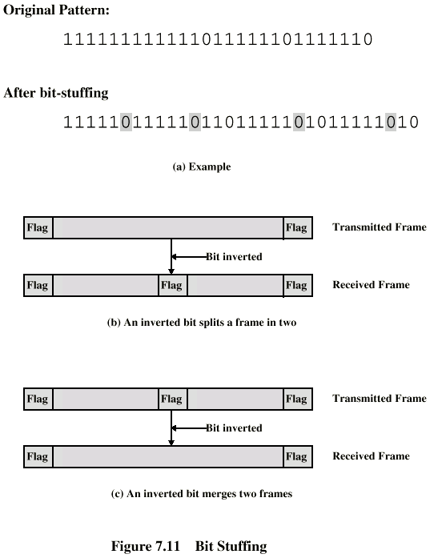
Bit Stuffing
Example with
possible errors

Slide 18
11-2 FLOW AND ERROR CONTROL
The most important responsibilities of the data link layer are flow control and error control. Collectively, these functions are known as data link control.
Topics discussed in this section:
Flow Control
Error Control
11.<number>

Slide 19
Note
Flow control refers to a set of procedures used to restrict the amount of data
that the sender can send before
waiting for acknowledgment.
11.<number>

Slide 20
Note
Error control in the data link layer is based on automatic repeat request, which is the retransmission of data.
11.<number>

Slide 21
11-3 PROTOCOLS
Now let us see how the data link layer can combine framing, flow control, and error control to achieve the delivery of data from one node to another. The protocols are normally implemented in software by using one of the common programming languages. To make our discussions language-free, we have written in pseudocode a version of each protocol that concentrates mostly on the procedure instead of delving into the details of language rules.
11.<number>

Slide 22

Figure 11.5 Taxonomy of protocols discussed in this chapter
11.<number>

Slide 23
11-4 NOISELESS CHANNELS
Let us first assume we have an ideal channel in which no frames are lost, duplicated, or corrupted. We introduce two protocols for this type of channel.
Topics discussed in this section:
Simplest Protocol
Stop-and-Wait Protocol
11.<number>

Slide 24

Figure 11.6 The design of the simplest protocol with no flow or error control
11.<number>

Slide 25
Example 11.1
Figure 11.7 shows an example of communication using this protocol. It is very simple. The sender sends a sequence of frames without even thinking about the receiver. To send three frames, three events occur at the sender site and three events at the receiver site. Note that the data frames are shown by tilted boxes; the height of the box defines the transmission time difference between
the first bit and the last bit in the frame.
11.<number>

Slide 26

Figure 11.7 Flow diagram for Example 11.1
11.<number>

Slide 27

Figure 11.8 Design of Stop-and-Wait Protocol
11.<number>

Slide 28
Example 11.2
Figure 11.9 shows an example of communication using this protocol. It is still very simple. The sender sends one frame and waits for feedback from the receiver. When the ACK arrives, the sender sends the next frame. Note that sending two frames in the protocol involves the sender in four events and the receiver in two events.
11.<number>

Slide 29

Figure 11.9 Flow diagram for Example 11.2
11.<number>

Slide 30
11-5 NOISY CHANNELS
Although the Stop-and-Wait Protocol gives us an idea of how to add flow control to its predecessor, noiseless channels are nonexistent. We discuss three protocols in this section that use error control.
Topics discussed in this section:
Stop-and-Wait Automatic Repeat Request
Go-Back-N Automatic Repeat Request
Selective Repeat Automatic Repeat Request
11.<number>

Slide 31
Note
Error correction in Stop-and-Wait ARQ is done by keeping a copy of the sent frame and retransmitting of the frame when the timer expires.
11.<number>

Slide 32
Note
In Stop-and-Wait ARQ, we use sequence numbers to number the frames.
The sequence numbers are based on modulo-2 arithmetic.
11.<number>

Slide 33
Note
In Stop-and-Wait ARQ, the acknowledgment number always announces in modulo-2 arithmetic the sequence number of the next frame expected.
11.<number>

Slide 34

Figure 11.10 Design of the Stop-and-Wait ARQ Protocol
11.<number>

Slide 35
Example 11.3
Figure 11.11 shows an example of Stop-and-Wait ARQ. Frame 0 is sent and acknowledged. Frame 1 is lost and resent after the time-out. The resent frame 1 is acknowledged and the timer stops. Frame 0 is sent and acknowledged, but the acknowledgment is lost. The sender has no idea if the frame or the acknowledgment is lost, so after the time-out, it resends frame 0, which is acknowledged.
11.<number>

Slide 36

Figure 11.11 Flow diagram for Example 11.3
11.<number>

Slide 37

Figure 11.12 Send window for Go-Back-N ARQ
11.<number>

Slide 38

Figure 11.13 Receive window for Go-Back-N ARQ
11.<number>

Slide 39
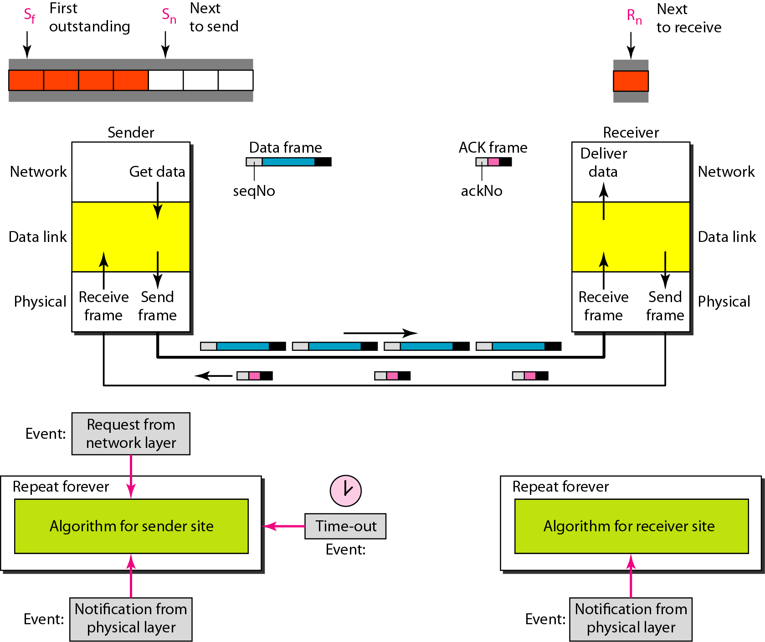
Figure 11.14 Design of Go-Back-N ARQ
11.<number>

Slide 40

Figure 11.15 Window size for Go-Back-N ARQ
11.<number>

Slide 41
Note
In Go-Back-N ARQ, the size of the send window must be less than 2^{m};
the size of the receiver window
is always 1.
11.<number>

Slide 42

Figure 11.18 Send window for Selective Repeat ARQ
11.<number>

Slide 43

Figure 11.19 Receive window for Selective Repeat ARQ
11.<number>

Slide 44
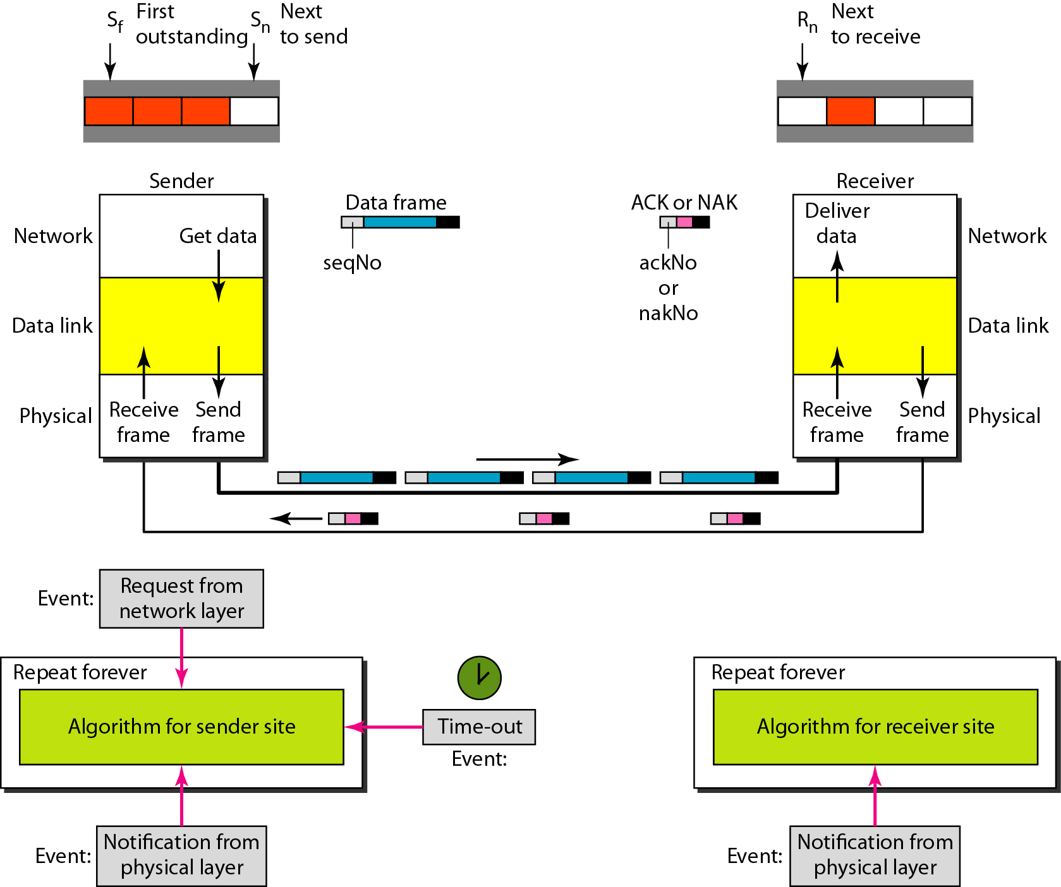
Figure 11.20 Design of Selective Repeat ARQ
11.<number>

Slide 45

Figure 11.21 Selective Repeat ARQ, window size
11.<number>

Slide 46
Note
In Selective Repeat ARQ, the size of the sender and receiver window
must be at most one-half of 2^{m}.
11.<number>

Slide 47

Figure 11.22 Delivery of data in Selective Repeat ARQ
11.<number>

Slide 48
11-6 HDLC
High-level Data Link Control (HDLC) is a bit-oriented protocol for communication over point-to-point and multipoint links. It implements the ARQ mechanisms we discussed in this chapter.
Topics discussed in this section:
Configurations and Transfer Modes
Frames
Control Field
11.<number>

Slide 49
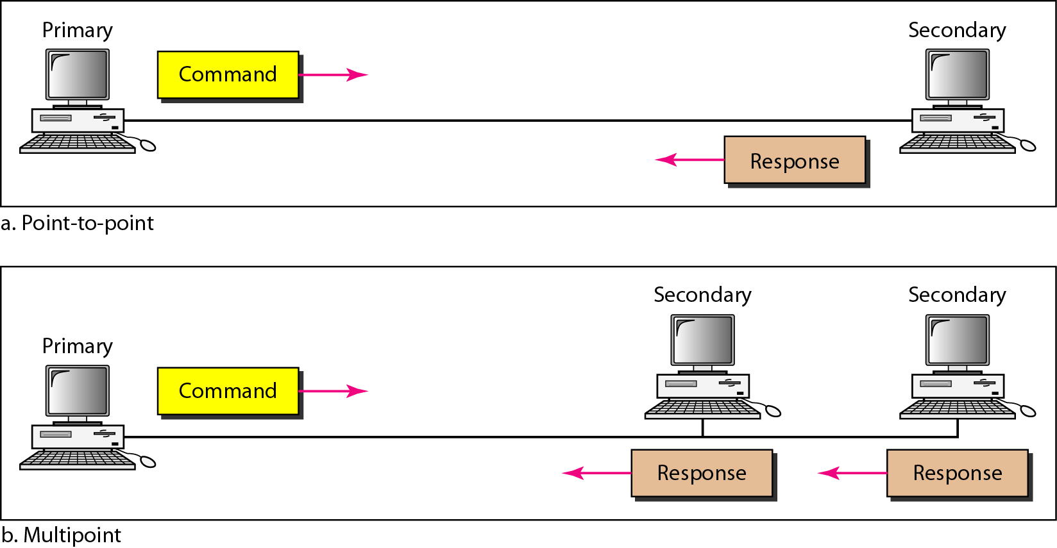
Figure 11.25 Normal response mode
11.<number>

Slide 50
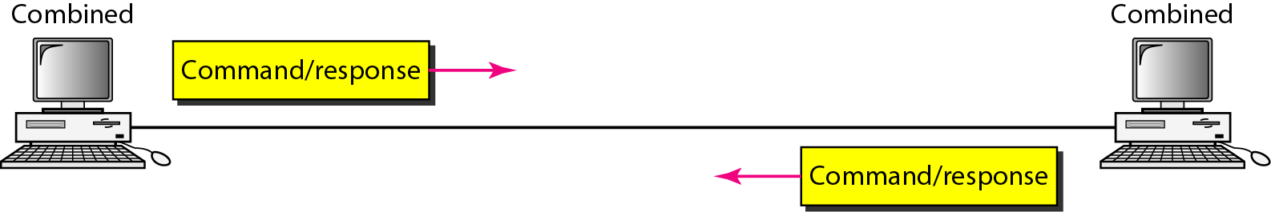
Figure 11.26 Asynchronous balanced mode
11.<number>

Slide 51
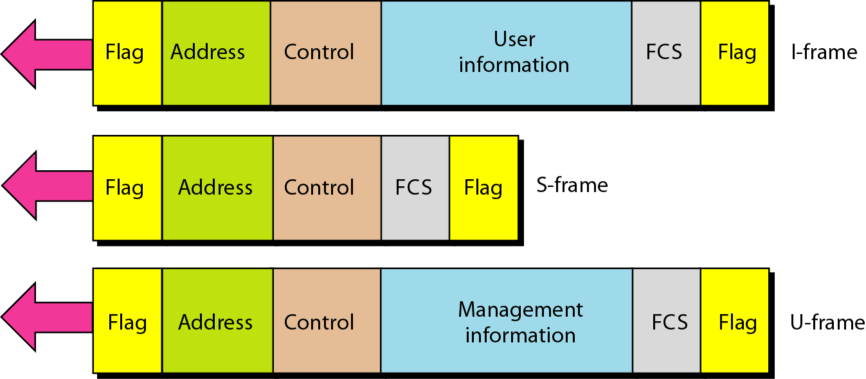
Figure 11.27 HDLC frames
11.<number>

Slide 52
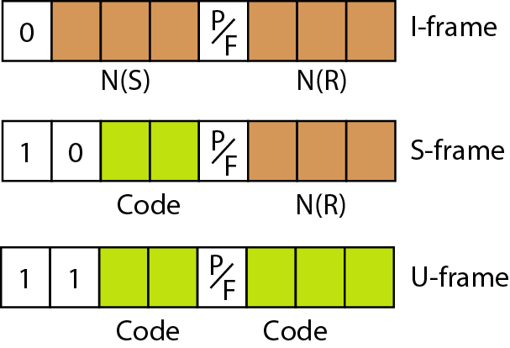
Figure 11.28 Control field format for the different frame types
11.<number>

Slide 53
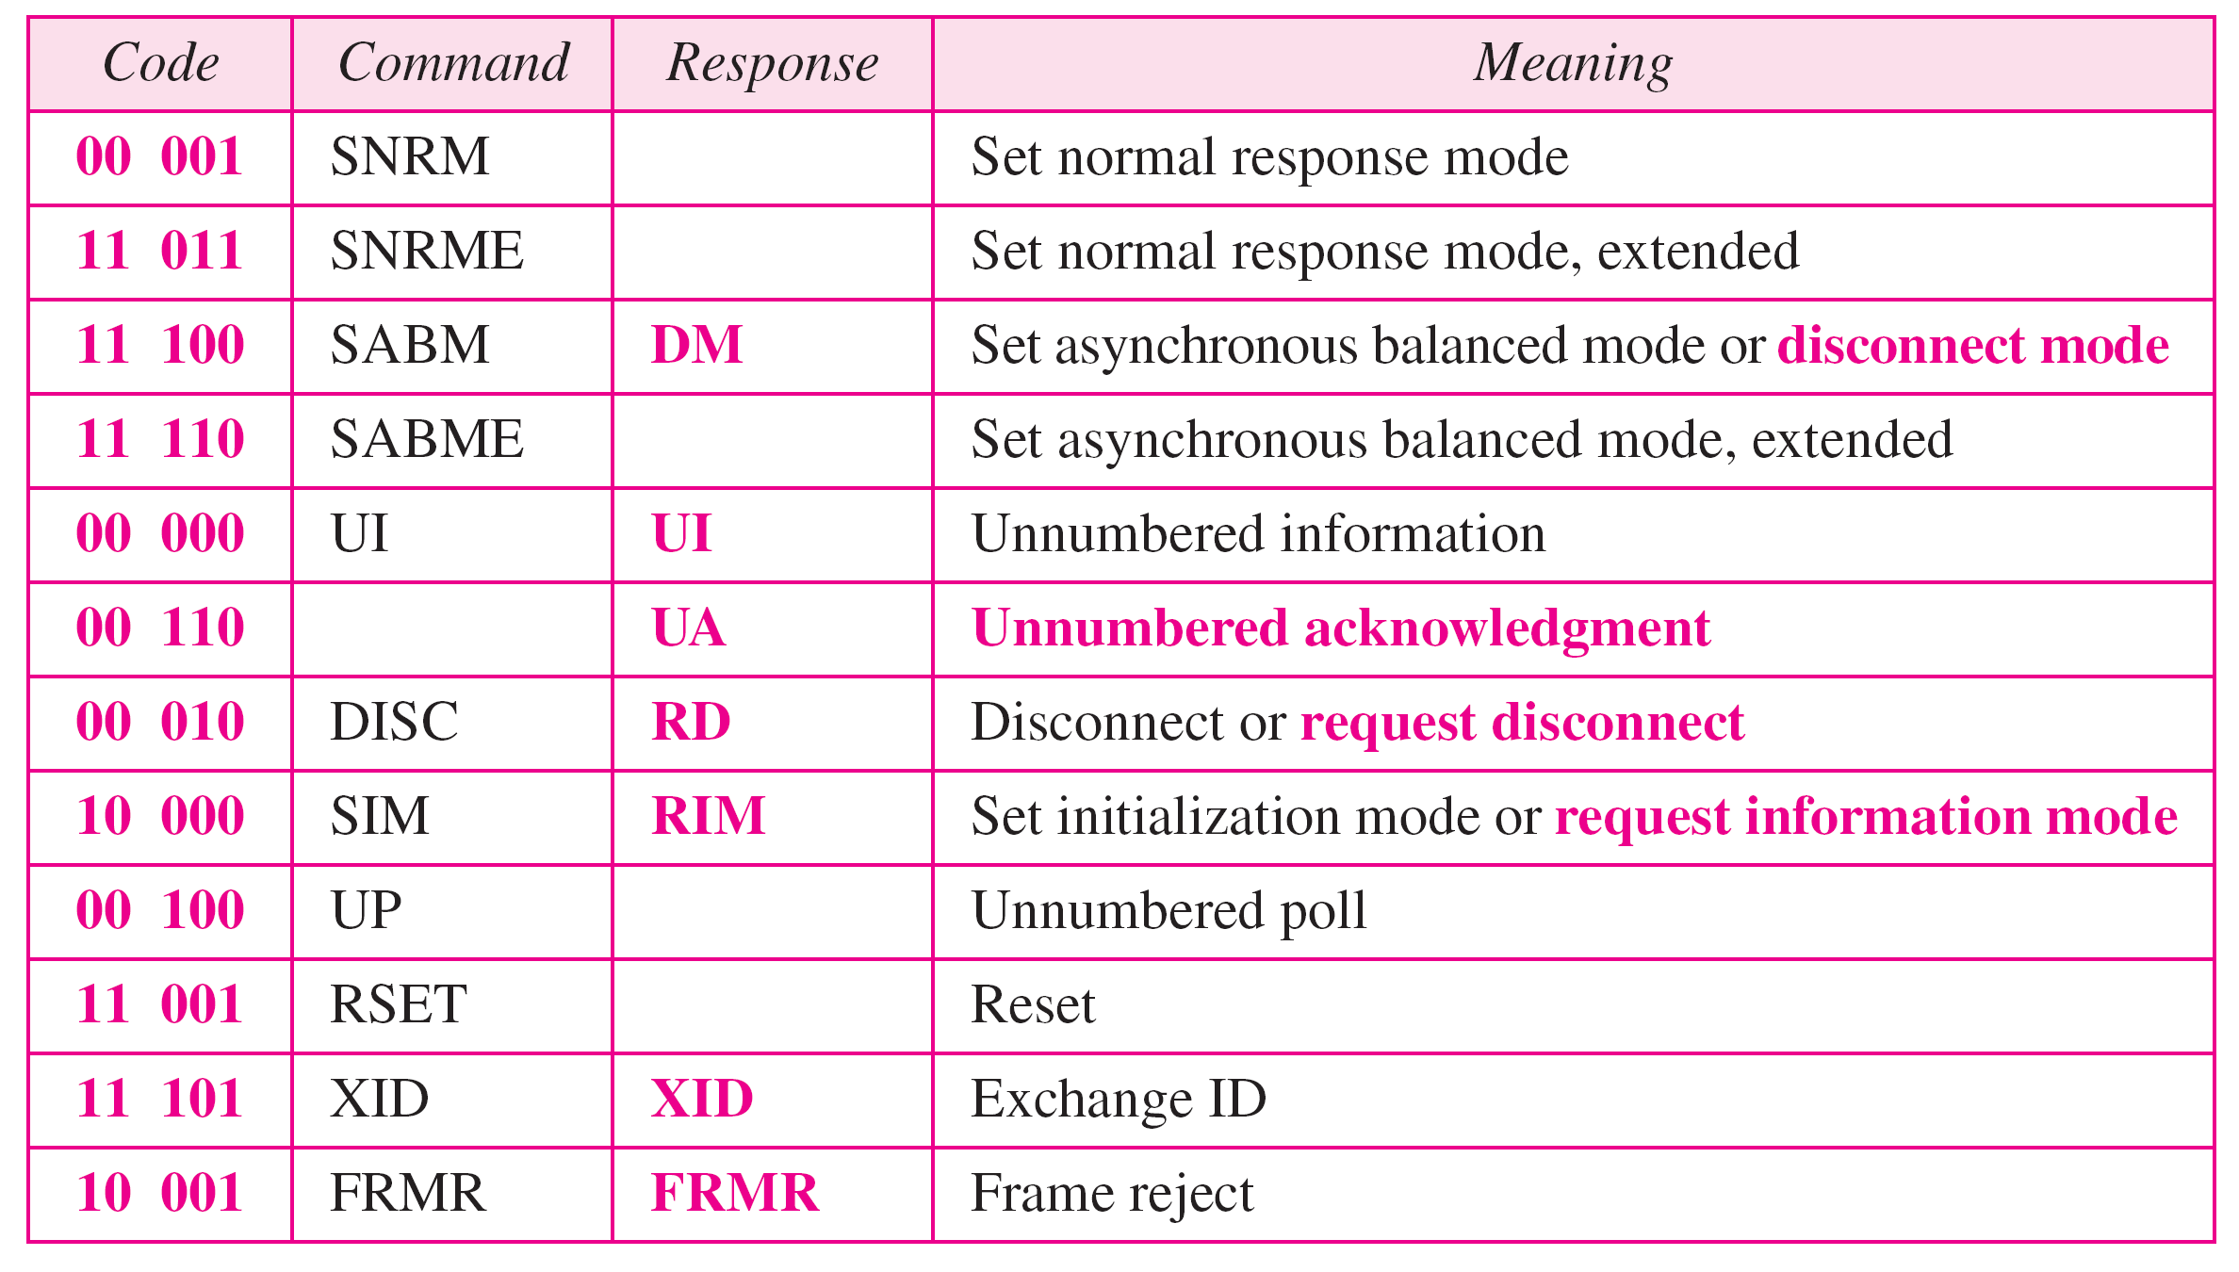
Table 11.1 U-frame control command and response
11.<number>

