Slide 1
The Basics

Slide 2
About me (Sakib)
Office Hours in Boleter 2432
Tuesday 1:30 – 3:30
Friday 11:30 – 12:30
Email
sakibsha@ucla.edu
Feel free to email me with questions, I am always available via email. (just put the title as CS31 pliss)
I will not be grading the correctness of your hw ☺
But will grade your reports, style, and comments ☺

Slide 3
Welcome to CS31!!!
Programming is a big part of computer science but what is it?

Slide 4
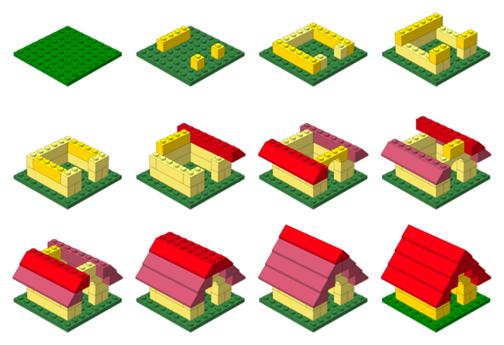
Telling the computer step by step what you want it to compute

Slide 5
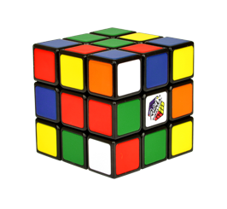
Think if it like solving a puzzle
The tools include the language you are using, and your brain, and your fingers
Rules are set by how much you can do with the language

Slide 6

What happens after you write the program?
You compile it into the language that your machine understands
Binary

Slide 7
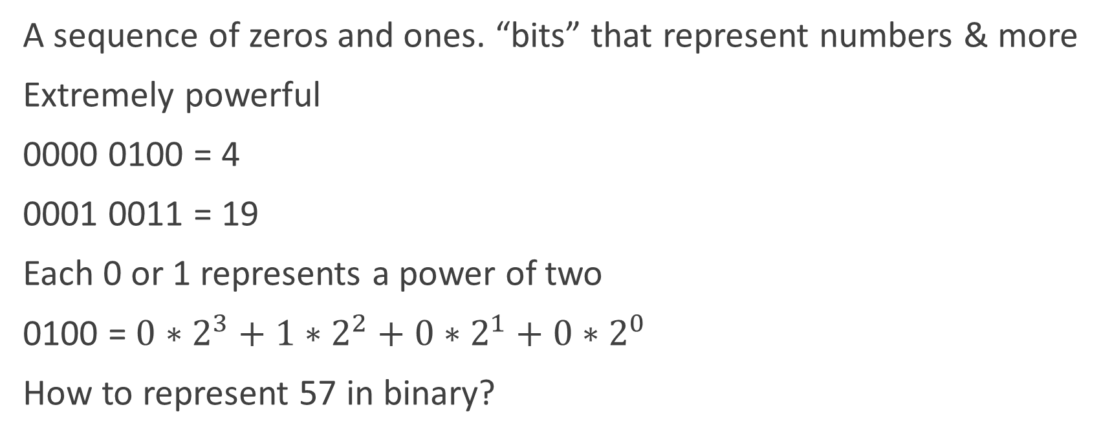
Binary
A sequence of zeros and ones. “bits” that represent numbers & more
Extremely powerful
0000 0100 = 4
0001 0011 = 19
Each 0 or 1 represents a power of two
0100 = $0∗2^{3}+1∗2^{2}+0∗2^{1}+0∗2^{0}$
How to represent 57 in binary?

Slide 8
Binary
8 bits = 1 Byte
Hex representation. Group 4 bits together
0-9, A, B, C, D, E, F
0001 1011 = 0x1B
Computers are either 32 bit or 64 bit architectures
A word in a 32 bit architectures = 4 bytes
10000111110001000100111110101001
How many bytes in 64 bit computer?

Slide 9


The IDE (Integrated Development Environment)
Sounds scary but its your best friend
Set of tools to help you write, compile, & debug code

Slide 10
IDE Setup
Xcode
Download from mac app store
Visual Studio
https://www.visualstudio.com/downloads/download-visual-studio-vs#d-2013-express
Use Express 2013 for windows desktop

Slide 11
Making a project

Slide 12
Visual Studio
Live demo

Slide 13
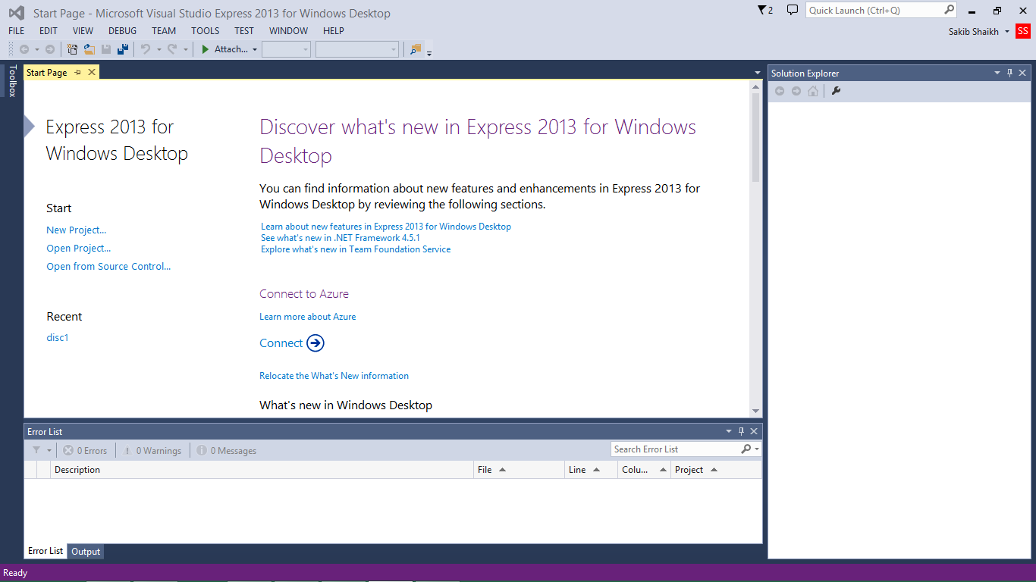

Slide 14
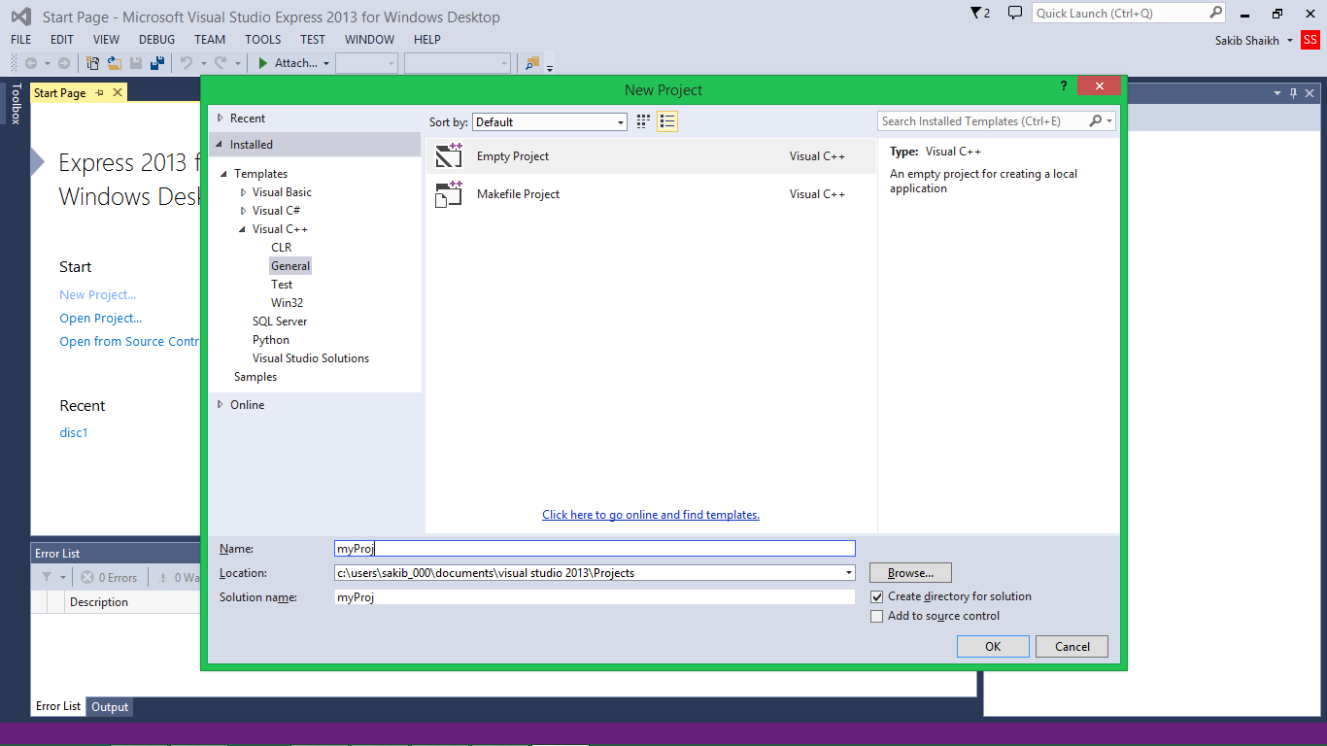

Slide 15
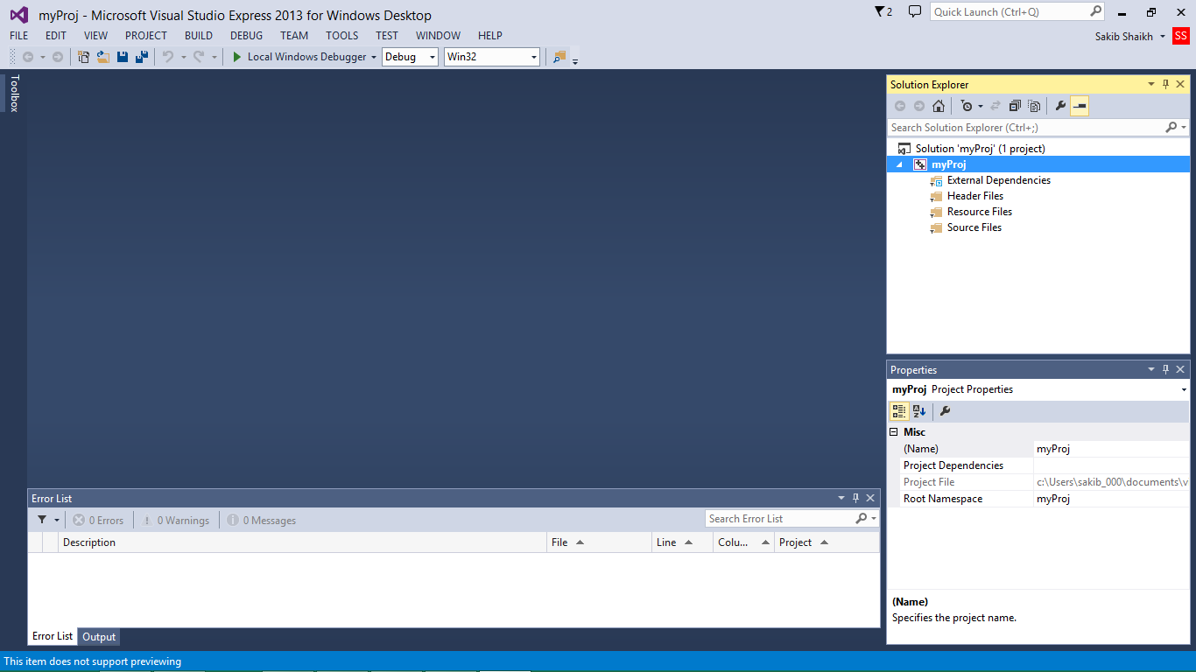

Slide 16
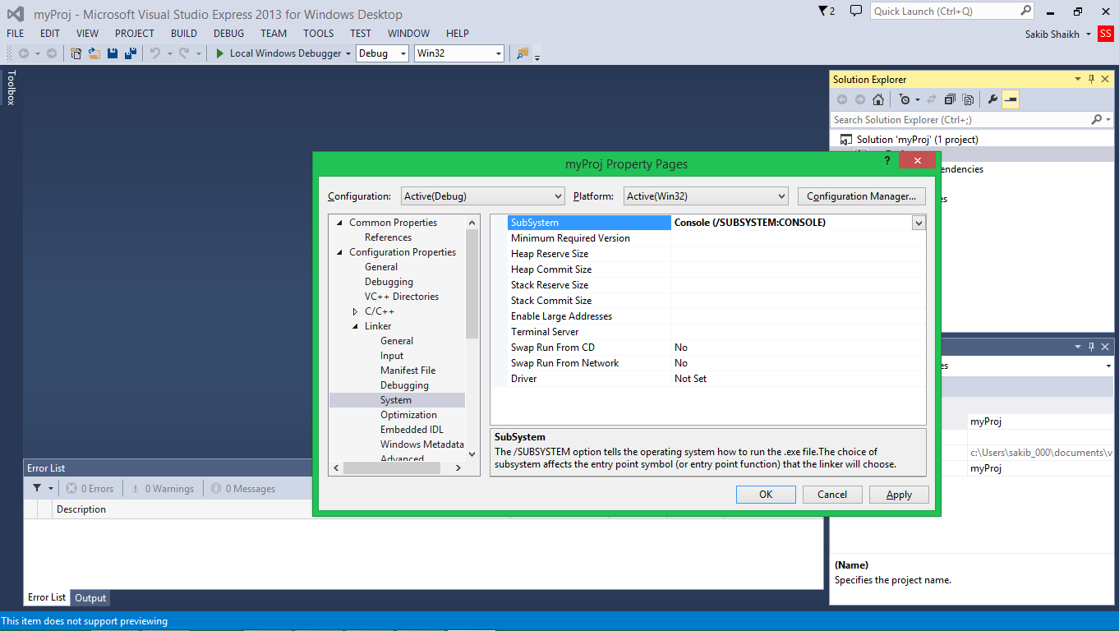

Slide 17
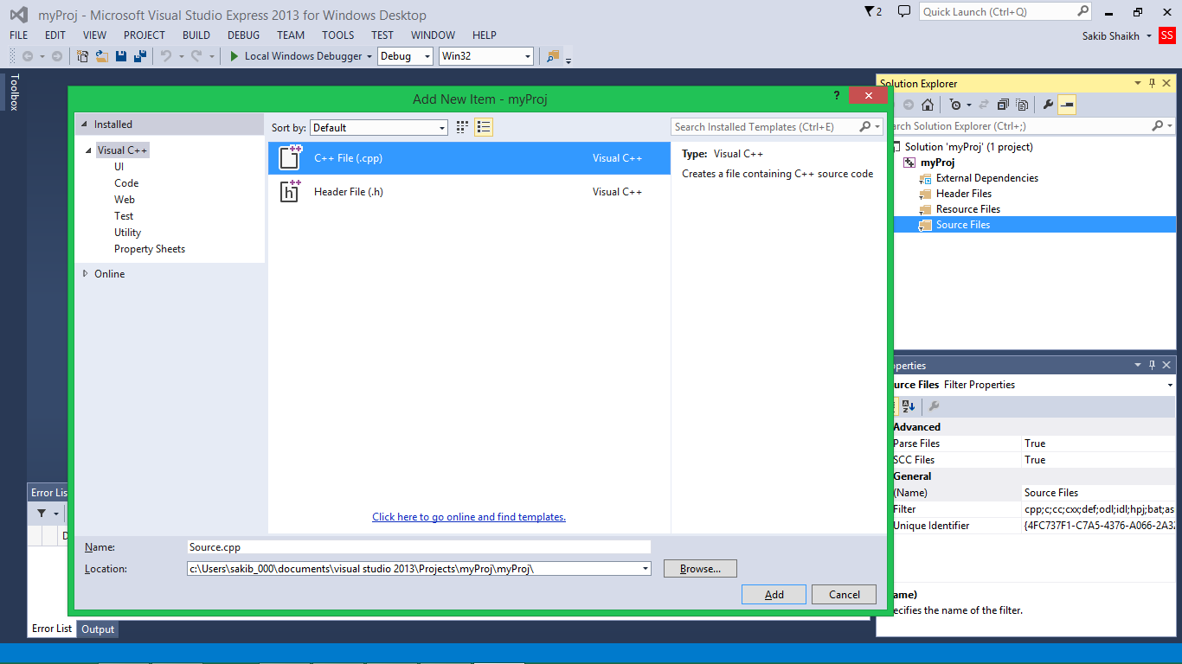

Slide 18
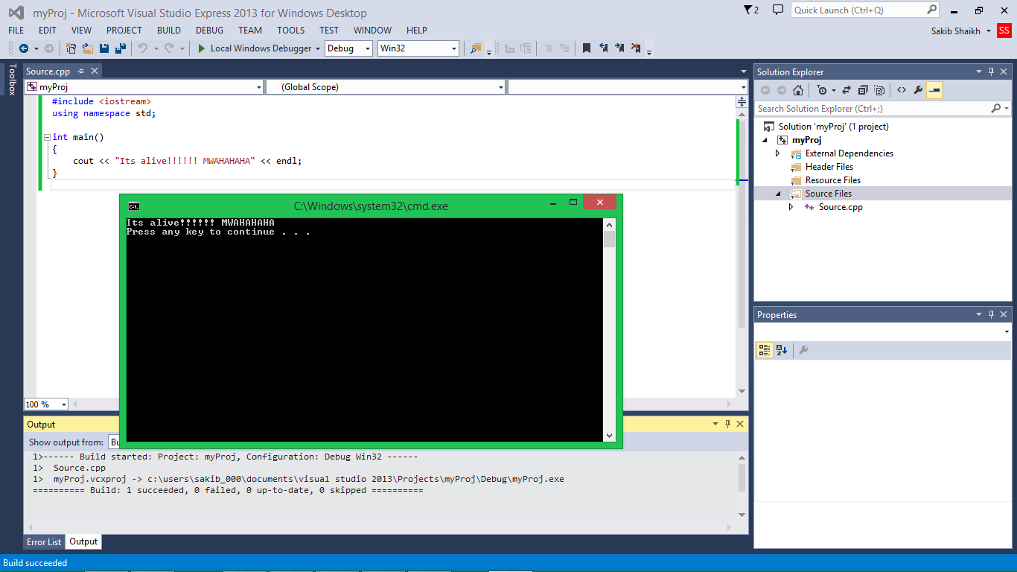

Slide 19
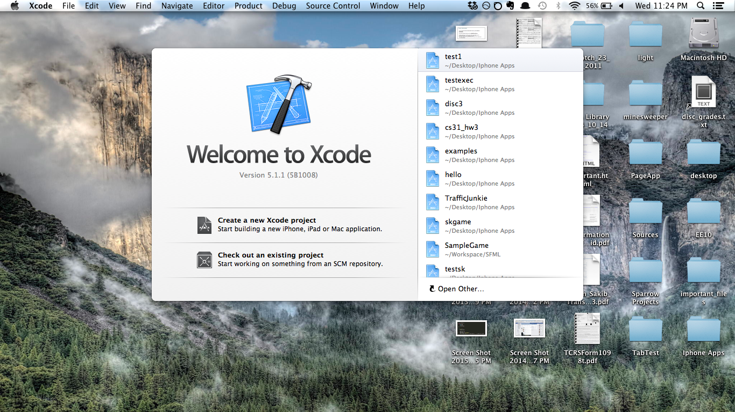
Xcode

Slide 20
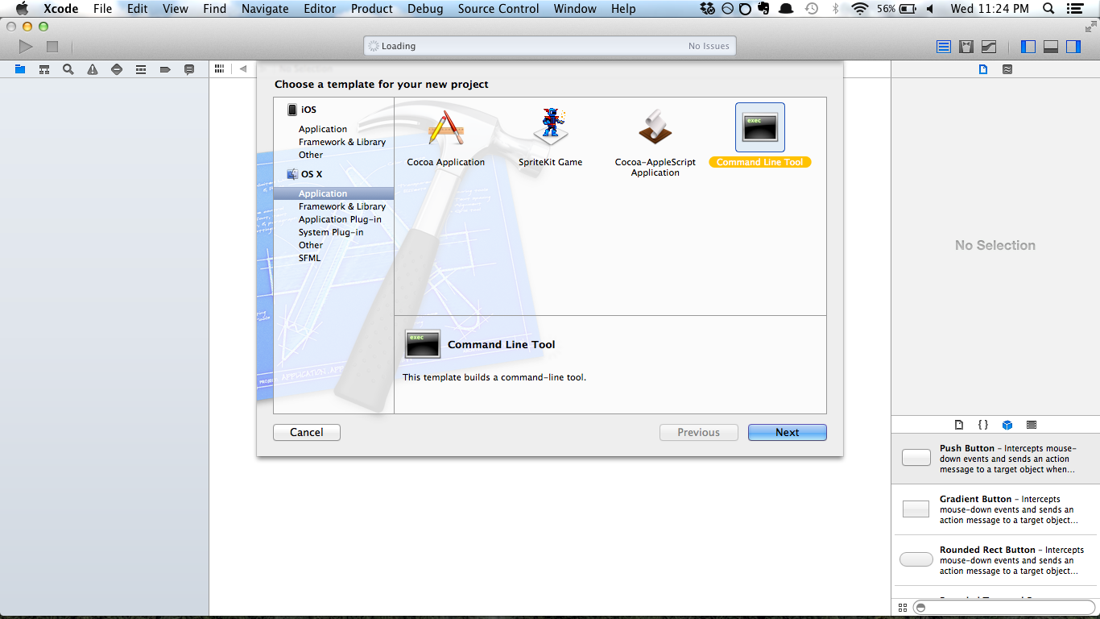

Slide 21
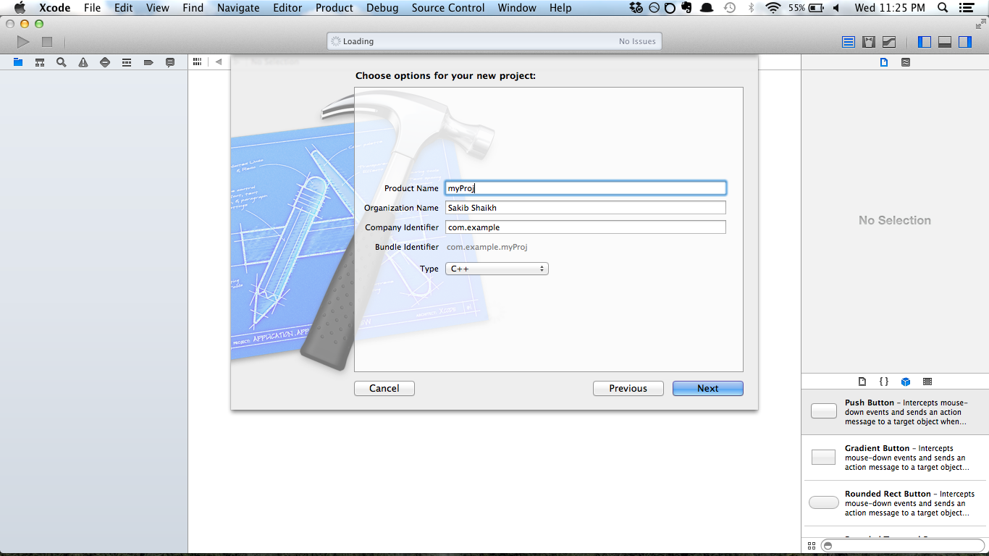

Slide 22
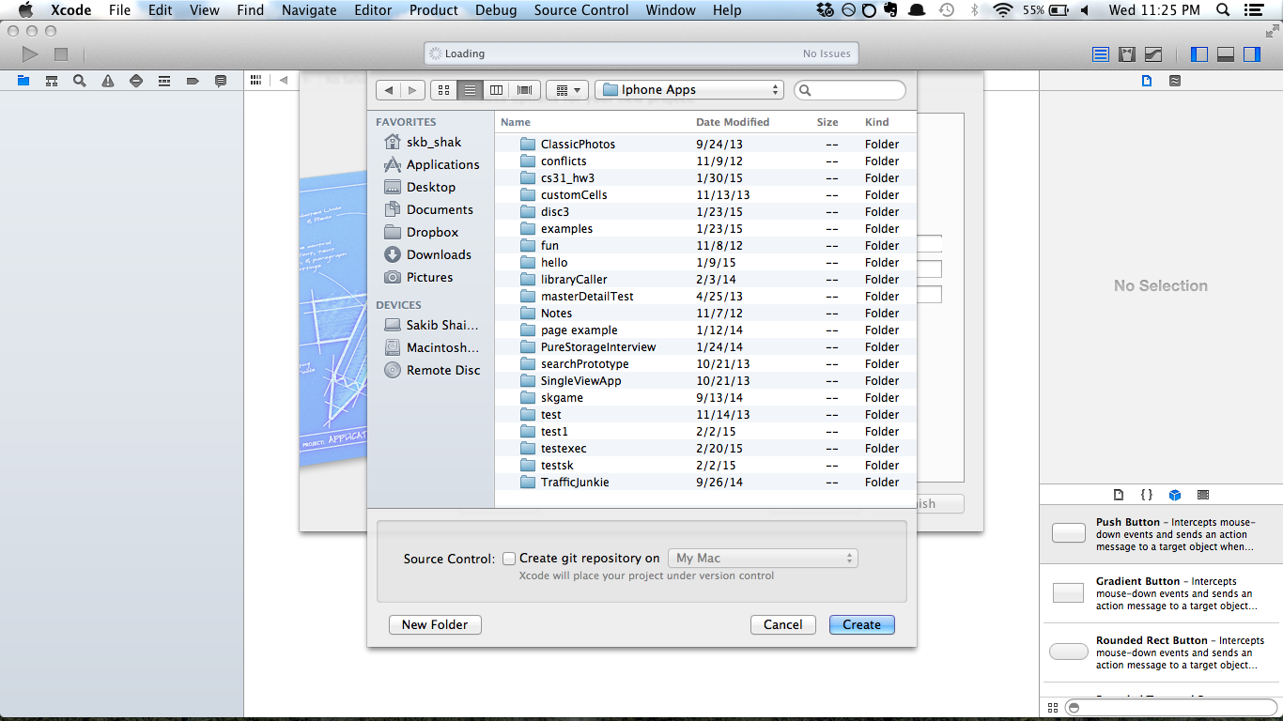

Slide 23
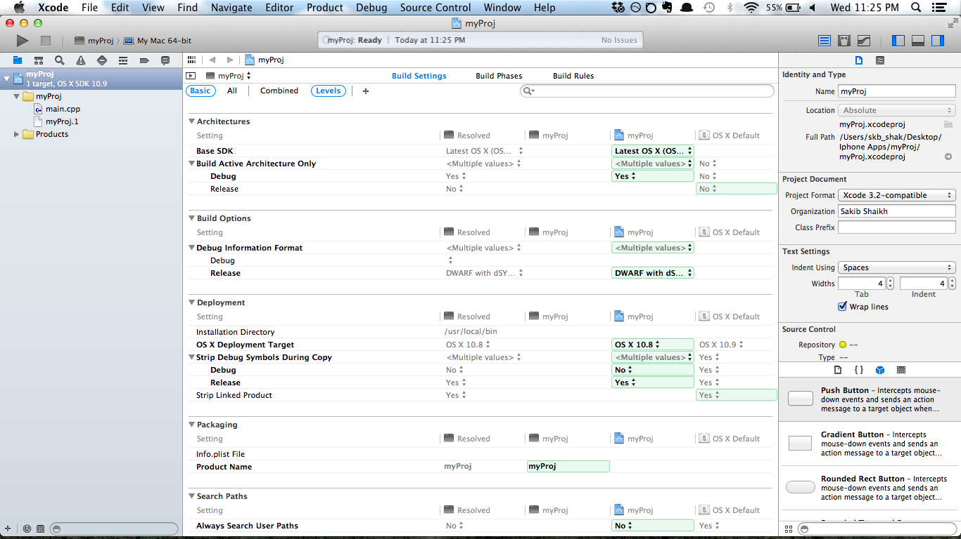

Slide 24
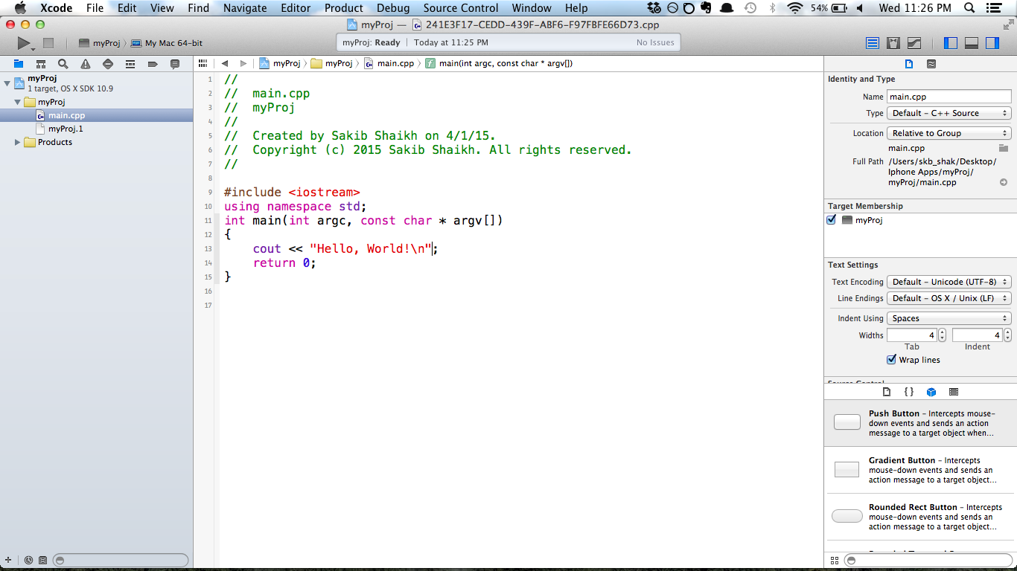

Slide 25
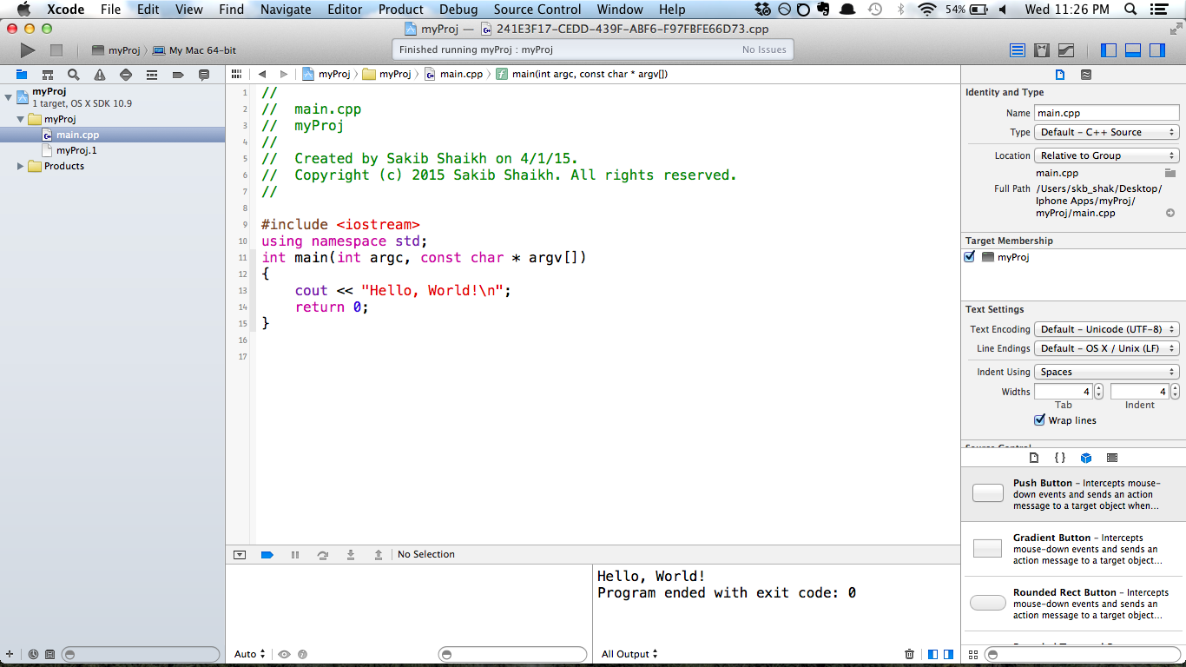

Slide 26
Our first program & dissecting what it means
They grow up so fast :’)
#include <iostream>
using namespace std;
int main()
{
cout << "Its alive!!!!!! MWAHAHAHA" << endl;
}

Slide 27
#include <iostream>
This is a library of code that has the implementation of cout and cin.
Without it they won’t work
By including the library, it is as if your program has that code
When compiling, compiler compiles the library code too
There are many other libraries! You’ll use more later.

Slide 28
using namespace std;
Everyone has a name but if you are talking about John with a friend and you all know 10 Johns, its not clear who you are talking about.
Namespace provide a context for an identifier just like how adding a last name could make it more specific which John we are talking about.
By adding the using namespace std, we are using the std namespace and all calls to cout, cin, and endl are the ones defined in the std namespace

Slide 29
The main function
This is the starting point of your program
We use int main() to specifiy it takes no parameters and returns an integer
In C++ the main function doesn’t need to explicitly return a value.
Return value used by programs that call your program
Want check if program ran successfully
0 means program ran successfully

Slide 30
#include <iostream>
using namespace std;
int main()
{
cout << "Its alive!!!!!! MWAHAHAHA" << endl;
return 0;
}

Slide 31

Sometimes our program won’t compile
Or if it does, it does not do the right things…

Slide 32

Syntax errors
You did not follow the language structure
Prevent compilation
Common errors
Forgot semicolon
Forgot brackets
Missing namespace or include definitions
Misspelled identifiers

Slide 33
#include <iostream>
using namespace std;
int main() {
int ThisIsCrazyYo = 4;
ThIsIsCrazyYo = 10;
cout << "The number is "
cout << ThisIsCrazyTo < endl;
}
There are 3 syntax errors

Slide 34
Runtime & logic errors
Program compiles but may break, crash, or do unexpected things when it is running
Examples
Division by 0
Overflow (trying to assign a larger number than a variable is meant to hold)
Using uninitialized values
Faulty logic

Slide 35
#include <iostream>
using namespace std;
int main() {
int x = 10;
int y = x / 0;
cout << y << endl;
}

Slide 36
A little bit about C++

Slide 37
Declaring variables
Need to specify type, name, and value
int is integer type. Whole numbers only (-130, 1, 100, 1000)
double for decimal values.
If you do not provide initial value, the variable is undefined or holds a junk value

Slide 38
// Declaring a variable of type int
// means that it is an integer with no decimal
int x;
// We can also declare multiple variables at once
int hereBeAnInt, // separate with commas!!
andAnotherInt;
// Or assign them
double testAssignment = 5.01,
reallyDescriptiveVariableName = -10.0;

Slide 39
Identifiers are names
In C++ identifier names MUST start with either a letter or underscore and all characters must be letters, digits, or underscore
Good
x, x1, x_1, _abc, ABC123z7, sum, RATE, count, data2, bigBonus
Bad
12, 3X, %change, data-1, myfirst.c, PROG.CPP
C++ is case sensitive!!!
MYVAR, myvar, myVar are all different names

Slide 40
Comments
Keep track of what you are doing
Future reference
For others to see and understand
Single lines
Multiple lines
Not compiled

Slide 41
// Here is an example of a line-item comment
// Anything after the two slashes is ignored
/*
* Here is an example of a block comment
* Anything between the first slash-asterisk and
* asterisk-slash is ignored. The asterisks on
* the left are for aesthetic appeal only
*/

Slide 42
Getting user inputs
Use cin to get input and store into variables
Program waits until you type something and press enter

Slide 43
#include <iostream>
using namespace std;
int main()
{
int favoriteNum;
int myFavoriteNum;
cout << "What is your favorite number?" << endl;
cin >> favoriteNum;
myFavoriteNum = favoriteNum + 2;
cout << "My favorite number is " << myFavoriteNum << endl;
}

Slide 44
If else statements
Introduce logic into your code
Do something if statement is true
3 components. Don’t need to have all
If
Else if
Else

Slide 45
#include <iostream>
using namespace std;
int main()
{
int x = 10;
if (x < 10)
cout << "less than 10" << endl;
else if (x > 10)
cout << "greater than 10" << endl;
else
cout << "equal to 10" << endl;
}

Slide 46
#include <iostream>
using namespace std;
int main()
{
int x = 10;
if (x < 10) {
cout << "x is ";
cout << "less than 10" << endl;
}
else if (x > 10) {
cout << "x is ";
cout << "greater than 10" << endl;
}
else {
cout << "x is ";
cout << "equal to 10" << endl;
}
}

Slide 47
Are the following the same?
int x = 10;
if (x > 1)
cout << "greater than 1" << endl;
else if (x > 5)
cout << "greater than 5" << endl;
else
cout << "x is " << x << endl;
int x = 10;
if (x > 1)
cout << "greater than 1" << endl;
if (x > 5)
cout << "greater than 5" << endl;
else
cout << "x is " << x << endl;

Slide 48
HW Tips
For future reference

Slide 49
Read things well. Read the spec, understand the requirements
Be precise in your coding and interpretation
Start early start early start early!!!!!!!!!!!!!!!!!!!!!!!!!!!!!!!!!
Gives you time to figure out what is going wrong
Reach out for help from TAs
Develop incrementally. Test your code often!!
cout is a good friend.

Slide 50
Remember to comment your code!!
Keep your code neat & organized for style pts
When you have to give testcases for future HWs, give actual values you used to test.
Be thorough

Slide 51
Project 1 is up!!

