Slide 1
Operators

Slide 2
if/else statements revisited
if (conditional1) {
// Execute everything in here if
// conditional1 was evaluated to true
}
else if (conditional2) {
// Execute everything in here if
// conditional1 was evaluated to false AND
// conditional2 was evaluated to true
}
else {
// Execute everything in here if
// conditional1 was evaluated to false AND
// conditional2 was evaluated to false
}

Slide 3
Does the following compile?
#include <iostream>
using namespace std;
int main() {
int x = 30;
if (x == 10)
cout << "Test 1! ";
cout << "x is 10" << endl;
else if (x == 20)
cout << "Test 1! ";
cout << "x is 10" << endl;
else
cout << "Test 1! ";
cout << "x is 10" << endl;
}

Slide 4
T or F?
The if statement evaluates a conditional statement between the parenthese
Uses operators like < or >
Operators are symbolic keywords used to compute values between operands, or the arguments to the operators
Evaluates to true or false
The number 0 equates to false
if (0)
cout << "Never gets printed :(" << endl;
else
cout << "Always printed :)" << endl;

Slide 5
Conditional operators
Operator | Meaning
== | Equal to
!= | Not Equal to
< | Less than
<= | Less than or equal to
> | Greater than
>= | Greater than or equal to

Slide 6
Checking multiple conditions
What if I wanted to check multiple conditions in an if statement?
X Is between 0 and 100
X is less than 0 or greater than hundred
There are special operators to do that
&& | AND
|| | OR

Slide 7
// Check between 0 (non inclusive) and 100
if (x > 0 && x <= 100)
cout << "Just right" << endl;
// Check if less than or equal to 0 and greater than 100
if (x <= 0 || x > 100)
cout << "So many numbers!!" << endl;

Slide 8
Mathematical operators
Operator | Meaning
+ | Plus
- | Minus
* | Multiply
/ | Divide
% | Modulo (gets remainder)
++ | Increment
-- | Decrement

Slide 9
Operators have Precedence
What does that even mean??
What if I gave you the following set of instructions: "Wash the car, dry the car, and do your homework."
In what order will you perform the tasks?
Chances are you'll do one of the following:
Wash the car, then dry the car, and then do your homework.
Do your homework, then wash the car, and then dry the car.
Some of you anarchists might want to wash the car, then do your homework, then dry the car because the man doesn't tell you how to clean.

Slide 10
Its all about the order of operations
Some operators have higher priority
are evaluated before others
http://en.cppreference.com/w/cpp/language/operator_precedence
PEMDAS to the next level
Associativity varies!
The direction in which operators evaluate their operands; can be left to right (e.g. 5 + 3 + 2) or right to left (e.g. i = 5;)

Slide 11
Manually set precedence
Use () to control the order of operations
Statement in () is evaluated before it is used

Slide 12
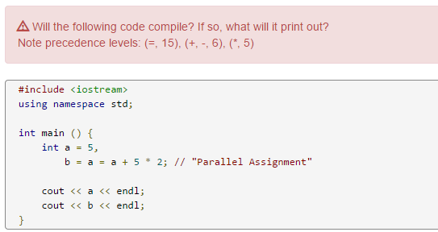
Some examples on precedence

Slide 13
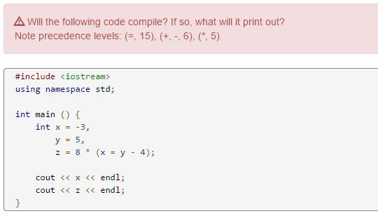

Slide 14
Strings
Strings objects that represent a sequence of characters
Surrounded by “ ”
You have been using strings with cout.
To use strings as variables need to #include <string>

Slide 15
Strings can be concatenated
The + operator behaves differently with strings
It combines strings into new string
Be careful!
You cannot concatenate a string and an int

Slide 16
What does the program print?
#include <iostream>
#include <string>
using namespace std;
int main() {
string me = "Sakib",
blank = "",
space = " ",
newLine = "\n",
result,
nothing;
result = me + "iscool";
cout << result << endl;
cout << "-----" << endl;
result = me + blank + blank + "=reallycool";
cout << result << endl;
cout << "-----" << endl;
}

Slide 17
Special characters
What if I want to print Enter or Tab?
‘\n’ is a new line
‘\t’ is a tab
These are treated as ONE character

Slide 18
How long is a string
Use the .length() method of a string to find out how many characters are in a string

Slide 19
#include <iostream>
#include <string>
using namespace std;
int main() {
string me = "Sakib",
blank = "",
space = " ",
newLine = "\n",
result;
cout << me << ": " << me.length() << endl;
cout << "blank" << ": " << blank.length() << endl;
cout << "space" << ": " << space.length() << endl;
// What will newLine.length() return?
cout << "newLine" << ": " << newLine.length() << endl;
cout << "result" << ": " << result.length() << endl;
}

