Slide 1

A New Method for Lung Nodule Detection Using Deep Neural Networks for CT Images
Supervisor
Dr. Pintu Chandra Shill
Professor,
Dept. of CSE
Khulna University of Engineering & Technology,
Khulna
Presented By:
Zarin Homayra (1407006)
Sakif Rahman (1407023)

Slide 2
OUTLINES
Introduction
Related Work
Proposed Methodology
Get Data
Clean & Manipulate Data
Train Model
Result
Conclusions

Slide 3
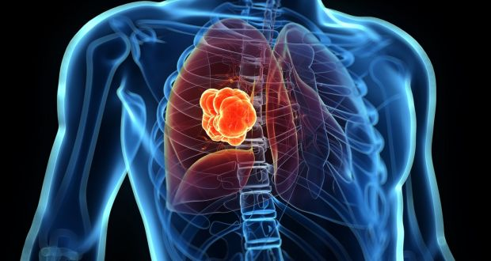
Problem Statement
Introduction
Related Work
Method
Result
Conclusion
Lung cancer is one of the most common and serious types of cancer.
Every year more people die of lung cancer than breast, colon and prostate cancers combined.
The survival rate of lung cancer for 5 year is only 18.7%

Slide 4
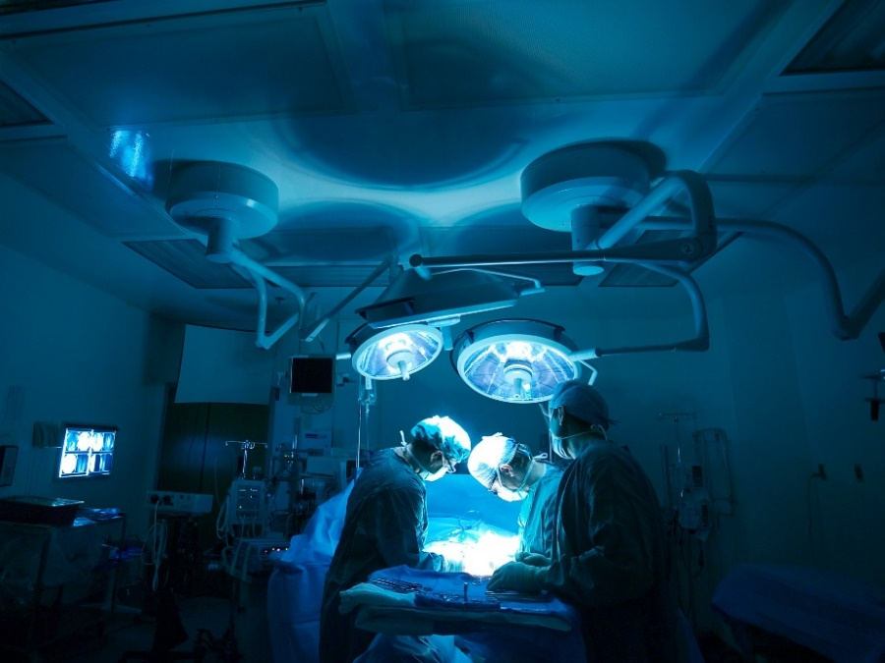
Motivation
Introduction
Related Work
Method
Result
Conclusion
Almost 49% chance of survival is present if lung cancer is diagnosed early and cancer nodule is 3 centimeter or smaller.
In this thesis, we try detect around 3 centimeter lung nodule on the CT images which is on early stage and can easily recoverable.

Slide 5
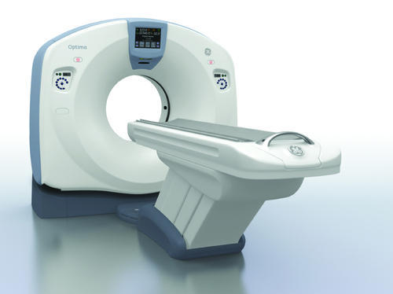
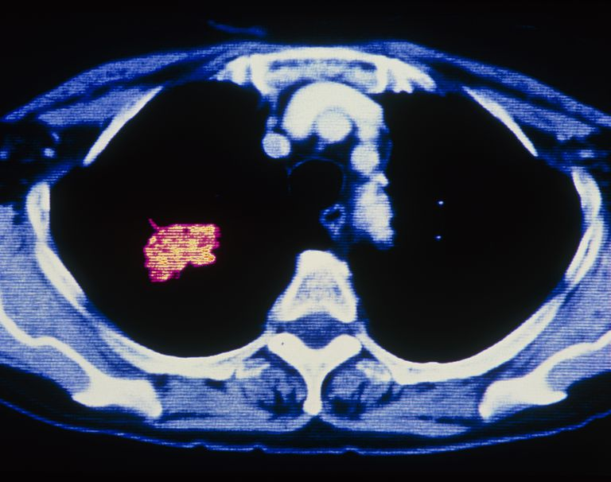
CT Scan
Introduction
Related Work
Method
Result
Conclusion
A computerized tomography (CT) or computerized axial tomography (CAT) scan combines data from several X-rays to produce a detailed image of structures inside the body. CT scans produce 2-dimensional images of a "slice" or section of the body, but the data can also be used to construct 3-dimensional images

Slide 6
Related Work: Lung Cancer Classification
Introduction
Related Work
Method
Result
Conclusion
Author : Jinsa Kuruvilla, K. Gunavathi
Segmentation:
1. CT image 2. Binary image 3. Morphological 4. Segmented
Opening Output Output
Artificial neural network :
ANN is used to classify the lung cancer

Slide 7
Related Work: Lung Cancer Classification
Introduction
Related Work
Method
Result
Conclusion
Experimental Results : Their maximum classification accuracy of 91.1%.
Limitation : The miss-classification occurred in the images where the cancer nodule located near the pleural side of the lungs.

Slide 8
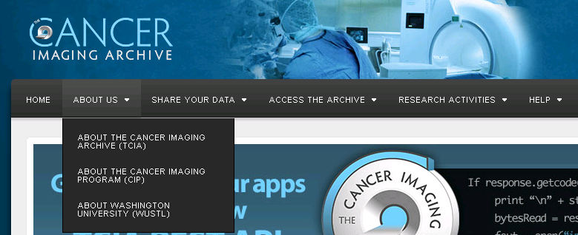
Introduction
Related Work
Method
Result
Conclusion
Get Data
Cleaning
Train
Testing
Collect Training Data
We collected the CT images from Cancer Imaging Archive. The Cancer Imaging Archiving (TCIA) works on cancer research and it has a large database of medical images.

Slide 9
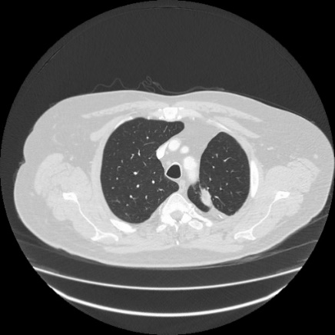
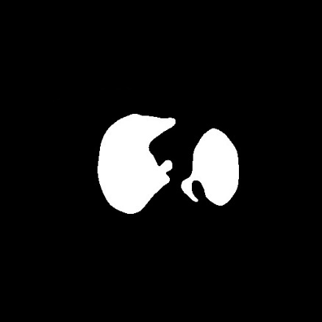
Introduction
Related Work
Method
Result
Conclusion
Get Data
Cleaning
Train
Testing
Clean & Manipulate Data
In cleaning process we need to modify a lung CT image (left) to a more simple image (right) for training models.

Slide 10
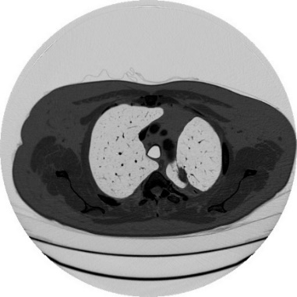
Introduction
Related Work
Method
Result
Conclusion
Get Data
Cleaning
Train
Testing
Negative CT Image
At first we negative this CT image by this formula
$PixelValue\left[x,y\right]=255− PixelValue\left[x,y\right]$

Slide 11
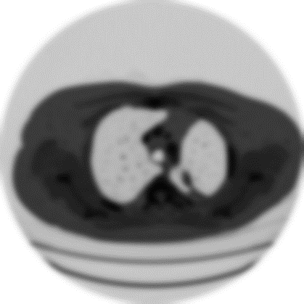
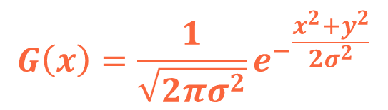
Introduction
Related Work
Method
Result
Conclusion
Get Data
Cleaning
Train
Testing
Gaussian Blur of CT Image
Gaussian blur is performed in each CT image for cover the small holes and reduce all the noise of the images .
$$G\left(x\right)=\frac{1}{\sqrt{2πσ^{2}}}{e^{−}}^{\frac{x^{2}+y^{2}}{2σ^{2}}}$$

Slide 12
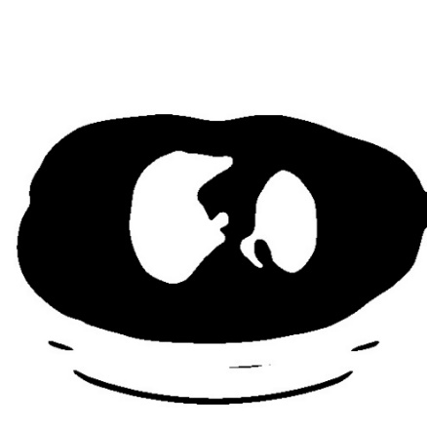
Introduction
Related Work
Method
Result
Conclusion
Get Data
Cleaning
Train
Testing
Otsu Thresholding
On the blurred CT image, we use Otsu Thresholding. Otsu’s algorithm find a threshold value (t) which minimizes the weighted within-class variance.

Slide 13
Introduction
Related Work
Method
Result
Conclusion
Get Data
Cleaning
Train
Testing
Best template matching
Template Matching are applied for finding the center the images.

Slide 14
Introduction
Related Work
Method
Result
Conclusion
Get Data
Cleaning
Train
Testing
Border Extraction
Other than the center part, all the pixel value of the image are turned into zero.

Slide 15

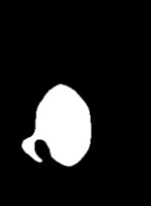
Introduction
Related Work
Method
Result
Conclusion
Get Data
Cleaning
Train
Testing
Split the Image
The center of the origin point is selected and split the right and left lung image by the help of template matching point.

Slide 16

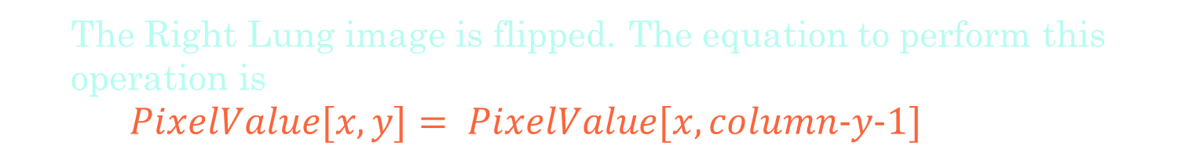
Introduction
Related Work
Method
Result
Conclusion
Get Data
Cleaning
Train
Testing
Flip Right Lung
The Right Lung image is flipped. The equation to perform this operation is
$PixelValue[x,y]= PixelValue[x,column−y−1]$

Slide 17
Introduction
Related Work
Method
Result
Conclusion
Block Diagram of Methodology
Image Pre-Processing
Train Model
Gaussian Blur
Calculate Last Layer Value of CT Image
Otsu Threshold
Select Training, Testing, Validation Data
Data
Template Matching
10,000 Steps for Final Layer of Graph
Split the Image
Flip the Image
Final Test Accuracy

Slide 18

Introduction
Related Work
Method
Result
Conclusion
Get Data
Cleaning
Train
Testing
Train Models
Deep learning has breakthrough achievement in image classification which also recognizes an object in an image. We use TensorFlow, an open framework for deep learning and an open-source project.
MobileNet
Inception-v3
VGG-8:

Slide 19

Introduction
Related Work
Method
Result
Conclusion
Get Data
Cleaning
Train
Testing
MobileNet
MobileNet is an efficient convolutional neural network. MobileNet is build which only depthwise separable convolution. This model is based on 1×1 convolution or point wise convolution. Where one filter in one input channel, the depthwise convolution can be derive.
$${\dot{G}}_{k,l,m}=\sum_{i,j}^{n}{{\dot{K}}_{k,l,m}}.F_{k+i−1,l+j−1,m}$$
Where (K ) ̇is convolutional kernel and in one of the channel in F to produce of the filtered output feature map G .
Input CT image
Batchnorm
ReLU
1×1 Convolution
Batchnorm
ReLU

Slide 20
Introduction
Related Work
Method
Result
Conclusion
Get Data
Cleaning
Train
Testing
MobileNet Training Process
Almost 500 images are selected which hold lung nodule and 500 CT images which do not hold lung nodule for training and testing purpose.
Training : 60%
Testing : 20%
Validation: 20%

Slide 21
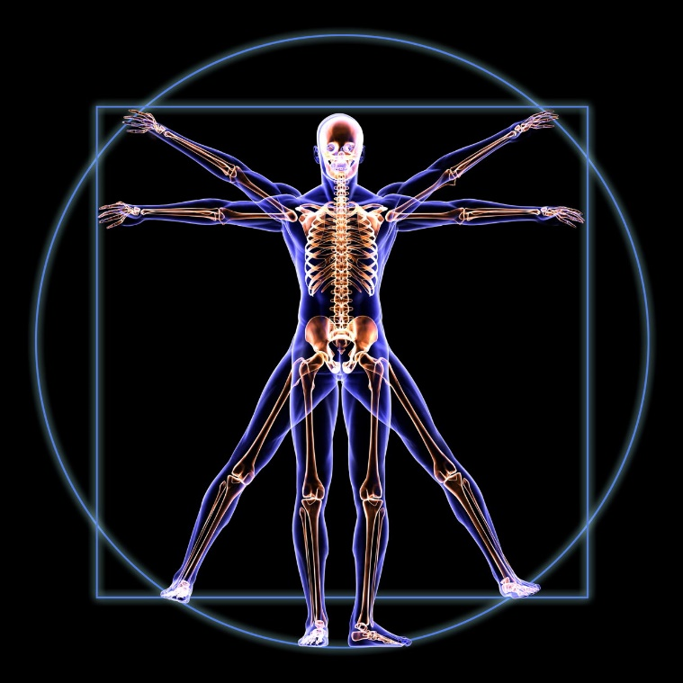
Introduction
Related Work
Method
Result
Conclusion
Get Data
Cleaning
Train
Testing
Main Idea
Split the left and the right lung in a CT image for reduce the pattern of the lung and give better accuracy and better performance in deep neural network.

Slide 22
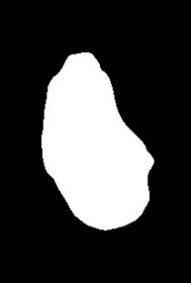
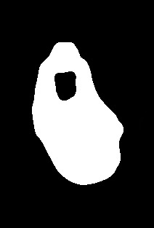
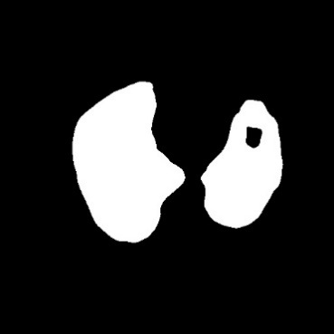
Introduction
Related Work
Method
Result
Conclusion
Get Data
Cleaning
Train
Testing
Results of Main Idea
Flip images get better accuracy then the whole images.
This is our new Idea. It has never been implemented before.

Slide 23
Introduction
Related Work
Method
Result
Conclusion
Get Data
Cleaning
Train
Testing
Final Result
Final result of the models.
MobileNet
Inception-v3
VGG-8
Image classifier | True Positive | True Negative | False Negative | False Positive
MobileNet | 103 | 91 | 4 | 2
VGG-8 | 98 | 91 | 9 | 2
Inception | 99 | 90 | 8 | 3

Slide 24

Introduction
Related Work
Method
Result
Conclusion
Get Data
Cleaning
Train
Testing
Final Result
Sensitivity = $\frac{tp}{tp+fn}$
Specificity = $\frac{tn}{tp+fn}$
Accuracy = $\frac{tp+tn}{tp+tn+fp+fn}$

Slide 25

Introduction
Related Work
Method
Result
Conclusion
Conclusion
Our aim is make a software that can predict cancer in the early age like a human expert.
This accuracy can also be improved by constantly checking only one patient at a time because the lung nodule will appear more than once sequentially in CT image.

Slide 26
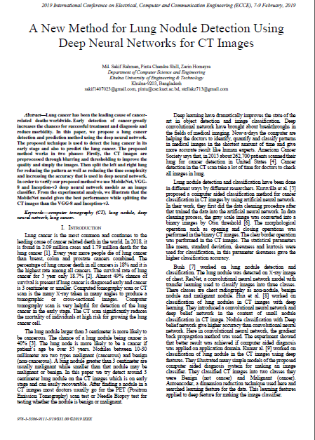
Introduction
Related Work
Method
Result
Conclusion
Our Paper

Slide 27

Introduction
Related Work
Method
Result
Conclusion

