Slide 1

Calculating credit worthiness for rural India
By SAKIL ANSARI

Slide 2
Calculating credit worthiness for rural India
Goal:
Performing descriptive analysis of the features of the data and understanding the maximum repayment capability of customers which can be used to grant them the desired amount

Slide 3
Calculating credit worthiness for rural India
Background
In Banking industry, loan applications are generally approved after a thorough background
check of the customer's repayment capabilities.
Credit Score plays a significant role in identifying customer's financial behaviour (specifically default).
People belonging to rural India do not have credit score and it is difficult to do a direct assessment.
Attribute Information
1. Id: Primary Key
2. Personal Details: city, age, sex, social_class
3. Financial Details: primary_business, secondary_business, annual_income, monthly_expenses,
old_dependents, young_dependents
4. House Details: home_ownership, type_of_house, occupants_count, house_area, sanitary_availability,water_availability
5. Loan Details: loan_purpose, loan_tenure, loan_installments, loan_amount (these contain loan details of loans that have been previously given, and which have been repaid)

Slide 4
Dataset & Attribute Information
Data Attribute Overview
Dataset
Dataset Attribute | Description
Data Set Characteristics | Multivariate
Number of Instances | 40000
Attribute Characteristics | Categorical, Integer,float,object
Number of Attributes | 21
Associated Tasks | Regression
The dataset contains some of the information that is collected for
loan applications of rural customers.

Slide 5
Solution Approach
Steps Followed for Building Machine Learning Model:
Step 1: Loading the dataset from the prompt
-The user is asked to select the input file
-The user is allowed to load only CSV file format as per current scenario
Step 2 :Handling missing values
-Mode is used for handling categorical missing value and mean is used for numerical value.
Step 3 :Performing one-hot encoding
-One-hot encoding is performed on categorical features:sex and type_of_house
Step 4:Converting loan_purpose features into 0 and 1:
-Top 10 most frequent categories in loan_purpose features are taken and one hot encoding is performed and the remaining categories are placed with 0.
Step 5 :Model Creation and Evaluation:
-Model is created , accuracy and MSE,MAE and RMSE are calculated

Slide 6
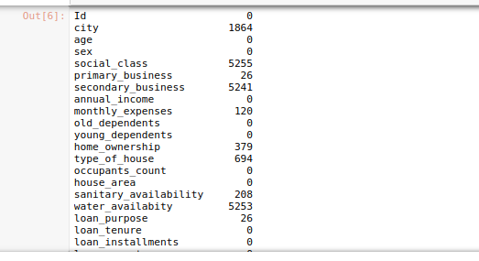
Features overview-Checking null values
Notes:
<number>

Slide 7
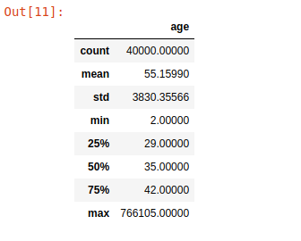
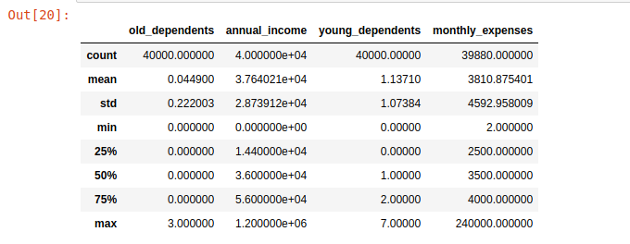
Summary Statistics
205,288 are the values of age features.
766105 is a mistyped age value
Since there are only such three records in the dataset,so we can drop those values.
.

Slide 8
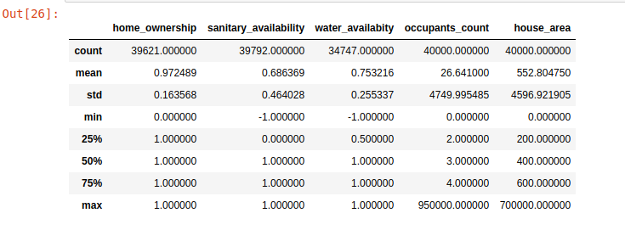
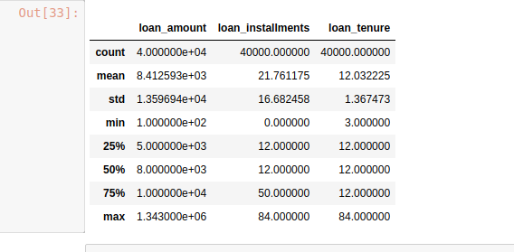
Summary Statistics

Slide 9
Handling Missing values and Categorical Features
Mode is used for handling categorical features and mean is used for handling numerical features.
Since sex and type of house are categorical feature, so one hot encoding is perfromed on these features.
Dummy variable trap is handled.
loan_purpose is a categorical feature and has many categories.Since loan_purpose is an important feature, this feature should be handled properly.
Top 10 most frequent categories are calculated and one hot encoding is performed on these features and for remaining categories 0 are placed.

Slide 10
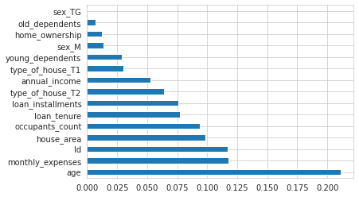
Feature Importance
Feature importance is calculated by using ExtraTreesRegressor
Monthly Expenses is the most important feature
Sex is the least important feature.

Slide 11
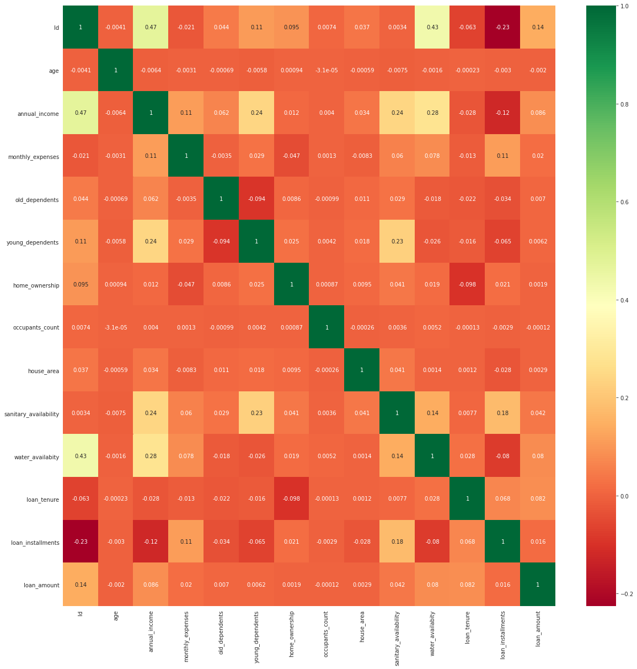
Correlation Matrix
No Feature are highly correlated

Slide 12
Model Creation
Various Machine learning algorithms are developed, and accuracy is compared.
Linear regression,Decision Tree and Random forest algorithms are used for creating model.
MAE,MSE and RMSE are used as metrics.

Slide 13
Model Accuracy Result
The model is trained on 70% data and the accuracy is compared by using the following formular:
errorrate=(abs(actualvalue-predictedvalue)/actualvalue)*100
meanerrorate=mean(errorrate)
accuracy=100-meanerrorate
Algorithms | Accuracy
Random Forest Regressor | 86.639
Decision Tree Regressor | 85.5
Linear Regression | 71.33

Slide 14
Model Accuracy Result
The model is trained on 70% data and MAE,MSE and RMSE are compared
Algorithms | MAE | MSE | RMSE
Random Forest Regressor | 2301 | 166813299 | 12915
Decision Tree Regressor | 1399 | 194093830 | 13931
Linear Regression | 2282 | 166992843 | 12922

Slide 15
Answers to the Problem
1. Do a descriptive analysis of all the variables.
Ans:A descriptive analysis is performed in EDA and Model creation jupyter notebook.
2.There is a new customer who needs a loan. Which models will be best suited to predict the loan_amount that can be granted to the customer?
Ans:This is a regression problem.Regression models will be best suited to predict the loan_amount that can be granted to the customer.I have used linear regression ,decision tree and Random forest algorithm.
3. Build a model to predict the maximum loan_amount that can be granted to the
customer. Which all variables are good predictors?
Ans: The code is shared and all good predictors are also included in the jupyter notebook
4.Is loan_purpose a significant predictor? The business has insisted on using
loan_purpose as a predictor. If it is not already a significant contributor, can we still
modify the model to include it?
Ans:I have included this feature in the model and I have handled this feature
5. How will you measure the fitness of the model? Which metrics (accuracy, recall, etc.)
are most relevant?
Ans: This answer is included in jupyter notebook.

Slide 16
Future work and Conclusion
Analysis for the data is performed and 86% accuracy is achieved.
The accuracy of the algorithm can be increased by increasing data and by hyperparameter tuning
Deep learning algorithms can be developed, and the accuracy can be compared.
The model created by auto ml gives less accuracy than the model created by machine learning.
Categorical features can be handled in other ways to check the accuracy of the model.

Slide 17



Linkedin :/sakilansari
Contact : 8179685293
Email : sakilansari4@gmail.com
Thank you

