Slide 1

Reducing Credit Default Rate at ABC Bank
By SAKIL ANSARI

Slide 2
Reducing Credit Default Rate at ABC Bank
Goal:
Finding out the risky customers using data, identify the characteristics and recommend suitable actions which will help the bank reduce overall default rate.

Slide 3
Reducing Credit Default Rate at ABC Bank
Background
ABC Bank is facing the challenge of high credit default rates.
One of the strategies which the bank has come up with is to identify the risky customers (those who are likely to default) and take proactive measures to perform actions for these risky customers before they actually default. .

Slide 4
Numerical and Categorical Features
Numerical Features
age
num_credits
duration
residing_since
inst_rate
amount
dependents
Categorical Features
personal_status
other_debtors
housing
credit_history
foreign_worker
inst_plans
property
job
checkin_acc
present_emp_since
residing_since
svaing_acc

Slide 5
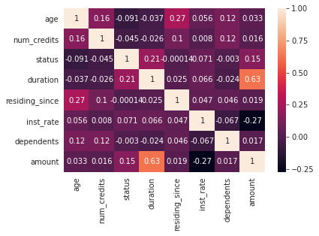
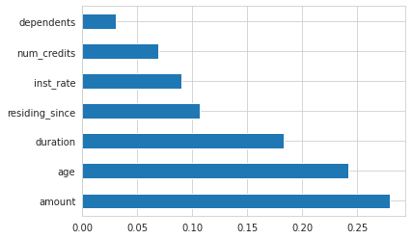
Features Importance-Numerical features
Extra tree regressor is used to calculate feature importance for numerical features.
Correlations among the features are calculated .
No numerical features are highly correlated.
Amount is considered as the most importat feature

Slide 6
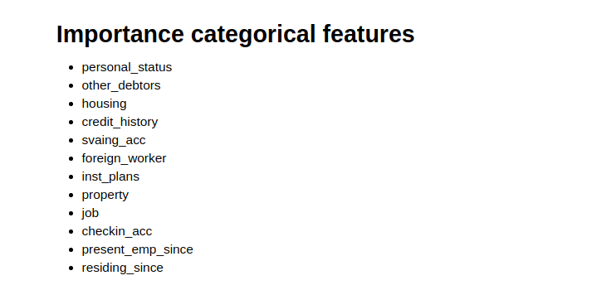
Features Importance-Categorical features
Categorical features are selected based on domain knowledge.

Slide 7
Modeling Techniques Details
Logistic Regression,Decision Tree,Random Forest and XGBoost algorithms are used to create model.
Decision Tree
Logistic Regression
Logistic Regression requires feature scaling, so feature scaling is performed
SMOTE is performed to handle imbalance data as this technique doesnot handle imbalance data automaticallly.
SMOTE is performed to handle imbalance data as this technique doesnot handle imbalance data automaticallly.
Random Forest
Xgboost
SMOTE is not performed to handle imbalance data as this technique handles imbalance data automaticallly.
SMOTE is not performed to handle imbalance data as this technique handles imbalance data automaticallly.

Slide 8
Methodology-Solution Approach
Steps Followed for Building Machine Learning Model:
Step 1: Loading the dataset
-The dataset is loaded using python
-Missing values, information regarding each features are being checked.
Step 2 :Preprocessing and Feature Engineering:
-Distribution of the class is checked(Here dataset is imbalance)
-Numerical and categorical features are selected from the dataset.
-EDA is performed on both numerical and categorical dataset
-Importance features are selected. I have used extra tree regressor and correlation matrix for feature importance for numerical features.
-Finally feature scaling is performed on numerical features(Here I have used standardscaler)
-Categorical features are selected based on domain knowledge
Step 3 :Performing one-hot encoding on categorical features
-One-hot encoding is performed on categorical features and dummy variable trap is handled.

Slide 9
Methodology-Solution Approach
Step 4:Handling Imbalance dataset:
-Since the dataset is imbalance ,SMOTE method is performed to balance the dataset.
Step 5: Model Creation:
-Both numerical and categorical encoded features are combined and splitted the data into train and test split
-Logistic regression,Decision tree ,Random forest and Xgboost algorithms are used create the model.
Step 5 :Model Evaluation:
-accuracy,precision ,recall and f1-score are calculated and compared among all the models.

Slide 10
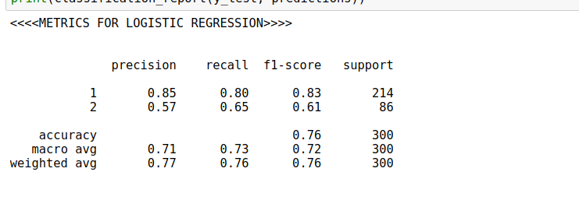
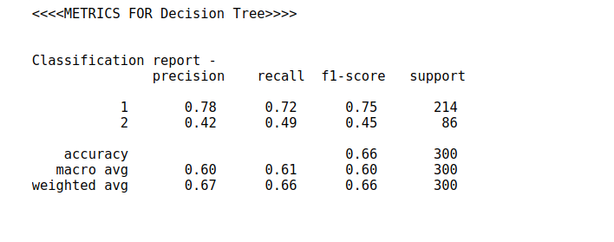
Final Model Performance Metrics
Accuracy,precision ,recall and f1-score are used as metrics

Slide 11
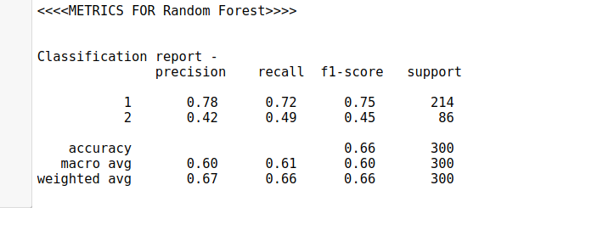
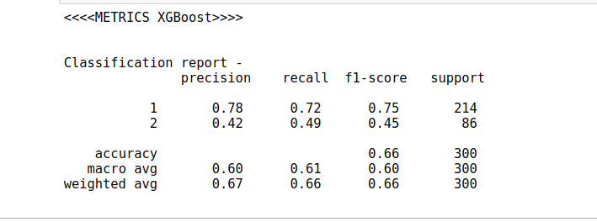
Final Model Performance Metrics
Accuracy,precision ,recall and f1-score are used as metrics
Accuracy,precision ,recall and f1-score are used as metrics
Logistic Regression performs well in our case though we try four different algorithms

Slide 12
Suitable RECOMMENDATIONS
Need to see the trend of credit score of the customer, if it is falling down try to get in touch with the customer.
Check how many existing credits are are available for a particular customer at this bank
Using PAN , number of existing credits can be checked and based on this ,the customer needs to be monitored if the customer has many existing credits.

Slide 13



Linkedin :/sakilansari
Contact : 8179685293
Email : sakilansari4@gmail.com
Thank you

