Slide 1

Teaching Assistant Evaluation
By SAKIL ANSARI

Slide 2
Teaching Assistant Evaluation
Goal:
Develop a Machine Learning Model that evaluates teaching performance scores : "low", "medium" or "high".

Slide 3
Teaching Assistant Evaluation
Background
The quality of teaching assistants’ work is important to students' education and inclusion, so it is of significance to evaluate and improve the performance of teaching assistants.
The teaching assistant evaluation reviews academic qualifications, relevant experience, quality of teaching, and professional contributions.
All aspects can be assessed by the students, peers or by the teachers themselves.
The project focuses on the application of some machine learning techniques on the data in order to develop a model that can use some past assessment to determine a future evaluation.
Attribute Information
1. Whether of not the TA is a native English speaker (binary); 1=English speaker, 2=non-English speaker
2. Course instructor (categorical, 25 categories)
3. Course (categorical, 26 categories)
4. Summer or regular semester (binary) 1=Summer, 2=Regular
5. Class size (numerical)
6. Class attribute (categorical) 1=Low, 2=Medium, 3=High

Slide 4
Dataset & Attribute Information
Data Attribute Overview
Dataset
Dataset Attribute | Description
Data Set Characteristics | Multivariate
Number of Instances | 151
Attribute Characteristics | Categorical, Integer
Number of Attributes | 5
Associated Tasks | Classification
The data consist of evaluations of teaching performance over three regular semesters and two summer semesters of 151 teaching assistant (TA) assignments at the Statistics Department of the University of Wisconsin-Madison.
The scores were divided into 3 roughly equal-sized categories ("low", "medium", and "high") to form the class variable.

Slide 5
Dataset Preparation
The data was given in text format with no header.
The header is added in the dataset as follows
Attribute Information | Header(Features)
Whether of not the TA is a native English speaker (binary); 1=English speaker, 2=non-English speaker | englishSpeaker
Course instructor (categorical, 25 categories) | CourseInstructor
Course (categorical, 26 categories) | Course
Summer or regular semester (binary) 1=Summer, 2=Regular | Semester
Class size (numerical) | Classsize
. Class attribute (categorical) 1=Low, 2=Medium, 3=High | grade

Slide 6
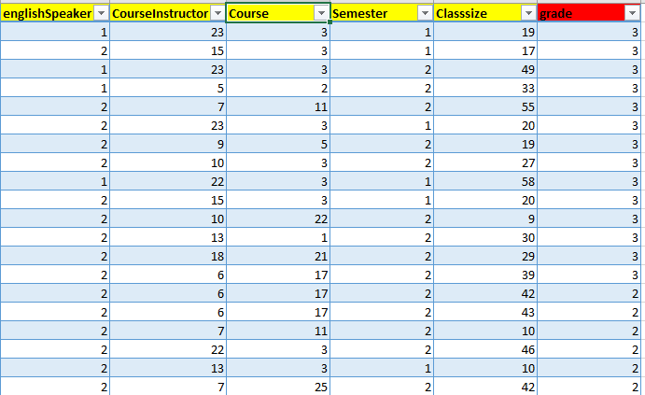
Sample Dataset
The table above shows sample of data.
Grade is target column for the model.

Slide 7
Features overview
Features
Features type | Count
Categorical features | 2
Numerical features | 1
binary features | 2
ClassType | Multiclass
Checking null value
Features | Null value count
englishSpeaker | 0
CourseInstructor | 0
Course | 0
Semester | 0
Classsize | 0
grade | 0
Notes:
<number>

Slide 8
Summary Statistics
Statistics | Classsize
count | 151.000000
mean | 27.867550
std | 12.893758
min | 3.000000
25% | 19.000000
50% | 27.000000
75% | 37.000000
max | 66.000000
The summary statistics of the dataset is performed on the Numeric features which is named Classsize.
The data range is 3-66.
The Inter Quartile Range(IQR) is 19 - 37

Slide 9
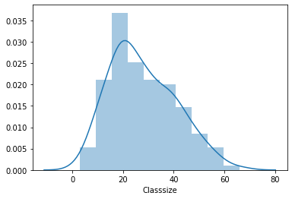
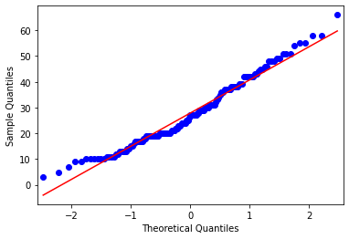
Exploratory Data Analysis for Numerical features(EDA)
Classsize feature follows Gaussian distribution.
Quantile-Quantile Plot(Q-Q plot ) is performed to validate Gaussian distribution.

Slide 10
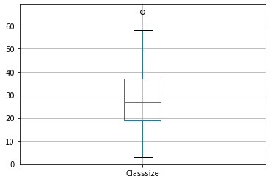
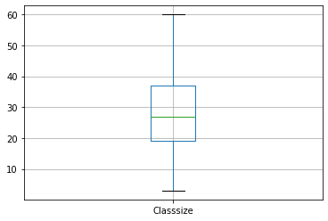
Outliers in Numerical variable
The outlier is present in the data. We need to remove the outlier.
3 sigma technique can be used for outlier detection as the data is following a normal distribution.
Outliers present in the data.
After removing the Outliers in the data.
Notes:
<number>

Slide 11
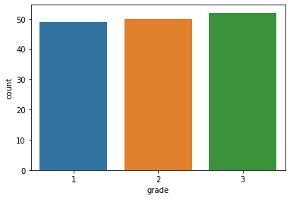
Checking the balance of the class
The dataset is balanced
Classes | Observation count
1 | 49
2 | 50
3 | 52
Observations in each class

Slide 12
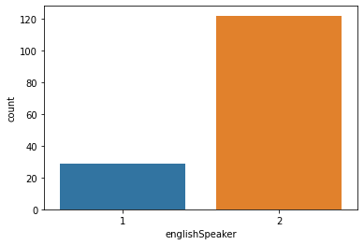
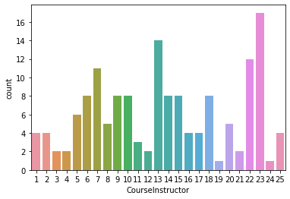
Bar graph for categorical features
Englishspeaker | count
1 | 29
2 | 122
More number of non English speaker course Instructor are available

Slide 13
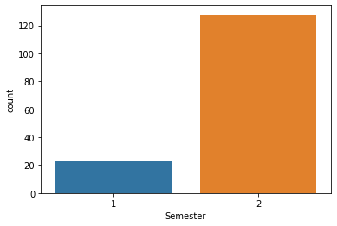
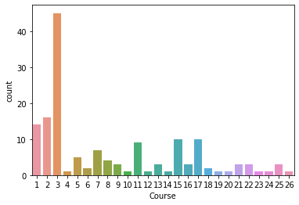
Bar graph for categorical features
Course 3 is more popular which has the count 45
Semester | Count
Summer(1) | 23
Regular(2) | 128

Slide 14
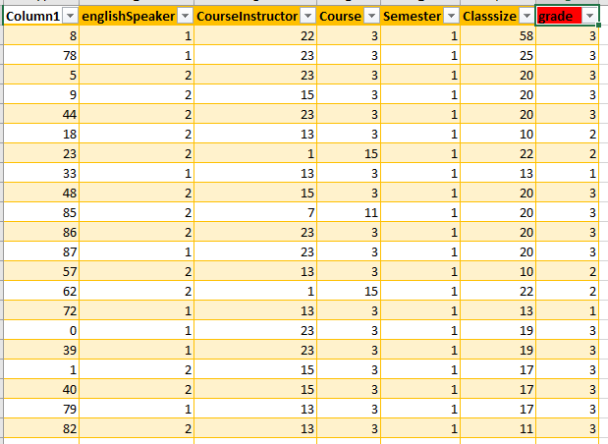
Summer Semester and Regular Semester Analysis
Summer Semester Sample Data
Observations
Summer semester has only 6 Course Instructor
Summer semester has only 2 courses.
Summer semester has only two courses.
Maximum class size for summer semester is 58.
Most of the English speaker has received grade 3.
23 observations are present in summer semester
9 English speaker and 14 non English speaker are present in summer semester
Notes:
<number>

Slide 15
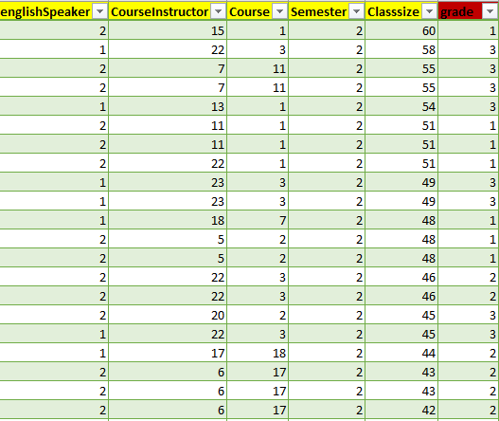
Summer Semester and Regular Semester Analysis
Observations
Regular Semester Sample Data
All course Instructor are present in regular semester.
Regular semester has all the courses.
Summer semester has only two courses.
Maximum class size for regular semester is 60..
128 observations are present in regular semester.
20 are English speaker and 108 are non English speaker in regular semester.
In regular semester ,more number of low grade is present.
Notes:
<number>

Slide 16
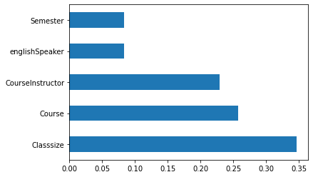
Feature Importance
Classsize is the most significance feature
Feature importance algorithm is used to find the probability of the features.

Slide 17
Hypothesis testing
Pearson’s correlation can not be used for categorical features so, we are using Chi-squared test.
Hypothesis testing is performed on categorical feature using Chi-Squared test.
Sample Hypothesis
H0: The features CourseInstructor and Course are independent (which means they are not associated).
H1: CourseInstructor and Course are not independent (which means they are associated).
H0: All CourseInstructor are not englishSpeaker
H1: All CourseInstructor are englishSpeaker(Rejecting null hypothesis)
H0:Null Hypothesis, H1:Alternate Hypothesis

Slide 18
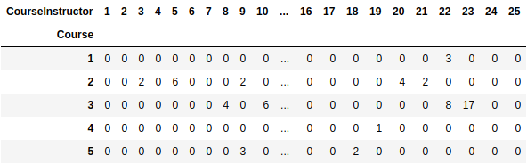
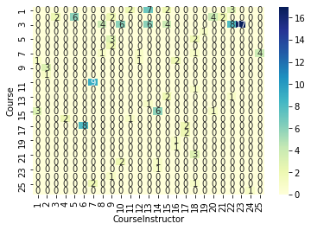
Contingency Table
Contingency table shows the frequency distribution of the features.
CourseInstructor 22 has taught course 1 three times times.
Here the correlation is shown between the Course and courseInstructor features.

Slide 19
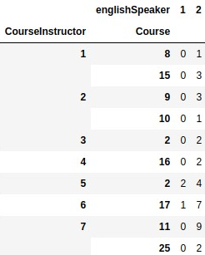
Contingency Table
Here the contingency table is made for three features CourseInstructor, Course and englishSpeaker.
CourseInstructor 1 has taught course 8 and course 15 who is non-englishSpeaker.

Slide 20
Preprocessing and Feature Engineering
The quality of data is checked. The data has no missing value
The data has two categorical features: CourseInstructor and course.
CourseInstructor has 25 categories
Course has 26 categories
Feature Engineering
Handling Categorical Features
The categorical features are handeled in following two ways:
One hot encoding
One-hot encoding on 10 most frequent categories.

Slide 21
Preprocessing and Feature Engineering
One Hot encoding
One hot encoding is performed on CourseInstructor and Course.
Dummy variable trap is handled.
We have 52 independent features.
Binary features Semester and englishInstructor are handled by replacing 1 as 0 and 2 as 1.
One-hot encoding on 10 most frequent categories
s
Top 10 most frequent features are taken and one hot encoding is performed and kept 0 for remaining features.
The feature is handled and accuracy is compared.

Slide 22
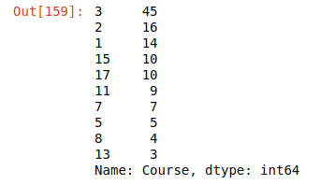
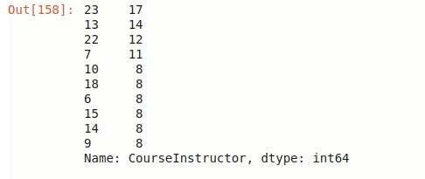
Preprocessing and Feature Engineering
One-hot encoding on 10 most frequent categories

Slide 23
Normalization
Input attribute (Class size-numerical) has numerical values that can be very distant from each other.
To prevent that we will normalize data set using Max-Min normalization and standardization.
The accuracy of the model doesn’t change much even after using standard scaler.

Slide 24
Model Creation
Various Machine learning algorithms are developed, and accuracy is compared.
An artificial Neural (ANN)Algorithm is also performed though the data is very small.
Randomized Search Cv and grid search are used for hyperparameter optimization.
Used auto-ml tool pycaret to compare the accuracy.
Precision, recall and F1 score are used as metrics.

Slide 25
Model Accuracy Result
The model is trained on 80% and 90% of the data and the accuracy is compared
Algorithms | Accuracy (Trained on 80%) | Accuracy (Trained on 90%)
Random Forest Classifier | 70.96 | 87.5
Support Vector Machine | 58.06 | 62.5
K Neighbors Classifier | 58.064 | 87.5
Xgboost | 62.5 | 58.06
Decision Tree | 70.96 | 98
ANN | 82 | 34

Slide 26
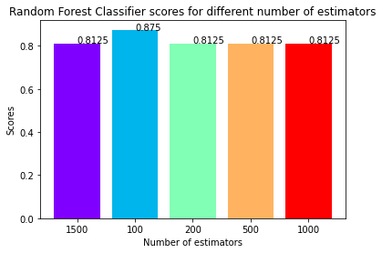
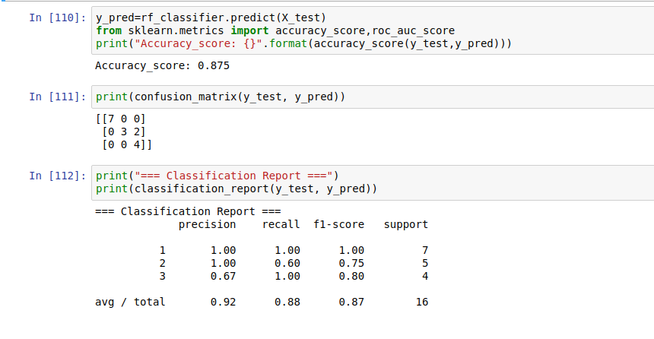
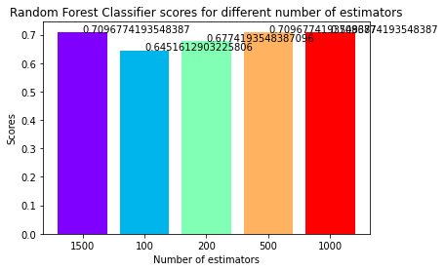
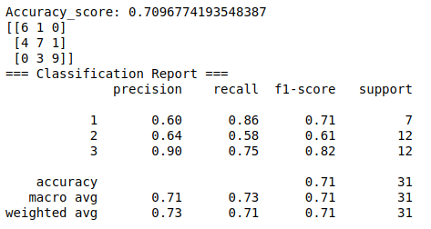
Model Accuracy Result (Random Forest Classifier)
Model is trained on 90 % of the data
Model is trained on 80 % of the data

Slide 27
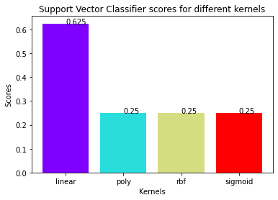
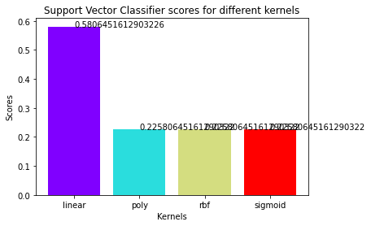
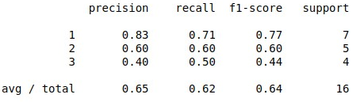
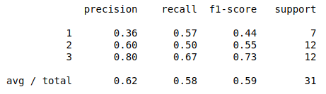
Model Accuracy Result (SVM)
Model is trained on 90 % of the data
Model is trained on 80 % of the data

Slide 28
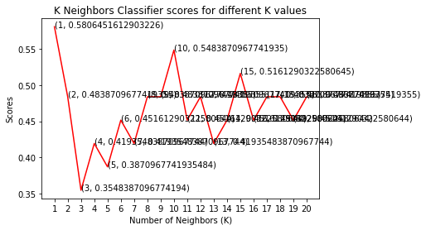
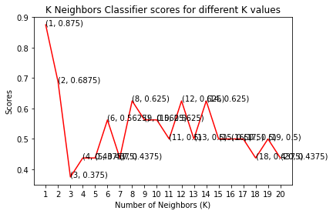
Model Accuracy Result (K Neighbors Classifier)
Model is trained on 90 % of the data
Model is trained on 80 % of the data

Slide 29
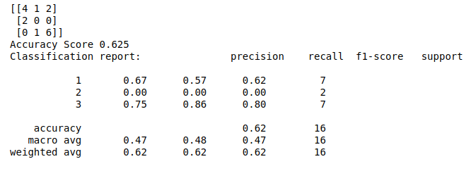
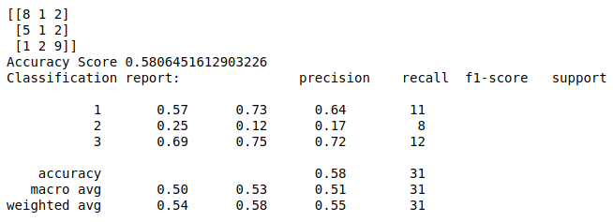
Model Accuracy Result (Xgboost)
Model is trained on 90 % of the data
Model is trained on 80 % of the data

Slide 30
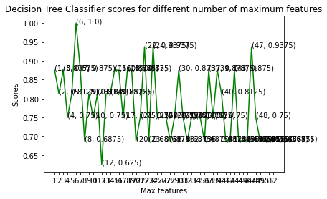
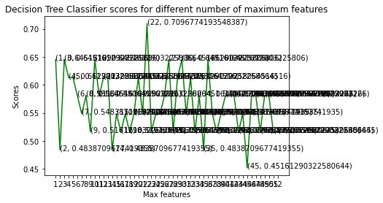
Model Accuracy Result (Decision Tree)
Model is trained on 80 % of the data
Model is trained on 90 % of the data

Slide 31
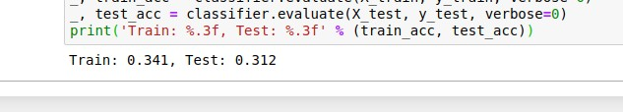
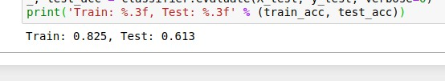
Model Accuracy Result (Artificial Neural Network)
Model is trained on 90 % of the data
Model is trained on 80 % of the data

Slide 32
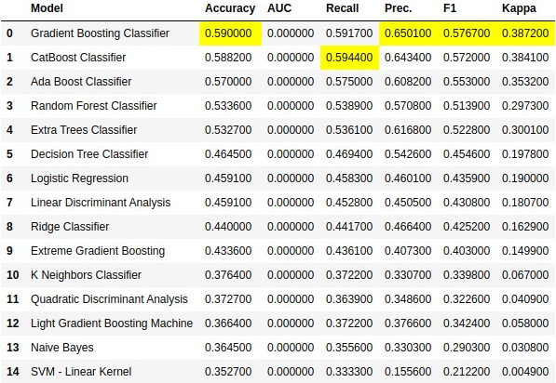
Model Accuracy Result using Automl:

Slide 33
Algorithms
Algorithms | Key Usage
Xgboost Classifier | It can solve complex non linear functions It is better in solve any kind of ML usecases. It has a great performance
Decision Tree | Simple and easy to understand Decision Tree can handle both continuous and categorical variables. Clear Visualization
Artificial Neural Network(ANN) | ANNs have the ability to learn and model non-linear and complex relationships ANNs are good for noisy datasets.
Random Forest Classifier | Doesn't Overfit Less Parameter Tuning required Suitable for any kind of ML problems

Slide 34
Algorithms
Algorithms | Key Usage
Support Vector Machine Classifier | SVM is more effective in high dimensional spaces. SVM is relatively memory efficient SVM’s are very good when we have no idea on the data Works well with even unstructured and semi-structured data like text, Images and trees. The kernel trick is real strength of SVM. With an appropriate kernel function, we can solve any complex problem. SVM models have generalization in practice, the risk of over-fitting is less in SVM.

Slide 35
Challenges, Future work and Conclusion
Analysis for the data is performed and 87.5% accuracy is achieved.
The accuracy of the algorithm can be increased by increasing data.
Machine learning and deep learning algorithms are developed, and the accuracy is compared.
The model created by auto ml gives less accuracy than the model created by machine learning.
The dataset was too small and also had too many categories in the categorical features which lead to difficulty in deciding which algorithm to choose.

Slide 36



Linkedin :/sakilansari
Contact : 8179685293
Email : sakilansari4@gmail.com
Thank you

