Slide 1
Customers-Satisfaction-with-the-Hotel-Services
Sakil Ansari

Slide 2
Introduction
A worldwide hotel brand wants to comprehend the customer feedback they have collected. The feedback
comprises textual reviews from different sources, such as online websites, surveys, and social media.
They want to find out how happy or unhappy the customers are with the hotel services. We require you
to examine the feedback and evaluate the customer satisfaction level. Design and code a solution using
Python and machine learning. Please provide well-documented code, a model if any, and clear instructions
to run the code.

Slide 3
SOLUTION
Our process will start with Exploratory Data Analysis, followed by Model Development employing both
Machine Learning and Deep Learning methodologies.

Slide 4
EXPLORATORY DATA ANALYSIS
Dataset : yelp ratings.ċsv is customer feedback data having columns text,stars and sentiment.
Observations :
The dataset contains a total of 44,530 records.
No null values are present within the dataset.
The dataset comprises three columns: ”text,” ”stars,” and ”sentiment.”
The ”stars” column encompasses four categories: 1.0, 2.0, 4.0, and 5.0
The ”sentiment” column consists of two categories: 0 and 1, where 0 signifies negative sentiment
and 1 represents positive sentiment.
Stars rated 1.0 and 2.0 are classified as negative sentiment (0), while stars rated 4.0 and 5.0 are
categorized as positive sentiments.

Slide 5
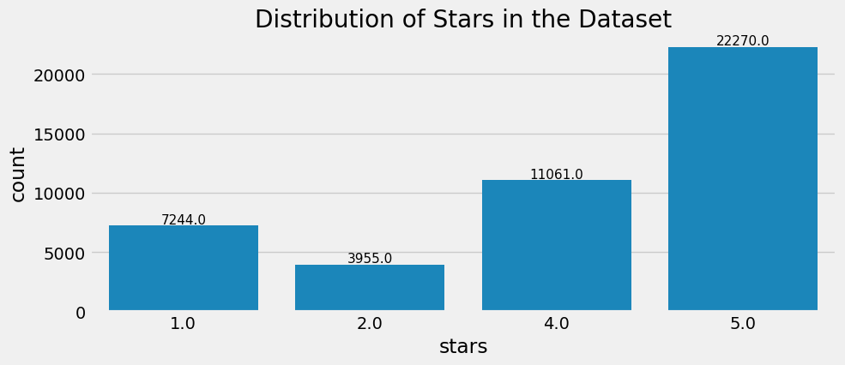
EXPLORATORY DATA ANALYSIS

Slide 6
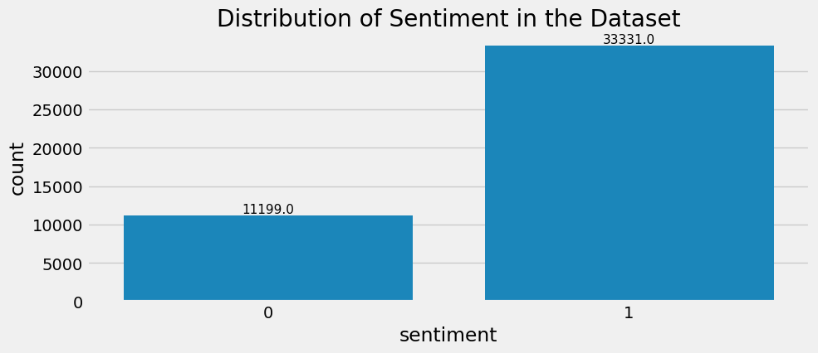
EXPLORATORY DATA ANALYSIS

Slide 7
DATA PREPORCESSING (FEATURE ENGINEERING) AND DATA CLEANING
Data Cleaning:The subsequent actions are taken in this step:
Eliminating punctuation marks from the reviews.
Removing Numbers from the reviews
Removing accented characters from the reviews.
Removing special characters from the reviews.
Removing stop words and applying lemmatization

Slide 8
Data Preporcessing(Feature Engineering)
Text Subjectivity:
In natural language, subjectivity refers to expression of opinions, evaluations, feelings, and speculations and thus incorporates sentiment. Subjective text is further classified with sentiment or polarity.We calculate the subjectvity of the Reviews by using TextBlob.

Slide 9
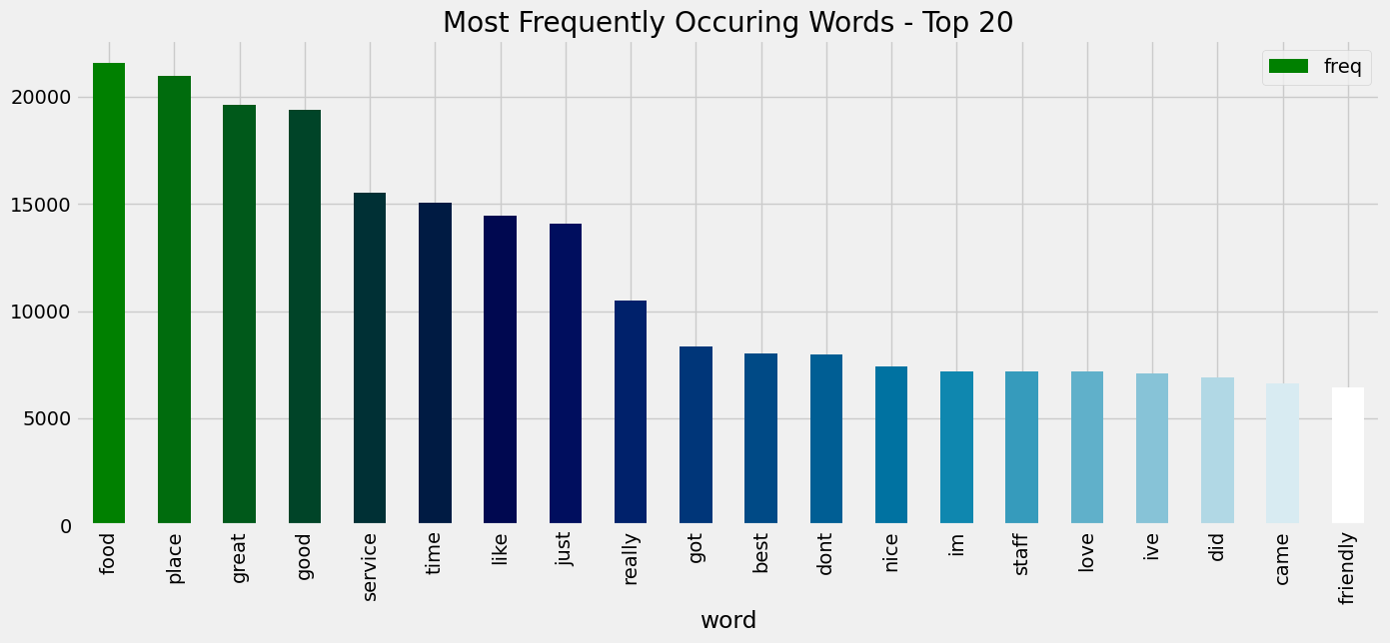
Most Frequently Occuring Words - Top 20

Slide 10
APPROACH
I prepare the training data from EDA step and the train data is used to develop the model.Initially, we adhere to the traditional Machine learning algorithmic approach, and subsequently, we employ deep learning techniques.
Machine Learning Approach:In this approach , we used three algorithms:
Naive Bayes Classifier
Randomforest Classifier
Xgboost Classifier

Slide 11
Deep Learning Approach
In deep learning approach, I experimented with a transformer-based model called BERT-base-uncased to assess its performance.
Implementation:
I employed the PyTorch framework to create a custom class, utilizing the DataLoader from PyTorch.
Additionally, a pre-trained model from Hugging Face was invoked.

Slide 12
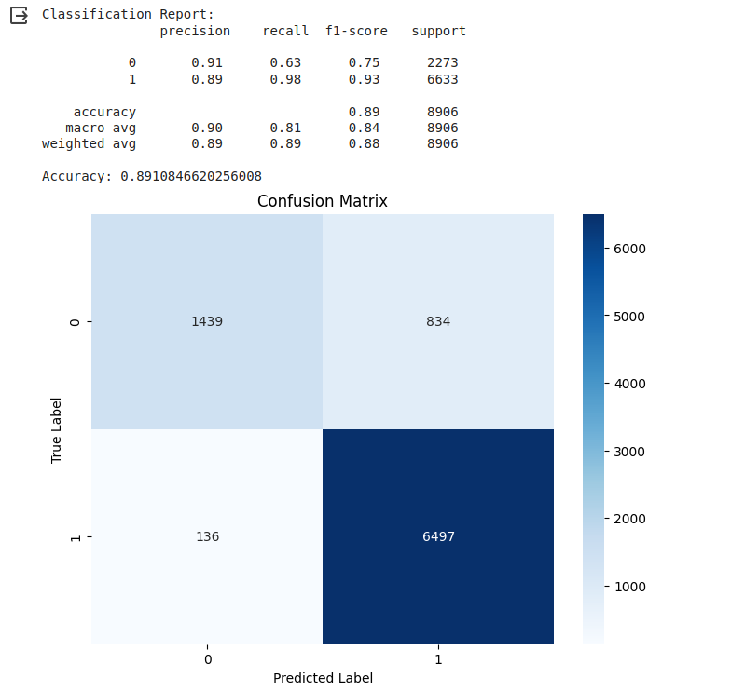
RESULT
The following diagram shows the confusion metrics for Naive Bayes algorithm:

Slide 13
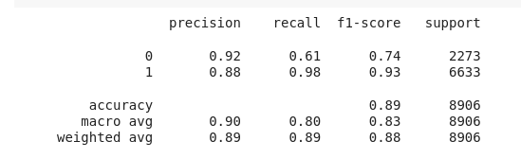
RESULT-Radomforest Classifier

Slide 14
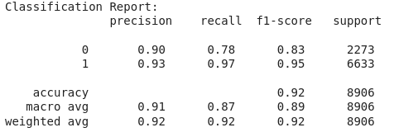
RESULT-Xgboost Classifier

Slide 15
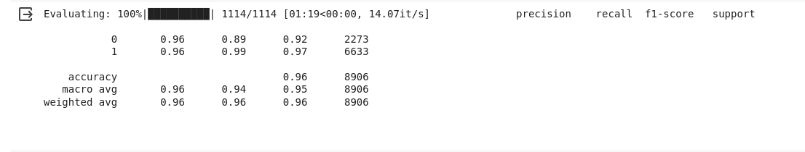
RESULT-BERT

Slide 16
Conclusion
BERT shows promise with higher over all accuracy, precision and F1-scores
We can try another deep learning model for better accuracy

