Slide 1


DeNTAS: De Novo Transcriptome Analysis and Statistics
DeNTAS
By
James Nicholson
Kristina Markova
Yusef Badi
Dania Vicente-Zamarreño

Slide 2
Talk Content
DeNTAS
Flask Framework & What DeNTAS does by Dania Vicente-Zamarreño:
Flask framework
What DeNTAS does:
User’s inputs
BLAST by Yusef
Statistics by James:
Front-end by Krisi

Slide 3
DeNTAS: Flask Web based
DeNTAS
Why Flask?
Flask is well supported:
Good tutorial online, i.e., https://blog.miguelgrinberg.com/post/the-flask-mega-tutorial-part-i-hello-world
Stackoverflow
Flask is a “microframework” aimed to small applications and simple requirements.
Flask allows flexibility to import different libraries:
db, URL structure, render_template

Slide 4
DeNTAS: What does it do?
DeNTAS
DeNTAS
DeNTAS performs differential gene expression analysis and visualization on transcriptomic data generated by de novo assemblies
Software tool designed to:
Take raw, unidentified FASTA sequences
Identify transcripts by BLASTn search
Petropus alecto
Homo sapiens
Mus musculus
Provide statistical analysis and visualisation of differential gene expression
Return results
Interactive table of results
Graphs
All content downloadable

Slide 5
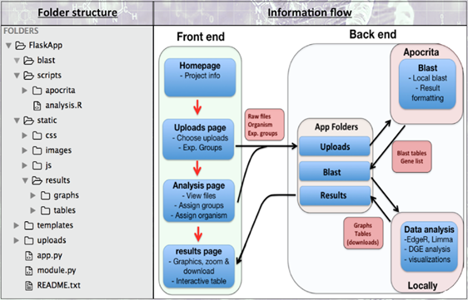
DeNTAS: Folder structure
DeNTAS
The app.py; is the main DeNTAS script
module.py, define functions called from app.py
upload; temporary storage of user loaded files
templates;
.html files
Static
CSS and js (javascript) files
images, website images
results,; files/figures from
blast;
Blast search data output in the form of .tsv files
sripts
apocrita
All scripts
Organisms database
analysis.R
R script

Slide 6
DeNTAS: Software architecture
DeNTAS
Front End
Homepage; project information
User interactive area
Upload page
Analysis page
Result back to the user
Back End
Files on uploads send to Apocrita for Blast search
Blast results sent to Blast folder
from Blast to Data analysis
from Data analysis to Results
from Results to user’s result page
downloadable
interactive table
graphs

Slide 7
BLAST
DeNTAS

Slide 8
What is BLAST?
DeNTAS
Query sequence is uploaded (e.g. FASTA file)
This is aligned against a database of sequences
Returns ID of the match & expect values (e values) indicating level of homology
We use BLASTn to identify gene matches to our unidentified de novo transcriptome assembly query sequences

Slide 9
High Performance Cluster Computing
DeNTAS
BLAST performed through online resources (like NCBI) has limitations
Chronic users are blacklisted
Local BLAST is the only option
No limitations in numbers of runs
Only limiting factor is power of server
We use Apocrita a powerful remote server to perform this
Faster than a personal computer
qsub request for each job run will request a run with our set specifications

Slide 10



Getting Started: setting up a local database
DeNTAS
Reference FASTA sequences for three major species were obtained
Human
Mouse
P Alecto (model test species)
Using NCBI ref-seq resource
Then databases were set up on Apocrita scratch space
With makeblastdb command

Slide 11
Running the BLAST
DeNTAS
A species specific “speices_blast.py” script is stored in Apocrita
Called upon when the app.py is run, specific to user species-request
Once the job is submitted, it is queued and then the BLAST runs
Opted for tsv output to produce custom tabular output
Easier to manipulate rather than parse from large XML file (default)
Lets us easily extract our required data
Qseqid = query seq Id + FPKM value
Sseqid = refseq Id session number of hit
Stitle = long gene name
Created table with BLAST Ids and associated FPKMs usable in R Achieved using bash’s text manipulation tool awk

Slide 12
Optimising the BLAST on Apocrita
DeNTAS
Used guidebooks to optimise Apocrita
Needed powerful enough reserve without long submit-queue
settled on balance: four cores with 1 GB/core
Optimised BLAST script to request four threads “-num_threads 4”

Slide 13
However, an issue arose: redundant matches
DeNTAS
Multiple query sequences aligned to same reference sequence within database
each one having a high homology (low E-value)
Analysis pipeline only handles one FPKM value to each transcript identified through BLAST
Notes:
A standard Trinity de novo assembly analysis pipeline uses RSEM (RNA-Seq by Expectation-Maximization) to uniquely assign multiple mapping reads during alignment based on a probabilistic model before calculation of FPKM (Haas et al., 2014; Li & Dewey, 2011).
We therefore decided to sum the FPKM values from redundant query-reference matches, as each read contributes to a single FPKM value, and all of those reads are attributed to the identified reference sequence. This was also achieved using the text manipulation tool awk.

Slide 14
Debugging: what causes it and how to solve?
DeNTAS
This is likely due to the de novo assembly of splice isoforms absent in the reference database
So Isoforms are picked up but all map to the one isoform present in reference database
As Trinity de novo pipeline assigns multiple mapping reads uniquely
We decided to sum the FPKM values from redundant query-reference matches, as each read contributes to a single FPKM value for that given transcript (it just happens that there are isoforms of it present)

Slide 15
Returning data to user
DeNTAS
This tabular tsv file output is then downloaded onto the user’s PC into the ‘BLAST’ folder and deleted off of Apocrita

Slide 16
Future developments – a dedicated server
DeNTAS
BLAST-ing is a high multi-threable process
A fully dedicated server where many species databases are stored
No queuing
Can have huge number of cores with high GB/core values
Can run large numbers of very big jobs
Streamlined multi-user functionality was a challenge in Apocrita
Dedicated server can work without having to parse in Apocrita

Slide 17
DeNTAS
Data Analysis and Visualization
R is an open source programming language & software environment for statistical computing and graphics
extensive list of biological statistics packages available on CRAN and Bioconductor
R version 3.3.1
Differntial gene expression : EdgeR & Limma
Graphcial visualization: Dendextend & Gplot

Slide 18
DeNTAS
Data Input
Python subprocess used to call the analysis.R script and parse in the required variable arguments;
>> subprocess.call(cmd, universal_newlines=True)
Args read into R as a single variable
>> myArgs <- commandArgs(trailingOnly = TRUE)
Filenames
Experimental groups
readDGE(sample files)

Slide 19
DeNTAS
Soft coding strategies
DeNTAS can accommodate 2-4 experimental groups
>> group_number
If – else statements to
Generate graph names
Create Limma contrast matrices
For loops
Generate one volcano plot for each experimental comparison

Slide 20
DeNTAS
Statistics
Raw FPKM values are log2 transformed
Data is filtered to exclude stochastic noise and low background levels of expression from analysis.
Limma creates a linear model for each row in the data matrix.
Analyses experiments as an integrated whole; sharing information between samples
increases the reliability of statistical conclusions drawn from low sample numbers (Ritchie et al. 2015).
Limma’s parametric empirical Bayes procedures
incorporates a mean-variance trend into the global variance estimate
accounts for the reduced reliability of low expression values (Sartor et al., 2006).

Slide 21
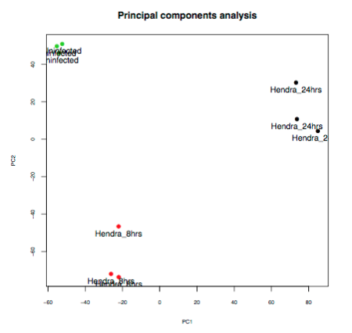
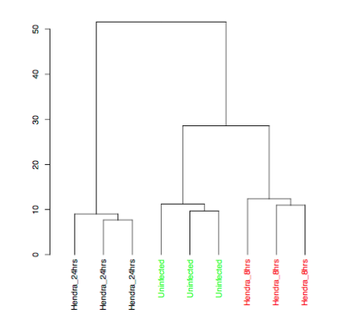
DeNTAS
Multivariate data exploration

Slide 22
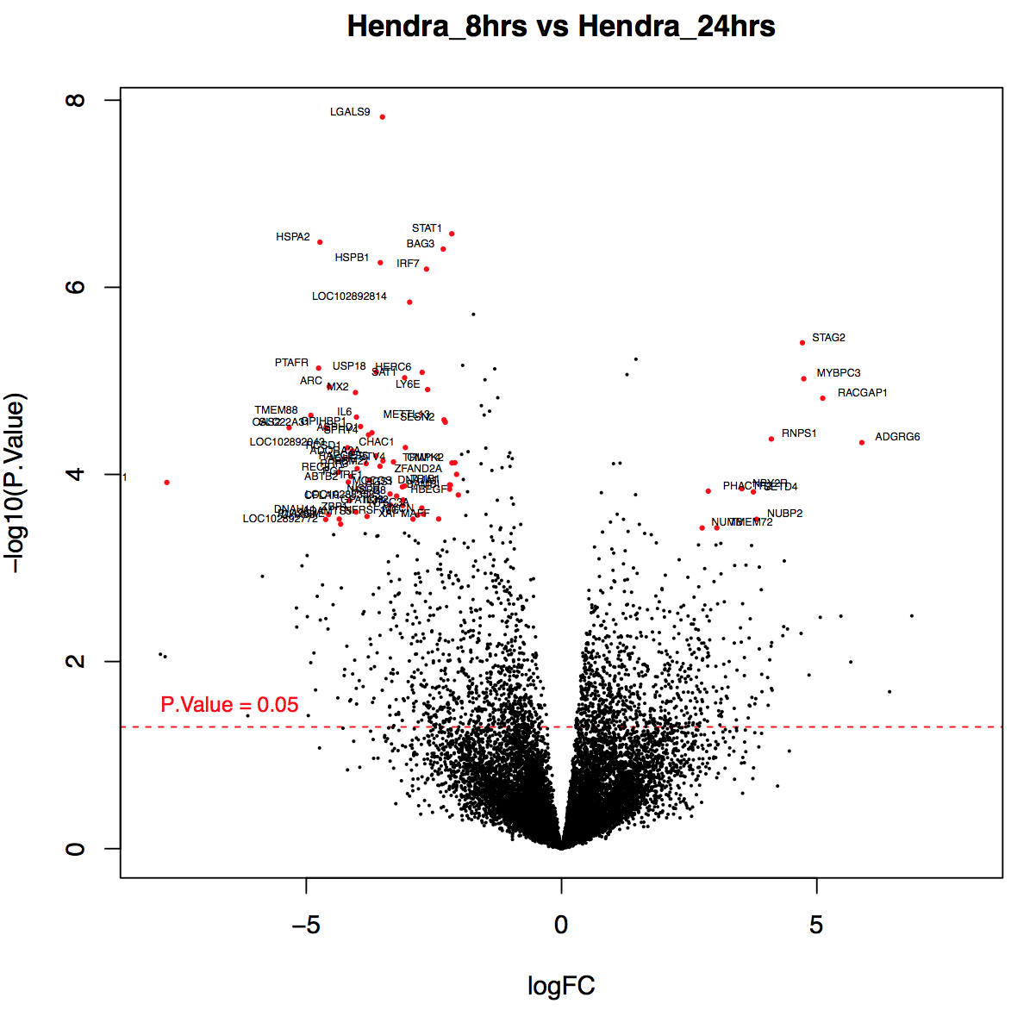
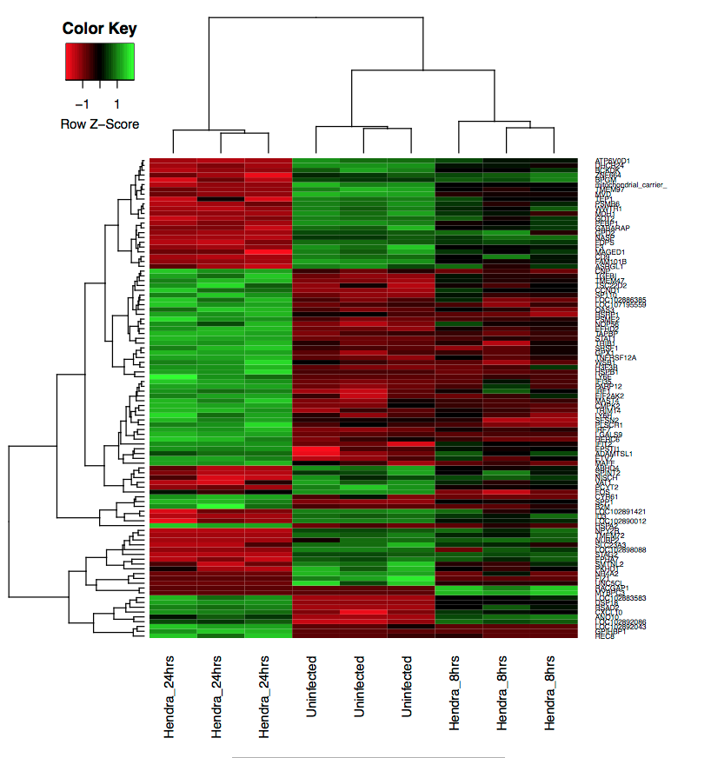
DeNTAS
Differential gene expression visualization

Slide 23
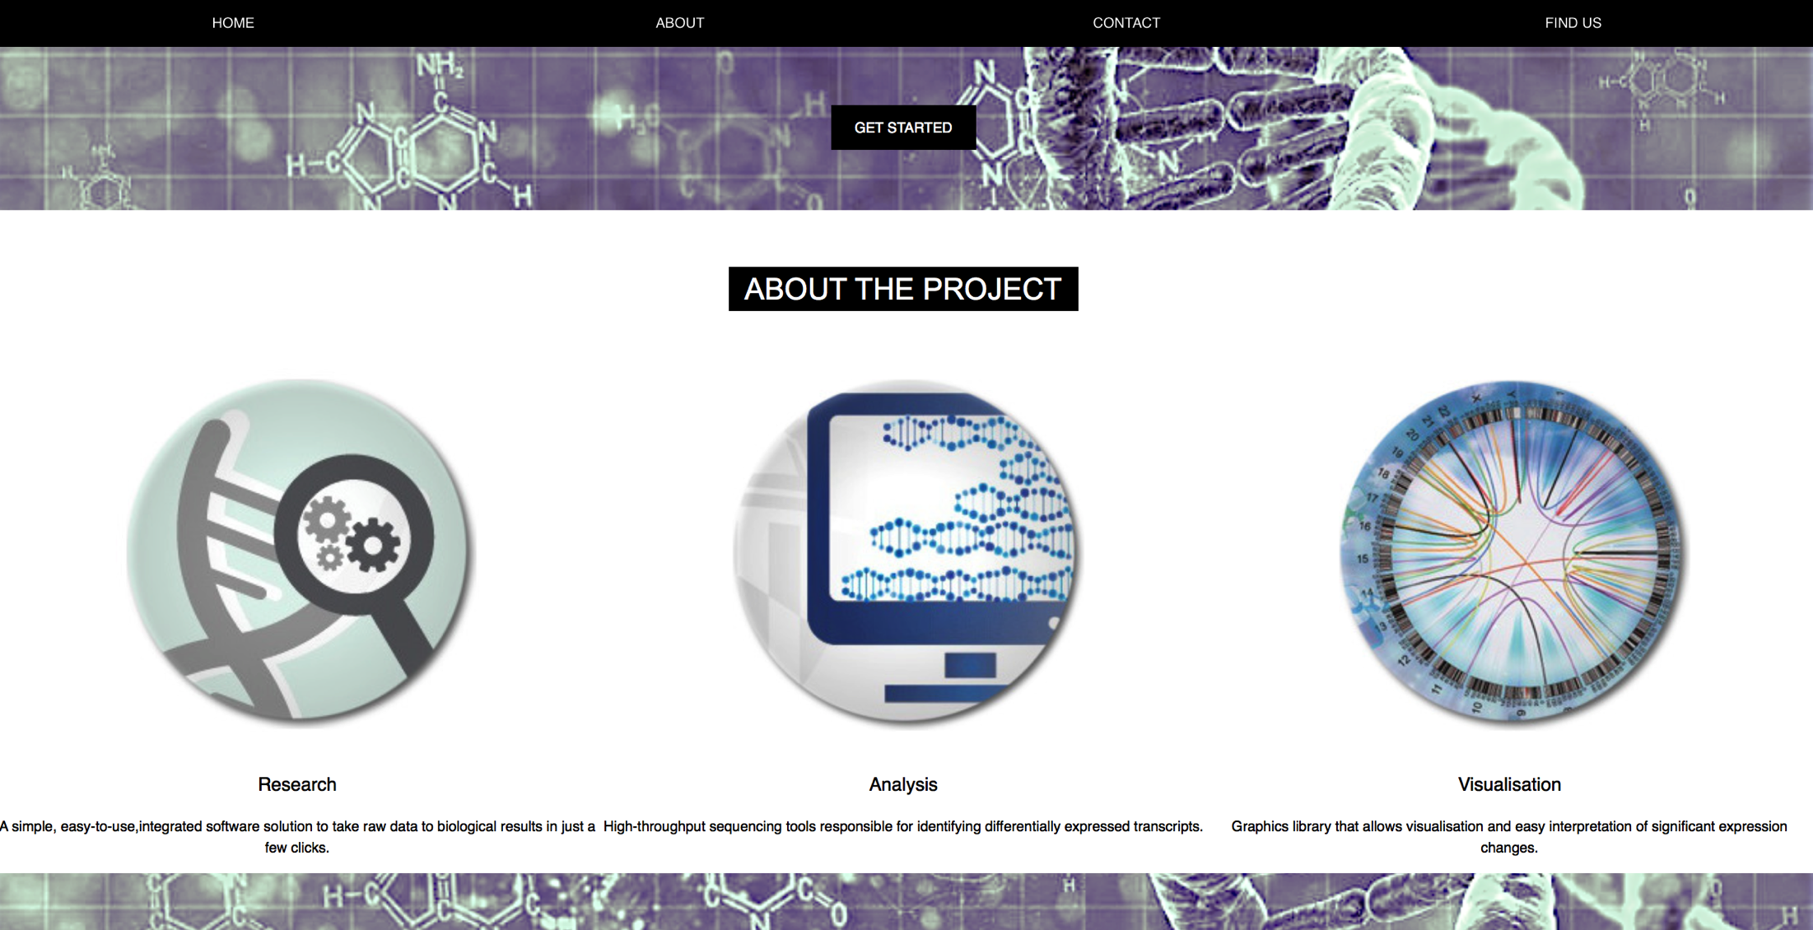
DeNTAS
Front end
Intuitive, responsive and attractive

Slide 24
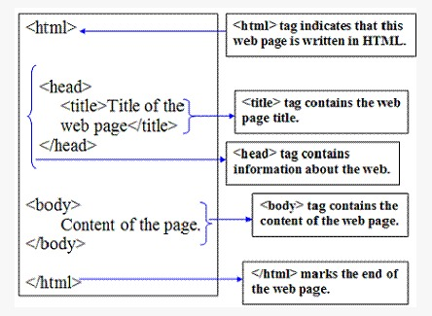
HyperText Markup Language (HTML)
DeNTAS
DeNTAS
•HTML elements are the basic building block of World Wide Web.
•HTML elements are represented by tags.
•HTML basic structure shown below
•Browsers do not display the HTML tags but use them to render the content of the web page.

Slide 25
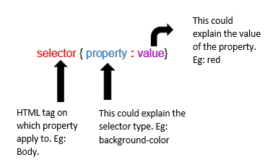
Cascading Style Sheets (CSS)
DeNTAS
•Describes how HTML elements are displayed on screen.
•Controls the layout of multiple web pages at once.
•Internal style sheets stored within an HTML document.

Slide 26
JavaScript & JQuery
DeNTAS
•JavaScript is a programming language of the Web.
•The <script> tags defines a JavaScript.
•JavaScript popup alert box displays information to the user.
•JQuery is a cross-platform of JavaScript library.
•JQuery generates comma separated values (CSV) table that contains all significantly differentially expressed genes.

Slide 27
Web standards and browser compatibility
DeNTAS
•The World Wide Web Consortium (W3C) offers validation tools that serve as a future-proof quality check.
•Creates compatible web pages.
•Reduces unexpected errors and makes the web pages more accessible.

