Slide 1
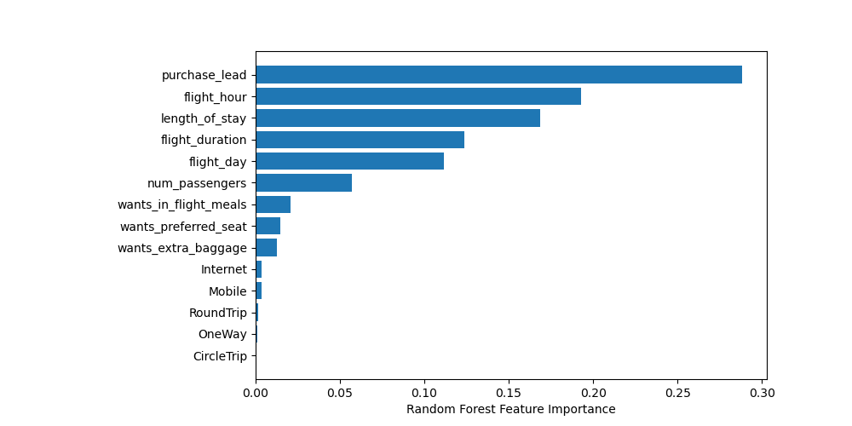
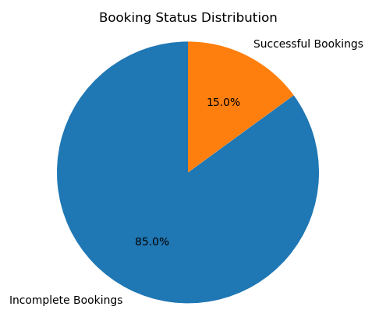
PREDICTIVE MODEL RESULTS
Imbalanced Data set:
50,000 Bookings in total
42,522 Incomplete Bookings
7,7478 Successful Bookings
Data set was trained with Random Forest Classifier Model
Top features that can affect successful bookings
Accuracy
85%
Model accuracy in predicting Complete and incomplete Bookings
Precision
48%
Predicted as actual complete bookings out of all successful Bookings
AUC-ROC
Score 52%
Model is heavily biased towards the majority class
Recall
Value
99% chance of predicting True Inomplete Bookings
6% Chance of predicting True Successful Bookings
Our concern is with not predeicting complete bookings accurately.
More measures should be done to balance the data.

