Slide 1

AI LITERACY FOR CHILDREN
Why It Matters · Why Now · Why Nigeria
AI FOR KIDS Book Launch
Thursday, 18th June 2026 · 4:00 PM
Basco Plaza, Bashorun, Ibadan
Presented by: Dr. Sakinat Folorunso | Women in AI Nigeria Lead | Associate Professor, OOU
Notes:
Welcome everyone to the AI FOR KIDS Book Launch. Introduce yourself as Women in AI Nigeria Lead and Associate Professor at OOU. Mention the significance of this moment for AI literacy in Nigeria.

Slide 2




The World Our Children Are Inheriting
85M
97M
70%
#1
Jobs transformed
by AI by 2025
New AI-related
roles emerging
Future jobs
not yet invented
Most needed skill:
Digital & AI literacy
Sources: World Economic Forum Future of Jobs Report 2023
Notes:
The world our children inherit is radically different from ours. AI is not a future concern — it is the present. These numbers from the WEF make one thing clear: AI literacy is not optional for the next generation.

Slide 3



What Is AI Literacy?
AI literacy is the ability to:
Awareness
Know what AI is and is not
Understand how AI systems work at a conceptual level
Use AI tools effectively and responsibly
Evaluate AI outputs critically
Design human-centred AI solutions
Ethics
Understand fairness, bias & safety
Agency
Create, not just consume AI
AI literacy is the reading and writing of the 21st century.
Notes:
AI literacy is not about making every child a programmer. It is about giving them the conceptual vocabulary and critical capacity to navigate an AI-shaped world. The three pillars — Awareness, Ethics, Agency — form the foundation.

Slide 4
Why Start with Children?
Ages 4–7
Ages 8–11
Ages 12–15
Ages 16+
Curiosity
Exploration
Creation
Leadership
AI lives in toys, voice assistants & games
Visual coding, smart apps, data patterns
Build AI models, chatbots, ML projects
Ethics, policy, entrepreneurship with AI
Early exposure builds cognitive scaffolding that lasts a lifetime.
Notes:
Children learn languages fastest before age 12. The same neuroplasticity applies to computational thinking. The earlier we introduce AI concepts — even informally — the more intuitive these skills become. The 'AI FOR KIDS' series targets exactly this critical window.

Slide 5
Nigeria's AI Opportunity — And Our Responsibility
Nigeria by Numbers
The Challenge
AI datasets rarely reflect African contexts
220M+
population — largest in Africa
Few AI books written for Nigerian children
Digital divide limits access & exposure
~43%
under 15 years old
Our Opportunity
200+
languages and cultures to represent in AI
Nigeria produces 2.3M graduates/year
Youth median age: 18.1 years
#1
tech startup ecosystem in Africa (Lagos)
Books like AI FOR KIDS fill a critical gap
Notes:
Nigeria has the youngest and largest population in Africa. Yet the AI tools, datasets, and educational materials that will shape the future rarely reflect Nigerian faces, names, languages, or contexts. Books like 'AI FOR KIDS' by Cecilia Adenusi are an act of cultural reclamation.

Slide 6



Introducing: AI FOR KIDS Book Series
by Mrs. Cecilia Adenusi · STEM Educator & AI Advocate
Book 1: Smart Machines Around Us
Age-Appropriate
Curriculum-Aligned
Values-Centred
Designed for children with relatable Nigerian characters & contexts
Supports STEM education goals with hands-on activities
Embeds responsible AI, kindness, and ethical thinking
Pre-order now at bit.ly/HSAIBOOK from 6th June 2026
Notes:
The 'AI FOR KIDS' series is a landmark publication — the first of its kind in Nigeria to use native contexts, relatable characters, and responsible AI values as its backbone. Book 1, 'Smart Machines Around Us', opens the door gently and powerfully.

Slide 7




What AI Literacy Unlocks for a Child
Critical Thinking
Digital Safety
Global Citizenship
Question AI outputs; spot misinformation and bias
Navigate online spaces with awareness and confidence
Engage with AI-driven global challenges responsibly
Career Readiness
Inclusive Innovation
Entrepreneurship
Prepared for jobs across ALL sectors that use AI
Build AI that reflects diverse African perspectives
Create apps, tools & businesses powered by AI
Notes:
AI literacy is not a narrow technical skill — it is a broad capability multiplier. A child who understands AI concepts thinks more critically, creates more boldly, and participates more equitably in a digital society.

Slide 8
How Parents & Educators Can Act Now
01
Read AI FOR KIDS together
Use Book 1 as a conversation starter at home and in class
02
Ask 'What do you think the AI is doing?'
When children use apps, voice assistants, or recommendation systems
03
Introduce visual / block coding
Scratch, Code.org, or micro:bit — free, fun, and AI-ready
04
Discuss AI ethics at the dinner table
Fairness, privacy, and kindness apply online too
05
Celebrate curiosity, not just answers
AI literacy thrives when children are empowered to question
Notes:
AI literacy starts at home and in the classroom. These five practical actions require no technical background — just intention and curiosity. Every parent and every teacher in this room can start today.

Slide 9



The Bigger Vision: African Children as AI Builders
We do not want Africa's children to simply consume AI built elsewhere.
We want them to BUILD AI — infused with African values, African languages, and African futures.
Represent
Participate
Lead
Nigerian stories, names, and contexts in every AI dataset and model
Nigerian researchers, developers, and entrepreneurs shaping global AI
Africa-first AI solutions to health, education, agriculture & governance
Notes:
The 'AI FOR KIDS' series is not just a book. It is a declaration: that African children deserve to see themselves in the future of AI — not as bystanders, but as architects.

Slide 10
Let's Build a Smarter, Kinder Future — Together!
📚 Buy the Book
🤝 Join the Movement
📢 Spread the Word
bit.ly/HSAIBOOK
Pre-order open now!
Women in AI Nigeria
AI advocacy for African children
Share this event
+234 806 064 0287
📅 18th June 2026 · 4:00 PM · Basco Plaza, Bashorun, Ibadan
Author: Mrs. Cecilia Adenusi | Foreword: Prof. O.R. Vincent | Women in AI Nigeria Lead: Dr. Sakinat Folorunso
DISCOVER · LEARN · THINK SMART · CHANGE OUR WORLD
Notes:
Close with energy! Invite the audience to get their copy, share with schools, and join the Women in AI Nigeria movement. Celebrate Mrs. Cecilia Adenusi and the entire panel for this landmark contribution to AI education in Nigeria.

Slide 11
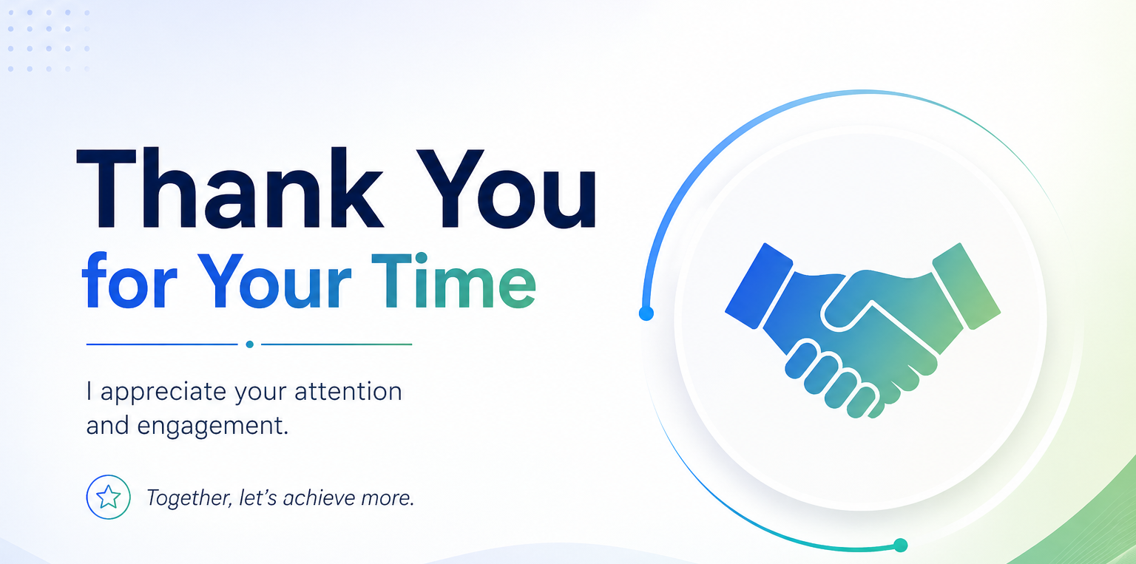

Slide 12
