Slide 1

AI & THE DIGITAL COMMUNITY:
Empowering Academia with Artificial Intelligence
A Practical Guide for Researchers, Lecturers & Educators
Academic AI Literacy Workshop
28/04/2026
By
DR SAKINAT FOLORUNSO
🎓 For Novice AI Users in Academia

Slide 2
The Big Question
Are you using AI yet - or is AI already using your time without you knowing?
73%
5×
60%
of global researchers use AI tools weekly
faster literature reviews with AI assistance
of lecturers save hours weekly using AI for content prep
Source: Nature, Springer & Educause Research Reports, 2024

Slide 3
What Exactly Is AI? (No Jargon, Promise!)
💡 Think of AI as a very well-read, very fast research assistant who has read millions of books - but still needs YOU to ask the right questions.
📊 Machine Learning
🗣️ Large Language Models
AI learns patterns from data - like how it learns to recognize spam emails from millions of examples.
The tech behind ChatGPT & Claude. Trained on vast text to understand and generate human-like language.
✨ Generative AI
🤖 AI Agents
AI that creates - text, images, code, audio. Your new creative collaborator in research & teaching.
AI that takes actions: searches the web, writes code, and completes multi-step tasks for you.

Slide 4
The Academic AI Landscape
6 Domains Where AI Transforms Your Work
📚 Research
✍️ Writing
🎓 Teaching
Literature review
Hypothesis generation
Data analysis
Draft papers
Editing & grammar
Paraphrasing
Lesson planning
Quiz generation
Student feedback
💡 Ideation
📊 Data
🌍 Communication
Brainstorming
Grant proposal ideas
Project planning
Statistical insights
Chart creation
Coding assistance
Translation
Presentation design
Email drafting

Slide 5
Right Tool. Right Task. Right Results.
💬 ChatGPT/Gemini (OpenAI)
📄 Claude (Anthropic)
USE FOR: Brainstorming, drafting, Q&A
USE FOR: Long document analysis, nuanced writing, research summaries
e.g. "Help me brainstorm 10 research gaps in renewable energy policy"
e.g. Upload a 50-page paper → "Summarize key findings and critique methodology"
🔬 Elicit
✅ Consensus
USE FOR: AI research assistant - finds & summarizes papers
USE FOR: Evidence-based answers from research papers
e.g. "Find empirical studies on student mental health in West Africa"
e.g. "Does active learning improve STEM outcomes?" → see what studies say
📊 Gamma / Beautiful.ai
✍️ Grammarly / QuillBot
USE FOR: AI-powered presentations & slides
USE FOR: Academic writing polish & paraphrasing
e.g. "Create a 10-slide deck on climate change for undergraduate students"
e.g. Paste your paragraph → improve grammar, reduce plagiarism risk

Slide 6
🔬 AI for Research: From Idea to Publication
1
Find the Gap
🛠 Elicit + Consensus
Search thousands of papers. Ask: "What is still unknown about X?"
2
Design Study
🛠 ChatGPT / Gemini / Claude
Generate methodology frameworks, suggest research designs & variables
3
Collect & Analyze
🛠 Claude + Code Interpreter
Upload datasets. Ask for statistical summaries, correlations, visualizations
4
Write & Refine
🛠 Claude + Grammarly
Draft sections, get critique, paraphrase, ensure academic tone

Slide 7
🎓 AI for Teaching & Lecture Preparation
📖 REAL SCENARIO: You need to teach a 2-hour lecture on Machine Learning to final-year students by tomorrow morning...
📋 Generate Lecture Outline
[ChatGPT or Gemini or or Claude]
❓ Create Quiz Questions
[ChatGPT]
"Create a 2-hour lecture plan on Intro to ML for 400-level students. Include learning objectives, activities and timing."
"Generate 20 MCQs on supervised learning with answer keys and difficulty levels (easy/medium/hard)."
📑 Simplify Complex Papers
[Claude]
🌍 Translate Materials
[ChatGPT / DeepL]
Upload research paper → "Explain this in simple terms I can use for undergraduate teaching."
"Translate these lecture notes into Yoruba/Hausa for better student comprehension."
🖼️ Create Visual Aids
[Claude / ChatGPT]
📊 Build Slides Fast
[Gamma.app]
"Suggest 5 analogies to explain neural networks to students unfamiliar with mathematics."
"Create a 15-slide presentation on climate change impacts on agriculture in Nigeria."

Slide 8
The Art of the Perfect AI Prompt
Garbage in = Garbage out. Gold in = Gold out.
PROMPT FORMULA: Role + Context + Task + Format + Constraints
❌ WEAK PROMPT
✅ POWER PROMPT
"Write about climate change"
Problems:
• No audience specified
• No length/format
• No purpose stated
• No depth/level
Result: Generic, shallow, possibly useless content
"Act as a climate scientist. Write a 500-word blog post on how rising temperatures affect food security in sub-Saharan Africa. Use simple language for a non-expert audience. Include 3 practical adaptation strategies."
✔ Role defined ✔ Word count ✔ Topic focused
✔ Audience specified ✔ Output format
✔ Actionable outcome requested

Slide 9
⚖️ Academic Integrity & AI Ethics
AI is a powerful tool - but power comes with responsibility.
✅ DO
❌ DON'T
Use AI to brainstorm, then write in your own voice
Disclose AI use as required by your institution
Verify all AI-generated facts against trusted sources
Use AI to improve your thinking, not replace it
Cite sources that AI points you to independently
Submit AI-generated text as entirely your own work
Trust AI outputs blindly - they hallucinate facts
Use AI to fabricate data or research findings
Share confidential student/research data with AI
Rely on AI to replace critical academic thinking

Slide 10
🛠 Let's Try It Right Now!
Open ChatGPT.com or Claude.ai on your device - free accounts available!
The Research Challenge
⏱ 3 mins
01
Type: "I am a lecturer in [your department]. Suggest 5 underexplored research topics that have high impact potential in Nigeria/Africa."
The Lecture Builder
⏱ 3 mins
02
Type: "Create a 45-minute lesson plan on [your topic] for 200-level students. Include learning objectives and one group activity."
The Paper Analyzer
⏱ 4 mins
03
Paste your abstract and type: "Critique this research abstract. What are its strengths, weaknesses, and how can it be improved?"
💬 Share your results with a neighbor - what surprised you?

Slide 11
Your Academic AI Toolkit - Quick Reference
Bookmark these. Use them weekly.
Claude.ai
ChatGPT
Elicit
Writing & Analysis
General AI Assistant
Research Papers
🔗 claude.ai
🔗 chat.openai.com
🔗 elicit.com
Consensus
Gamma.app
Perplexity
Evidence Synthesis
AI Presentations
AI Search Engine
🔗 consensus.app
🔗 gamma.app
🔗 perplexity.ai
Grammarly
QuillBot
Notion AI
Writing Quality
Paraphrasing
Notes & Planning
🔗 grammarly.com
🔗 quillbot.com
🔗 notion.so

Slide 12
AI will not replace academics.
But academics who use AI will replace those who do not.
3 Things to Do This Week:
1
Create a free account on Claude.ai OR ChatGPT - explore for 30 minutes
2
Use Elicit to find 5 new papers on your research topic in under 10 minutes
3
Ask AI to draft your next lecture outline - then improve it yourself
Thank You! • Questions? • AI & Digital Community • Academia AI Literacy Workshop 2025

Slide 13
Example 1: Brainstorming Research Topics with ChatGPT
SCENARIO: Dr. Sakinat is a lecturer in Public Health at Olabisi Onabanjo University. She wants fresh research ideas but has limited time for deep literature search.
STEP 1 - Dr. Sakinat types this prompt into ChatGPT:
"Act as a public health research expert. I am a lecturer in Nigeria interested in maternal health. Suggest 5 underexplored research topics with high publication potential in sub-Saharan Africa. For each topic, give: (1) the research gap, (2) suggested methodology, (3) one potential journal to target."
STEP 2 - ChatGPT responds with (sample):
Topic 1:
Community-level predictors of antenatal dropout in rural Nigeria
Gap:
Most studies focus on urban centers; rural access barriers understudied
Method:
Mixed-methods: survey + focus groups in 3 LGAs
Journal:
BMC Pregnancy & Childbirth (Open Access, Impact Factor 3.1)
Result: In under 30 seconds, Dr. Sakinat has 5 structured research directions with methodology and journal targets!

Slide 14
Example 2: Analyzing a Research Paper with Claude
SCENARIO: Prof. Sakinat Tijani downloaded a 40-page journal article but has only 20 minutes before his postgraduate seminar. He needs the key insights FAST.
What Prof. Sakinat Tijani Does
Claude's Output (excerpt)
1. Opens Claude.ai and uploads the PDF
Summary:
The paper examines how community health worker programs reduce maternal mortality in 3 West African nations...
2. Types: "Summarize this paper in 5 bullet points. What is the main argument? What methodology did the authors use? What are 2 weaknesses you notice?"
Method:
Quasi-experimental design with 1,200 participants across 6 districts, 2018-2022.
3. Follows up: "How does this relate to healthcare delivery in low-income countries?"
Weakness 1:
Selection bias - only volunteers participated; may not represent reluctant community members.
4. Finally: "Generate 3 discussion questions I can ask my postgraduate students about this paper"
Discussion Q:
"To what extent can this model be replicated in Nigeria's primary health care system?"
Time saved: ~60 minutes of reading condensed into 3 minutes of AI-assisted extraction!

Slide 15
Example 3: Literature Review in 10 Minutes Using Elicit
SCENARIO: PhD student Fatima needs to write the literature review section for her proposal on "AI adoption in Nigerian secondary schools." She has no idea where to start.
01
Go to elicit.com
02
Filter Results
Type her research question: "What factors affect AI adoption in secondary education in developing countries?" — Elicit searches 200M+ papers automatically.
Elicit shows 30+ relevant papers ranked by relevance. Fatima filters by year (2019-2024) and study type (empirical). She gets 12 high-quality papers in seconds.
03
Extract Key Data
04
Generate Summary
She clicks "Extract data" and Elicit automatically pulls: findings, sample size, country, limitations — from all 12 papers at once. No manual reading needed yet.
She asks Elicit: "Summarize the main themes across these papers." It identifies 3 recurring themes: infrastructure gaps, teacher training, and curriculum misalignment.
Result: A structured, evidence-based literature map in 10 minutes — ready to write from.

Slide 16
Example 4: Building a Full Lesson Plan with ChatGPT
SCENARIO: Dr. Oluwabukonla teaches Environmental Science. He needs a 2-hour lesson on "Climate Change & Agriculture" for 300-level students by 8am tomorrow.
The Prompt He Uses:
"Act as an experienced university environmental science lecturer in Nigeria. Create a detailed 2-hour lesson plan on Climate Change and its impact on agriculture. Students are 300-level. Include: learning objectives (3), lecture outline with timing, one group activity, 5 exam-style questions, and one recommended YouTube video or resource."
Time
Section
Detail
0:00-0:15
Introduction
Hook: Show a 2-min video of drought in Northern Nigeria. Ask: "Have you noticed food prices rising?"
0:15-0:45
Core Lecture
Content: Greenhouse effect, CO2 rise, crop yield impact. Key stat: 25% yield decline projected by 2050.
0:45-1:15
Group Activity
Students in groups of 4 map local crops vs. predicted rainfall changes using provided data cards.
1:15-1:45
Case Study
Nigeria's food import surge 2015-2023. Students identify which crops are most at risk in their regions.
1:45-2:00
Wrap-Up & Q&A
Summary of 3 adaptation strategies. Preview next week. 2 exam questions distributed as practice.
Full lesson plan generated in ~25 seconds. Dr. Oluwabukonla now spends his time refining, not starting from scratch.

Slide 17
Example 5: Drafting a Grant Proposal Abstract with Claude
SCENARIO: Associate Prof. Ngozi has a grant deadline in 48 hours. She has the ideas but struggles with academic writing in English. She needs a polished abstract.
📝 Her Raw Notes (rough ideas)
"Study wants to look at how mobile phone use in rural areas helps women know more about breast cancer early signs. Survey 400 women in Ogun State. Hope to find that phone-based health messages work better than paper flyers."
💬 Her Prompt to Claude
"Rewrite this as a formal academic grant abstract (250 words) for submission to the African Research Council. Use formal academic tone. Include: background, objectives, methodology, expected outcomes, significance."
✅ Claude Output (excerpt)
Background: Breast cancer constitutes the leading cause of cancer mortality among women in sub-Saharan Africa, with late-stage diagnosis attributed to limited health literacy... Objectives: This study examines the efficacy of mobile health (mHealth) interventions in improving breast cancer screening awareness among rural women in Ogun State, Nigeria... Methodology: A cross-sectional survey design will be employed with a stratified random sample of 400 women aged 25-60...
Bonus: Ask Claude to also generate a project budget justification, objectives matrix, or logframe!

Slide 18
Example 6: Generating Exam Questions & Marking Schemes
SCENARIO: Dr. Sakinat teaches Biochemistry. End-of-semester exams are next week, and he needs 20 MCQs + 5 essay questions with a marking guide. He has 1 hour.
Prompt used:
"Generate 5 multiple choice questions on enzyme kinetics and the Michaelis-Menten equation for 300-level biochemistry students. For each question: provide 4 options (A-D), indicate the correct answer, give a brief explanation of why, and classify difficulty as Easy/Medium/Hard."
Q1 (Easy): Which of the following best describes Km in the Michaelis-Menten equation?
EASY
Q2 (Hard): An enzyme has Km = 2mM and Vmax = 100 umol/min. At [S] = 8mM, what is the reaction velocity?
HARD
A) Maximum reaction velocity
A) 25 umol/min
B) Substrate concentration at half Vmax
B) 50 umol/min
C) Enzyme concentration at equilibrium
C) 80 umol/min
D) Rate of product formation
D) 100 umol/min
Answer: B — Km represents the substrate concentration at which reaction velocity is half of Vmax, reflecting enzyme-substrate affinity.
Answer: C — Using v = Vmax[S]/(Km+[S]) = 100x8/(2+8) = 80 umol/min. Tests quantitative application.
ChatGPT or Gemini or Claude can generate 20 MCQs + marking guide in under 2 minutes. Always review and adjust!

Slide 19
Example 7: Real-Time Research with Perplexity AI
SCENARIO: Dr. Bamidelekeke is preparing a conference paper. She needs current statistics on AI adoption in African universities - data from 2023-2024. Regular Google search returns outdated results.
Why Perplexity over Google?
Sample Perplexity Session
Cites sources inline
🧑‍💼 You:
Every claim links to its source paper or article - no guessing
AI adoption in African universities 2024 statistics
Searches current web
Updated daily - finds 2024 reports Google might bury
🤖 Perplexity:
Synthesizes answers
As of 2024, 34% of African universities have formal AI policies, up from 11% in 2021 [UNESCO 2024]. Nigeria leads with 67 institutions piloting AI-assisted learning tools [NUC Report 2023]...
Doesn't just list links - actually answers your question
Academic mode
🧑‍💼 You:
"Focus: Academic Papers" filters for peer-reviewed sources only
Which Nigerian universities are leading AI adoption?
Follow-up questions
Ask "tell me more about point 3" - it remembers context
🤖 Perplexity:
University of Lagos, Covenant University, and OAU Ile-Ife are at the forefront, with dedicated AI research centers established 2022-2024 [TETFUND Report, 2024]...
Visit: perplexity.ai | Free plan available | Pro plan unlocks Academic paper search mode

Slide 20
Example 8: Polishing Academic Writing with Grammarly & QuillBot
SCENARIO: Postgraduate student Rukayat wrote his discussion section but his supervisor said it reads like informal speech and needs to be more academic. He cannot afford a professional editor.
DISCUSSION PARAGRAPH | Tool: Grammarly Premium + QuillBot Academic Mode
BEFORE
AFTER
The results we got showed that most of the students in our study did not like online learning. This is because they said the internet was bad and the lecturers were not teaching well online. We think this is a big problem.
The findings revealed that a significant proportion of participants expressed dissatisfaction with online learning experiences, attributing this to inadequate internet connectivity and perceived deficiencies in instructional quality during virtual delivery. These results underscore a systemic challenge warranting urgent policy attention.
->
METHODOLOGY SENTENCE | Tool: Claude: 'Rewrite this in formal academic methodology style'
BEFORE
AFTER
We used questionnaires to collect data from 200 students and then put the numbers in SPSS and ran some tests.
Data were collected through structured questionnaires administered to a purposive sample of 200 undergraduate students, and the resultant quantitative data were subjected to inferential statistical analysis using SPSS version 26.
->
Free tools: grammarly.com | quillbot.com | Claude.ai - all have free tiers sufficient for academic use

Slide 21
Which AI Tool for Which Academic Task?
Quick-reference comparison guide for academia
ChatGPT
Claude
Elicit
Consensus
Perplexity
Grammarly
QuillBot
Gamma.app
Literature Review
Good
Good
Best
Best
Best
—
—
—
Drafting Papers
Best
Best
—
—
Basic
Good
Best
—
Lesson Planning
Best
Best
—
—
—
—
—
Good
Quiz/Exam Gen
Best
Best
—
—
—
—
—
—
Grant Writing
Best
Best
Basic
Basic
Good
Good
Good
—
Data Analysis
Good
Best
—
—
—
—
—
—
Presentation
Good
Basic
—
—
—
—
—
Best
Citation Help
Basic
Basic
Good
—
Good
—
—
—
Best
Good
Basic
— N/A
All tools have free tiers | Best results come from combining tools

Slide 22
Top 6 Mistakes Academics Make with AI (+ Fixes)
01
Accepting AI output without verification
02
Using vague, one-line prompts
e.g. AI states: "The WHO reports a 45% malaria rate in Nigeria in 2024" - this figure may be hallucinated.
e.g. "Write my introduction" gives generic, unusable content.
FIX: Always verify statistics against the original source. Ask AI: "Give me the source URL for this claim." Then check it.
FIX: Use the Role+Context+Task+Format formula. The more detail you give, the better the output.
03
Submitting AI text without editing
04
Not disclosing AI use where required
e.g. AI-generated text often lacks your specific field insight, local examples, and personal voice.
e.g. Many journals and universities now require AI use disclosure. Failing to do so risks retraction.
FIX: Use AI as a first draft only. Rewrite in your own voice. Add your expertise, local data, and citations.
FIX: Check your institution's and target journal's AI policy. Add a brief disclosure statement in your methods.
05
Using AI for tasks that need human judgment
06
Sharing confidential research data with AI
e.g. Asking AI to evaluate a student's creative thesis or make ethical research decisions.
e.g. Uploading patient data, unpublished datasets, or proprietary survey data to public AI tools.
FIX: Reserve AI for information processing. Use your own professional judgment for evaluation and ethics.
FIX: Anonymise data before uploading. Use institution-licensed AI tools with data privacy agreements.
Knowing what NOT to do is just as important as knowing what to do with AI.

Slide 23
Ethical Use of AI in Academia
Responsibilities for researchers, lecturers, and institutions
⚠️
Hallucination
📋
Academic Integrity
🔒
Data Privacy
AI can produce false information that sounds plausible. Always verify AI-generated facts with original sources.
Students (and sometimes staff) may use AI to write work dishonestly. Institutions must update policies accordingly.
Never input confidential research data, participant information, or unpublished findings into public AI tools.
⚖️
Bias in AI
©️
Copyright & IP
♿
Digital Inclusion
AI models may reflect biases in their training data. Outputs related to gender, race, or geography must be critically examined.
AI-generated content raises questions about intellectual property. Understand your institution's guidelines before publishing.
Not all students or colleagues have equal access to AI tools. Equitable access must be a consideration in policy-making.
AI & Digital Community | Academic Training Series
Ethics & Responsibility
Notes:
SLIDE 7 — ETHICAL USE OF AI IN ACADEMIA With all of the benefits I have described, it is equally important that we are honest about the risks and ethical responsibilities involved. This is where your role as academics is most critical. [Hallucination] AI tools sometimes produce what researchers call "hallucinations" — information that sounds accurate but is completely fabricated. In 2023, two American lawyers submitted legal briefs that cited court cases that did not exist — the cases had been invented by ChatGPT. For academics, this is a serious warning: never cite or use AI-generated information without verifying it against authoritative original sources. [Academic Integrity] The use of AI raises profound questions for academic integrity. If a student submits an essay written entirely by AI, is that plagiarism? Many institutions are still developing their policies. As academics, you need to engage with these questions and help your institutions establish clear, fair guidelines. [Data Privacy] This is critically important for researchers: never input personal data about research participants, confidential institutional information, or unpublished research findings into public AI tools. These inputs may be stored and used to train future AI models, potentially exposing sensitive information. [Bias in AI] AI models are trained on data generated mostly by certain groups of people — predominantly Western, English-speaking, and male voices. This means AI outputs can reflect biases that may be harmful or misleading, particularly around African contexts, indigenous knowledge, gender, and race. Always critically evaluate AI outputs with this in mind. [Copyright and Intellectual Property] There are unresolved legal questions about whether AI-generated content can be copyrighted, and who owns content that AI helped create. Until clearer legal frameworks exist, academics should be cautious and transparent about how AI was used in their published work. [Digital Inclusion] Finally, as we introduce AI into academic practice, we must not create new inequalities. Colleagues and students without reliable internet access, or those in under-resourced institutions, may not have access to the same AI tools. Equity must be central to any AI policy.

Slide 24
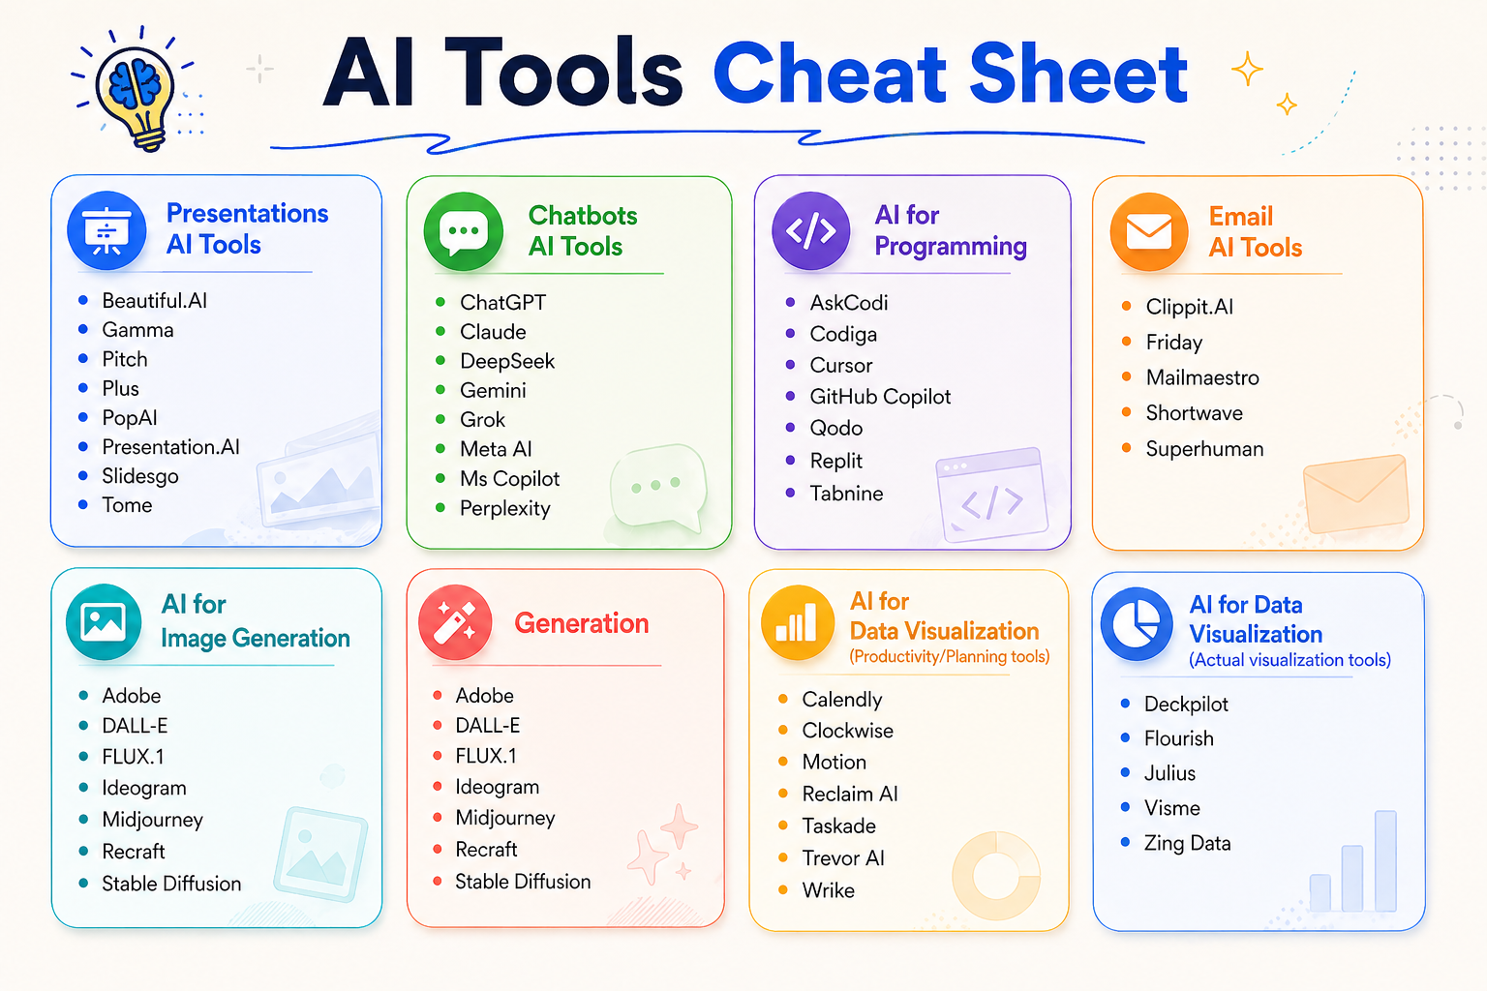

Slide 25
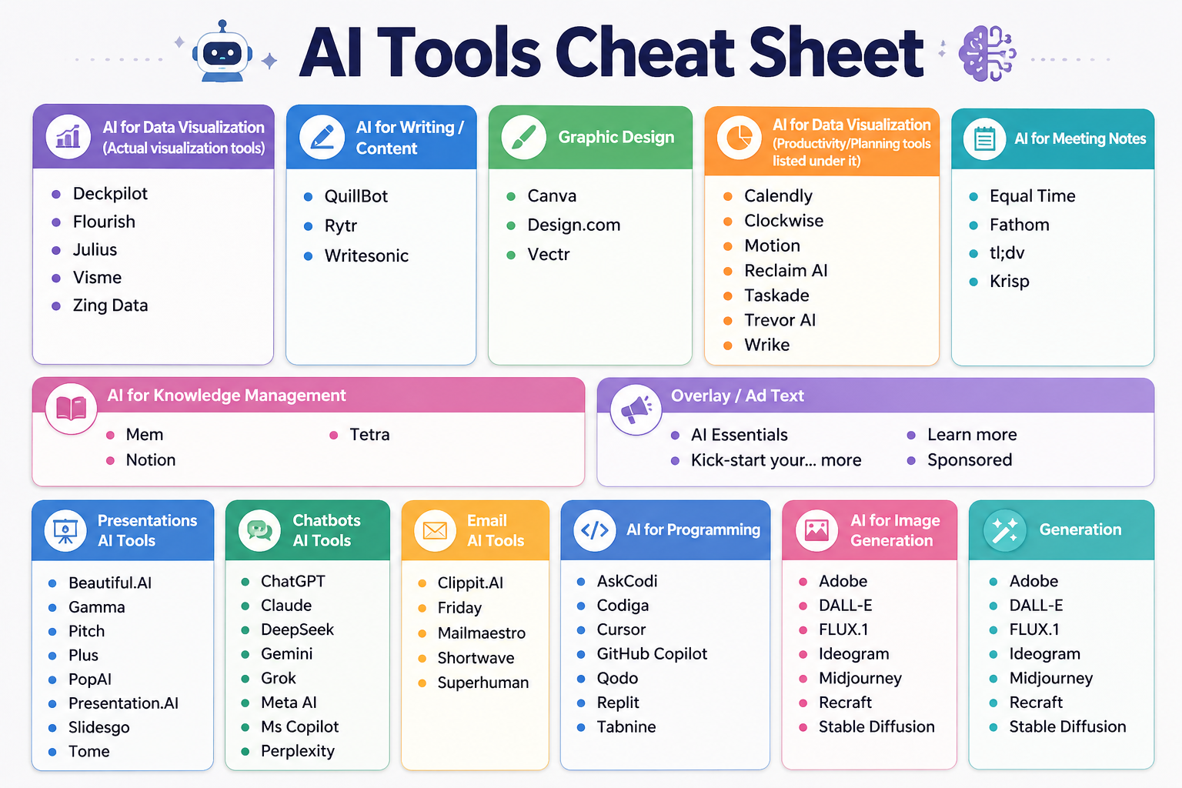

Slide 26


Slide 27
