Slide 1
ATC Africa (OOU Chapter) Virtual Event · 2nd April 2026
AI is Your Pen, Not Your Painter.
How to Stay the Artist in an Algorithmic World
Dr. Sakinat Folorunso | Keynote Speaker

Slide 2
The Question Every Creator Is Asking
“Is AI going to
replace me?”
Short answer: No — but only if you understand what AI actually is.
AI is a tool. A very powerful one. But a tool doesn't paint the Mona Lisa —
an artist does.

Slide 3
Understanding the Tool
✅ What AI CAN Do
❌ What AI CANNOT Do
Generate text, images, code fast
Remix and recombine existing patterns
Handle repetitive tasks at scale
Suggest, draft, prototype quickly
Respond to well-crafted prompts
Feel, experience, or truly intend
Have original aesthetic vision
Take creative risk or own meaning
Understand cultural context deeply
Choose what matters — and why

Slide 4
✏️
AI = A Sophisticated Pen
🖊 The pen generates marks — AI generates outputs.
🧠 The author decides meaning — You decide meaning.
The Pen
Metaphor
🎯 Direction comes from human intent, not the tool.
A pen doesn't write
the story.
YOU do.
🔥 The spark of originality is always yours.

Slide 5
3 Modes of Using AI as a Creator
Which one are you?
LOW AGENCY
BALANCED
HIGH AGENCY
🛠️
🤝
🎨
The Technician
The Collaborator
The Auteur
AI does the work. You click.
You direct. AI assists.
You think in systems.
Output is generic.
You're a copy-paste artist.
Output reflects your vision.
AI amplifies your voice.
AI is your canvas and brush.
Your vision leads everything.
👇 The goal of this talk: move you from Mode 1 → Mode 3

Slide 6
5 Principles to Stay the Artist
01
Own the Brief
AI can't know what you want if you don't. Define your vision clearly before you prompt.
04
Learn the Language of Prompts
05
Protect Your Voice
Prompting is a new literacy. Master it like you master a brush, a chord, or a line of code.
Use AI to amplify your style, not replace it. Let your fingerprint show in the final output.
02
Curate Ruthlessly
AI produces abundance. Artists make choices. Edit, reject, refine — curation is creativity.
03
Inject Your Context
Add your cultural lens, lived experience, and perspective. That's what AI will never have.

Slide 7
⚡ Let's Try It!
LIVE DEMO
Two prompts. Same AI. Different artists.
Prompt A: "Write me a poem about Lagos."
Prompt B:
"Write a 12-line poem about Lagos at 3 am through the eyes of a night bus conductor who misses his mother in Ogun State."
🎯 Your specificity = Your artistry
The AI didn't change. Your vision did.

Slide 8
Why This Matters More for African Creators
The Challenge
The Opportunity
Most AI models are trained on Western, English-heavy data
African languages, music, and stories are underrepresented
AI may flatten or misrepresent our cultures if left unchecked
Generic AI output risks erasing local nuance
You hold cultural knowledge AI doesn't have
Use AI to scale and amplify — not replace — your voice
Build datasets and tools that represent us
You are the bridge between heritage and the future

Slide 9
Your AI Toolkit as a Creator
Start today — no expensive hardware needed
💬 Writing & Text
🖼️ Image Generation
🎵 Music & Audio
ChatGPT · Claude · Gemini
Midjourney · DALL·E · Stable Diffusion
Suno · Udio · ElevenLabs
Draft, brainstorm, edit, research
Visual assets, concept art, covers
Beats, vocals, sound effects
🎬 Video Creation
💻 Coding Help
🧠 Research & Ideas
Runway ML · Pika · HeyGen
GitHub Copilot · Cursor · Claude
Perplexity · NotebookLM
Short clips, AI avatars, edits
Code faster, debug smarter
Synthesize info, find insights

Slide 10
Prompt Makeovers: Same Task, Different Artist
MUSIC
NO VISION
THE ARTIST
"Make me an Afrobeats song."
VS
"Write lyrics for an Afrobeats song about leaving Ibadan for the first time — excitement, fear, and calling home after a week. Upbeat but bittersweet."
CODE
NO VISION
THE ARTIST
"Write a Python script to analyse data."
VS
"Read a CSV of Nigerian school results, flag students who improved 20%+ between terms, output a congratulations message in Pidgin English."
DESIGN
NO VISION
THE ARTIST
"Design a flyer for an event."
VS
"A4 flyer for a Lagos Gen-Z tech hackathon. Electric colours, Afrofuturism aesthetic, Yoruba tagline below the English headline."
The words you add are your brushstrokes.

Slide 11
Real Creators Already Using AI as a Pen
🎤 Burna Boy's team
📖 African writers on Substack
Used AI to rapid-prototype beat variations while keeping the Afrofusion signature intact. The sound is his — AI handled the speed.
Use Claude/ChatGPT to break writer's block: ask for 5 scene options, discard 4, then rewrite the 5th entirely in their own voice.
💡 AI accelerated, not replaced, the vision.
💡 AI as sparring partner, not ghostwriter.
🖼️ Nigerian visual artists
💻 Student developers (like YOU)
Use Midjourney to generate Aso-oke and Benin-bronze mood boards, then hand-refine every detail back to cultural accuracy.
GitHub Copilot writes the boilerplate. The saved hours go into the real work — the algorithm, the logic, the idea that is uniquely yours.
💡 The cultural lens is yours. AI just renders fast.
💡 Ship faster. Think deeper. Stay the engineer.

Slide 12
Your Context is the Secret Ingredient
What YOU bring that no AI ever will:
🌍 Where you grew up
AI knows Lagos exists. It does not know the smell of rain on hot asphalt in Surulere, or what it means when NEPA light comes back on.
🗣️ Your language & code-switching
You mix Yoruba, Pidgin, and English in one sentence naturally. That texture is a creative asset AI cannot authentically replicate.
📻 What your generation lived through
ASUU strikes, japa dreams, petrol queues — your cohort has stories AI has only read about. Put them in your work.
🤝 Who you are making it for
You know your audience: your coursemates, your neighbourhood, your future self. AI does not know them. You do.

Slide 13
When Creators Step Back — AI Gets It Wrong
Real examples of AI failing without a strong human hand:
🎵 African Music
With the artist: Artists who directed AI with specific BPM, lyrical themes from their city, and an emotional arc produced something real.
Without the artist: AI "Afrobeats" for Western brands: right instruments, wrong soul. No story, no grit. It sounds like a caricature.
📰 Journalism
With the artist: A Nigerian journalist used AI to transcribe interviews and draft structure — but kept every voice and every nuance their own.
Without the artist: AI asked to write about "poverty in Nigeria" generated Western aid-narrative cliches — no agency, no complexity, no humanity.
🖼️ Brand Design
With the artist: Their designer used AI only for colour palette options, then hand-crafted every element from their specific cultural heritage.
Without the artist: A startup auto-generated "African-inspired" branding. The result mixed motifs from 5 countries — no one from any of them recognised it.

Slide 14
⚠️ Watch Out: The Creativity Traps
⚠ The Shortcut Trap
⚠ The Credit Trap
Using AI to skip thinking. You save time but lose skill. Your creative muscle atrophies.
Blurring lines between AI-assisted and AI-generated work. Ethically and professionally dangerous.
✅ Always draft your own ideas first, then use AI to expand.
✅ Be transparent. Own what's yours. Disclose AI involvement.
⚠ The Clone Trap
⚠ The Dependency Trap
Your work starts to look like everyone else's. Generic prompts → generic output.
"I can't create without AI anymore." You've outsourced your imagination.
✅ Add constraints that force uniqueness: your city, your language, your story.
✅ Practice creating without AI regularly. It's like gym day — keep that muscle.

Slide 15
THE AI-ERA CREATOR'S MANIFESTO
I define the vision. AI executes my will.
I bring the soul. AI brings the speed.
I own my cultural knowledge. It cannot be automated.
I use AI as a pen — I am the story.
I am not replaceable. I am irreplaceable.

Slide 16
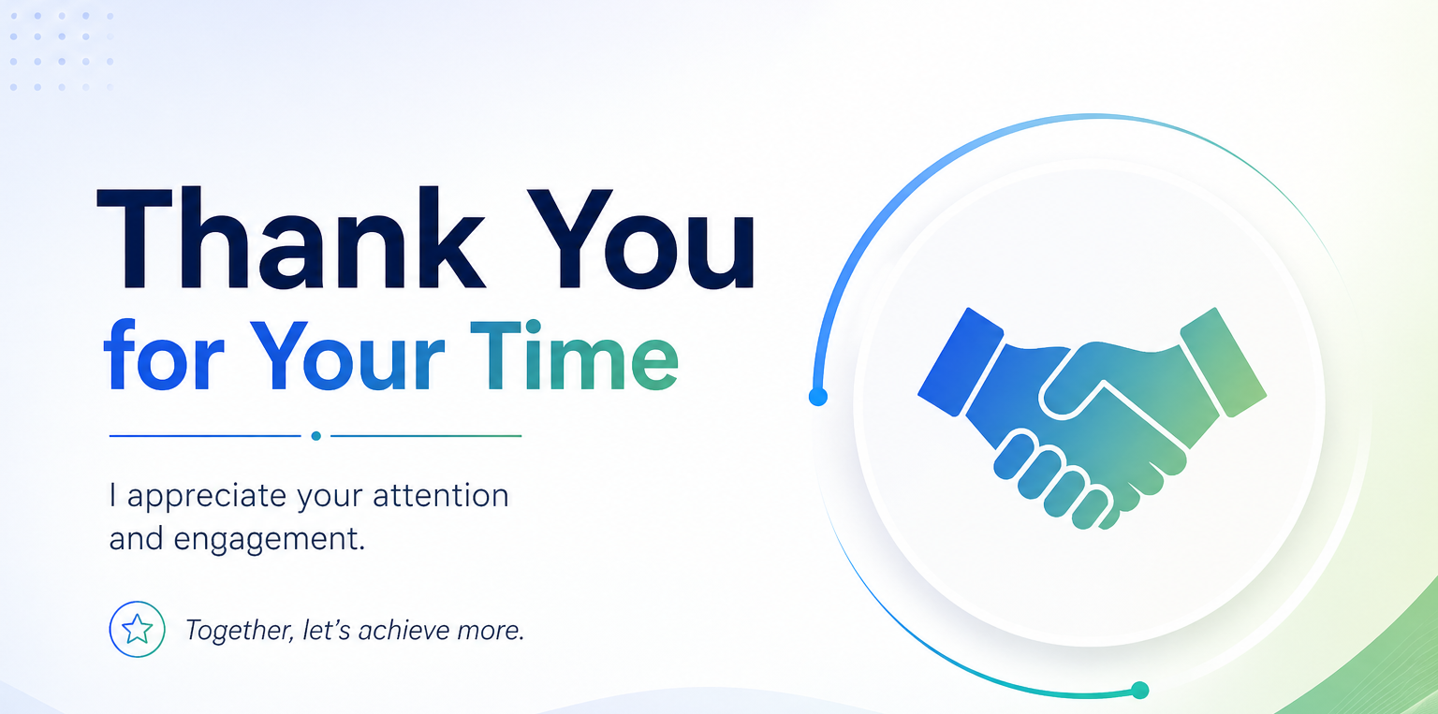

Slide 17
So, What Will YOU Create?
The algorithm doesn't dream. You do.
Your homework this week:
Pick ONE creative project. Use AI as your pen.
Share what you make.
Dr. Sakinat Folorunso
Department of Computer Sciences
Olabisi Onabanjo University
'AI is your pen. Now write something worth reading.'

Slide 18
