Slide 1

CS 0445
Data Structures
Fall 2017
Recursion III
Sherif Khattab
ksm73@pitt.edu
6307 Sennott Square

Slide 2
Administrivia
Assignment 3 postponed to this Friday 10/26

Slide 3
Earlier on Recursion
Components of a recursive method
Examples of recursive methods
on Arrays
on Linked Chains
Towers of Hanoi
Running-time analysis
Formulating the recurrence relation
Coming up with an intuition for a closed-form
Proving the intuition by induction

Slide 4
Today’s Topics
Call Tree
Converting recursion to iteration
Converting to tail-recursion then to iteration
Simulating the call stack
Backtracking
(Some slides are from Dr. John Ramirez)

Slide 5
Single recursion
A recursive algorithm with a single recursive call still provides a linear chain of calls
Calls build run-time stack
Stack shrinks as calls finish

Slide 6
Double recursion
When a recursive algorithm has 2 calls, the execution trace is now a binary tree, as we saw with the trace on the board
This is execution is more difficult to do without recursion
To do it, programmer must create and maintain his/her own stack to keep all of the various data values
This increases the likelihood of errors / bugs in the code
Later we will see some other classic recursive algorithms with multiple calls
Ex: MergeSort, QuickSort
Notes:
Note: We will discuss binary trees in detail later

Slide 7
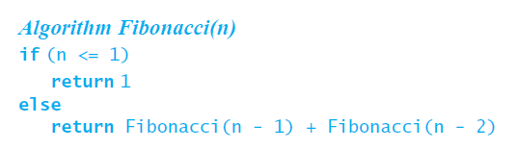
Poor Solution to a Simple Problem
Algorithm to generate Fibonacci numbers.
Why is this inefficient?

Slide 8
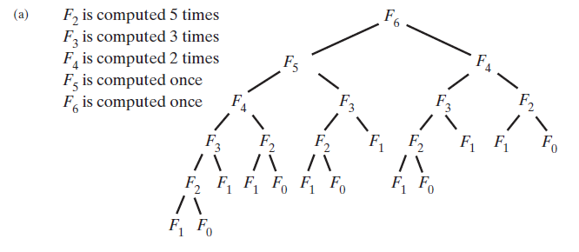
Poor Solution to a Simple Problem
The computation of the Fibonacci number F₆ using (a) recursion … F_{n} = Ω(2^{n})

Slide 9
Converting Recursion into Iteration
Can we tell if a recursive algorithm can be easily done in an iterative way?
Yes – any recursive algorithm that is exclusively tail recursive can be done simply using iteration without recursion
Most algorithms we have seen so far are exclusively tail recursive

Slide 10
Tail Recursion
So what is tail recursion?
Recursive algorithm in which the recursive call is the LAST statement in a call of the method
What are the implications of tail recursion?
Any tail recursive algorithm can be converted into an iterative algorithm in a methodical way
In fact some compilers do this automatically

Slide 11
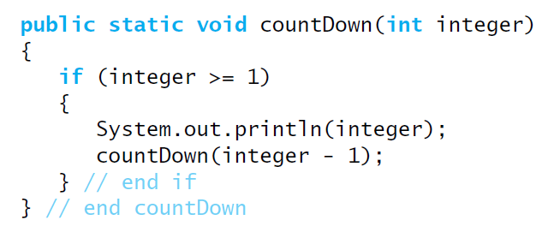
Tail Recursion
When the last action performed by a recursive method is a recursive call.

Slide 12
Tail Recursion
In a tail-recursive method, the last action is a recursive call
This call performs a repetition that can be done by using iteration.
Converting a tail-recursive method to an iterative one is usually a straightforward process.

Slide 13
Converting to tail-recursion
Examples (Done on board)
Power
Fibonacci
Towers of Hanoi

Slide 14
Converting tail-recursion into iteration
Examples (Done on board)
CountDown
Power
Fibonacci
Towers of Hanoi

Slide 15
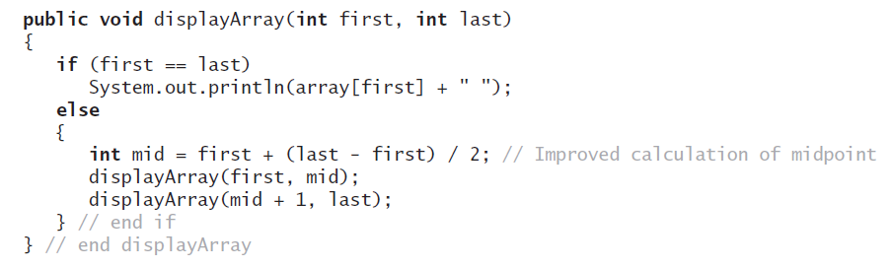
Using a Stack Instead of Recursion
An example of converting a recursive method to an iterative one

Slide 16
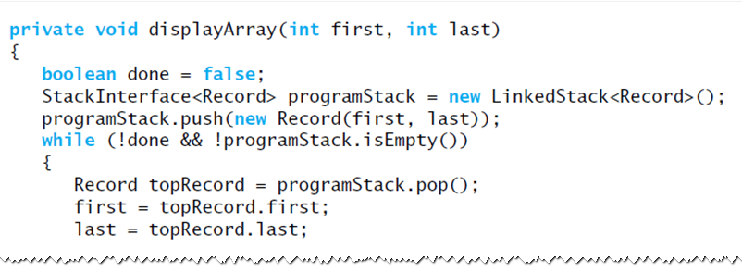
Using a Stack Instead of Recursion
An iterative displayArray to maintain its own stack

Slide 17
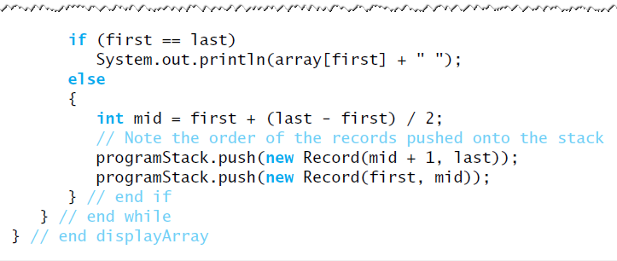
Using a Stack Instead of Recursion
An iterative displayArray to maintain its own stack

