Slide 1

CS 0445
Data Structures
Fall 2017
Recursion IV
Sherif Khattab
ksm73@pitt.edu
6307 Sennott Square

Slide 2
Administrivia
Assignment 3 postponed (again). Will be posted by this Friday 11/03.
This week’s lab is for credit
You can make-up for missed mandatory labs (only once)

Slide 3
Earlier on Recursion
Components of a recursive method
Examples of recursive methods
Running-time analysis
Call Tree
Converting recursion to iteration
Converting to tail-recursion then to iteration

Slide 4
Today’s Topics
Converting recursion to iteration
Simulating the call stack
Backtracking
Sorting
(Some slides are from Dr. John Ramirez)

Slide 5
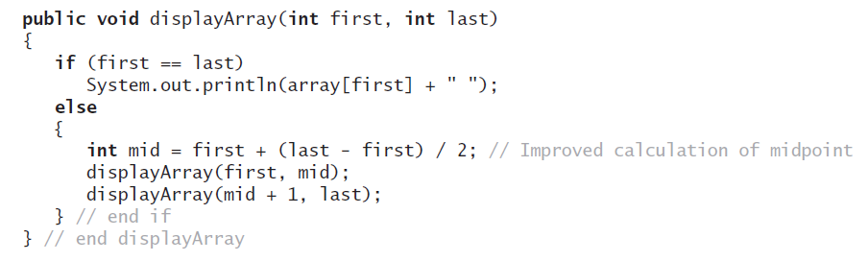
Using a Stack Instead of Recursion
An example of converting a recursive method to an iterative one

Slide 6
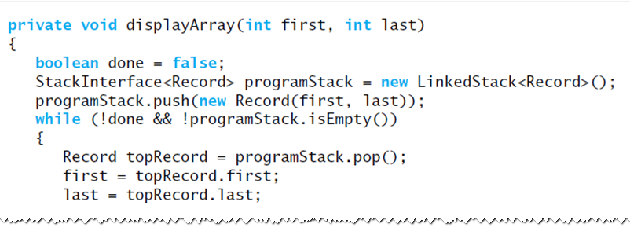
Using a Stack Instead of Recursion
An iterative displayArray to maintain its own stack

Slide 7
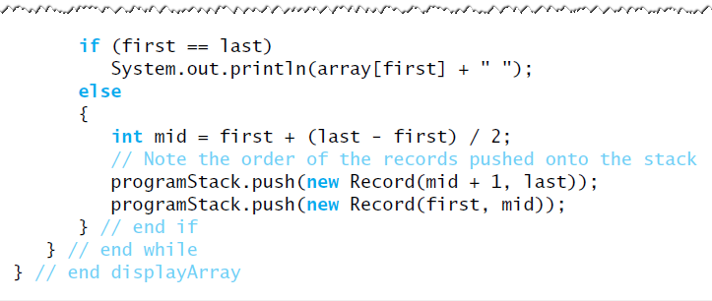
Using a Stack Instead of Recursion
An iterative displayArray to maintain its own stack

Slide 8
Another example
Towers of Hanoi
Check “Recursion to Iteration” handout

Slide 9
Overhead of Recursion
Why do we care?
Recursive algorithms have overhead associated with them
Space: each activation record (AR) takes up memory in the run-time stack (RTS)
If too many calls "stack up" memory can be a problem
Time: generating ARs and manipulating the RTS takes time
A recursive algorithm will always run more slowly than an equivalent iterative version

Slide 10
Recursion and Divide and Conquer
Divide and Conquer
The idea is that a problem can be solved by breaking it down to one or more "smaller" problems in a systematic way
Usually the subproblem(s) are a fraction of the size of the original problem
Usually the subproblems(s) are identical in nature to the original problem
It is fairly clear why these algorithms can typically be solved quite nicely using recursion

Slide 11
Recursion and Divide and Conquer
We can think of each lower level as solving the same problem as the level above
The only difference in each level is the size of the problem, which is ½ of that of the level above it
Note how quickly the problem size is reduced

Slide 12
Recursion and Divide and Conquer
How can we apply this to the Power fn?
We typically need to consider two important things:
How do we break up or "divide" the problem into subproblems?
In other words, what do we do to the data to process it before making our recursive call(s)?
How do we use the solutions of the subproblems to generate the solution of the original problem?
In other words, after the recursive calls complete, what do we do with the results?
For X^{N} the problem "size" is the exponent, N
So a subproblem would be the same problem with a smaller N

Slide 13
Recursion and Divide and Conquer
Let's try cutting N in half – use N/2
1) We want to define X^{N} somehow in terms of X^{N/2}
We can't forget the base case
2) We need to determine how the original problem is solved in terms of the solution X^{N/2}
Done on board (and see notes below)
Will this be an improvement over the other version of the function?
It seems like it since the problem is being cut in half each time
Informal analysis shows we only need O(log₂N) multiplications in this case (see text)
Notes:
X^{N} = (X^{N/2})²
Ok, but we need a base case as always
We can use the same as before: X⁰ = 1
But will this always work? We need to make sure that our solution is always correct.
Let's try 2³ = (2¹)² = ((2⁰)²)² = (1²)² = 1
What went wrong? Well the solution above works only when the exponent is EVEN. If the exponent is odd, due to integer division truncation, we lose information. We need a different case here. Let's try again
X^{N} = (X^{N/2})² when N is even and > 0
= X * (X^{N/2})² when N is odd and > 0
= 1 when N = 0

Slide 14
Overhead of Recursion
So what else is recursion good for?
For some problems, a recursive approach is more natural and simpler to understand than an iterative approach
Once the algorithm is developed, if it is tail recursive, we can always convert it into a faster iterative version
For some problems, it is very difficult to even conceive an iterative approach, especially if multiple recursive calls are required in the recursive solution
Example: Backtracking problems

Slide 15
Recursion and Backtracking
Idea of backtracking:
Proceed forward to a solution until it becomes apparent that no solution can be achieved along the current path
At that point UNDO the solution (backtrack) to a point where we can again proceed forward
Example: 8 Queens Problem
How can I place 8 queens on a chessboard such that no queen can take any other in the next move?
Recall that queens can move horizontally, vertically or diagonally for multiple spaces

Slide 16
8 Queens Problem
How can we solve this with recursion and backtracking?
We note that all queens must be in different rows and different columns, so each row and each column must have exactly one queen when we are finished
Complicating it a bit is the fact that queens can move diagonally
So, thinking recursively, we see the following
To place 8 queens on the board we need to
Place a queen in a legal (row, column)
Recursively place 7 queens on the rest of the board
Where does backtracking come in?
Our initial choices may not lead to a solution – we need a way to undo a choice and try another one

Slide 17
8 Queens Problem
Using this approach we come up with the solution as shown in 8-Queens handout
8Queens.java
Idea of solution:
Each recursive call attempts to place a queen in a specific column
A loop is used, since there are 8 squares in the column
For a given call, the state of the board from previous placements is known (i.e. where are the other queens?)
This is used to determine if a square is legal or not
If a placement within the column does not lead to a solution, the queen is removed and moved "down" the column

Slide 18
8 Queens Problem
When all rows in a column have been tried, the call terminates and backtracks to the previous call (in the previous column)
If a queen cannot be placed into column i, do not even try to place one onto column i+1 – rather, backtrack to column i-1 and move the queen that had been placed there
See handout for code details
Why is this difficult to do iteratively?
We need to store a lot of state information as we try (and un-try) many locations on the board
For each column so far, where has a queen been placed?

Slide 19
8 Queens Problem
The run-time stack does this automatically for us via activation records
Without recursion, we would need to store / update this information ourselves
This can be done (using our own Stack rather than the run-time stack), but since the mechanism is already built into recursive programming, why not utilize it?
There are many other famous backtracking problems
http://en.wikipedia.org/wiki/Backtracking

Slide 20
Sorting
We seek algorithms to arrange items, a_{i} such that entry 1 ≤ entry 2 ≤ . . . ≤ entry n
Sorting an array is usually easier than sorting a chain of linked nodes
Efficiency of a sorting algorithm is significant

