Slide 1

CS 0445
Data Structures
Fall 2017
Sorting
Sherif Khattab
ksm73@pitt.edu
6307 Sennott Square

Slide 2
Administrivia
Assignment 3 posted this Friday 11/03
This week’s lab is for credit
You can make-up for missed mandatory labs (only once)
Graded exam papers next Tuesday

Slide 3
Earlier in the course
Bag and Stack ADTs
Recursion

Slide 4
Today’s Topics
Sorting
O(n²)
SelectionSort
InsertionSort
O(n log n)
MergeSort
QuickSort
O(1) Sorting
Radix Sort

Slide 5
Sorting
We seek algorithms to arrange items, a_{i} such that entry 1 ≤ entry 2 ≤ . . . ≤ entry n
Sorting an array is usually easier than sorting a chain of linked nodes
Efficiency of a sorting algorithm is significant

Slide 6
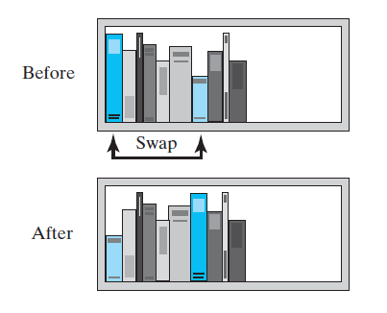
Selection Sort
FIGURE 8-1 Before and after exchanging the shortest book and the first book

Slide 7
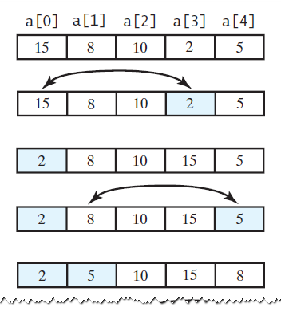
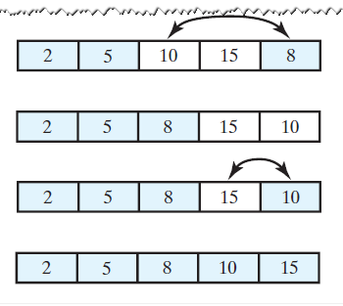
Selection Sort
FIGURE 8-2 A selection sort of an array of integers into ascending order

Slide 8
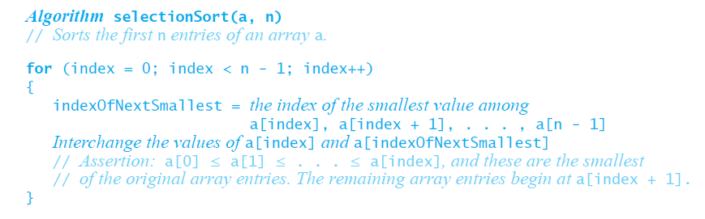
Iterative Selection Sort
This pseudocode describes an iterative algorithm for the selection sort

Slide 9
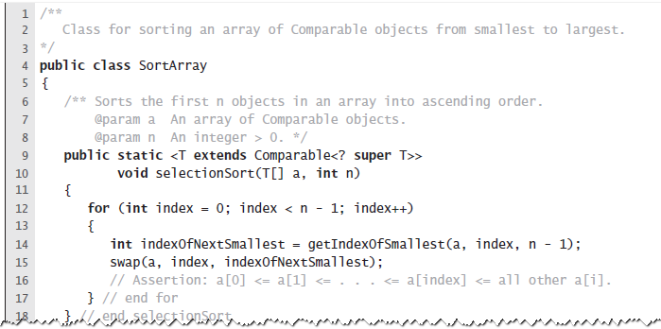
Iterative Selection Sort
LISTING 8-1 A class for sorting an array using selection sort

Slide 10
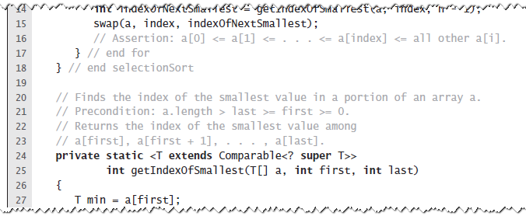
Iterative Selection Sort
LISTING 8-1 A class for sorting an array using selection sort

Slide 11
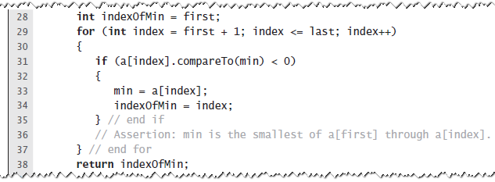
Iterative Selection Sort
LISTING 8-1 A class for sorting an array using selection sort

Slide 12
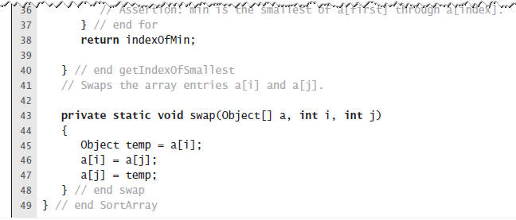
Iterative Selection Sort
LISTING 8-1 A class for sorting an array using selection sort

Slide 13
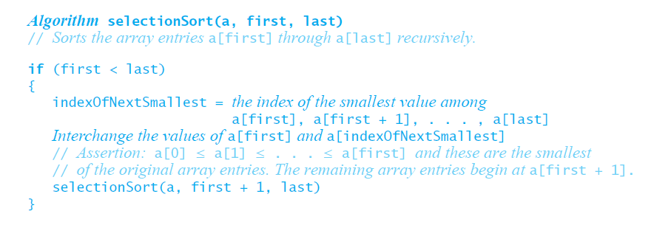
Recursive Selection Sort
Recursive selection sort algorithm

Slide 14
Efficiency of Selection Sort
Selection sort is O(n²) regardless of the initial order of the entries.
Requires O(n²) comparisons
Does only O(n) swaps

Slide 15
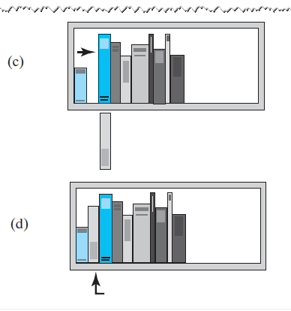
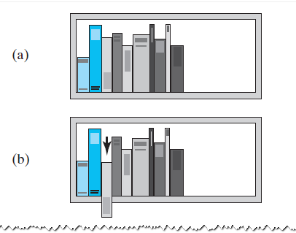
Insertion Sort
FIGURE 8-3 The placement of the third book during an insertion sort

Slide 16
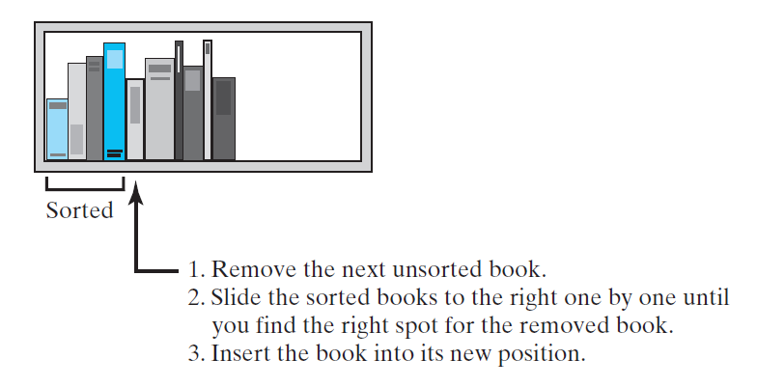
Insertion Sort
FIGURE 8-4 An insertion sort of books

Slide 17
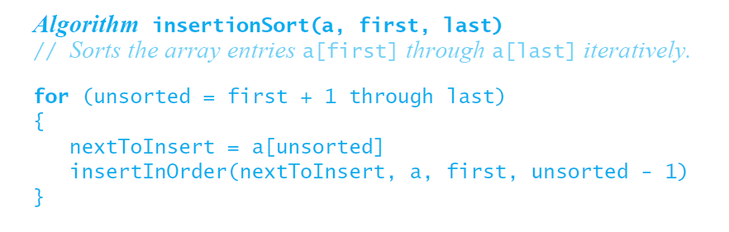
Iterative Insertion Sort
Iterative algorithm describes an insertion sort of the entries at indices first through last of the array a

Slide 18
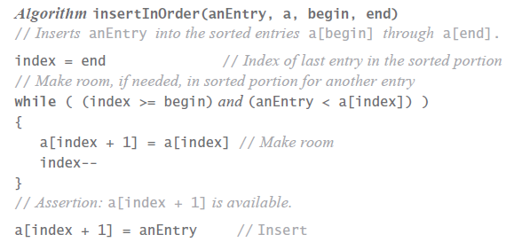
Iterative Insertion Sort
Pseudocode of method, insertInOrder, to perform the insertions.

Slide 19
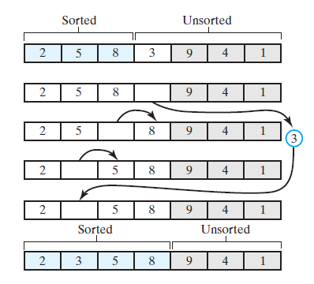
Iterative Insertion Sort
FIGURE 8-5 Inserting the next unsorted entry into its proper location within the sorted portion of an array during an insertion sort

Slide 20
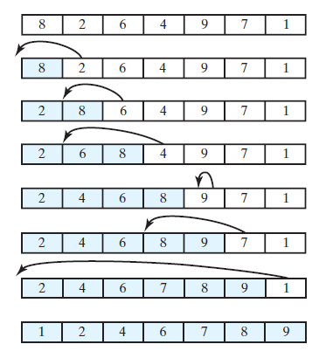
Iterative Insertion Sort
FIGURE 8-6 An insertion sort of an array of integers into ascending order

Slide 21
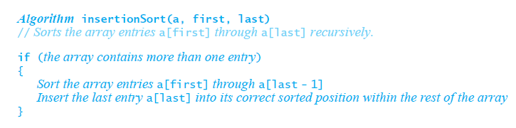
Recursive Insertion Sort
This pseudocode describes a recursive insertion sort.

Slide 22
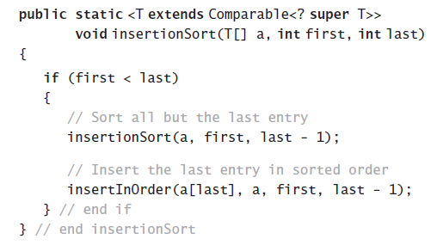
Recursive Insertion Sort
Implementing the algorithm in Java

Slide 23
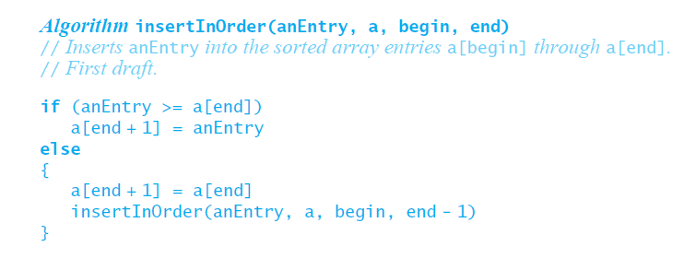
Recursive Insertion Sort
First draft of insertInOrder algorithm.

Slide 24
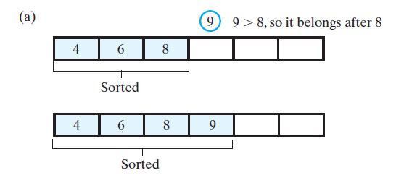
Recursive Insertion Sort
FIGURE 8-8 Inserting the first unsorted entry into the sorted portion of the array. (a) The entry is greater than or equal to the last sorted entry

Slide 25
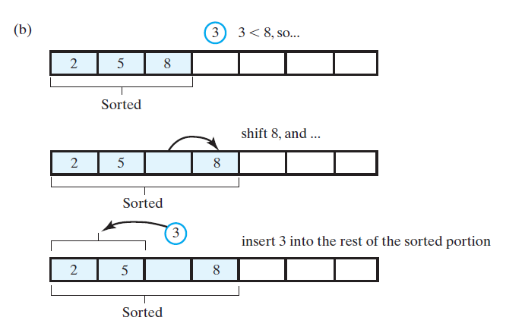
Recursive Insertion Sort
FIGURE 8-8 Inserting the first unsorted entry into the sorted portion of the array. (b) the entry is smaller than the last sorted entry

Slide 26
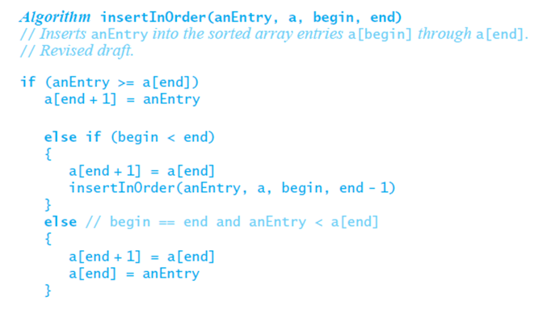
Recursive Insertion Sort
The algorithm insertInOrder: final draft. Note: insertion sort efficiency (worst case) is O(n²)

